Slide 1
Malicious Messages Detector Based on Neural Network
Supervisor: Jean-Philippe MONTEUUIS
Guodong SUN
Liang WANG

Slide 2
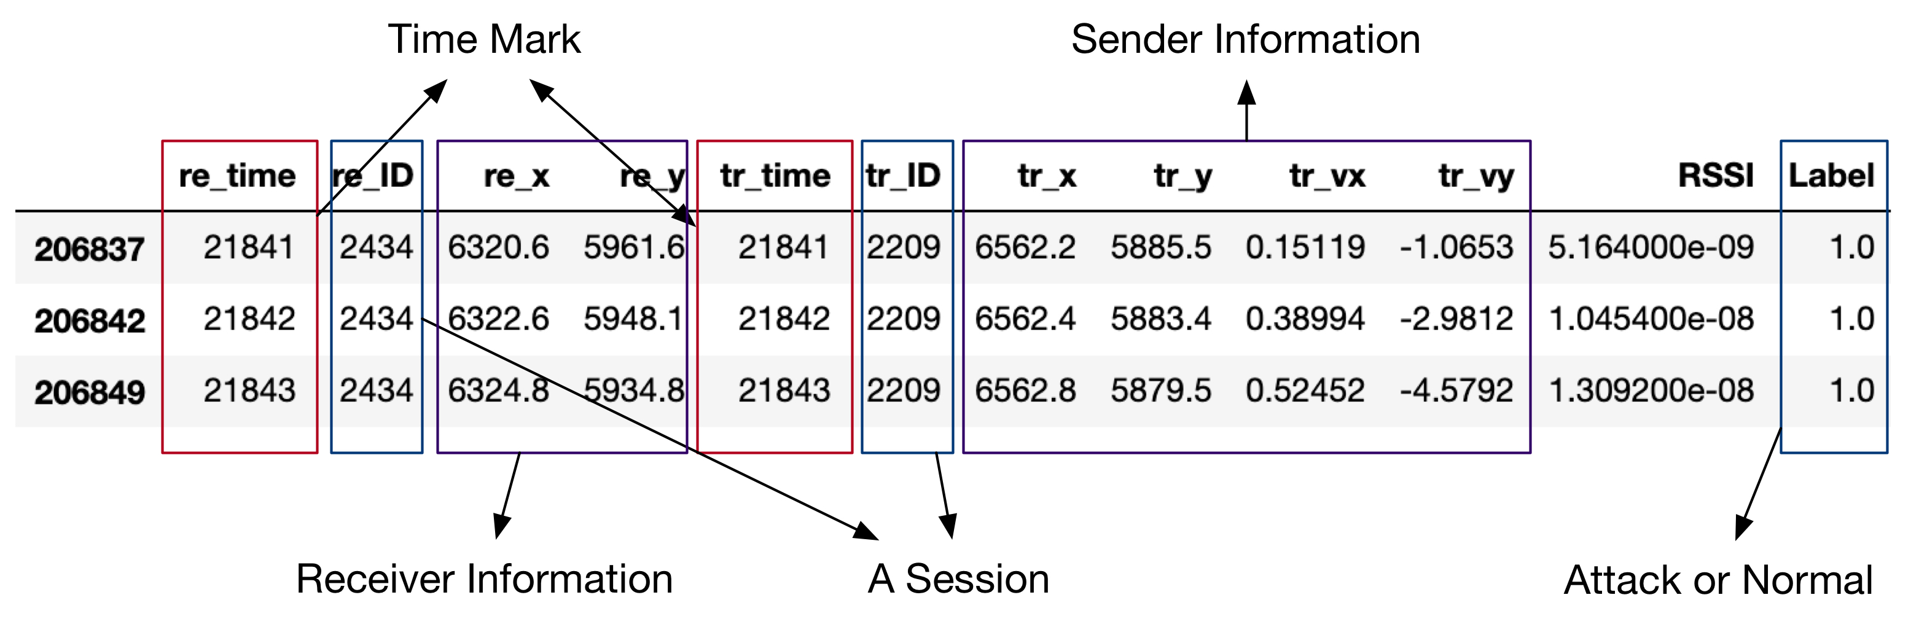
The datasets
 | # Rows | # Sessions | # Normal | # Attack
Type 1 | 387516 | 30588 | 0.3143 | 0.6857
Type 2 | 387516 | 30588 | 0.3143 | 0.6857
Type 4 | 387634 | 30642 | 0.3449 | 0.6551
Type 8 | 386747 | 30596 | 0.2551 | 0.7449
Type 16 | 386834 | 30601 | 0.2964 | 0.7036
A communication session between
a sender and a receiver.
A session is whether
‘Normal’ or ‘Attack’.
Here is a typical session.

Slide 3
Type of Attackers
-Constant : Attacker report a false position which is a constant value.
-Constant Offset : Attacker transmits a fixed offset added to the real position.
-Random : Attacker sends a random position inside the simulation area.
-Random Offset : Attacker sends a random position within a rectangle around the vehicle.
-Eventual Stop : Attackers behave normally for some time and then attacks by transmitting the same position repeatedly.

Slide 4
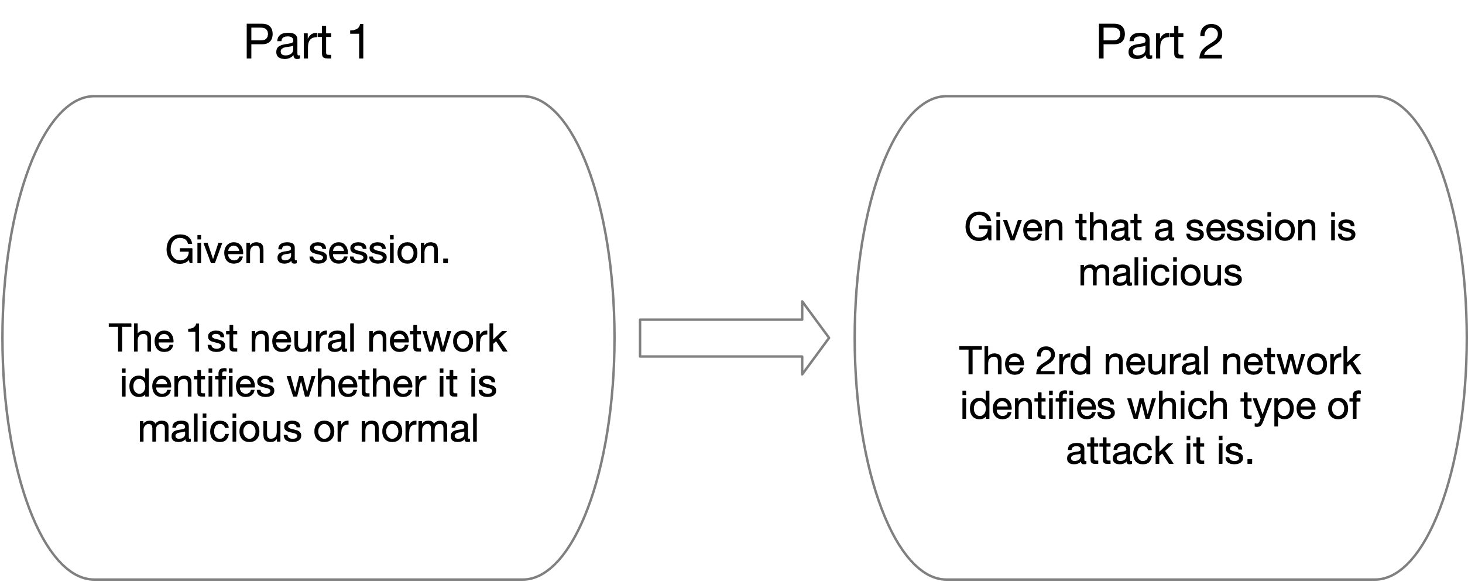
Our Neural Network Model

Slide 5
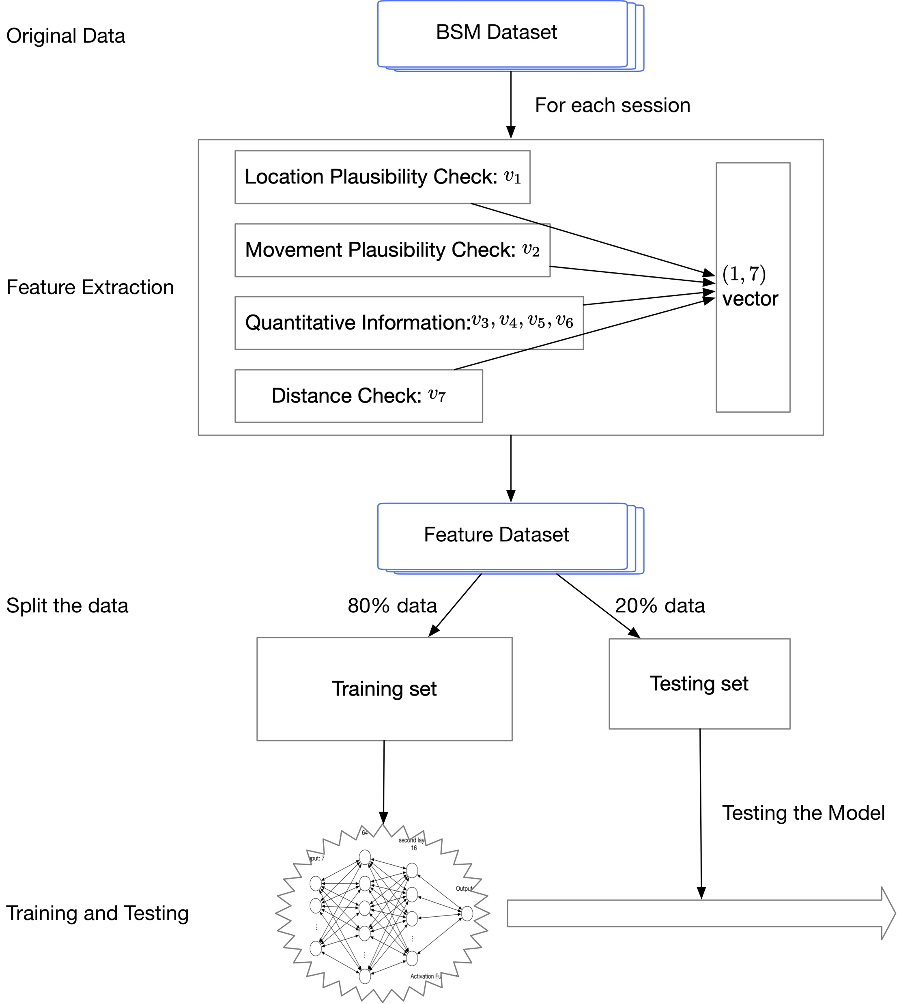
Step 1
Step 2
Work Flow
(for both models)
Step 3
Step 4

Slide 6
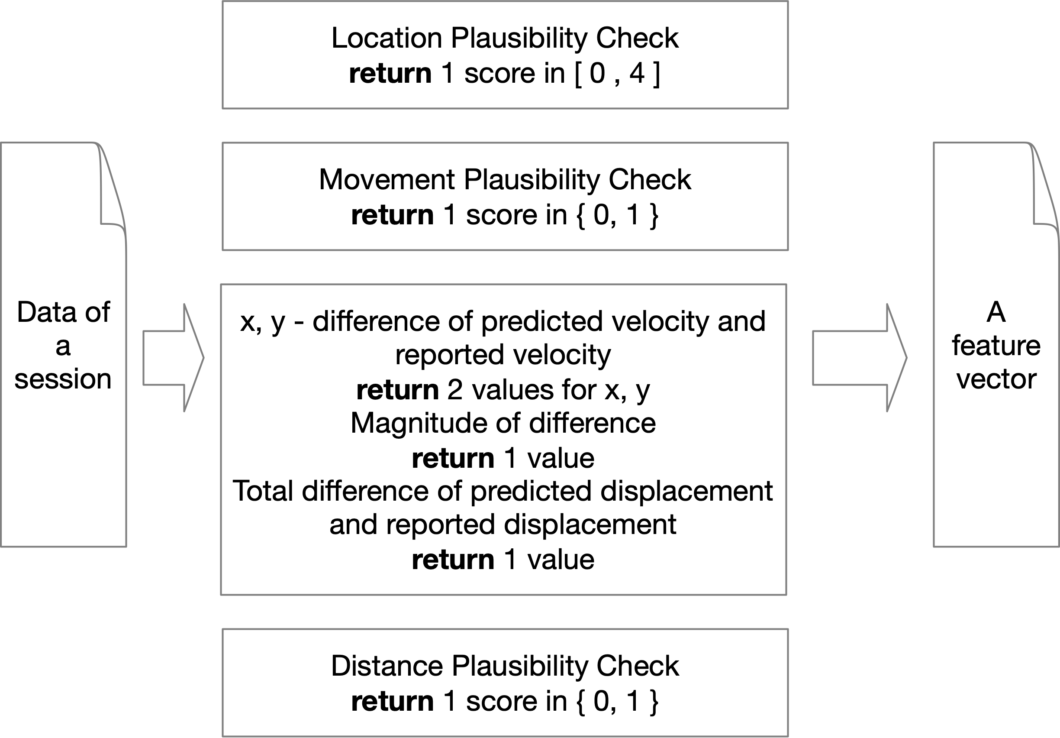
Feature Vectors
Feature vectors

Slide 7
Splitting the datasets
We split all the datasets into 80% for training and 20% for testing
 | Sessions | Training datasets |  | Testing datasets
 |  | Attack | Normal | Attack | Normal
Type 1 | 30588 | 0.3122 | 0.6877 | 0.3228 | 0.6771
Type 2 | 30588 | 0.3142 | 0.6857 | 0.3146 | 0.6853
Type 4 | 30642 | 0.3456 | 0.6543 | 0.3414 | 0.6585
Type 8 | 30596 | 0.2582 | 0.7417 | 0.2424 | 0.7575
Type 16 | 30601 | 0.2982 | 0.7017 | 0.2888 | 0.7111
All data | 153015 | 0.3047 | 0.6952 | 0.3060 | 0.6939

Slide 8
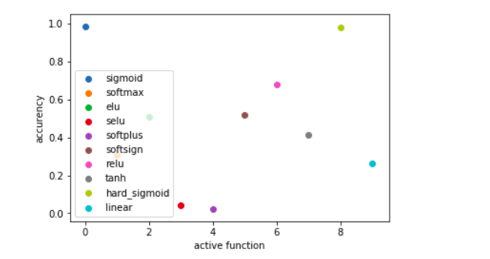
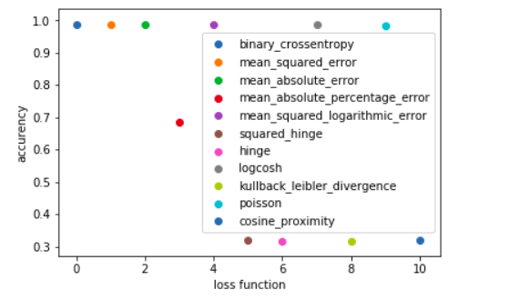
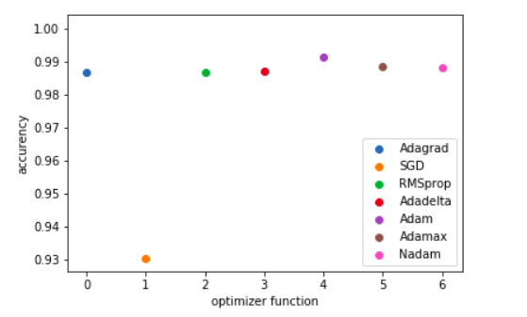
Chose of parameters
According to the expirement, we find best parameters in active function, loss function and optimizer function.

Slide 9
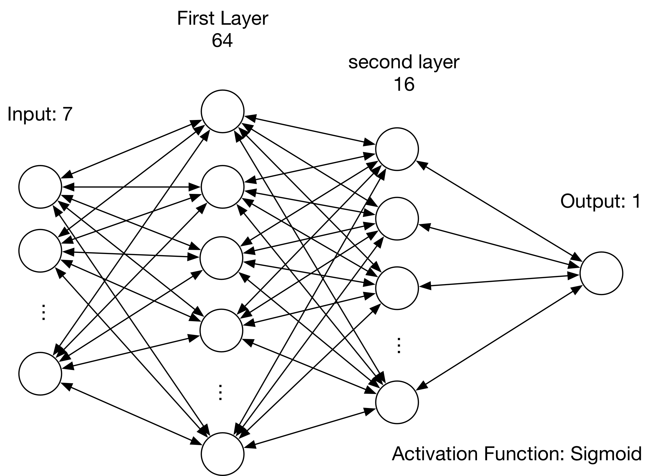
Detector Model
Loss function: Mean_Absolute_Error
Optimizer: RMSprop

Slide 10
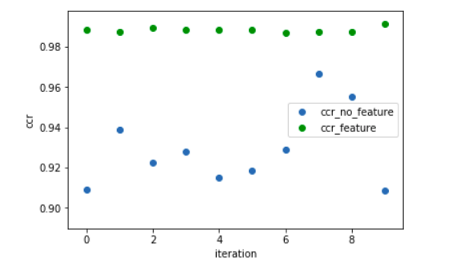
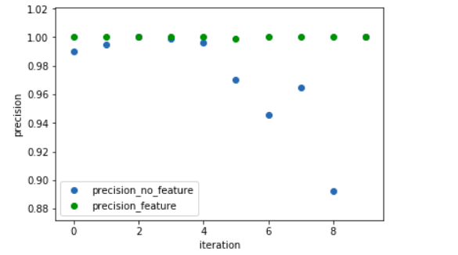
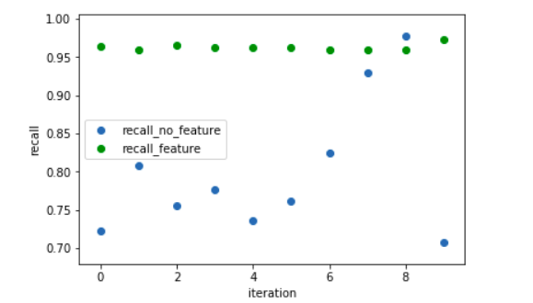
Comparison: dataset with feature and original dataset

Slide 11
Experiment Results: Attack 1,2,4,8,16
 | attack 1 |  |  | attack 2 |  |  | attack 4 |  |  | attack 8 |  |  | attack 16
 | SVM | KNN | Neural Net | SVM | KNN | Neural Net | SVM | KNN | Neural Net | SVM | KNN | Neural Net | SVM | KNN | Neural Net
CCR | 0.9452 | 0.9564 | 0.9907 | 0.7508 | 0.7543 | 0.6854 | 0.9463 | 0.9116 | 0.9825 | 0.9471 | 0.9177 | 0.9725 | 0.8173 | 0.8403 | 0.9647
Precision | 0.9521 | 1.000 | 1.0 | 0.5613 | 0.5729 | 0.0 | 0.9506 | 0.8149 | 0.9990 | 0.9627 | 0.8035 | 0.9955 | 0.7143 | 0.8162 | 0.985
Recall | 0.8328 | 0.8290 | 0.9702 | 0.1937 | 0.1788 | 0.0 | 0.8363 | 0.8860 | 0.9498 | 0.8253 | 0.8755 | 0.8908 | 0.4254 | 0.4636 | 0.891
*** Note that Neural network based
model could not detect attack 2
CCR: Correct Categorical Rate.
Precision
Recall

Slide 12
Experiment Results: Overall Attack
 | SVM | KNN | Neural Net
CCR | 0.8788 | 0.8838 | 0.9244
Precision | 0.8879 | 0.8716 | 0.9948
Recall | 0.6166 | 0.6515 | 0.7868

Slide 13
Classification Results
 | Type 1 (Predict) | Type 2 (Predict) | Type 4 (Predict) | Type 8 (Predict) | Type 16 (Predict)
Type 1 (real) | 0.7623 | 0.0212 | 0.0779 | 0.0191 | 0.1145
Type 2 (real) | 0.0016 | 0.9401 | 0.0096 | 0.0444 | 0.0043
Type 4 (real) | 0.0005 | 0 | 0.9909 | 0.0068 | 0.0018
Type 8 (real) | 0 | 0.0458 | 0.0040 | 0.9259 | 0.0243
Type 16 (real) | 0.2707 | 0.0620 | 0.0344 | 0.0450 | 0.5879
***Note that it is invalid for Type 2 attacker, because the first step, i.e. identifying whether the session
is malicious or does not success.

Slide 14
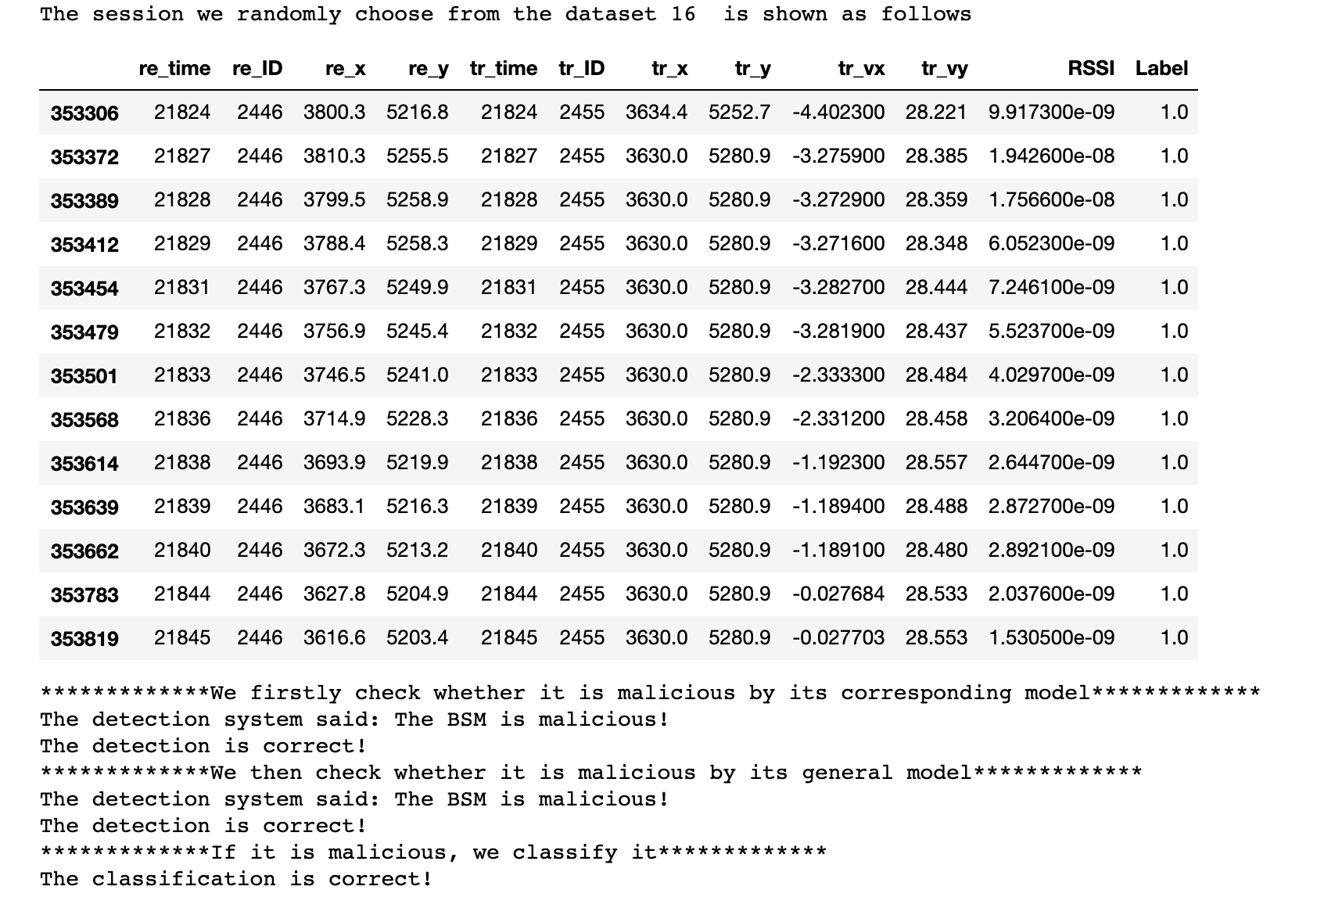
Test Model

Slide 15
Thanks!

