Slide 1
shell编程用户管理
指导老师：杨爱光
答辩人：梁炜婧

Slide 2
目录
CONTENTS
01
设计要求与需求分析
03
系统测试
02
系统设计
04
总结

Slide 3
01
设计要求与需求分析

Slide 4
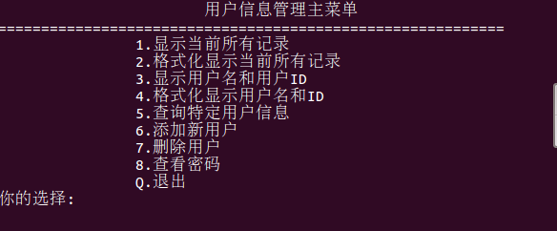
设计要求
设计要求
掌握linux操作系统中shell脚本编程技术中的：变量定义、变量使用、循环控制结构、条件选择结构、用户交互、文件读写、文本内容分析以及linux重要命令的使用等。
编写一个shell程序，能够对系统的用户进行增加、删除、查找、显示特定用户信息等功能。

Slide 5
系统实现
用户信息显示及其格式化.
01
用户名和ID显示及其格式化
02
shell编程
用户管理
增加和删除用户
03
用户搜索及密码查询.
04

Slide 6
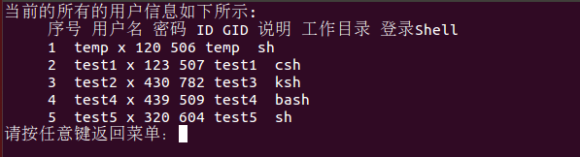
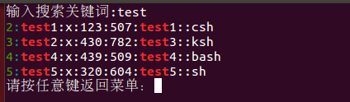
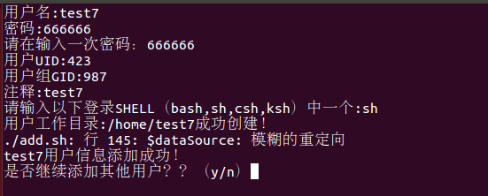
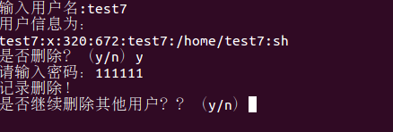
需求分析
01 BUSINESS SECTION
We have many PowerPoint templates that has been specifically designed to help anyone that is stepping into the world of PowerPoint for the very first time.
查询功能
搜索功能
添加用户
删除用户

Slide 7
02
系统设计

Slide 8
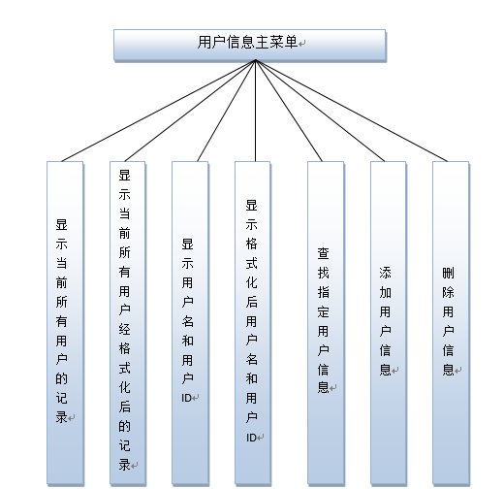
功能图

Slide 9
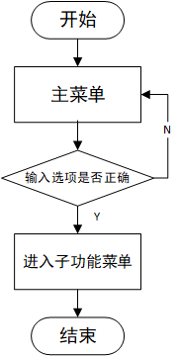
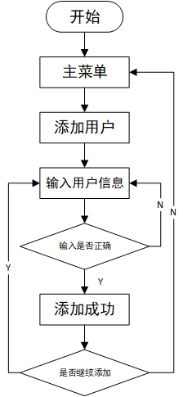
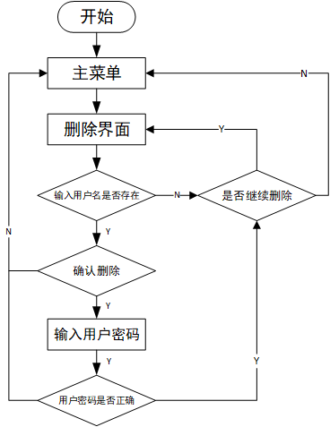
模块设计
菜单
Delete模块
Add模块.

Slide 10
03
系统测试

Slide 11


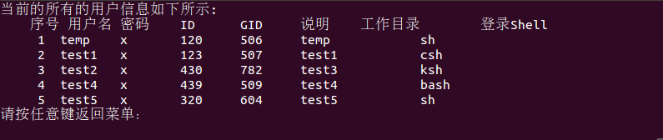

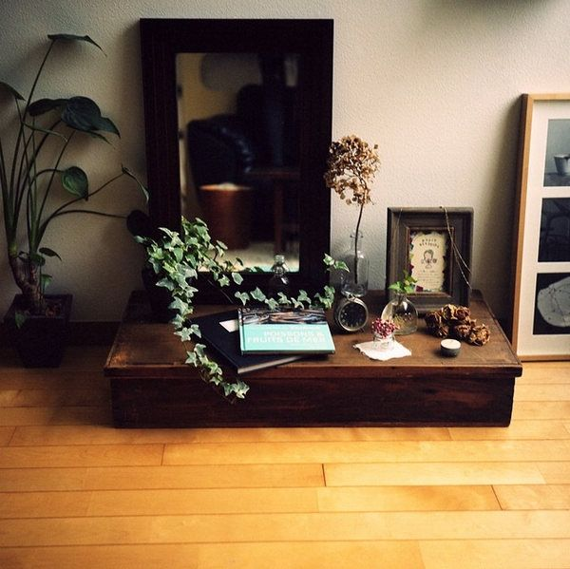
功能测试
TOPIC HEADER ONE
We have many PowerPoint templates that has been specifically designed to help anyone that is stepping into the world of PowerPoint for the very first time.
显示用户信息
TOPIC HEADER THREE
We have many PowerPoint templates that has been specifically designed to help anyone that is stepping into the world of PowerPoint for the very first time.
格式化输出用户信息

Slide 12
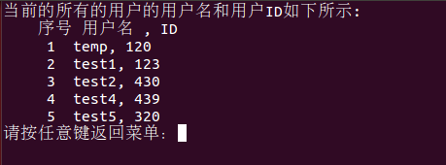
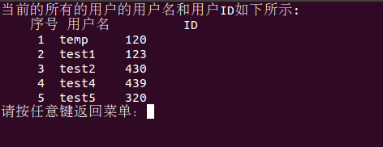
功能测试
TOPIC HEADER ONE
We have many PowerPoint templates that has been specifically designed to help anyone that is stepping into the world of PowerPoint for the very first time.
显示用户名和 ID
TOPIC HEADER THREE
We have many PowerPoint templates that has been specifically designed to help anyone that is stepping into the world of PowerPoint for the very first time.
格式化显示用户名和 ID

Slide 13
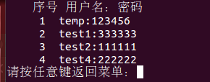
功能测试
TOPIC HEADER ONE
We have many PowerPoint templates that has been specifically designed to help anyone that is stepping into the world of PowerPoint for the very first time.
搜索
查看密码

Slide 14
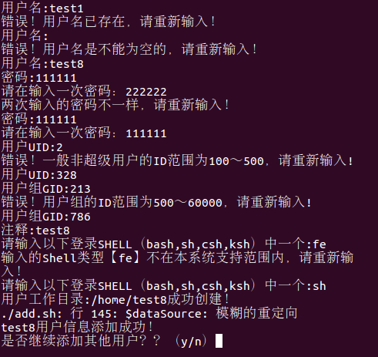
鲁棒性测试
TOPIC HEADER ONE
We have many PowerPoint templates that has been specifically designed to help anyone that is stepping into the world of PowerPoint for the very first time.
添加用户

Slide 15



鲁棒性测试
菜单输入错误
搜索输入错误
删除输入错误

Slide 16
04
总结

Slide 17
系统特点与不足
系统的界面做的比较简陋，比如菜单页面没有居中，显示用户信息虽然使用了TAB键来格式化但是依然在显示页面上无法对齐。.
用户可以通过可视化界面更加直观的了解自己和其他用户的情况，方便管理。
在添加用户功能中用户输入密码时没有隐藏显示秘密。.
系统对关键字进行特殊颜色标注。系统在添加用户时对用户密码进行加密处理。

Slide 18

总结
shell编程用户管理
总结
本次项目实现了shell编程的模拟Ubuntu系统的用户管理。在Ubuntu下用户的增删改查主要是通过编辑修改/etc/passwd文件来实现的。/etc/passwd文件有七个字段：分别是用户名：密码：UID：GID：注释：工作目录：登录shell。本项目通过新建的passwd文件来模拟/etc/passwd文件，实现用户的增删改查。
通过此项目我对Linux的操作系统有了更深一步的了解，同时从头学习了shell编程的语法，又掌握了一门新的脚本语言。

