Slide 1

mlog
Log modem message to kernel

Slide 2
API
#include "mlog.h“
extern int mlog(const char *fmt, ...);
Args:
variable argument lists
Return:
>=0: return the number of characters printed
< 0 : on error.

Slide 3
Example
const char *foo = “Hello World!”;
mlog(“%s\n”, foo);

Slide 4
Description
The mlog init task run on “RCINIT_GROUP_0” level
Can be used before init, but all the early buffer limit to 1K
Block call

Slide 5
Output
Output in linux kernel kmsg with “[MODEM]”
eg.
"[MODEM] Hello World!"

Slide 6
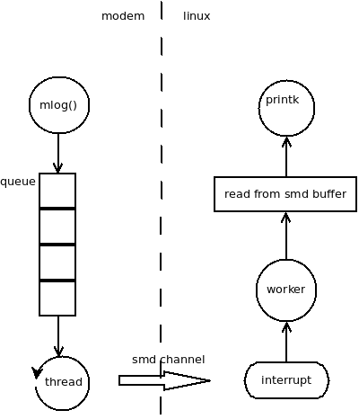
Implement

Slide 7
Code
Modem
  core/mproc/smd/src/mlog.c
core/mproc/smd/src/list.h
core/api/mproc/mlog.h
Kernel
drivers/TCT_debug/mlog.c

Slide 8
Debug
Filter out mlog from kernel message:
cat /proc/kmsg | grep “MODEM”
Dump mlog from procfs:
cat /proc/mlog
Loopback:
echo “xxx” > /proc/mlog

