Slide 1
OS experiment report——lottery
09022107 梁耀欣
东南大学
09022107 Yaoxin Liang
Southeast University

Slide 2
Section 1: solution ideas

Slide 3
Solution ideas
What should we do
Put a new scheduler into xv6:
Lottery scheduler
1.Add two new system calls;
2.Change the scheduler programs;
3.Generate random number;
4.Make a gragh that shows the number of time slices.

Slide 4
Solution ideas
Related files
Usys.S;
Proc.h;
Proc.c;
Pstat.h;rand.h;tester.c;rand.c;
Syscall.h;
Syscall.c;
Syspro.c;
User.h;
Makefile;

Slide 5
Section 2: what I did

Slide 6

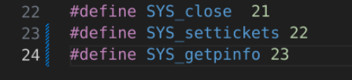

What I did
Syscall.h,syscall.c
Purpose: System call dispatcher. Define syscall numbers.
Modification: Add entries for “settickets” and “getpinfo”.

Slide 7

What I did
User.h
Purpose: Header file for user-level programs.
Modification: Add prototypes for the new system calls.

Slide 8
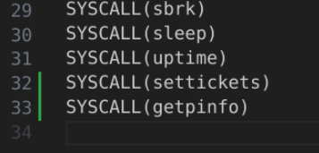
What I did
Usys.S
Purpose: Contains assembly code to define user-space system calls.
Modification: Add entries for the new system calls “settickets” and “getpinfo”.

Slide 9
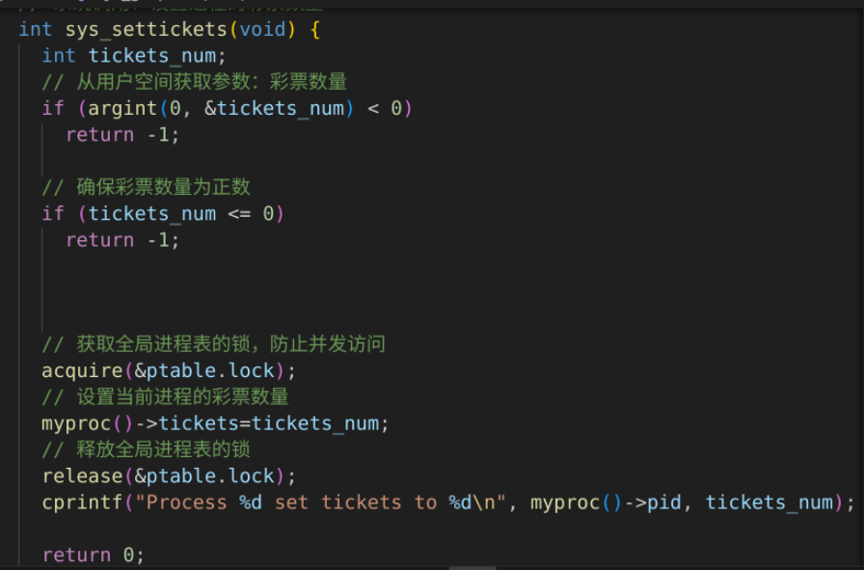
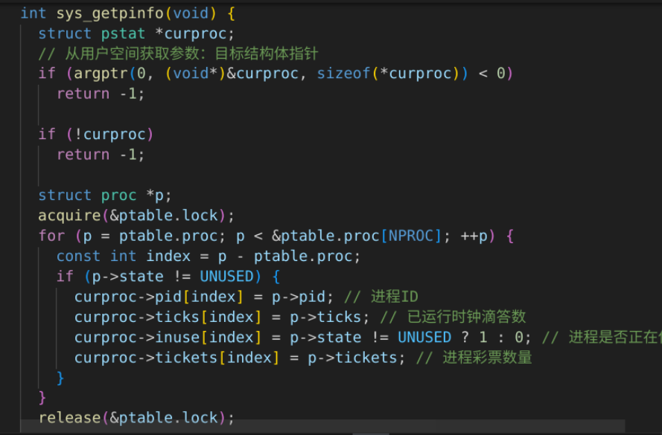
What I did
Sysproc.c
Purpose: Contains implementations of system calls related to process management.
Modification: Implement sys_settickets and sys_getpinfo.

Slide 10
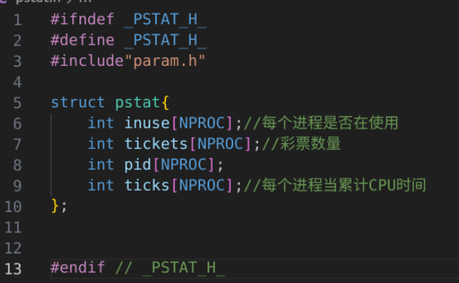
What I did
Pstat.h
Purpose: Defines the pstat structure used by getpinfo system call.

Slide 11

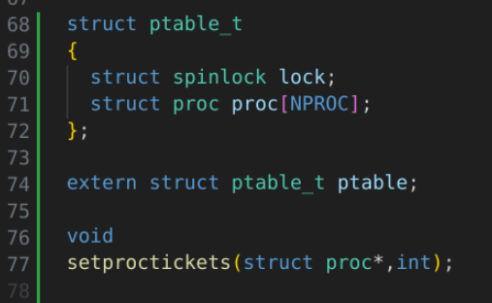
What I did
Proc.h
Purpose: Defines the proc structure and other process-related constants and types.
Modification: Add a field to store the number of tickets for each process and include the new system calls.→ptable,spinlock,

Slide 12
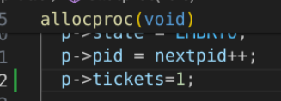
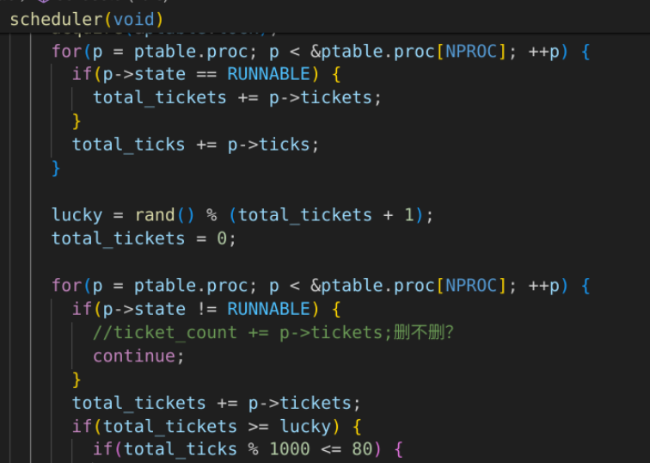
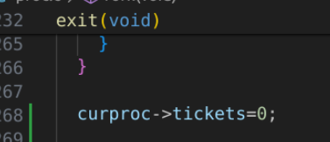

What I did
Proc.c
Purpose: Contains the core process management code, including the scheduler.
Modification: Implement the lottery scheduler, initialize tickets in allocproc(), and modify scheduler() to perform the lottery.

Slide 13
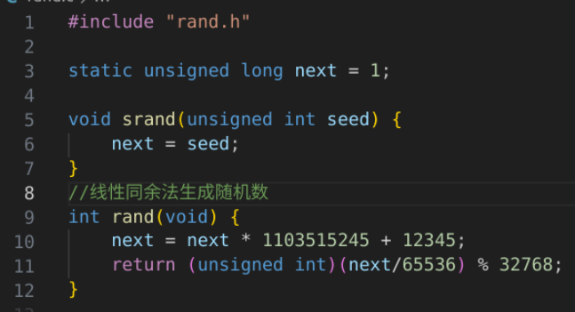
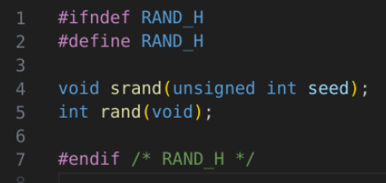
What I did
Rand.h,Rand.c
Purpose: Random number generation functions.
Modification: Define the random number generator function prototype.

Slide 14
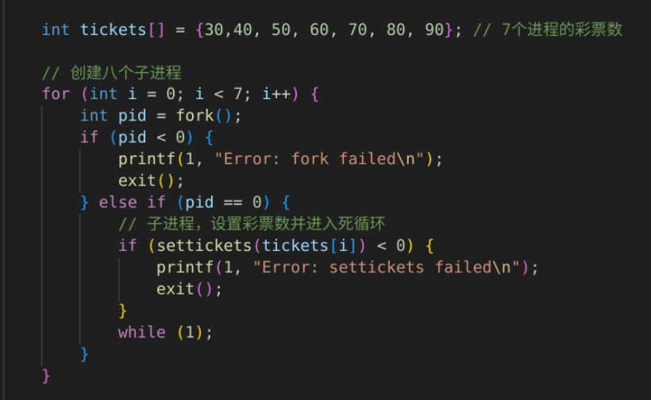
What I did
Tester.c
Purpose: User-space program to test the lottery scheduler.
Modification: Write code to create processes with different ticket counts and use getpinfo to gather scheduling data.

Slide 15
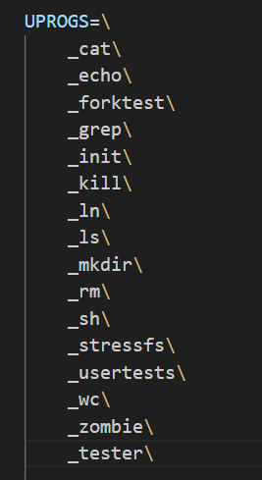
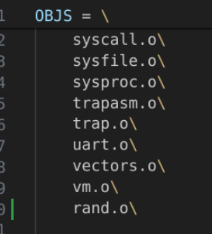
What I did
makefile
Purpose: Build configuration for xv6.
Modification: Ensure new files are compiled and linked.

Slide 16
Section 3: results

Slide 17
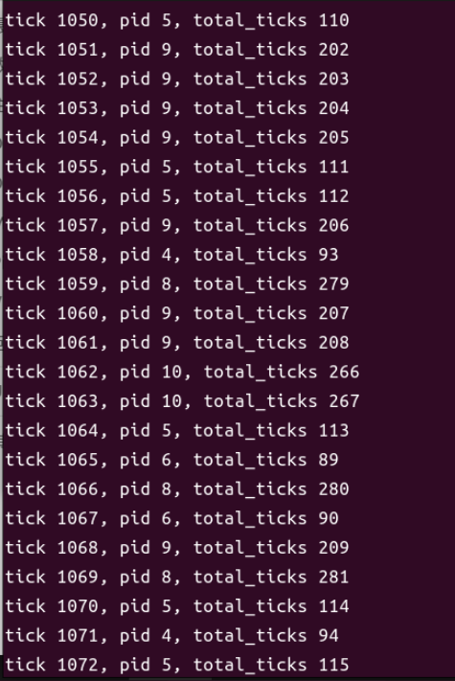
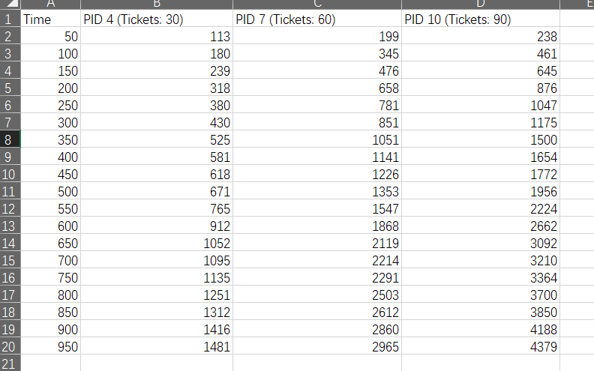
results
./tester

Slide 18
Thanks for Listening!

