Slide 1
Compiler Principle
——Lexical Analysis
Zhizheng Zhang
Southeast University
Notes:
1

Slide 2
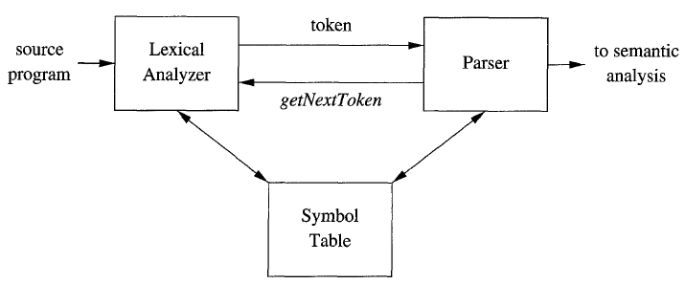
1. The Role of Lexical Analyzer

Slide 3
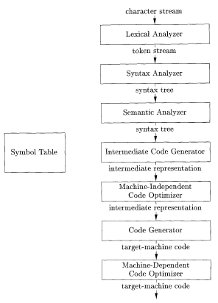

Slide 4
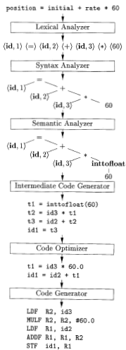
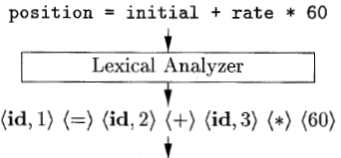
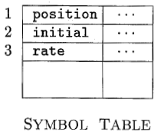
Example.
position = initial + rate * 60

Slide 5
Sometimes, lexical analyzers are divided into a cascade of two processes:
Scanning consists of the simple processes that do not require tokenization of the input, such as deletion of comments, compaction of consecutive whitespace characters into one, generation of error messages, and the expansion of macros.
Lexical analysis, where the scanner produces the sequence of tokens as output.

Slide 6
1. 1 Scanning vs. Parsing
Why the analysis portion of a compiler is normally separated into lexical analysis and parsing (syntax analysis) phases.
Simplicity of design is the most important consideration.
Compiler efficiency is improved.
Compiler portability is enhanced.

Slide 7
1. 2 Tokens, Patterns, and Lexemes
A token is a pair consisting of a token name and an optional attribute value.
A pattern is a description of the form that the lexemes of a token may take.
A lexeme is a sequence of characters in the source program that matches the pattern for a token and is identified by the lexical analyzer as an instance of that token.

Slide 8
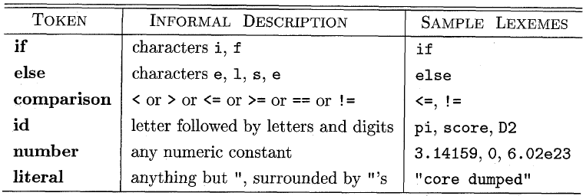

Slide 9
1. 3 Attributes for Tokens
The most important example is the token id, where we need to associate with the token a great deal of information, e.g., its lexeme, its type, and the location at which it is first found (in case an error message about that identifier must be issued) - is kept in the symbol table.
Thus, the appropriate attribute value for an identifier is a pointer to the symbol-table entry for that identifier.

Slide 10
E = M ∗ C ∗∗ 2
<id, pointer to symbol-table entry for E>
< assign-op >
<id, pointer to symbol-table entry for M>
<mult -op>
<id, pointer to symbol-table entry for C>
<exp-op>
<number , integer value 2 >

Slide 11
1. 4 Lexical Errors
It is hard for a lexical analyzer to tell, without the aid of other components.
E.g., fi (b == f(x)) …
The lexical Analyzer cannot tell fi is wrong without the help of parser.

Slide 12
If the lexical analyzer is unable to proceed because none of the patterns for tokens matches any prefix of the remaining input. Possible error-recovery actions are:
Delete one character from the remaining input.
2. Insert a missing character into the remaining input.
3. Replace a character by another character.
4. Transpose two adjacent characters.

Slide 13
Exercise. 3.1.2
Tagged languages like HTML or XML are different from conventional programming languages in that the punctuation (tags) are either very numerous (as in HTML) or a user-definable set (as in XML). Further, tags can often have parameters. Suggest how to divide the following HTML document:
Here is a photo of <B>my house</B>:
<P><IMG SRC = "house. gif I1><BR>
See <A HREF = "morePix. Html’'>More Pictures</A> if you
liked that one. <P>
into appropriate lexemes. Which lexemes should get associated lexical values, and what should those values be?

Slide 14
2. Input Buffering
Problem:
How to read the source program fast and correctly.
Difficult:
Have to look one or more characters beyond the next lexeme before we can be sure we have the right lexeme.

Slide 15
For instance,
We cannot be sure we've seen the end of an identifier until we see a character that is not a letter or digit.
In C, single-character operators like -, =, or < could also be the beginning of a two-character operator like ->, ==, or <=.

Slide 16
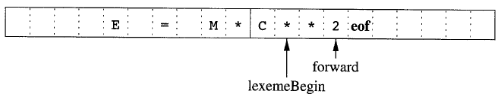
2.1 Buffer Pairs
Using a pair of input buffers
Each buffer is of the same size N, and N is usually the size of a disk block,
e.g., 4096 bytes

Slide 17
Two pointers to the input are maintained:
Pointer lexemeBegin, marks the beginning of the current lexeme, whose extent we are attempting to determine.
Pointer forward scans ahead until a pattern match is found.

Slide 18
Works in this way…
Once the next lexeme is determined, forward is set to the character at its right end.
After the lexeme is recorded as an attribute value of a token returned to the parser, lexemeBegin is set to the character immediately after the lexeme just found.
Advancing forward requires that we first test whether we have reached the end of one of the buffers, and if so, we must reload the other buffer from the input, and move forward to the beginning of the newly loaded buffer

Slide 19
NOTE: As long as we never need to look so far ahead of the actual lexeme that the sum of the lexeme's length plus the distance we look ahead is greater than N, we shall never overwrite the lexeme in its buffer before determining it.

Slide 20
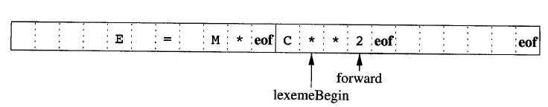
2.2 Sentinels
We can combine the buffer-end test with the test for the current character if we extend each buffer to hold a sentinel character at the end.
Sentinels at the end of each buffer

Slide 21
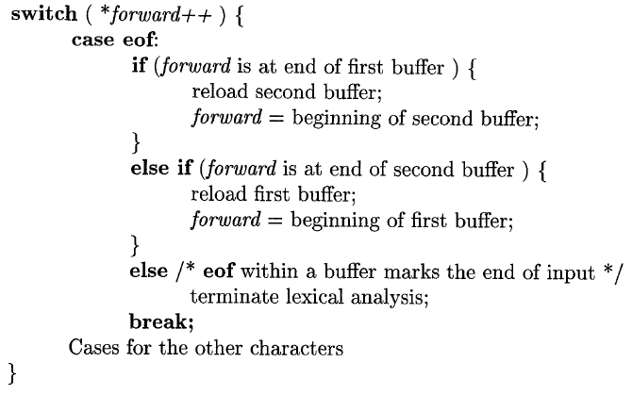
Lookahead code with sentinels

Slide 22
3. Specification of Tokens
Regular Expressions
Regular Grammar/Regular Definition

Slide 23
3.1 Regular Expression
Example.Identifier Token
letter_(letter_|digit)*

Slide 24
Regular Expression and its language
BASIS: Given an alphabet table Σ, there are two rules that form the basis:
1. ε is a regular expression, and L(ε) is {ε} .
2. If a is a symbol in Σ, then a is a regular expression, and L(a) = {a}.
INDUCTION: Suppose r and s are regular expressions denoting languages L(r) and L(s), respectively
1. (r)|(s) is a regular expression denoting the language L(r) ∪L(s).
2. (r)(s) is a regular expression denoting L(r) L(s) .
3. (r) * is a regular expression denoting (L (r)) * .
4. (r) is a regular expression denoting L(r). That means, the pairs of parenthesis cannot change the language they denote.

Slide 25
PRECEDENCE
The unary operator * has highest precedence and is left associative.
b) Concatenation has second highest precedence and is left associative.
c) | has lowest precedence and is left associative.

Slide 26
Example : Let Σ = {a, b}.
The regular expression a|b denotes the language {a, b}.
2. (a|b)(a|b) denotes {aa, ab, ba, bb}. Another regular expression for the same language is aa|ab|ba|bb.
3. a* denotes the language consisting of all strings of zero or more a's, that is, {ε, a, aa, aaa, . . . }.
4. (a|b)* denotes {ε, a, b, aa, ab, ba, bb, aaa, . . .}. Another regular expression for the same language is (a*b*)*.
5. a|a*b denotes the language {a, b, ab, aab,aaab,. . .}.

Slide 27
A language that can be defined by a regular expression is called a regular set.
If two regular expressions r and s denote the same regular set, we say they are equivalent and write r = s. For instance, (a|b) = (b|a).

Slide 28
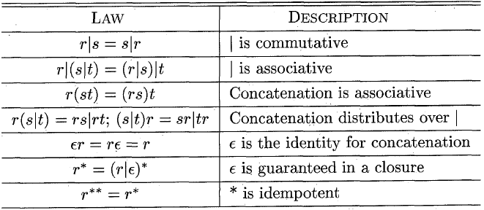

Slide 29
3.2 Regular Definition
If Σ is an alphabet of basic symbols, then a regular definition is a sequence of definitions of the form:
d₁ → r₁
d₂ → r₂
…
d_{n} → r_{n}
where:
1. Each d_{i} is a new symbol, not in Σ and not the same as any other of the d's, and
2. Each r_{i} is a regular expression over the alphabet Σ ∪ {d₁, d₂,. . . , d_{i-l}).

Slide 30

Example

Slide 31
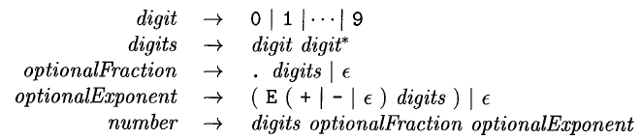
Example

Slide 32
NOTE: for convenient description, we also use
r⁺ to denote r*r;
[abc] to denote a|b|c.
L(r?) to denote L(r)∪{ε}.

Slide 33

Example

Slide 34
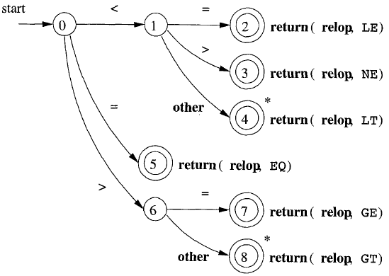
3.3 Transition Diagram
* means that we must retract one position.

Slide 35
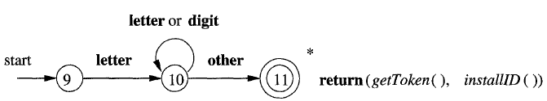

Slide 36
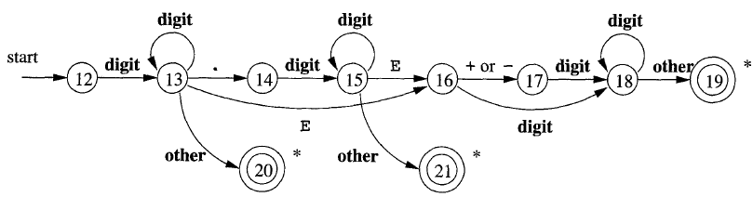

Slide 37
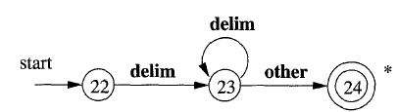

Slide 38
4 Tokens Recognization
TASK
Developing programs that can recognize the lexemes by the token patterns.
Derivation for regular grammars.
Reduction for regular grammars.
……

Slide 39
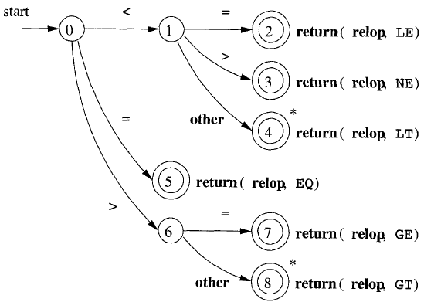
Example. RELOP Recognization

Slide 40
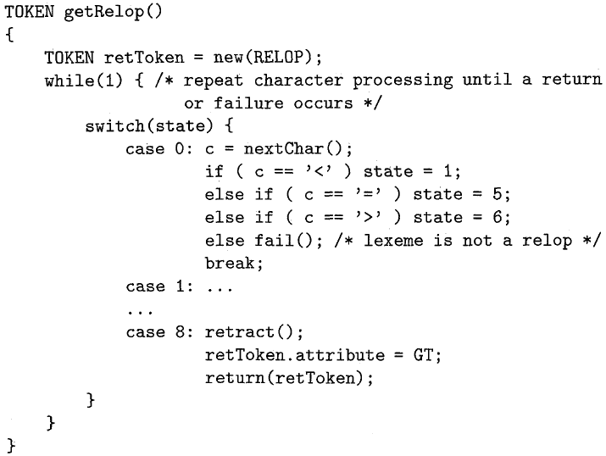
Example. RELOP Recognization

Slide 41
Questions
Can we find the corresponding transition diagram for a regular expressions?
Can we construct the transition diagram for a regular grammar?

Slide 42
Answer
YES.
DFA/Transition Diagram
RE
RG
NFA

Slide 43
4.1 Finite State Automata
Nondeterministic Finite Automata
Deterministic Finite Automata

Slide 44
4.1.1 NFA
A nondeterministic finite automaton consists of:
1. A finite set of states S.
2. A set of input symbols Σ, the input alphabet. We assume that ε, which stands for the empty string, is never a member of Σ.
3. A transition function that gives, for each state, and for each symbol in Σ U {ε} a set of next states.
4. A state s_{o} from S that is distinguished as the start state (or initial state).
5. A set of states F, a subset of S, that is distinguished as the accepting states (or final states).

Slide 45
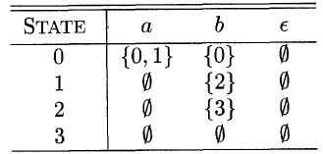
Example.
The transition graph for an NFA recognizing
the language of regular expression
(a|b)*abb is shown

Slide 46
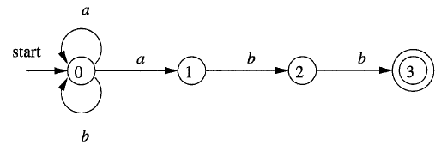

Slide 47
An NFA accepts input string x if and only if there is some path in the transition graph from the start state to one of the accepting states, such that the symbols along the path spell out x.
aabb is accepted.

Slide 48
The language defined (or accepted) by an NFA is the set of strings labeling some path from the start to an accepting state.

Slide 49
4.1.2 DFA
A deterministic finite automaton consists of:
1. A finite set of states S.
2. A set of input symbols Σ, the input alphabet. We assume that ε, which stands for the empty string, is never a member of Σ.
3. A transition function that gives, for each state, and for each symbol in Σ U {ε} a next states.
4. A state s_{o} from S that is distinguished as the start state (or initial state).
5. A set of states F, a subset of S, that is distinguished as the accepting states (or final states).

Slide 50
Algorithm : Simulating a DFA.
INPUT: An input string x terminated by an end-of-file character eof. A DFA D with start state so, accepting states F, and transition function move.
OUTPUT: Answer ''yes" if D accepts x; "no" otherwise.
METHOD: Apply the algorithm to the input string x. The function move(s, c) gives the state to which there is an edge from state s on input c. The function nextChar returns the next character of the input string x.

Slide 51
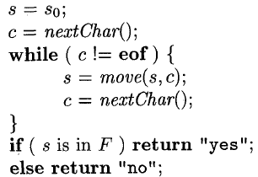

Slide 52
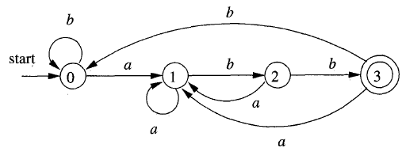
Example.
(a|b)*abb is accepted.

Slide 53
4.2 RE⇒NFA
Algorithm
Input. A regular expression r over an alphabet Σ
Output. An NFA N accepting L( r)

Slide 54
1. For ε,
1
ε
2
1
a
2. For a in Σ,
2

Slide 55
1
αβ
2
1
α
1‘
β
2
α
α|β
1
1
2
β
2
β
^{β*}
1
2
ε
ε
1
1‘
2

Slide 56
Example., Let us construct N( r) for the regular expression r=(a|b)*(aa|bb)(a|b)*
(a|b)*(aa|bb)(a|b)*
x y
(a|b)*
(aa|bb)
(a|b)*
x
1
2
y
a|b
a|b
ε
ε
aa
ε
ε
x
5
1
2
6
y
bb
a
a
3
a
a
ε
ε
ε
ε
x
5
1
2
6
y
b
b
b
4
b

Slide 57
4.3 NFA⇒DFA
Algorithm : The subset construction of a DFA from an NFA.
INPUT: A NFA N
OUTPUT: A DFA D accepting the same language as N.
METHOD: Our algorithm constructs a transition table Dtran for D.

Slide 58
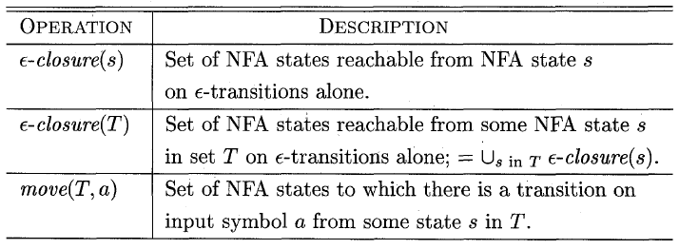

Slide 59
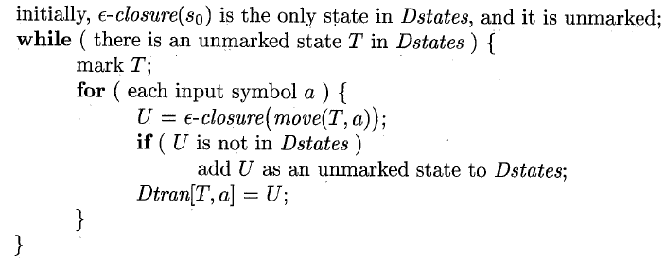

Slide 60
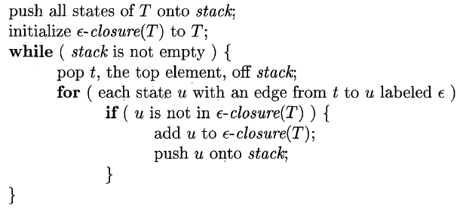
Computing the ε-closure

Slide 61
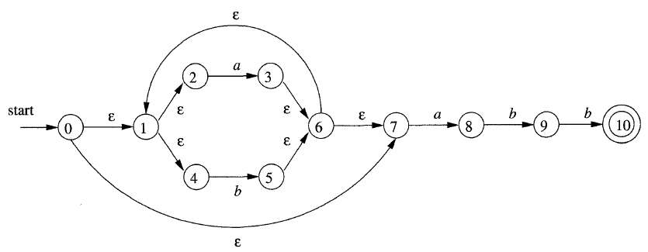
Example.

Slide 62
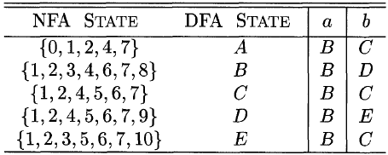
ε-closure(0) = {0, 1, 2, 4, 7}

Slide 63
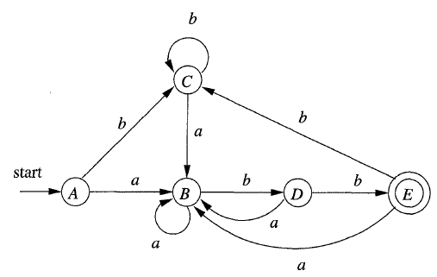

Slide 64
4.3 Minimal DFA
Algorithm : Minimizing the number of states of a DFA.
INPUT: A DFA D with set of states S, input alphabet Σ, state state s_{o}, and set of accepting states F.
OUTPUT: A DFA D' accepting the same language as D and having as few states as possible.

Slide 65
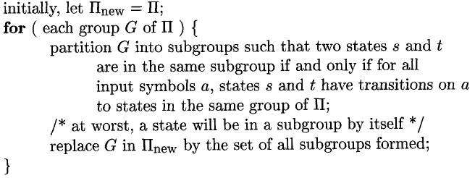
METHOD:
Step1. Start with an initial partition Π with two groups, F and S - F, the accepting and non-accepting states of D.
Step2. Apply the procedure to construct a new partition Π_{new}

Slide 66
Step3. If Π_{new} = Π, let Π_{final} = Π and continue with step (4). Otherwise, repeat step (2) with Π_{new} in place of Π.
Step4. Choose one state in each group of Π_{final} as the representative for that group. The representatives will be the states of the minimum-state DFA D'. The other components of D' are constructed as follows:
(a) The state state of D' is the representative of the group containing the start state of D.
(b) The accepting states of D' are the representatives of those groups that contain an accepting state of D.
(c) Let s and t be representative states for s’s and t’s group respectively, and suppose on input a there is a transition of M from s to t. Then M’ has a transition from s to t on a.

Slide 67
Step5. If D’ has a dead state(a state that is not accepting and that has transitions to itself on all input symbols),then remove it. Also remove any states not reachable from the start state.

Slide 68
Example. Minimize the following DFA.
a
a
b
1
3
4
a
b
a
0
b
a
a
b
b
b
a
2
5
6
b

Slide 69
1. Initialization: ∏₀＝{{0,1,2},{3,4,5,6}}
2.1 For Non-accepting states in ∏₀ :
a: move({0,2},a)={1} ; move({1},a)={3} . 1,3 do not in the same subgroup of ∏₀.
So ,∏₁`＝{{1}，{0,2}，{3,4,5,6}}
b: move({0},b)={2}; move({2},b)={5}. 2,5 do not in the same subgroup of ∏₁‘.
So, ∏₁``＝{{1}，{0}，{2}，{3,4,5,6}}

Slide 70
2.2 For accepting states in ∏₀ :
a: move({3,4,5,6},a)={3,6}, which is the subset of {3,4,5,6} in ∏₁“
b: move({3,4,5,6},b)={4,5}, which is the subset of {3,4,5,6} in ∏₁“
So, ∏₁＝{{1}，{0}，{2}，{3,4,5,6}}.
3.Apply the step (2) again to ∏₁ ,and get ∏₂.
∏₂＝{{1},{0},{2},{3,4,5,6}}= ∏₁ ,
So, ∏_{final} = ∏₁
4. Let state 3 represent the state group {3,4,5,6}

Slide 71
So, the minimized DFA is :
1
a
a
a
0
b
a
3
b
b
b
2

Slide 72
Why the State-Minimization Algorithm Works?
P₁₈₂

Slide 73
5. LEX
SELF-Study

