Slide 1

LEDA使用说明

Slide 2

一.LEDA 概述
LEDA是Synopsys 公司的一种可编程代码设
计规则检查器，它提供全芯片级混合语言
（Verilog和VHDL）处理能力,从而加快了复
杂的SOC设计的开发。

Slide 3
1. LEDA 作用
（１）LEDA预装的检查规则大大地增强了设计人员检查HDL代码的能力，包括可综合性，可仿真性、可测试性和可重用性。利用所提供的设计规则，能进一步的提高Synopsys工具，例如VCS、Design Compiler以及Formality的性能。
（２）LEDA的规则集有助于设计人员共享他们的设计经验，对硬件设计预检查，且将设计风险降到最低。

Slide 4
1. LEDA 作用
（３）使用LEDA，可以对硬件设计的仿真和综合进行预检查，消除设计流程中的瓶颈，其中Verilog代码设计规则可确保按内部或外部工具要求优化代码 。
（４）LEDA提供的设计规则可提高Synopsys工具的性能。

Slide 5
２．LEDA功能
（１）支持Verilog/VHDL混合语言的设计 。
（２）包含先进的硬件设计推测和层次化检查的能力，确保设计人员对特殊硬件结构(包括时钟、寄存器、锁存器)进行规则检查 。
（３）包括预装全面的设计规则检查和规范集。
（４）针对Synopsys工具性能优化的HDL代码检查，以确保与工具(如Design Compiler、VCS和Formality)的最新功能要求兼容 。

Slide 6
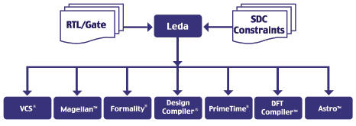
LEDA关系图

Slide 7
二．LEDA详细介绍

Slide 8
１.结构
LEDA包含Checker 和Specifier两个功能不同的工具．
Checker是主要的检查工具，如果LEDA自带的prepackaged rule能满足用户检查需要，那么我们可以直接用Checker进行检查．
Specifier是自定义Rule的工具，当prepackaged rule不能满足用户的检查需要时，我们需要Specifier 定义需要的Rule，再进行检查．

Slide 9
２.流程
当LEDA自带的prepackaged rule能满足用户检查需要，可立刻进行检查．
当LEDA自带的prepackaged rule部分满足用户检查需要，可先对prepackaged rule进行修改，再进行检查．
当LEDA自带的prepackaged rule完全不符合用户检查需要，那就需要Specifier重新定义需要的Rule，再进行检查．

Slide 10
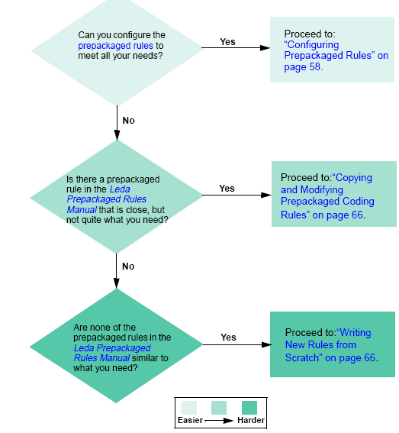

Slide 11
３.模式
LEDA有三种操作模式，分别为：
①GUI mode
②Batch mode
③TCL mode

Slide 12
①GUI mode
GUI mode 即图形界面模式，主要适合于初学者使用．
无论之前使用什么模式，用户都可以使用GUI mode 进行回顾和调试错误．
用户在GUI mode 下可以在主菜单的控制台上转换到TCL mode．
LEDA默认模式为GUI mode

Slide 13
②Batch mode
此模式适合于对LEDA比较熟悉的用户．
用户可以在此模式下进行脚本操作．

Slide 14
③TCL mode
用户使用较多的一种模式．
用户可以通过TCL shell使用Design Query Language (DQL)进行设计规则的检查．
还可以通过此模式进行Leda projects的管理, rule configurations, 还有运行 Checker．

Slide 15
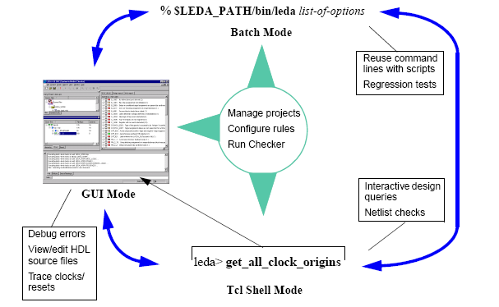
三种模式关系

Slide 16
４．Checker 使用介绍
在命令行键入“LEDA”,LEDA启动，默认为ＧＵＩ模式，我们以GUI模式为主，详细介绍LEDA用法．(以Verilog为例)

Slide 17
⑴Creating Projects to Check HDL Code
①在主菜单选择Project > New.
Enter the full path and name for your project in the Project Name field at the top of the window, or enter just a project name and use the Browse button to navigate to a directory where you want to store your project data. Then click the Next button at the bottom right of the window to start the Wizard

Slide 18
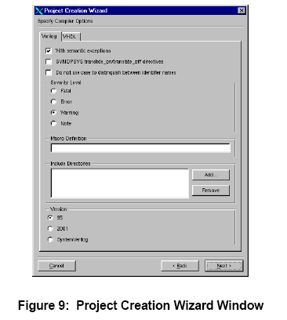

Slide 19
②Specify Compiler Options
With semantic exceptions：enabled by default，选择此选项能避免不必要的报错．
Example:This standard does not allow parameters declared with a range, as shown in the following example:
parameter [3:0] p=4'b0101; (illegal in IEEE mode)
(legal in exception mode)

Slide 20
②Specify Compiler Options
SYNOPSYS translate_on and translate_off directives: disabled by default.当用户选择disabled 时，Leda将不会尝试translate有限制的代码，这样对没有综合的代码来说，可以起到testbenches的作用，也就是说可能导致不可预知的结果，从而起到检查作用．

Slide 21
②Specify Compiler Options
Do not use case to distinguish identifier names: disabled by default. 对于Verilog有效,如果需要辨别标识符,请选上.

Slide 22
②Specify Compiler Options
Severity Level panel: The default is Warning.
LEDA报错的级别,分别fatal,error,warning,note,用户选择的选项以下的级别将不会被报告出来.

Slide 23
②Specify Compiler Options
Include Directories pane : use the Add button to navigate to any directories that you want to be searched for included files in your design.
Macro Definition field : specify the values for any preprocessor macros that you want to be in effect for the analysis.
Version pane : depending on the version of Verilog you are using. The default is Verilog 95. For information on Leda’s support levels for Verilog 2001 and System Verilog,

Slide 24
②Specify Compiler Options
Working libraries pane : click on the New button and use the New Library Window to specify the name of a working library that you want to add to your project.

Slide 25
②Specify Compiler Options
Library directories and Library files panes : click on the Add button and navigate to the locations of any required source code libraries to be searched by the Verilog analyzer in order to resolve unresolved module instances. Click on the Enable Checks check box if you want Leda to check selected rules in the specified library directories or files.

Slide 26
②Specify Compiler Options
Directories/Files pane : opens the Add Directory/File window. Navigate to the location of the .v, .ve, or .inc files you want to check.

Slide 27
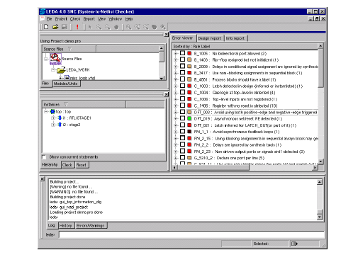

Slide 28
(2) Using Rule wizard to select/deselect Rule
With a project built, you can customize the Checker to run just the rules that you are interested in against your VHDL and Verilog source code.

Slide 29
(2) Using Rule wizard to select/deselect Rule
①set up your environment for running the Checker.
②define any macros needed for expanding rules prior to checking.
③from the main menu, choose Check > Configure. This opens the Rule Wizard ;

Slide 30
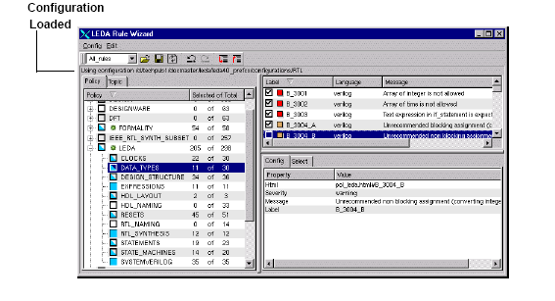

Slide 31
(3)Using Prebuilt Configurations
To load a different rule configuration, from the Rule Wizard choose Config > Load configuration

Slide 32
(3)Using Prebuilt Configurations:(Ⅰ)
Gate-level: contains 90 chip-level and netlist/design rules selected from the Designand Leda general coding guidelines policies.
Leda-classic: contains roughly 1,300 rules drawn from every prepackaged policy except DesignWare and STARC. It is close to the default configuration used in previous versions of the tool.

Slide 33
(3)Using Prebuilt Configurations : (Ⅱ)
Leda-optimized: contains roughly 1,100 rules from the same policies as Leda-classic. This configuration is “optimized” to remove similar rules from different policies.
RTL: contains about 70 rules drawn from the DC, DFT, Formality, RMM, and Leda general coding guidelines policies. This configuration is the default.

Slide 34
(3)Using Prebuilt Configurations : (Ⅲ)
Custom:if you choose Custom, use the Load configuration window that pops up to navigate to and select your custom configuration.

Slide 35
(4)Selecting or Deselecting Rules
Use the Policy and Topic tabs on the left side of the window to select or deselect entire policies, topics, or rulesets from either the policy or topic point of view.

Slide 36
(4)Selecting or Deselecting Rules
The box icons in the Policy tab on the left side of the Rule Wizard display tell you the rule selection status for the rules in each policy:
An open box (clear):indicates that all rules in that policy are deselected for checking;
A full box (set): indicates that all rules in that policy are selected for checking;

Slide 37
(4)Selecting or Deselecting Rules
A half-full box (partially set): indicates that some, but not all rules in that policy are selected for checking.
A green star : The green star only appears when you deselect a policy in the Rule Wizard window and then select it again for checking, If you use the Wizard to change any of the defaults for that policy, the green star goes away.

Slide 38
(5)Deactivating Rules
In addition to the Rule Wizard that you typically use before you run the Checker, Leda provides several other ways to deactivate rules

Slide 39
①Deactivating Rules with a rule configuration File
You can edit a rule configuration file (config.tcl) to select or deselect policies, rulesets or rules. Point to the directory that contains this config.tcl file using the -config path_to_dir batch option or the $LEDA_CONFIG environment variable.

Slide 40
①Deactivating Rules with a rule configuration File
To deselect a rule, use the following Tcl command in your configuration file:
rule_deselect -rule rule_label
For example, to deselect a rule labeled B_1000:
rule_deselect -rule B_1000

Slide 41
②Deactivating Rules from within HDL source Files
Another approach to deactivating all rule checking for selected blocks of code is to add the “leda off” and “leda on” pragmas to your HDL code

Slide 42
②Deactivating Rules from within HDL source Files
For example:
Module m (a, b, c):
Input a, b;
// leda off or // leda rule_1 off
Output c:
// leda on or // leda rule_1 on
means that the line “Output c:” does not get checked.

Slide 43
③Deactivating Verilint Policy Rules
If you want to deactivate rules just from the Verilint policy, use the following pragmas in your source code:
Module m (a, b, c):
Input a, b;
// verilint off
Output c:
// verilint on

Slide 44
④Deactivating Rules from the error viewer
use the Error Viewer after you run a check. Right click on the error message that you want to deactivate, and select “Disable the rule” or “Disable redundant rules“.

Slide 45
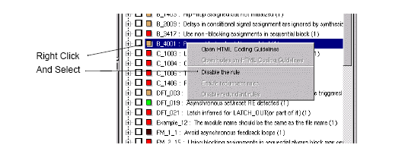

Slide 46
(5)Running the Checker
When you finish selecting the rules you want to check, you can run the Checker and analyze the results. Follow these steps:

Slide 47
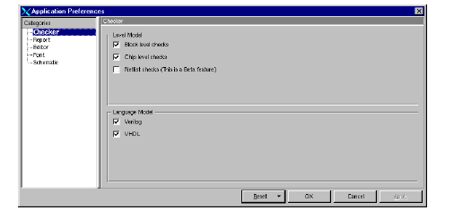
(5)Running the Checker
①From the main menu, choose File > Options.

Slide 48
(5)Running the Checker
②Choose Check > Run. This brings up the Get Design Constraints window .Use this window to specify the “top” file in your design using the Unit Name and Library Name menus.

Slide 49
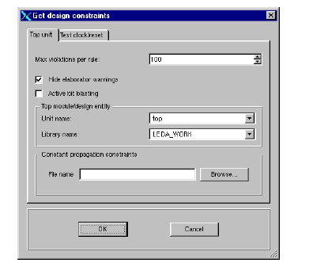

Slide 50
(5)Running the Checker
③If you want to enable the Clock and Reset Tree browsers in the Error Viewer after your Checker run, select that checkbox in the Get Design Constraints window.

Slide 51
(5)Running the Checker
④The Max violations per rule is set to 100 by default. If you want Leda to show a larger or smaller number of violations per rule, use the dial-up/down menu to set the new number.

Slide 52
(5)Running the Checker
⑤If you want to create test clocks or test/resets from ports named in the Get Design Constraints window, click on the Test clock/reset tab.

Slide 53
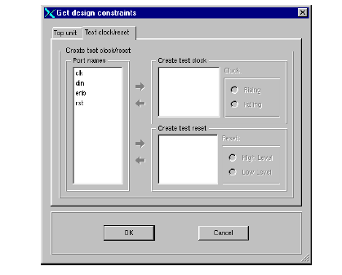

Slide 54
(5)Running the Checker
⑥For each test clock that you want to create :
Select a port name from the Port names listbox.
Click on the arrow button to add the selected name to the Create test clock listbox.
Specify Rising or Falling edge for the clock cycle using the radio buttons in the Create test clock panel.

Slide 55
(5)Running the Checker
⑦For each test reset :
Select a port name from the Port names listbox.
Click on the arrow button to add the selected name to the Create reset clock listbox.
Specify the first level (High or Low) for the scan shift phase.

Slide 56
(5)Running the Checker
⑧When you are done making all your selections, click on the OK button. The Checker compares your HDL source files against the policies or rules you selected, and displays the results.

Slide 57
(6)Fixing Errors Found by the Checker
After you run the Checker on a design, the main window fills up with a lot of detailed information about your HDL design, including a complete hierarchy of all your source files, a summary panel that reports the number and kind of errors found, and an Error Viewer that you can use to learn more about the rules that were violated using the HTML-based help system.

Slide 58
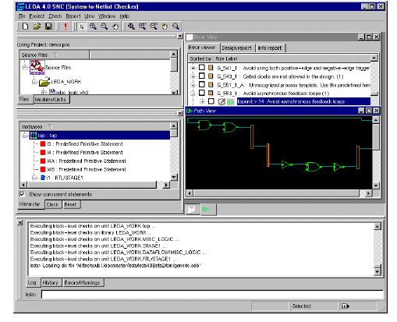

Slide 59
(6)Fixing Errors Found by the Checker
①For each warning or message in the error report, click on the (+) box icon to the left of the message in the Error Viewer. This expands the display to show the HDL source file for the rule that was violated. When you click on the (+) box icon at this next level, Leda displays part of the HDL file that was tested.

Slide 60
(6)Fixing Errors Found by the Checker
②For each warning or error message in the Error Viewer, double-click on the line of code next to the green pointer. This opens a text editor on the file. The suspect code is already highlighted in the file.

Slide 61
(6)Fixing Errors Found by the Checker
③When you are done fixing the errors that you consider to be significant, choose Checker > Run again from the main menu.

Slide 62
(7) Sorting the Error Viewer Display
choosing File > Options from the main window.
Click on the Report category to view and edit your Error Report Viewer preferences.
Specify how you want the display sorted (by Label, Master Rule, File, Policy, Module/Unit, Severity, or Master Rule).

Slide 63
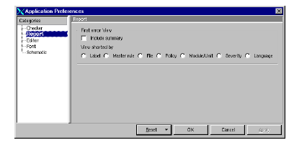

Slide 64
(7) Sorting the Error Viewer Display
To make Leda generate a summary report at the top of the Error Viewer, click on the “Include Summary” check box in the Report Preferences window.
With the summary report open, you can click on any of the blue hyperlink totals to sort the display in the Error Viewer by that item.

Slide 65
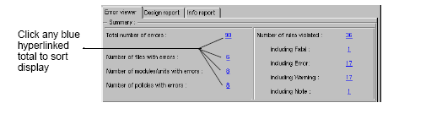

Slide 66
(8) Error Report Displays
The display you get in the Error Report depends on the sorts and filters that you have applied. Leda determines the most appropriate view based on your sorting and filtering selections. There are two basic types of displays:rule displays and file displays

Slide 67
①Rule Display
Leda displays the total number of violations for each rule in parentheses at the end of this line.

Slide 68
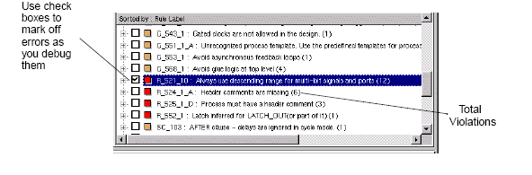

Slide 69
①Rule Display
The second level in the rule display shows all violations of the rule, listed by file name. From this view, you can hyperlink directly to a text editor and correct your source files

Slide 70
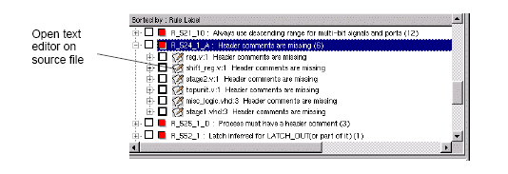

Slide 71
①Rule Display
The third level in the rule display shows the HDL code where the rule violation was found, with the line indicated by a green triangle.

Slide 72
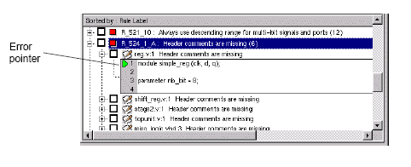

Slide 73
②File Display
the first level in the Error Viewer shows the file name and the number of violations found in that file in parentheses at the end of the line.
The second level lists all the violations in that file. For each violation, the Error Viewer displays the severity, label, and message for the rule that was violated

Slide 74
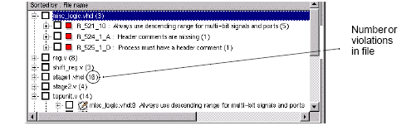

Slide 75
②File Display
The third level shows the HDL code fragment where Leda found the violation and tracing information for chip-level errors.

Slide 76
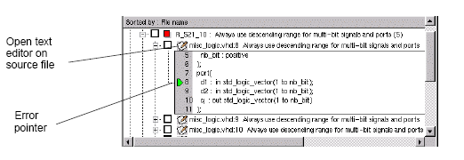

Slide 77
(9)Using the Path Viewer Window
For some chip-level rules, it can be useful to visualize the sub-hierarchy that caused an error. To make the Path Viewer appear, click on the circuit symbol.

Slide 78
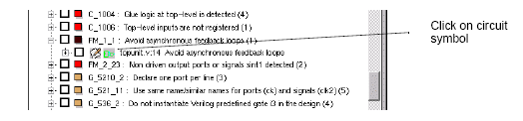

Slide 79
(9)Using the Path Viewer Window
This bring ups an integrated Path Viewer window in the lower half of the Error Viewer

Slide 80
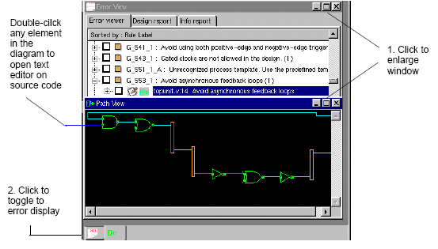

Slide 81
5 Specifier tool 使用介绍
当LEDA自带的RULE不能满足用户的检查需要时,我们可以使用Specifier 设计需要的规则
在终端输入:
$LEDA_PATH/bin/leda -specifier &
启动Specifier .

Slide 82
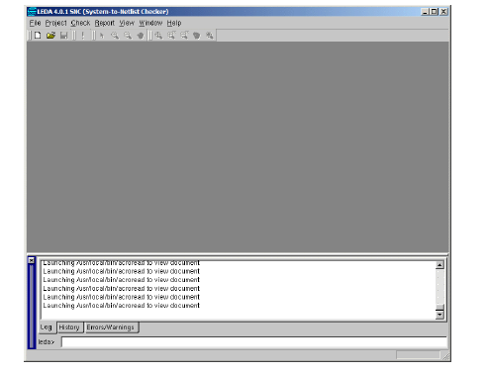

Slide 83
(1)Creating Ruleset Files
① Using a text editor
You can use the text editor in the Specifier by choosing File > New.
② Create the file as “ruleset.sl”. Note that “.sl” is the standard extension for Verilog ruleset files.

Slide 84
(1)Creating Ruleset Files
For example:Suppose we need four new rules that:
● Make sure latches are not used in the design
● Make sure that clocks are named “clock” or end in “_clk”

Slide 85
(1)Creating Ruleset Files
TUT_1:
ruleset TUTOR_RS is
no latch in always_construct
message "Avoid using latches in design“
end ruleset

Slide 86
(1)Creating Ruleset Files
TUT_2:
ruleset TUTOR_CLOCK is
limit clock to CLOCK_WITH_ID
message "Clock name must end with _clk or be clock“
end ruleset

Slide 87
(2)Creating Policies
Now that we have a ruleset .sl file that contains our new rules, we need to store the new rules in a policy. To do that, follow these steps:

Slide 88
(2)Creating Policies
① From the Specifier main window, first open the Rule Wizard (Check > Configure). From there, open the Policy Manager window (Tool > Policy Manager).
② Click the Verilog tab. Then click the New button on the right side of the display. Type in a name for the new policy (for example, “MY_TUTOR”) and click OK.

Slide 89
(2)Creating Policies
③ When your new policy name appears in the Policies pane, click it to highlight the name and then click in the Rulesets pane. Click the Add button. This opens the “Please choose a rule file” window.

Slide 90
(2)Creating Policies
④ Navigate to the location of the ruleset.sl file you just created and click on the file name. Then click the Add button. This causes the tool to compile your new rulesets.

Slide 91
(2)Creating Policies
You should see messages in the Log tab at the bottom of the Specifier main window similar to the following:
Compiling ruleset TUTOR_RS
Compiling ruleset TUTOR_CLOCK

Slide 92
(2)Creating Policies
⑤ Close the Policy Manager window.

Slide 93
(3) Using Tcl Shell Mode to create new policies
我们也可以用TCL来create new policies, use the following command at the Tcl shell prompt:
leda> rule_manage_policy –policy MY_TUTOR create
to compile the ruleset.rl file you created for this tutorial, use the following command at the Tcl shell prompt:
leda> rule_manage_policy -policy MY_TUTOR compile ruleset.sl

Slide 94
(4) Creating a Verilog Test File
To test these rules, we need to create some Verilog code to check them against.
●Using a text editor, type in the following text, and save the file as test.v.

Slide 95
(5)Creating a Project File
Before we can use Leda to test our new rule against the sample Verilog file we created, we must first create a project file. The steps
was say above;

Slide 96
(6) Running the Checker & Fixing the Errors
With the project built, we will now set up and run the Checker, which will check our sample Verilog code against the coding rules we created. The steps was say above;

Slide 97
6 VeRSL 简单介绍
VeRSL is a macro-based language used for writing rules that check Verilog code for errors or anomalies that you specify using prebuilt templates and attributes, and a simple set of commands.

Slide 98
(1) VeRSL commands:
There are six VeRSL commands:
force, no, limit, set, max, and min.

Slide 99
(2)VeRSL Templatesets and Rulesets
VeRSL contains two types of high-level semantic units: templatesets and rulesets. A templateset is like a Verilog module. It contains a set of template declarations. No commands are allowed in templatesets, but they can contain other templateset units.
Rulesets can contain template declarations, commands, and other templateset units.

Slide 100
(3)VeRSL Rules
A VeRSL rule can contain five parts, most often in this order:
command attribute context message severity

Slide 101
(3)VeRSL Rules
Command: Keyword that specifies how to constrain a Verilog item.
Attribute : Keyword that specifies the Verilog item to be constrained.
Context: Keyword that refines the focus of where the Verilog item is to be constrained.

Slide 102
(3)VeRSL Rules
Message : Text to be displayed in the Checker’s Error Viewer when the rule is violated.
Severity : The severity level for violation of this rule (note, warning, error, or fatal)

Slide 103
(3)VeRSL Rules
详细 VeRSL Rules可以参考LEDA自带的文档 versl.pdf .

Slide 104
谢谢大家!

