Slide 1
Instance Based Learning
k-Nearest Neighbor
Locally weighted regression
Radial basis functions
Case-based reasoning
Lazy and eager learning

Slide 2
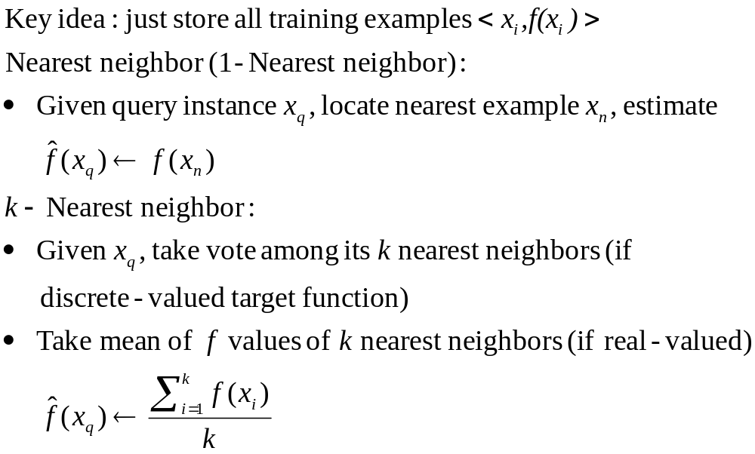
Instance-Based Learning

Slide 3
When to Consider Nearest Neighbor
Instance map to points in R^{n}
Less than 20 attributes per instance
Lots of training data
Advantages
Training is very fast
Learn complex target functions
Do not lose information
Disadvantages
Slow at query time
Easily fooled by irrelevant attributes

Slide 4
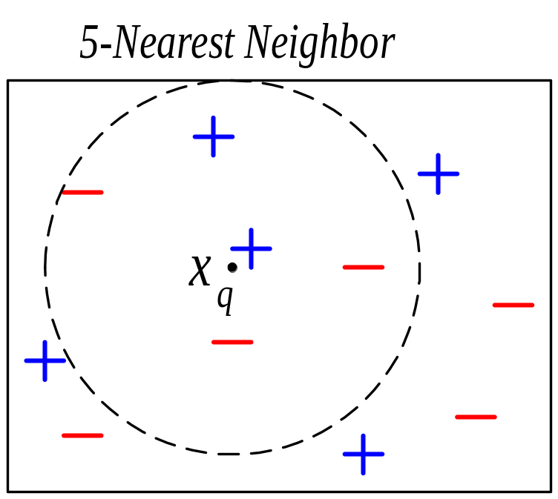
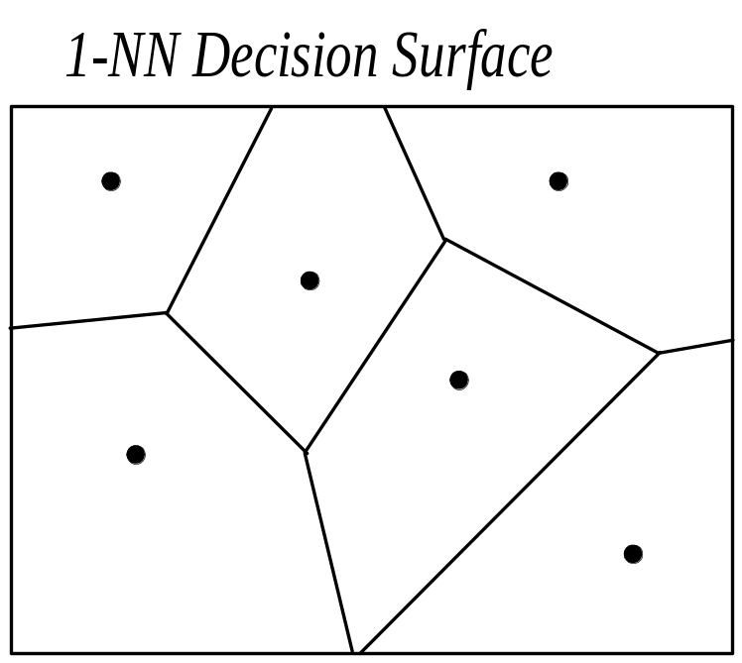
k-NN Classification

Slide 5
Behavior in the Limit
Define p(x) as probability that instance x will be labeled 1 (positive) versus 0 (negative)
Nearest Neighbor
As number of training examples approaches infinity, approaches Gibbs Algorithm
Gibbs: with probability p(x) predict 1, else 0
k-Nearest Neighbor:
As number of training examples approaches infinity and k gets large, approaches Bayes optimal
Bayes optimal: if p(x) > 0.5 then predict 1, else 0
Note Gibbs has at most twice the expected error of Bayes optimal

Slide 6
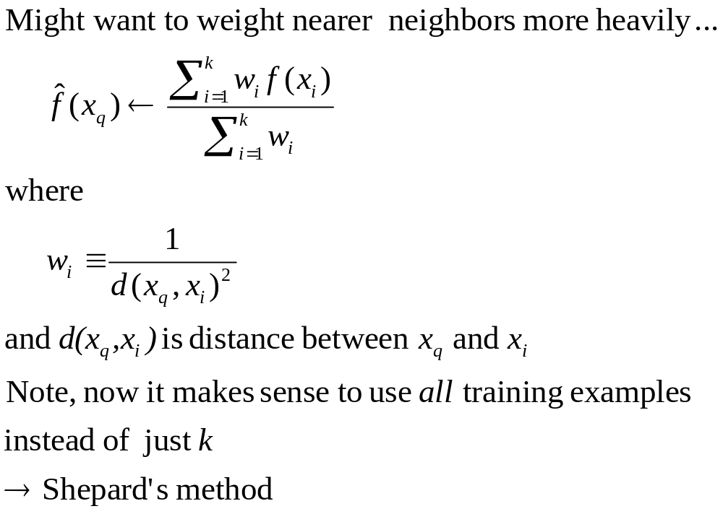
Distance-Weighted k-NN

Slide 7
Curse of Dimensionality
Imagine instances described by 20 attributes, but only 2 are relevant to target function
Curse of dimensionality: nearest neighbor is easily misled when high-dimensional X
One approach:
Stretch jth axis by weight z_{j}, where z₁,z₂,…,z_{n} chosen to minimize prediction error
Use cross-validation to automatically choose weights z₁,z₂,…,z_{n}
Note setting z_{j} to zero eliminates dimension j altogether
see (Moore and Lee, 1994)

Slide 8
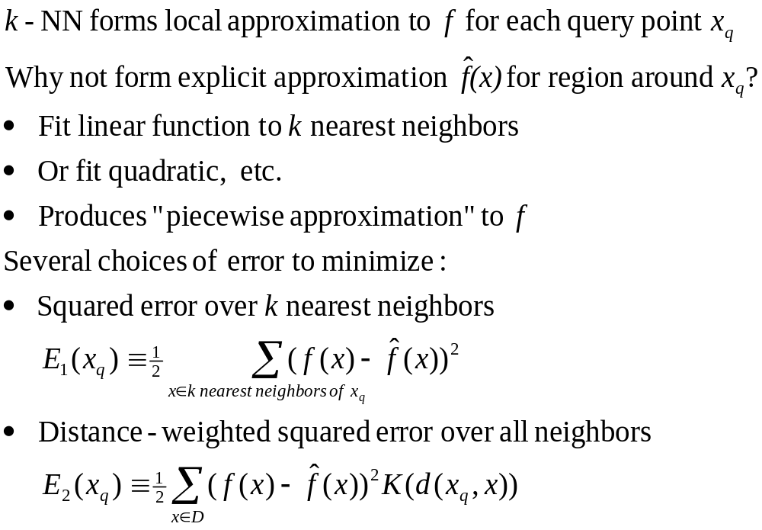
Locally Weighted Regression

Slide 9
Radial Basis Function Networks
Global approximation to target function, in terms of linear combination of local approximations
Used, for example, in image classification
A different kind of neural network
Closely related to distance-weighted regression, but “eager” instead of “lazy”

Slide 10
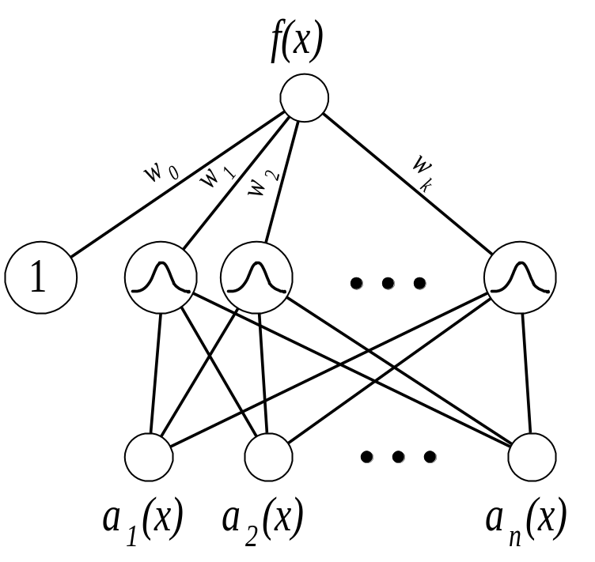
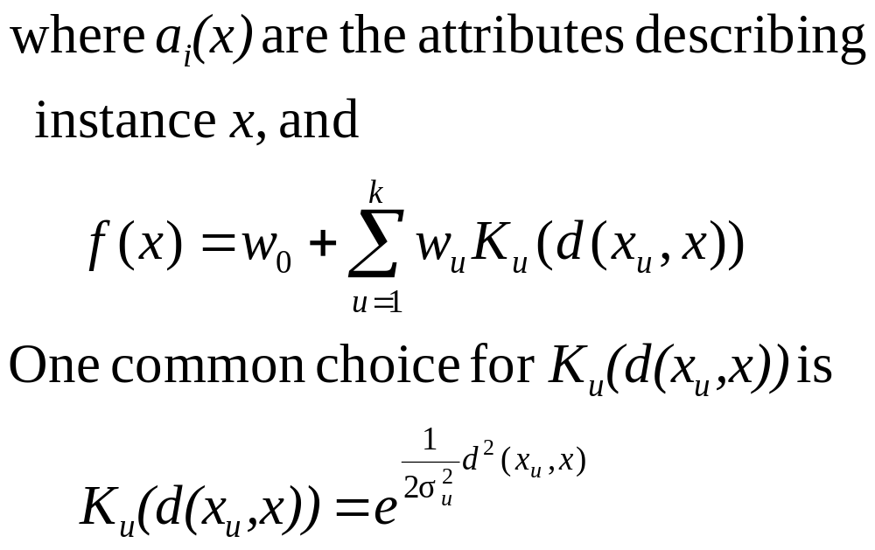
Radial Basis Function Networks

Slide 11
Training RBF Networks
Q1: What x_{u} to use for kernel function K_{u}(d(x_{u},x))?
Scatter uniformly through instance space
Or use training instances (reflects instance distribution)
Q2: How to train weights (assume here Gaussian K_{u})?
First choose variance (and perhaps mean) for each K_{u}
  e.g., use EM
Then hold K_{u} fixed, and train linear output layer
  efficient methods to fit linear function

Slide 12
Case-Based Reasoning
Can apply instance-based learning even when X R^{n}
→ need different “distance” metric
Case-Based Reasoning is instance-based learning applied to instances with symbolic logic descriptions:
((user-complaint error53-on-shutdown)
(cpu-model PowerPC)
(operating-system Windows)
(network-connection PCIA)
(memory 48meg)
(installed-applications Excel Netscape VirusScan)
(disk 1Gig)
(likely-cause ???))

Slide 13
Case-Based Reasoning in CADET
CADET: 75 stored examples of mechanical devices
each training example:
<qualitative function, mechanical structure>
new query: desired function
target value: mechanical structure for this function
Distance metric: match qualitative function descriptions

Slide 14
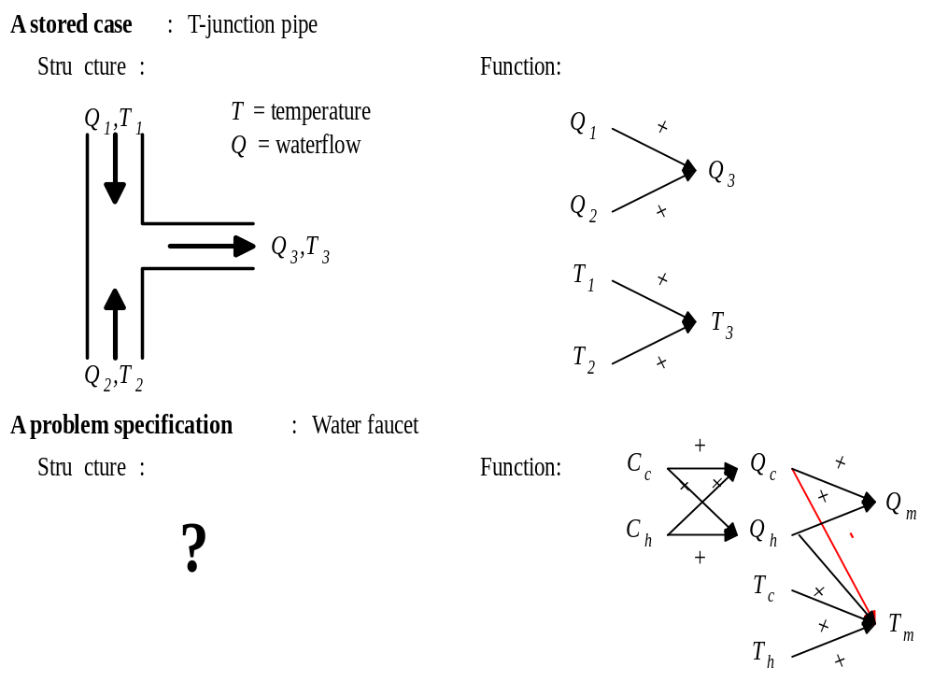
Case-Based Reasoning in CADET

Slide 15
Case-Based Reasoning in CADET
Instances represented by rich structural descriptions
Multiple cases retrieved (and combined) to form solution to new problem
Tight coupling between case retrieval and problem solving
Bottom line:
Simple matching of cases useful for tasks such as answering help-desk queries
Area of ongoing research

Slide 16
Lazy and Eager Learning
Lazy: wait for query before generalizing
k-Nearest Neighbor, Case-Based Reasoning
Eager: generalize before seeing query
Radial basis function networks, ID3, Backpropagation, etc.
Does it matter?
Eager learner must create global approximation
Lazy learner can create many local approximations
If they use same H, lazy can represent more complex functions (e.g., consider H=linear functions)

Slide 17
kd-trees (Moore)
Eager version of k-Nearest Neighbor
Idea: decrease time to find neighbors
  train by constructing a lookup (kd) tree
  recursively subdivide space
    ignore class of points
    lots of possible mechanisms: grid, maximum variance, etc.
  when looking for nearest neighbor search tree
  nearest neighbor can be found in log(n) steps
  k nearest neighbors can be found by generalizing process (still in log(n) steps if k is constant)
Slower training but faster classification

Slide 18
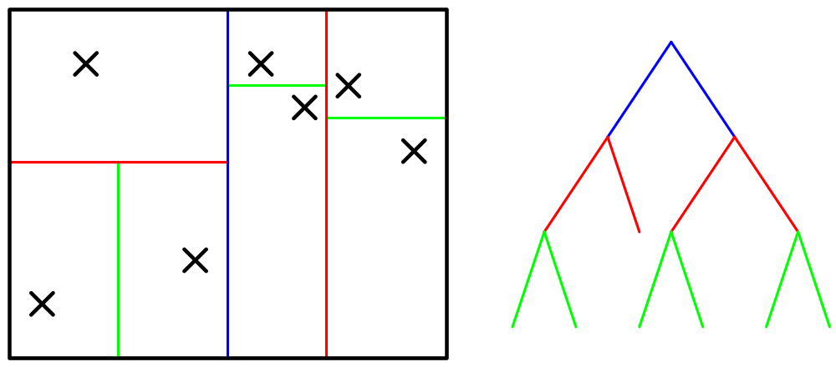
kd Tree

