Slide 1
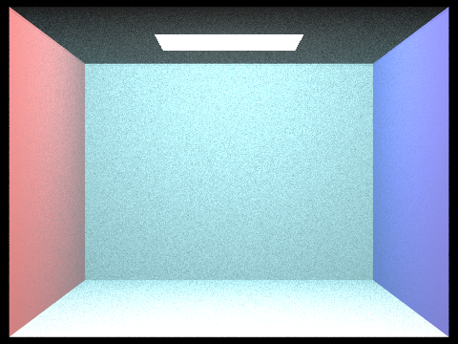
WEEK 1 MILESTONE
Photic
A path tracer that renders how light fades underwater
Week 1 Milestone · CS 184: Computer Graphics, Summer 2026
Zachary Liang & Blair Xu
Notes:
Hey, I'm Zachary and this is Blair. Our final project is called Photic. It's our Homework 3 path tracer, but now it can render water. In HW3, light just travels in a straight line between surfaces and nothing happens to it along the way. Underwater that's not true: the water absorbs and scatters light the whole way through. So that's what we added this week.

Slide 2
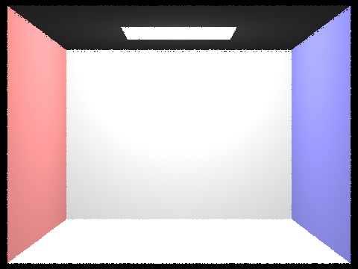
What we built
The water
Water fills whatever scene we load, so we didn't have to build any new geometry
It absorbs light per color channel and scatters it as the ray travels
We pick where the ray scatters directly, so there's no slow ray-marching
Each scatter point samples the lights, and multiple scattering happens on its own as rays keep bouncing
With water turned off, it renders exactly like our old HW3
HW3, no water
Measuring it
We render the same scene at a few different depths
Then measure how fast each color channel fades, which gives us Kd
And compare that to the simple prediction that ignores scattering
The Secchi-disk check is already wired up for next week
With water (turbidity 0.15)
Notes:
There are two halves to this. First the water itself: we wrote a medium that absorbs light per color and scatters it, and figures out where along the ray a scattering event happens. Multiple scattering comes for free because the rays keep bouncing. If you don't turn water on, it renders exactly like the old HW3. The second half is measurement: we render the scene at a few depths and measure how fast each color fades, which gives us Kd. On the right is the box with no water, then with water.

Slide 3
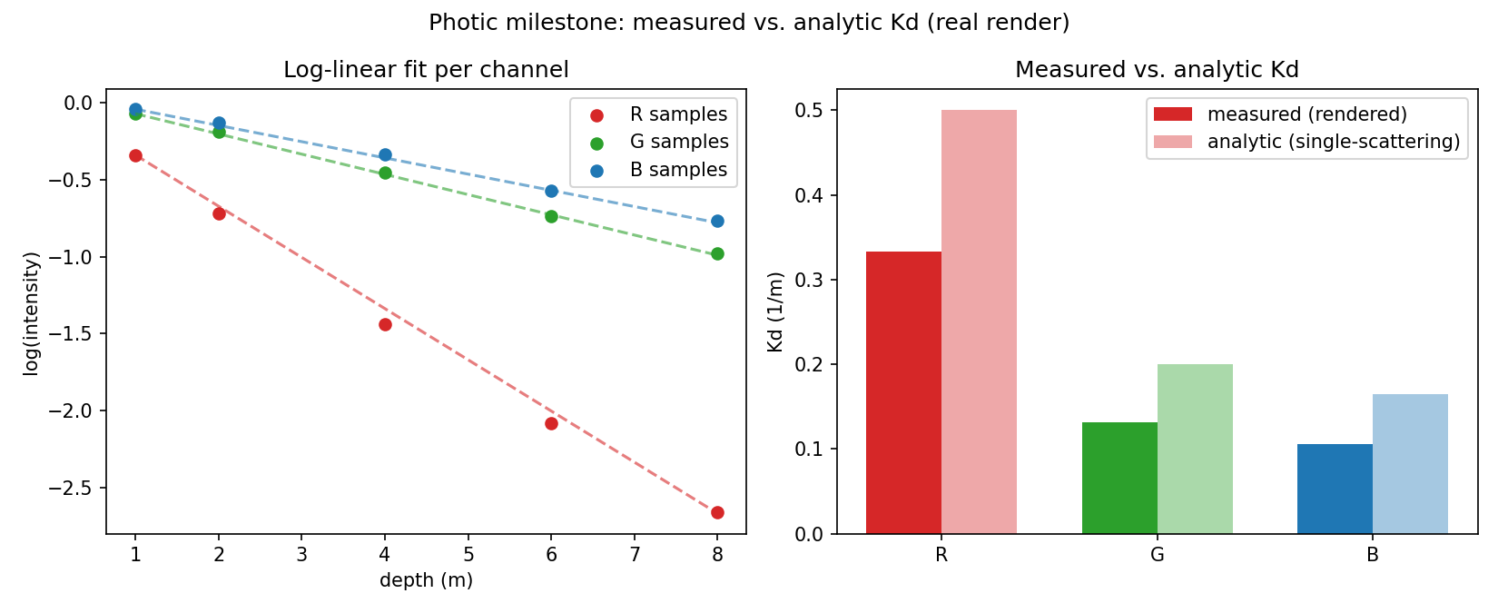
The result
The water fades slower than the simple math predicts, on every color channel.
33-36%
lower than the simple prediction, every channel
channel | measured Kd | simple prediction | how much it scatters
R | 0.333 | 0.500 | low
G | 0.131 | 0.200 | medium
B | 0.105 | 0.165 | high
Photic · CS 184 Summer 2026 · Zachary Liang & Blair Xu
Why it matters
The gap is biggest for blue and smallest for red, matching how much each color scatters versus absorbs. We didn't code that ordering in, it came out on its own.
Next week
Real Henyey-Greenstein scattering, a Secchi-disk test, and a convergence study.
Notes:
Here's the main result. The Kd we measured is about a third lower than what the simple no-scattering math predicts. That's the whole point: when light scatters it doesn't just vanish, a lot of it comes back into view, so the water fades slower than the naive number says. And the gap is biggest for blue and smallest for red, which lines up with how much each color scatters versus absorbs, and we never told it to do that, so the color side is working. A few things are still rough, like the isotropic scattering and the ballpark coefficients, and next week we add the real Henyey-Greenstein scattering, a Secchi-disk test, and a convergence study.

