Slide 1



Rapid adaptation to unfamiliar lexical tone systems: the effects of dialect and explicit exposure
Liang Zhao¹ and Eleanor Chodroff²
University of York¹, University of Zurich²
June 3, 2023

Slide 2
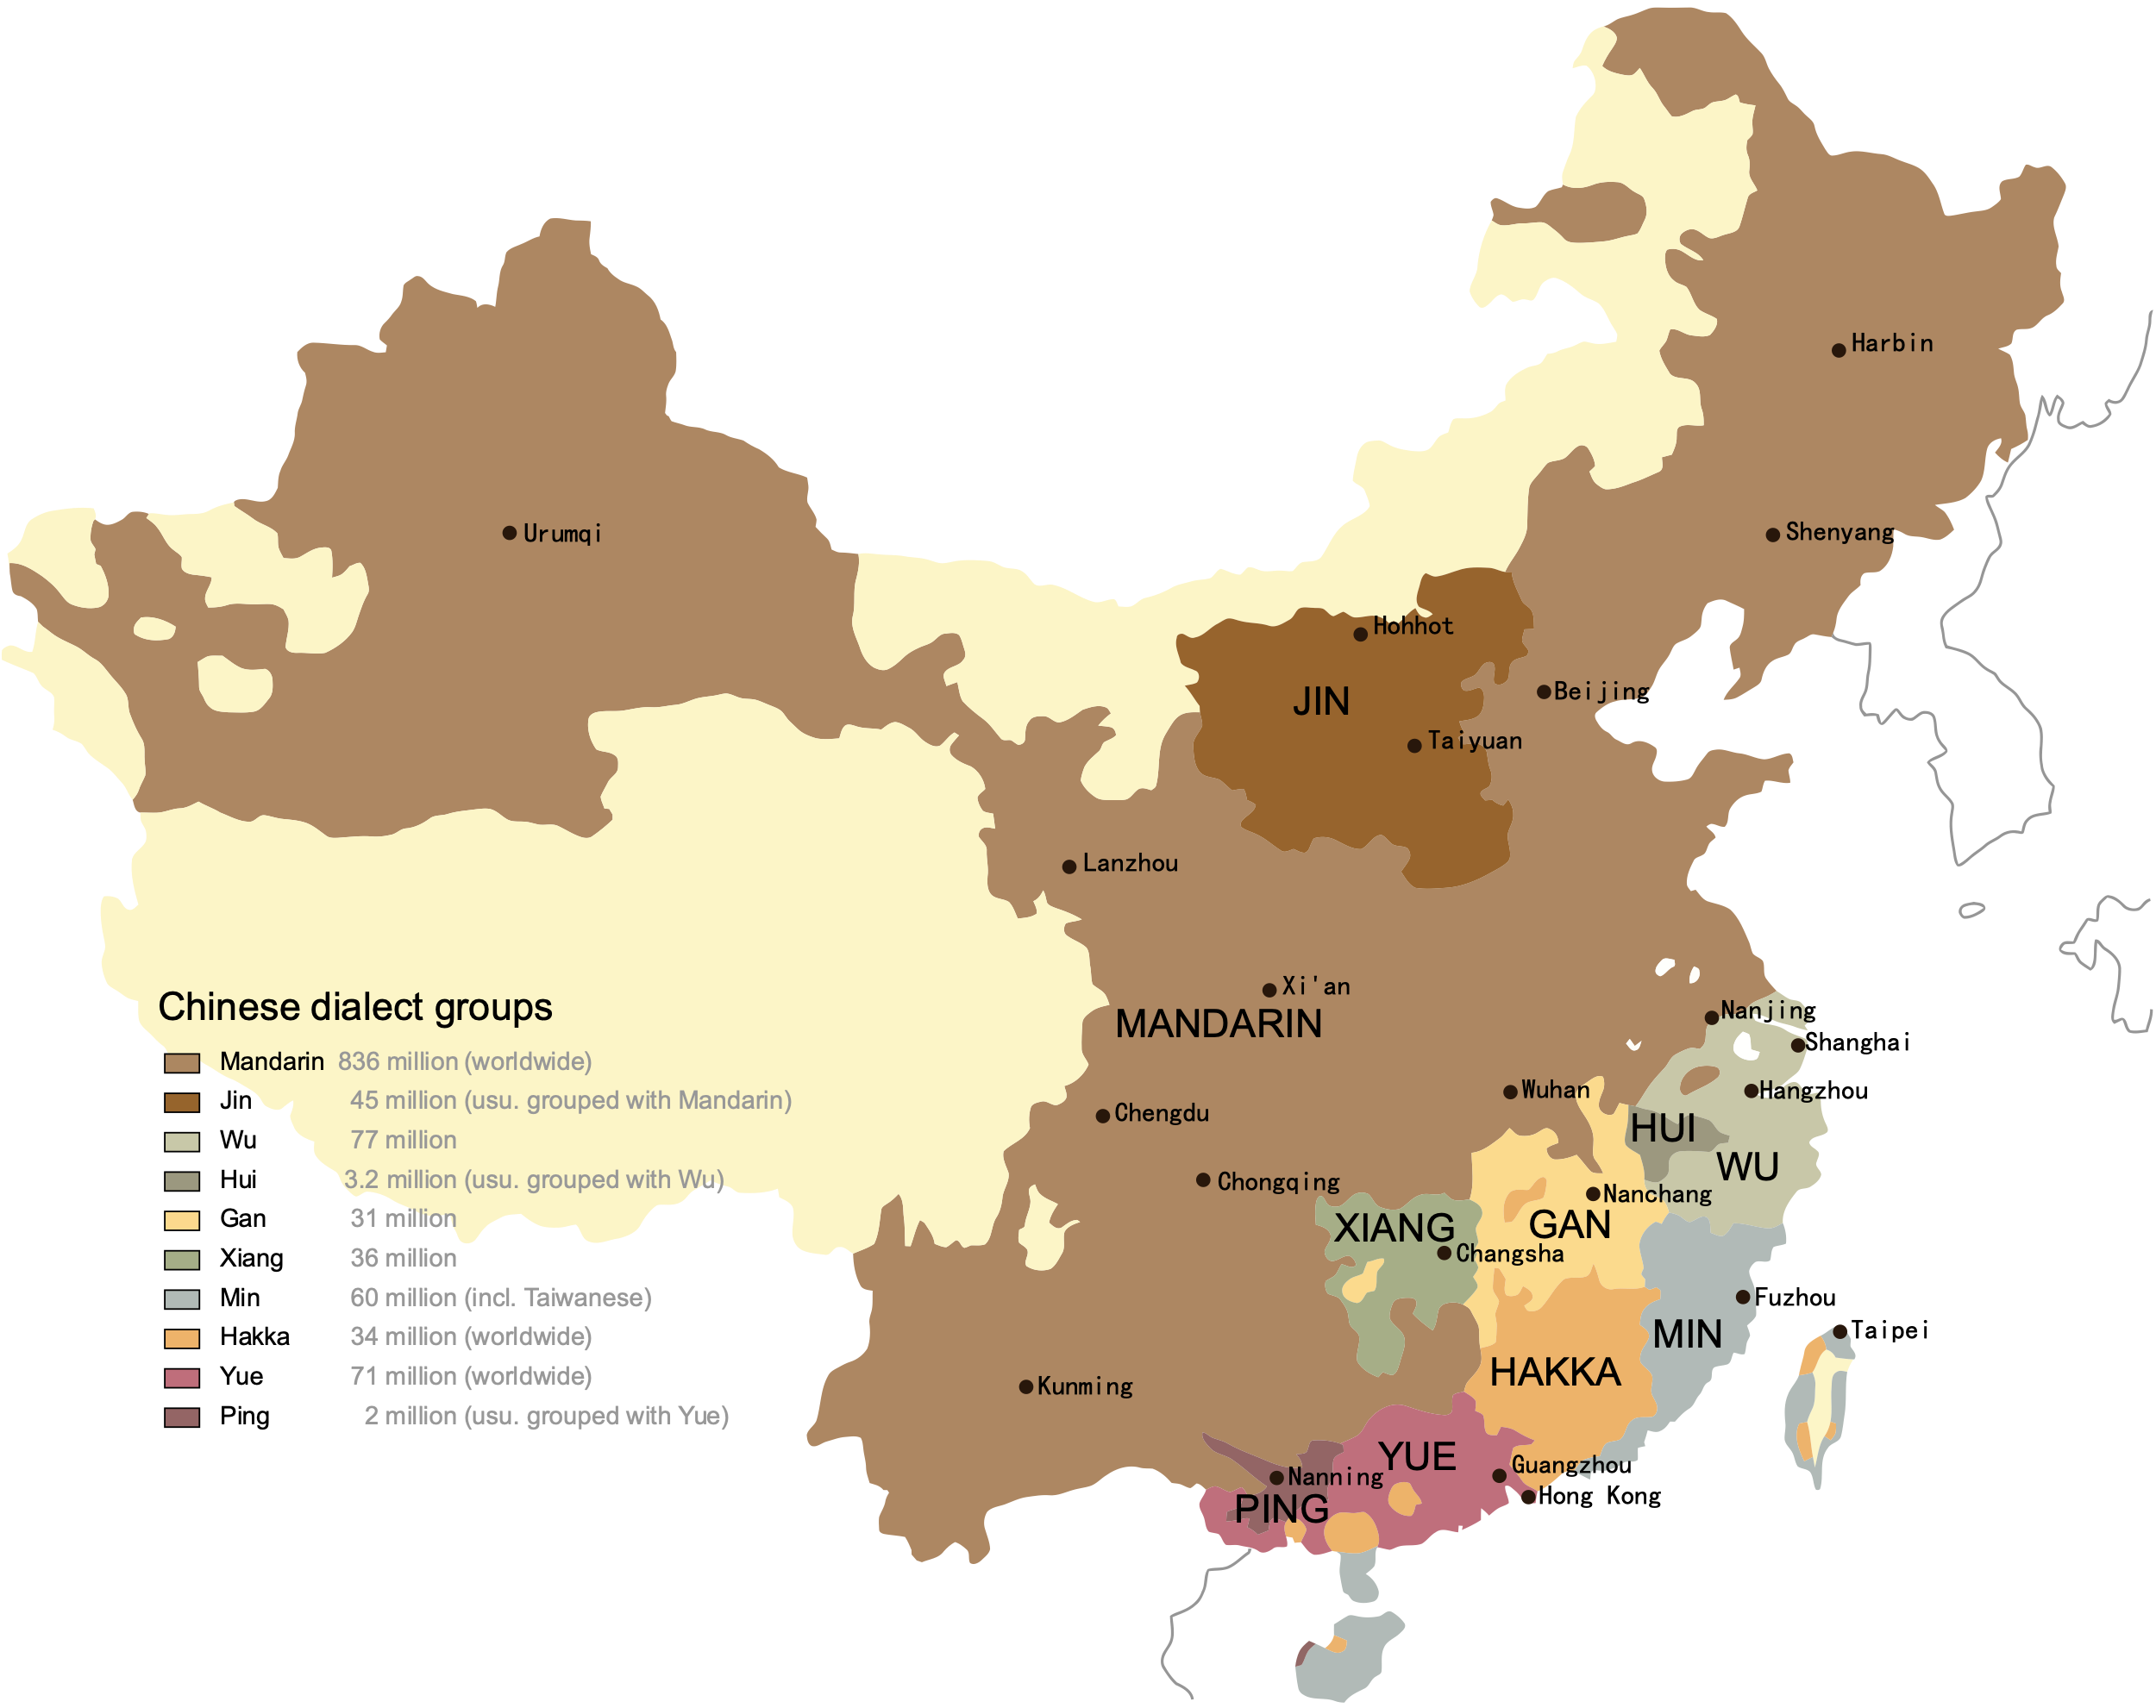
Language Atlas of China (1989)
Mandarin regional dialects
Mandarin branch dialects: relatively mutually intelligible (Tang & van Heuven, 2007, 2008, 2009)
Mandarin
Non-Mandarin branch dialects:
Wu
Hui
Gan
Xiang
Min
Hakka
Yue
Ping
Notes:
Start with the dialect background and what do we mean by dialect

Slide 3
Mandarin regional dialects
Comparable segmental inventories, but distinct tone realizations
Evidence from:
Chao tone descriptions from the canonical Chinese dialect dictionaries (Li, 1998; Hou, 2002)
---- “tang1”: tang55 (Standard Mandarin), tang35 (Jinan), tang 213 (Chengdu)
Corpus-phonetic analysis of the tone systems with the spoken data (ManDi Corpus, Zhao & Chodroff, 2022)

Slide 4
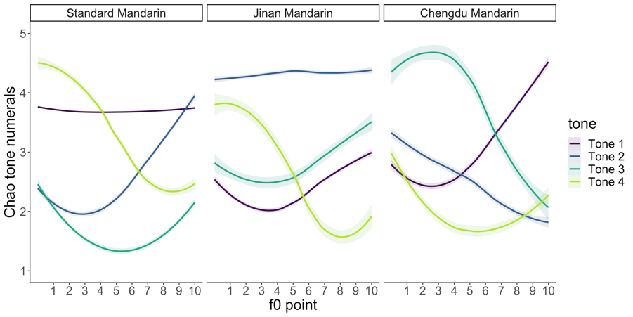

Example word: tang1 /taŋ/ (“soup”; 汤）
Mandarin dialects:
Comparable segmental inventories, but distinct tone realizations
Notes:
Standard: high level
Jinan: dipping, Chengdu: rising

Slide 5
Standard Mandarin vs. Jinan & Chengdu
Jinan Mandarin: phonetically and perceptually similar contours compared to Standard Mandarin

Slide 6
Standard Mandarin vs. Jinan & Chengdu
c
c
Chengdu Mandarin: phonetically and perceptually less similar compared to Standard Mandarin

Slide 7



Task for the listener ?
Processing unfamiliar Mandarin dialectal speech:
Segmental information: familiar
Tonal information: unfamiliar
Notes:
Is it guided by top-down expectedness?

Slide 8
How do listeners process novel tones?
General questions:
What perceptual mechanisms are used in processing phonetic tone variation in these dialects?
What might be the potential factors affecting perceptual adaptation to an unfamiliar tone system?
Notes:
Is it guided by top-down expectedness?

Slide 9
Background: Novel tone processing
Joint top-down & bottom-up processing for lexical access with tone information:
Predominant use of sentential context and segmental information
Evidence that listeners are sensitive to new tone acoustics and phonological associations
Listeners start to adapt to an unfamiliar tone system from experimental trials directly
(Zhao, Sloggett & Chodroff, 2022, 2023)
Notes:
Is it guided by top-down expectedness?

Slide 10
Primary questions
Does adaptation differ between dialects?
---- Is adaptation easier for a tone system that is more dissimilar to the listener’s native tone system? (e.g., Perceptual Assimilation Model, Best & Tyler, 2007; So & Best, 2011)
Chengdu >> Jinan
What about explicit exposure?
---- Can explicit exposure to the target dialect further facilitate adaptation?
(post-exposure >> pre-exposure)
Notes:
Is it guided by top-down expectedness?

Slide 11
Perception experiment: surprisal-based processing
24 sentence pairs were created manipulating the phonetic tone of one target word to be:
low-surprisal (semantically plausible sentence)
high-surprisal (semantically implausible sentence)
low-surprisal condition | high-surprisal condition
a) 有 一只 鹰 在 天上 飞 You3 yi4 zhi1 ying1 zai4 tian1 shang4 fei1 There is an eagle in the sky flying “There is an eagle flying in the sky” | b)* 有 一只 鹰 在 天上 肥 You3 yi4 zhi1 ying1 zai4 tian1 shang4 fei2 There is an eagle in the sky gaining weight “There is an eagle gaining weight in the sky”
Sentence plausibility judgment task (“yes”/”no”)
“Does this sentence make sense to you?”

Slide 12
Perception experiment
Participants: Standard Mandarin speakers from China
14 in the Chengdu Condition
13 in the Jinan Condition
Procedure (with Gorilla Experiment builder):
Familiarization
Pre-exposure task
Post-exposure task
Explicit exposure: North Wind and the Sun
Explicit exposure: North Wind and the Sun with fill-in-the-blank task

Slide 13
Measures
Accuracy (Bayesian logistic mixed-effects regression)
Response time (Bayesian linear mixed-effects regression (Bürkner, 2018)
calculated as the interval between the end of the audio file and the click registering a judgment
Factors
Surprisal (high vs low)
Dialect (Chengdu vs Jinan)
Exposure (pre vs post)
(Tone)

Slide 14
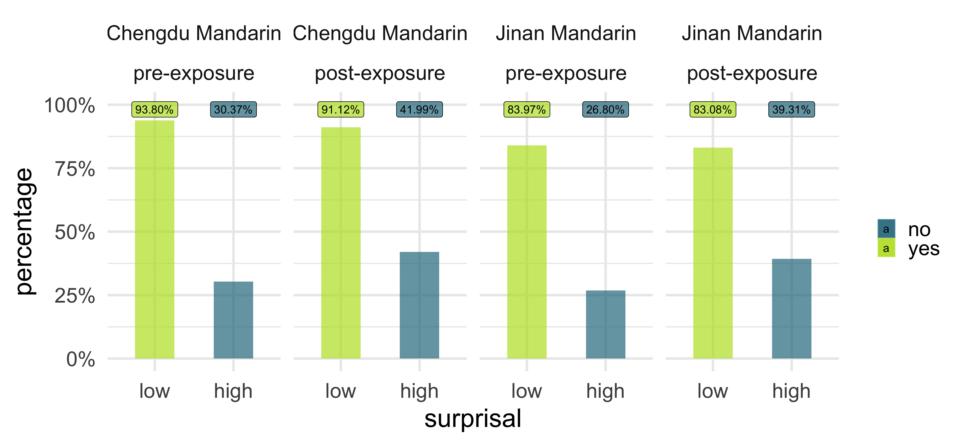
Accuracy
Credible main effects of surprisal and exposure
Surprisal: low-surprisal >> high-surprisal
Listeners strongly report the sentences as plausible in both surprisal conditions
Figure: Percentage of “correct” responses across dialect, surprisal, and exposure conditions.

Slide 15
Accuracy
Credible main effects of surprisal and exposure
Exposure: post-exposure >> pre-exposure
Explicit exposure reliably improved accuracy of the sentence plausibility judgment task for both dialects
Figure: Percentage of “correct” responses across dialect, surprisal, and exposure conditions.

Slide 16
Accuracy
No effect of dialect, tone or any interaction:
Dialect: Chengdu ≈ Jinan
For accuracy, adaptation to the novel tone system did not reliably differ between Chengdu and Jinan Mandarin
Figure: Percentage of “correct” responses across dialect, surprisal, and exposure conditions.

Slide 17
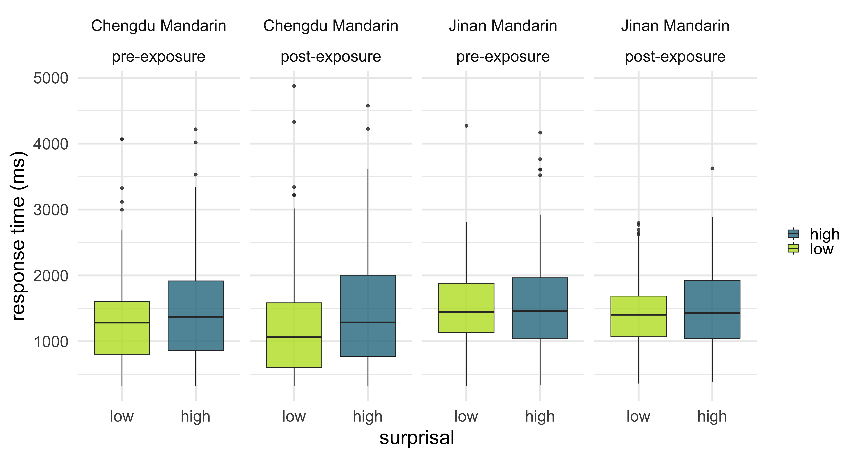
Response time
Credible main effects of surprisal, dialect, interaction between dialect and surprisal, and interaction of surprisal, dialect and exposure
Surprisal: consistent slowdown for high-surprisal sentences
Listeners were sensitive to the unfamiliar tones in both dialects
*Listeners are not completely discarding tone information*
Figure: Response times across dialect, surprisal, and exposure conditions.

Slide 18
Response time
Credible main effects of surprisal, dialect, interaction between dialect and surprisal, and interaction of surprisal, dialect and exposure
Dialect: faster responses for Chengdu sentences
Chengdu sentences might be easier to understand than Jinan sentences
Figure: Response times across dialect, surprisal, and exposure conditions.

Slide 19
Response time
Credible main effects of surprisal, dialect, interaction between dialect and surprisal, and interaction of surprisal, dialect and exposure
Dialect x surprisal: slower responses to the high-surprisal condition for Chengdu sentences than Jinan
Increased sensitivity to the surprisal difference for Chengdu sentences than Jinan sentences
Figure: Response times across dialect, surprisal, and exposure conditions.
Notes:
(Chengdu has the less similar set of phonetic contours to SM)

Slide 20
Response time
Credible main effects of surprisal, dialect, interaction between dialect and surprisal, and interaction of surprisal, dialect and exposure
Dialect x surprisal x exposure: even slower responses for Chengdu high-surprisal sentences after exposure
Explicit exposure facilitates discrimination between surprisal conditions more for Chengdu sentences than Jinan sentences
Figure: Response times across dialect, surprisal, and exposure conditions.

Slide 21
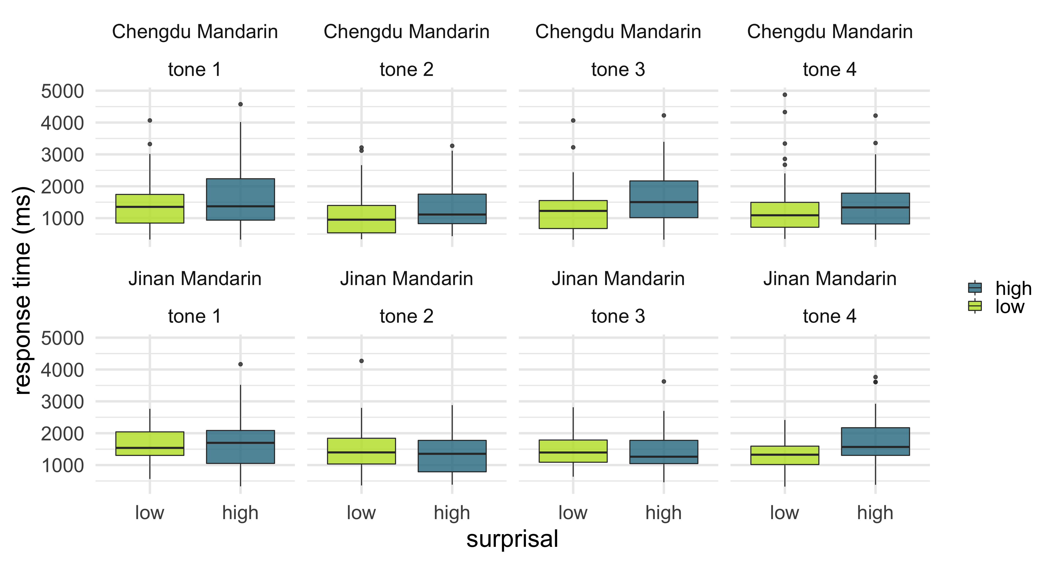
Response time
Credible main effect of tone comparison between tone 2 and tone 4
Tone 2 vs. tone 4: faster responses to tone 2 in general
Response times did not vary considerably across tone categories, except for faster responses for Tone 2 than Tone 4
Figure: Response times across dialect, surprisal, and exposure conditions.

Slide 22
Response time
Credible main effect of tone comparison between tone 2 and tone 4
Tone 2 vs. tone 4: slower responses to tone 4 in general
Tone 4 has similar falling components across all three dialects
Tone 2 has disparate contour types in both dialects compared to Standard Mandarin

Slide 23
Conclusions
Accuracy
Strong use of top-down information for lexical access
Possible use of a “benefit of the doubt” strategy (“I don’t think you meant to say something that strange”)
Explicit exposure reliably improved adaptation to a novel tone system
Response time
Sensitivity to tonal contrasts in the new tone system
Listeners were more sensitive to the surprisal manipulation in Chengdu Mandarin (phonetically less similar) than in Jinan Mandarin (phonetically more similar)
Tones with similar contour–category mappings across dialects slow down response times

Slide 24
Conclusions
Tone information always processed in lexical access even if it’s not directly used
Implications for models of lexical access in tone languages (e.g., Gao et al. 2009)
More sensitivity to the less similar tone systems
Greater dissimilarity leads to better discrimination (Perceptual Assimilation Model, Best & Tyler, 2007; So & Best, 2011)

Slide 25
Thank you!
Thanks also to:
Shayne Sloggett, University of York
SNSF Grant 208460
No thanks to DHL UK

Slide 26

The word yi (/iː/, “one, single”; 一) in four tone categories

Slide 27

Surprisal sentences
24 sentence pairs were created manipulating the phonetic tone of one target word to be:
low-surprisal (semantically implausible sentences)
high-surprisal (semantically plausible sentence)*
 | low-surprisal condition | high-surprisal condition
 | a) 有 一只 鹰 在 天上 飞 You3 yi4 zhi1 ying1 zai4 tian1 shang4 fei1 There is an eagle in the sky flying “There is an eagle flying in the sky” | b)* 有 一只 鹰 在 天上 肥* You3 yi4 zhi1 ying1 zai4 tian1 shang4 fei2* There is an eagle in the sky gaining weight* “There is an eagle gaining weight in the sky”
Chengdu | Chengdu low-surprisal | Chengdu high-surprisal
Jinan | Jinan low-surprisal | Jinan high-surprisal

Slide 28

Data analysis (models)
Accuracy: Bayesian logistic mixed-effects regression
Response time: Bayesian linear mixed-effects regression (Bürkner, 2018)
Each model included
The fixed effects: surprisal, dialect, exposure and the interactions of the three factors, trial number, tone comparisons and their interaction with dialect
The random effects:
For participant: an intercept for participant, slopes for surprisal, dialect, trial number, the interaction between surprisal and dialect
For sentence frame, an intercept and random slope for dialect
Weakly informed priors
Accuracy model: 𝒩(0, 20) for the intercept and the fixed factors, 𝒩(0, 0.05) for the random effects
RT model: 𝒩(0, 7) for the intercept, 𝒩(0, 1) for the fixed factors, 𝒩(0, 0.01) for the random effects

Slide 29
R codes: accuracy model
fit_acc_bayes <- brm(acc2 ~ nDialect + nSurprisal + nExposure +
nDialect:nSurprisal + nDialect:nExposure + nSurprisal:nExposure +
nDialect:nSurprisal:nExposure + nTrial + nTone1 + nTone2 + nTone3 +
nTone1:nDialect + nTone2:nDialect + nTone3:nDialect +
(1 + nSurprisal + nExposure + nTrial + nSurprisal:nExposure | subj)
+ (1 + nSurprisal + nDialect | frame), prior = c(prior(normal(0, 20), class = Intercept),
prior(normal(0, 20), class = b, coef = nDialect), prior(normal(0, 20), class = b, coef = nSurprisal), prior(normal(0, 20), class = b, coef = nExposure),
prior(normal(0, 20), class = b, coef = nTone1), prior(normal(0, 20), class = b, coef = nTone2), prior(normal(0, 20), class = b, coef = nTone3),
prior(normal(0, 20), class = b, coef = nDialect:nSurprisal),
prior(normal(0, 20), class = b, coef = nDialect:nExposure),
prior(normal(0, 20), class = b, coef = nSurprisal:nExposure),
prior(normal(0, 20), class = b, coef = nDialect:nTone1), prior(normal(0, 20), class = b, coef = nDialect:nTone2), prior(normal(0, 20), class = b, coef = nDialect:nTone3),
prior(normal(0, 20), class = b, coef = nDialect:nSurprisal:nExposure),
prior(normal(0, 0.05), class = sd, group = subj, coef = Intercept), prior(normal(0, 0.05), class = sd, group = subj, coef = nSurprisal),
prior(normal(0, 0.05), class = sd, group = subj, coef = nExposure), prior(normal(0, 0.05), class = sd, group = subj, coef = nTrial),
prior(normal(0, 0.05), class = sd, group = subj, coef = nSurprisal:nExposure),
prior(normal(0, 0.05), class = sd, group = frame, coef = Intercept), prior(normal(0, 0.05), class = sd, group = frame, coef = nSurprisal),
prior(normal(0, 0.05), class = sd, group = frame, coef = nDialect)
), family = "bernoulli", d)

Slide 30
R codes: RT model
fit_rt_bayes <- brm(rt ~ nDialect + nSurprisal + nExposure +
nDialect:nSurprisal + nDialect:nExposure + nSurprisal:nExposure +
nDialect:nSurprisal:nExposure + nTrial +
nTone1 + nTone2 + nTone3 +
nTone1:nDialect + nTone2:nDialect + nTone3:nDialect +
(1 + nSurprisal + nExposure + nTrial +
nSurprisal:nExposure | subj)
+ (1 + nSurprisal + nDialect | frame), prior = c(
prior(normal(7, 1), class = Intercept),
prior(normal(0, 1), class = b, coef = nDialect), prior(normal(0, 1), class = b, coef = nSurprisal),
prior(normal(0, 1), class = b, coef = nExposure), prior(normal(0, 1), class = b, coef = nTrial),
prior(normal(0, 1), class = b, coef = nTone1), prior(normal(0, 1), class = b, coef = nTone2), prior(normal(0, 1), class = b, coef = nTone3),
prior(normal(0, 1), class = b, coef = nDialect:nSurprisal),
prior(normal(0, 1), class = b, coef = nDialect:nExposure),
prior(normal(0, 1), class = b, coef = nSurprisal:nExposure),
prior(normal(0, 1), class = b, coef = nDialect:nTone1),
prior(normal(0, 1), class = b, coef = nDialect:nTone2),
prior(normal(0, 1), class = b, coef = nDialect:nTone3),
prior(normal(0, 1), class = b, coef = nDialect:nSurprisal:nExposure),
prior(normal(0, 0.01), class = sd, group = subj, coef = Intercept),
prior(normal(0, 0.01), class = sd, group = subj, coef = nSurprisal),
prior(normal(0, 0.01), class = sd, group = subj, coef = nExposure),
prior(normal(0, 0.01), class = sd, group = subj, coef = nTrial),
prior(normal(0, 0.01), class = sd, group = subj, coef = nSurprisal:nExposure),
prior(normal(0, 0.01), class = sd, group = frame, coef = Intercept),
prior(normal(0, 0.01), class = sd, group = frame, coef = nSurprisal),
prior(normal(0, 0.01), class = sd, group = frame, coef = nDialect)
), family = lognormal(), subset(d, rt > 0))

Slide 31
Data analysis: Does minimal-pair presentation matter?
Our previous study found that minimal-pair presentation of the stimuli did not credibly affect listeners’ sensitivity to the surprisal manipulation (Zhao, Sloggett & Chodroff, ICPhS 2023)
For this study, we also ran the accuracy and RT models with presentation (with-minimal-pair design vs. no-minimal-pair design) as a fixed factor
Accuracy model: no difference in accuracy between the two designs
Response time model: faster responses when minimal pairs were presented.
But this might be just because listeners heard more trials (24 trials) in the with-minimal-pair experiment than the no-minimal-pair experiment (12 trials per participant)

Slide 32
Perception experiment: surprisal-based processing
Surprisal sentence pairs in sentence plausibility judgment task (“yes”/”no”)
“Does this sentence make sense to you?”
24 sentence pairs were created manipulating the phonetic tone of one target word to be:
low-surprisal (semantically implausible sentences)
high-surprisal (semantically plausible sentence)*
low-surprisal condition | high-surprisal condition
a) 有 一只 鹰 在 天上 飞 You3 yi4 zhi1 ying1 zai4 tian1 shang4 fei1 There is an eagle in the sky flying “There is an eagle flying in the sky” | b)* 有 一只 鹰 在 天上 肥* You3 yi4 zhi1 ying1 zai4 tian1 shang4 fei2* There is an eagle in the sky gaining weight* “There is an eagle gaining weight in the sky”

