Slide 1
PantryPilot
Final Project Presentation
Smart meal and grocery planning with executable, safety-aware quality controls
System
Quality focus
Prepared by
Meal plans, substitutions, pantry use, and grocery lists
Risk, CM, traceability, and system-level testing
Zixuan Liang
CISC 594
Prepared by Zixuan Liang
CISC 594 - Final Project Presentation - 1/14
Notes:
Open with the central message: PantryPilot is useful only when intelligent behavior is bounded by traceable, executable quality controls.

Slide 2
Required final presentation sections
Assignment coverage map
1
Project introduction and system features
Central message
2
Role of each group member
PantryPilot combines useful automation with disciplined SQA: risks are identified, controls are versioned and tested, and the same evidence is visible in a live web demo.
3
Risk identification and tracking
4
Configuration management approach
5
System testing approach and outcome
Prepared by Zixuan Liang
CISC 594 - Final Project Presentation - 2/14
Notes:
Preview the five required presentation sections. Tell the audience that the live demo will connect features, risk controls, CM evidence, and testing.

Slide 3
Zixuan Liang
Project introduction: why PantryPilot exists
Planning friction
Constraint complexity
Food waste
Users often decide meals, check ingredients, and build grocery lists in separate tools.
Allergies, disliked ingredients, budgets, nutrition goals, and preferences can conflict.
Pantry items expire while shopping decisions ignore what is already available at home.
PantryPilot answer
A smart meal and grocery planning system that maintains profiles, recipes, pantry inventory, weekly meal plans, AI substitutions, and consolidated grocery lists.
Prepared by Zixuan Liang
CISC 594 - Final Project Presentation - 3/14
Notes:
Introduce the project from the user's point of view and then bridge into quality concerns.

Slide 4
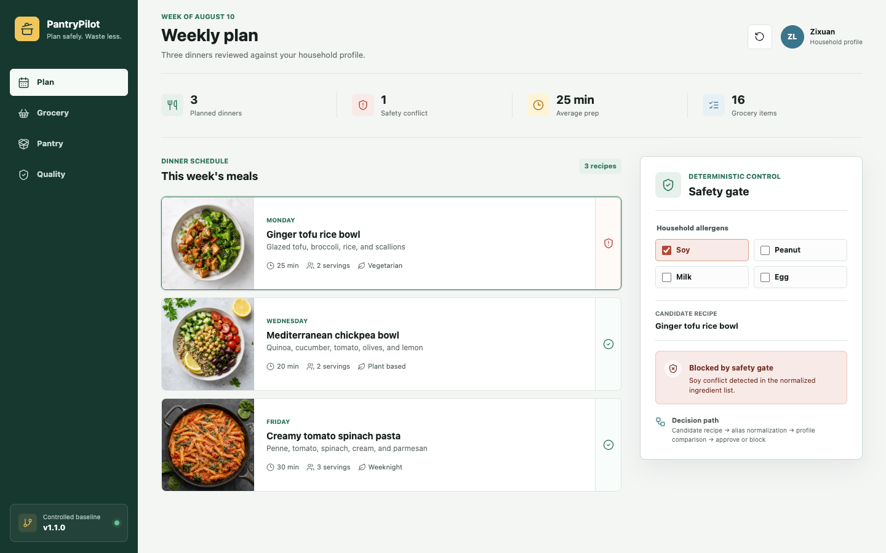
Project features
System features and live demonstration
Controlled v1.1.0 baseline
- Deterministic allergen conflict detection
- Grocery aggregation by canonical name and unit
- Inclusive pantry-expiry boundary logic
- Release identity and required quality gates
- Six repeatable release-level scenarios
Live demo path: Plan safety gate -> Grocery aggregation -> Pantry expiry -> Quality evidence.
Prepared by Zixuan Liang
CISC 594 - Final Project Presentation - 4/14
Notes:
Live demo transition. Start the local server before presenting. Show the Plan view first and point to the soy conflict blocked by the deterministic safety gate. Then visit Grocery, Pantry, and Quality.

Slide 5
System architecture
Executable design: browser to deterministic controls
Household profile
Browser UI
Flask API
Core controls
Safety gate
Evidence
Allergens and preferences
->
Plan, Grocery, Pantry, Quality
->
Stable local HTTP routes
->
Aggregate grocery and classify expiry
->
Allergen alias blocking
->
UI decision plus release scenarios
Design decision
The browser never decides safety; Flask delegates to deterministic, test-covered functions.
Prepared by Zixuan Liang
CISC 594 - Final Project Presentation - 5/14
Notes:
Explain the executable path: the browser calls Flask endpoints, Flask delegates to the same deterministic Python functions used by tests, and the Quality view exposes the six release scenarios.

Slide 6
Prepared by Zixuan Liang
Role of each group member
This was completed as an individual project, so Zixuan Liang owned each presentation section and project artifact.
Project and requirements
Risk management
Defined the PantryPilot concept, V1/V1.1 scope, requirements, adverse conditions, and quality goals.
Built and updated the risk table, likelihood-impact scores, mitigation strategy, and weekly tracking history.
Configuration management
System testing
Consolidated the project into GitHub, preserved tags/history, controlled the Flask UI files, and updated the CI and CM evidence.
Implemented the web demo, six release scenarios, five Flask endpoint tests, responsive browser QA, and the final test report.
Prepared by Zixuan Liang
CISC 594 - Final Project Presentation - 6/14
Notes:
This is an individual project. Call out ownership of the web implementation, repository consolidation, updated risk register, and current verification evidence.

Slide 7
Risk score = likelihood x impact
Risk identification and tracking method
Identification
Scoring
Tracking
Risks were identified from safety-sensitive outputs, external dependencies, optimization complexity, data handling, and release scope.
Each risk received a probability score and an impact score from 1 to 5; total priority equals probability times impact.
Risk status was reviewed weekly and linked to controls, tests, CI checks, release notes, or retirement rationale.
Current risk posture
R1-R5 remain active; R6 and new R8 UI/demo consistency are monitored; R7 scope expansion remains retired/controlled.
Prepared by Zixuan Liang
CISC 594 - Final Project Presentation - 7/14
Notes:
Risk management is iterative. R8 was added only after the web presentation layer existed; it is monitored through endpoint tests, local assets, and browser review.

Slide 8
Risk identification and tracking
Top project risks by score
Priority conclusion
- Highest: unsafe LLM output to an allergic user
- Critical: optimizer infeasibility or runtime
- R8 UI/demo consistency: 8 (medium)
- Five web tests keep the backend as source of truth
Prepared by Zixuan Liang
CISC 594 - Final Project Presentation - 8/14
Notes:
The chart uses probability times impact. R8 scores 8, below safety and data risks, but it still matters because a UI/backend mismatch could misrepresent a safety decision.

Slide 9
Risk mitigation and control
How the main risks were reduced
Risk | Reduction control | Verification evidence
Unsafe allergen output | Deterministic allergen filter blocks conflict before display | System test V1.1-ST-01 returned safe=false for soy conflict
Optimizer failure | Bounded solver concept and explicit future relaxation order | Kept out of V1.1 release baseline
Recipe API instability | Offline fixtures/cache strategy and normalized ingredient model | System tests avoid external network dependency
Pantry expiry boundary | Inclusive 3-day rule; expired items excluded | V1.1-ST-03 passed today/+3/+4/yesterday boundary checks
UI/demo consistency | Flask API is source of truth; assets are local; demo state is resettable | WEB-01 through WEB-05 pass; desktop/mobile browser review completed
Control rule: each major risk requires a design control and repeatable evidence.
Prepared by Zixuan Liang
CISC 594 - Final Project Presentation - 9/14
Notes:
Connect mitigation to evidence. For R8, the Flask API is the source of truth and WEB-01 through WEB-05 verify the browser-facing contracts.

Slide 10
GitHub-based CM
Configuration management approach
1
2
3
4
5
Main baseline
->
Feature branch
->
Pull request
->
CI gate
->
Release tag
Stable release branch
feature/safety-grocery-controls
Scope, tests, and review evidence
11 pytest tests plus 6 system scenarios
v1.1.0 tagged; web demo [Unreleased]
Controlled items
Backend and Flask source, template, JavaScript, CSS, local assets, tests, requirements, CI workflow, changelog, reports, and release records.
Prepared by Zixuan Liang
CISC 594 - Final Project Presentation - 10/14
Notes:
Describe CM as a release discipline. v1.1.0 remains the tagged backend baseline; the Flask demo is intentionally listed under [Unreleased] until it completes the same branch/review/tag process.

Slide 11
Repository and release records
Configuration management evidence
Evidence | Project record
Repository package | github.com/liangzixuan/cisc-594 / PantryPilot_CM_Generic_Files
Branches | main; feature/safety-grocery-controls; full history preserved in root repo
Release tags | v1.0.0 and v1.1.0 tagged; Flask demo recorded under [Unreleased]
Key commits | 842ae5e baseline; 72a997e feature; 834e64e release; 51e7a65 history merge
CI workflow | .github/workflows/pantrypilot-ci.yml runs pytest and system_test_runner.py
Traceability | CHANGELOG, release notes, tests, updated reports, and Git history preserve traceability
Prepared by Zixuan Liang
CISC 594 - Final Project Presentation - 11/14
Notes:
Show the real repository paths and preserved history. The complete CISC-594 folder is now the GitHub repository root.

Slide 12
Methodology and environment
System testing approach
Methodology
Environment
Setup
Six release scenarios cover core behavior; five Flask test-client cases verify routes, requests, decisions, and evidence reporting.
macOS 26.5.1, Python 3.11.15, CI Python 3.12, Flask 3.1.1, pytest 8.2.2, Chrome 150.0.7871.129.
Install requirements; run pytest and system_test_runner.py; start the demo with python -m src.web_app.
Test class | Coverage target
Release readiness | Version identity and required quality gates
Core + web/API workflow | Grocery aggregation plus Flask route, request, response, and quality-summary checks
Safety behavior | Allergen conflict blocked; safe recipe allowed
Boundary conditions | Pantry item expires today, +3 days, +4 days, and yesterday
Prepared by Zixuan Liang
CISC 594 - Final Project Presentation - 12/14
Notes:
Testing has two layers: six formal release scenarios and five Flask integration tests. Manual browser QA checks responsive presentation behavior that the API tests do not cover.

Slide 13
Actual results
System testing outcome
11/11
pytest tests passed
6 / 6 formal release scenarios also passed; no defects were observed.
Scenario | Actual result
V1-ST-01 release identity | PantryPilot 1.1.0: Safety & Grocery Controls
V1-ST-02 quality gates | ci_required, pull_request_required, review_required, unit_tests_required
V1-ST-03 grocery aggregation | rice quantity 3.0 cup
V1.1-ST-01 allergen conflict | soy conflict detected; safe=false
V1.1-ST-02 safe recipe | safe=true
V1.1-ST-03 expiry window | today=true, +3=true, +4=false, yesterday=false
Prepared by Zixuan Liang
CISC 594 - Final Project Presentation - 13/14
Notes:
State both numbers precisely: 11 of 11 pytest tests passed, including five web/API regressions; 6 of 6 formal system scenarios also passed.

Slide 14
Closing
Final takeaway and references
PantryPilot's quality story is visible in working software, not just documents.
The web demo makes the same deterministic safety decisions, versioned controls, risk mitigations, and test evidence inspectable in one flow.
Project sources
- Updated risk, CM, and system testing reports
- CISC-594 GitHub repository and CI workflow
- PantryPilot Flask demo and local visual assets
- 11 pytest tests plus 6 release scenarios
Questions
Prepared by Zixuan Liang
CISC 594 - Final Project Presentation - 14/14
Notes:
Close on the thesis that the UI does not replace the reports. It makes the same controls and evidence observable in a short, repeatable demonstration.

