Slide 1
Towards Automatic Discovery of Deviations in Binary Implementations with Applications to Error Detection and Fingerprint Generation
David Brumley, Juan Caballero, Zhenkai Liang, James Newsome, and Dawn Song
Carnegie Mellon University

Slide 2

Introduction
Many different implementations usually exist for the same protocol
  HTTP Servers: Apache, Miniweb, …
Deviation — difference in how two implementations of the same protocol interpret the same input
Deviations are often results of
  Implementation errors
  Different interpretations of the same protocol specification

Slide 3
Importance of Deviations
Security applications of deviations
Error detection
  Deviations suggest good candidate for errors
  No need for complex protocol model
Fingerprint generation
  Inputs triggering deviation are natural fingerprints
  Automatic fingerprint generation is important for fingerprinting tools

Slide 4
Problem Definition: Deviation Detection
We focus on behavior-related deviations, instead of minor output details
  HTTP Status 200 vs. Status 404
We view program as function from input space I to protocol state space S
  Apache maps “GET /index.html” to Status 200
Given two programs P_{A} and P_{M} of the same protocol, easy to find an input i,
Our goal: Automatically generate input j,
P : I ! S
P_{A}(i) = P_{M}(i) = s
P_{A}(j) ≠ P_{M}(j)

Slide 5


Problem Setting
Are there deviations between server A and server M?
A
If yes, how to find inputs to demonstrate them?
M

Slide 6


Naïve Solution: Random Testing
Possible HTTP Queries
A
Status 200
M
Status 200

Slide 7
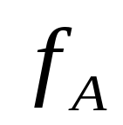

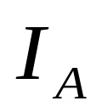

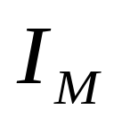
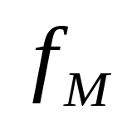
Inferring Inputs
Possible HTTP Queries
A
Status 200
Symbolic
Input
Status 200
M
(I_{A} [ I_{M})¡(I_{A} \ I_{M})

Slide 8
Our Approach
INPUT: two implementations P_{A} and P_{M} of the same protocol
Create formula f_{A} modeling how P_{A} interprets a symbolic input, formula f_{M} modeling how P_{M} interprets the same input
  Symbolic formula: predicate over symbolic inputs
Use f_{A} and f_{M} to infer (I_{A} [ I_{M})¡(I_{A} \ I_{M})?
  Generate candidate deviation inputs
Validate candidate deviation inputs
OUTPUT: generated list of inputs that make P_{A} and P_{M} reach different protocol states

Slide 9
Contributions
A novel approach for automatically discover deviations in binaries of a protocol
  Build symbolic formulas to compare two implementations
Benefits:
  Faithful to implementations
  No source code needed
  Efficient
Two applications of deviations
  Error detection
  Fingerprint generation
Found errors and fingerprints in real programs

Slide 10
Talk Outline
Introduction
Approach Overview
Evaluation
Related Work
Summary

Slide 11







Approach Overview
(I_{A} [ I_{M})¡(I_{A} \ I_{M})
A
M
1. Formula Extraction
2. Deviation Detection
3. Validation
Symbolic Formulas
Candidate Deviation Inputs
Deviation Inputs

Slide 12
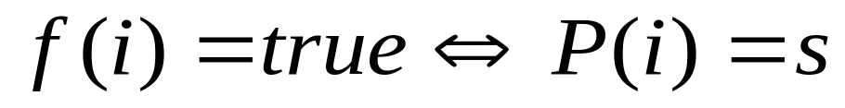
Key Concepts
Key idea: Use a symbolic formula f to represent how a program P interprets a symbolic input i
Recall: A program P is a function from input space to protocol state space
A symbolic formula f is a predicate on symbolic inputs.
  Formula f represents the inputs can make program P reaches protocol state s

Slide 13
Key Concepts (Cont.)
Formula f can be generated by calculating weakest precondition from P and s
For a reasonable formula size, our current approach generates formulas on a single program path

Slide 14

Step 1: Formula Extraction
x86 instructions
MOV AL, [ECX]
SUB AL, ‘/’
JZ NEXT
...
GET /index.html
INPUT[4]
A
Intermediate Language (ILA)
AL = INPUT[4]
AL = AL – ‘/’
ZF = (AL == 0)
IF (ZF==1) THEN JMP(NEXT)
: ZF == 1
Symbolic formula
f_{A}(INPUT) = (INPUT[4] == ‘/’)

Slide 15
Step 2: Deviation Detection
Formulas from Step 1
  Server A: f_{A} (INPUT) = (INPUT[4] == ‘/’)
  Server M: f_{M} (INPUT) = (INPUT[4] != 0)
Construct queries
Solve f_{A}^:f_{M} , :f_{A}^f_{M}
  Candidate deviation inputs
  GET %index.html
  GET Aindex.html
  ...
f_{A}^:f_{M}
:f_{A}^f_{M}
I_{M}-I_{A}

Slide 16
Step 3: Validation
Problem: Multiple paths to a protocol state
  Our formula is based on a single path
  Candidate deviation inputs may not lead to deviations
Solution: Validate candidate deviation inputs
  Send candidate deviation inputs to both implementations
  Compare resulting protocol states
Deviation inputs
  GET %index.html, GET Aindex.html, …

Slide 17
Talk Outline
Introduction
Approach Overview
Evaluation
Related Work
Summary

Slide 18
Evaluation Overview
Implementation
  BitBlaze binary analysis platform
  Solver: STP (decision procedure)
  Supports Windows and Linux binaries
Evaluated text and binary protocols
  Text-based protocol: HTTP
    Apache 2.2.4, Miniweb 0.8.1, Savant 3.1
  Binary-based protocol: NTP
    NetTime 2.0b7, NTPD 4.1.72

Slide 19
Evaluation: HTTP
Input: Request for homepage
GET /index.html
 | Step 2: Detection | Step 3: Validation
f_{Apache}^:f_{Miniweb} | No candidate
f_{Apache}^:f_{Savant} | Candidate | No deviation
f_{Miniweb}^:f_{Apache} | Candidate | Deviation
f_{Miniweb}^:f_{Savant} | Candidate | Deviation
f_{Savant}^:f_{Apache} | No candidate
f_{Savant}^:f_{Miniweb} | No candidate

Slide 20
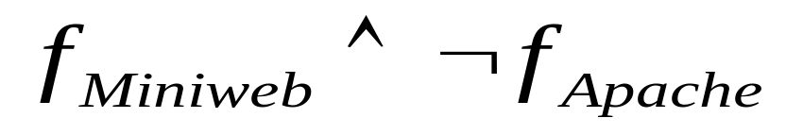
HTTP Deviation: Error Detection
Miniweb follows its original path, while Apache doesn’t.
Original input: GET /index.html
Deviation inputs: GET %index.html
GET Aindex.html
Miniweb Response:
HTTP/1.1 200 OK
Server: Miniweb
Cache-control: no-cache
content of /index.html
Apache Response:
HTTP/1.1 400 Bad Request Date: Sat, 03 Feb 2007 05:33:55 GMT
Server: Apache/2.2.4 (Win32)
...

Slide 21
Evaluation: NTP
Input:
Client query for time synchronization
 | Step 2: Detection | Step 3: Validation
f_{NetTime}^:f_{NTPD} | Candidate | Deviation
f_{NTPD}^:f_{NetTime} | No candidate

Slide 22
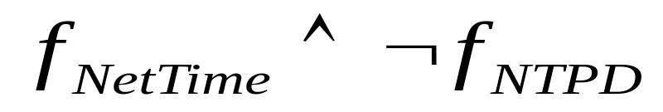
NTP Deviation: Fingerprint Generation
Original input Deviation input
First byte:
1
1
1
0
0
0
1
1
1
1
0
0
0
0
1
1
Leap Indicator
Version
Mode
Leap Indicator
Version
Mode
RFC 4330 (SNTP): Version 0 is reserved and should not be supported.
Older specification:
No special treatment of version 0
NTPD didn’t respond.
NetTime responded normally.

Slide 23
Performance
Symbolic formula
Candidate Deviation Inputs
 | Time
Apache | 39.5s
Miniweb | 20.5s
Savant | 21.5s
NTPD | 5.37s
NetTime | 5.05s
 | Time
Apache & Miniweb | 21.3s
Apache & Savant | 11.8s
Savant & Miniweb | 9.0s
NetTime & NTPD | 0.56s
NTP: 6 seconds to detect deviation
HTTP: 1 minute to detect deviation

Slide 24
Future Work
Explore different program paths
  Rudder: automatic dynamic path exploration
Create multi-path formulas
  The weakest precondition algorithm used in our approach can handle multiple program paths
Details at http://bitblaze.cs.berkeley.edu

Slide 25
Related Work
Symbolic execution [King76] and weakest precondition [Dijkstra76, Cohen90, Brumley07]
Fuzz testing [Kaksonen01,Marquis05,Oehlert05,Xiao03]
  Random and semi-random input generation
  No deep analysis on how an input is used
Implementation error detection
  Static source code analysis [Chen02, Udrea06] and Model checking [Chaki03, Musuvathi02, Musuvathi04]
    Need manually defined models
Protocol fingerprint generation
  Manual fingerprint generation [Comer94, Paxson97]
    Need manual analysis
  Automatic fingerprint generation [Caballero07]
    Need semi-random input selection

Slide 26
Summary
A novel approach for automatically discover deviations in binaries
  Use symbolic formulas to represent how a program interprets inputs
  Solve formulas to compare two implementations
  Validate generated inputs
Applications of deviations
  Error detection
  Fingerprint generation

Slide 27
Thank you!
For more information and related projects:
Visit http://bitblaze.cs.berkeley.edu

