Slide 1
On the Convergence of IRLS and Its Variants in Outlier-Robust Estimation
@CVPR 2023 (Highlight)
THU-AM-127
Liangzu Peng ⃰ Christian Kümmerle° René Vidal ⃰
⃰ : Johns Hopkins → UPenn
°: University of North Carolina at Charlotte

Slide 2
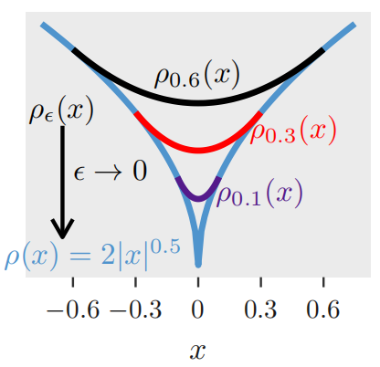
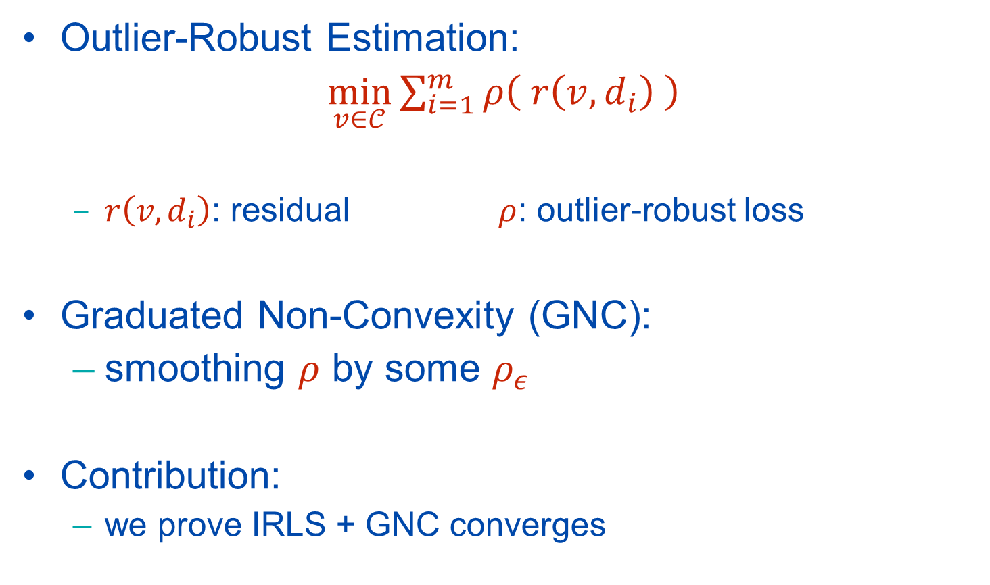
IRLS + GNC for Outlier-Robust Estimation
Outlier-Robust Estimation:
$\min_{v∈𝒞}{\sum_{i=1}^{m}{ρ\left( r\left(v,d_{i}\right) \right)}}$
$r\left(v,d_{i}\right)$: residual $ρ$: outlier-robust loss
Graduated Non-Convexity (GNC):
smoothing $ρ$ by some $ρ_{ε}$
Contribution:
we prove IRLS + GNC converges

Slide 3
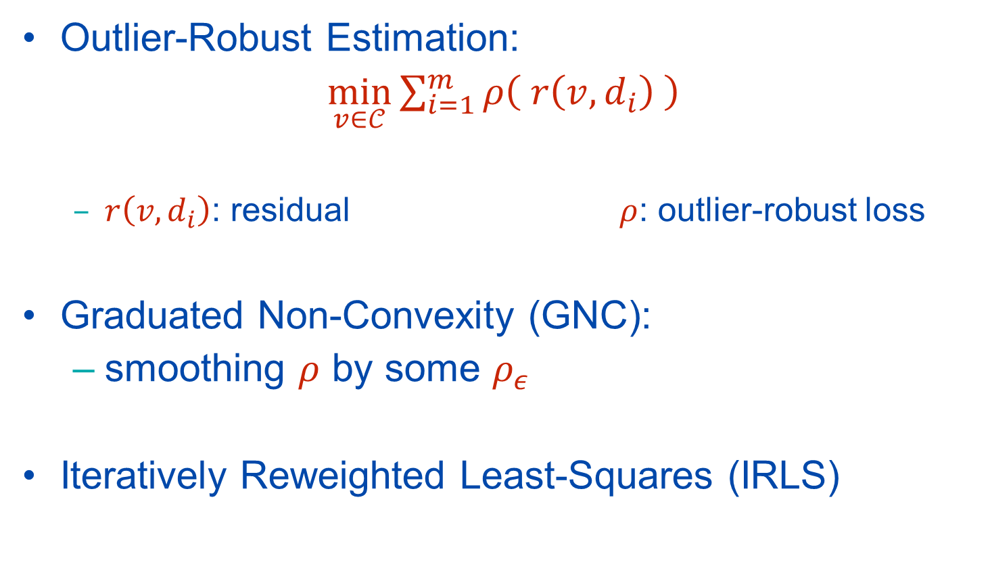
IRLS + GNC for Outlier-Robust Estimation
Outlier-Robust Estimation:
$\min_{v∈𝒞}{\sum_{i=1}^{m}{ρ\left( r\left(v,d_{i}\right) \right)}}$
$r\left(v,d_{i}\right)$: residual $ρ$: outlier-robust loss
Graduated Non-Convexity (GNC):
smoothing $ρ$ by some $ρ_{ε}$
Iteratively Reweighted Least-Squares (IRLS)

Slide 4
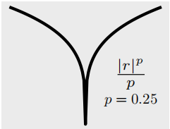



IRLS + GNC for Outlier-Robust Estimation
Outlier-Robust Estimation:
$\min_{v∈𝒞}{\sum_{i=1}^{m}{ρ\left( r\left(v,d_{i}\right) \right)}}$
$r\left(v,d_{i}\right)$: residual $ρ$: outlier-robust loss
Linear Regression:
$d_{i}=\left(x_{i},y_{i}\right)$
$r\left(v,d_{i}\right)=\left|x_{i}^{⊤}v−y_{i}\right|$
Point Cloud Registration:
$d_{i}=\left(x_{i},y_{i}\right)$, $v=(R,t)$
$r\left(v,d_{i}\right)=|\left|y_{i}−Rx_{i}−t\right|{\left.​\right|}_{2}$
Essential Matrix Estimation:
$d_{i}=\left(x_{i},y_{i}\right)$, $v=E$
$r\left(v,d_{i}\right)=\left|x_{i}^{⊤}Ey_{i}\right|$
$ℓ_{p}$:
$ρ\left(r\right)=\frac{{\left|r\right|}^{p}}{p}$

Slide 5
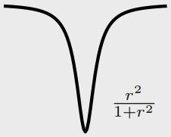


IRLS + GNC for Outlier-Robust Estimation
Outlier-Robust Estimation:
$\min_{v∈𝒞}{\sum_{i=1}^{m}{ρ\left( r\left(v,d_{i}\right) \right)}}$
$r\left(v,d_{i}\right)$: residual $ρ$: outlier-robust loss
Linear regression:
$d_{i}=\left(x_{i},y_{i}\right)$
$r\left(v,d_{i}\right)=\left|x_{i}^{⊤}v−y_{i}\right|$
Point Cloud Registration:
$d_{i}=\left(x_{i},y_{i}\right)$, $v=(R,t)$
$r\left(v,d_{i}\right)=|\left|y_{i}−Rx_{i}−t\right|{\left.​\right|}_{2}$
Essential Matrix Estimation:
$d_{i}=\left(x_{i},y_{i}\right)$, $v=E$
$r\left(v,d_{i}\right)=\left|x_{i}^{⊤}Ey_{i}\right|$
$ℓ_{p}$:
$ρ\left(r\right)=\frac{{\left|r\right|}^{p}}{p}$
Geman-McClure (GM):
$ρ\left(r\right)=\frac{r^{2}}{1+r^{2}}$

Slide 6
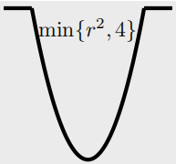

IRLS + GNC for Outlier-Robust Estimation
Outlier-Robust Estimation:
$\min_{v∈𝒞}{\sum_{i=1}^{m}{ρ\left( r\left(v,d_{i}\right) \right)}}$
$r\left(v,d_{i}\right)$: residual $ρ$: outlier-robust loss
Challenge: Non-Smooth Non-Convex Optimization
Linear regression:
$d_{i}=\left(x_{i},y_{i}\right)$
$r\left(v,d_{i}\right)=\left|x_{i}^{⊤}v−y_{i}\right|$
Point Cloud Registration:
$d_{i}=\left(x_{i},y_{i}\right)$, $v=(R,t)$
$r\left(v,d_{i}\right)=|\left|y_{i}−Rx_{i}−t\right|{\left.​\right|}_{2}$
Essential Matrix Estimation:
$d_{i}=\left(x_{i},y_{i}\right)$, $v=E$
$r\left(v,d_{i}\right)=\left|x_{i}^{⊤}Ey_{i}\right|$
$ℓ_{p}$:
$ρ\left(r\right)=\frac{{\left|r\right|}^{p}}{p}$
Geman-McClure (GM):
$ρ\left(r\right)=\frac{r^{2}}{1+r^{2}}$
TLS:
$ρ\left(r\right)=\min\left\{r^{2},c^{2}\right\}$

Slide 7
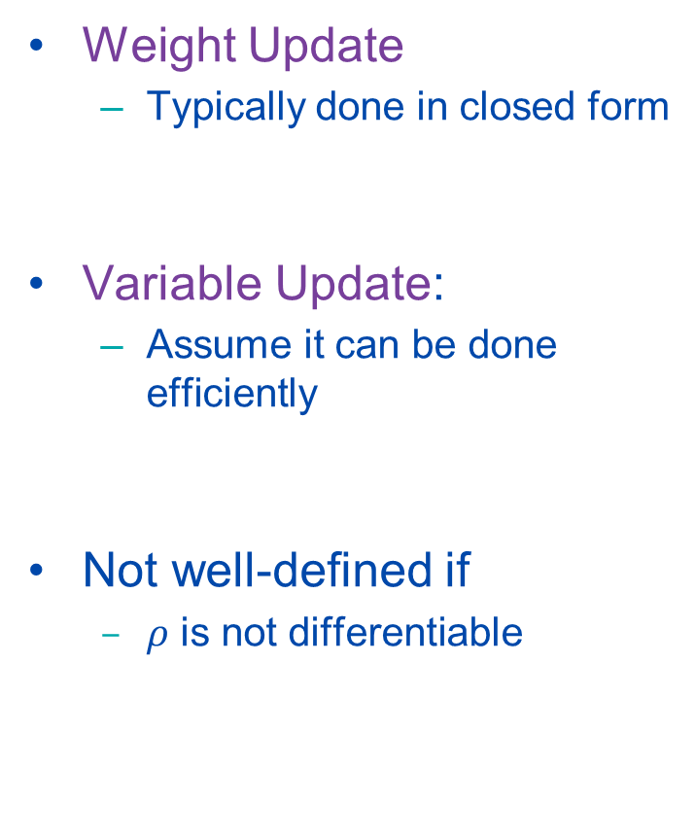
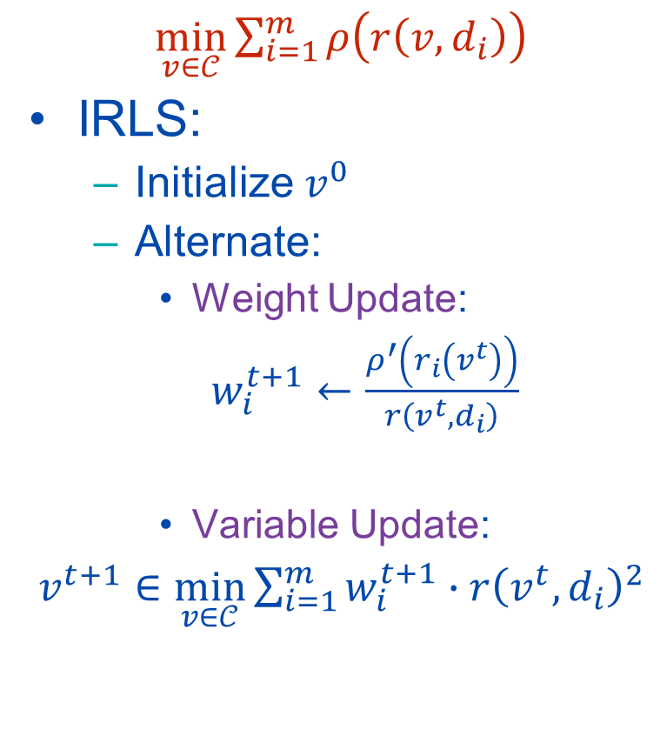
IRLS
$\min_{v∈𝒞}{\sum_{i=1}^{m}{ρ\left(r\left(v,d_{i}\right)\right)}}$
IRLS:
Initialize $v^{0}$
Alternate:
Weight Update:
$w_{i}^{t+1}←\frac{ρ^{′}\left(r_{i}\left(v^{t}\right)\right)}{r\left(v^{t},d_{i}\right)}$
Variable Update:
$v^{t+1}∈\min_{v∈𝒞}{\sum_{i=1}^{m}{w_{i}^{t+1}∙{r\left(v^{t},d_{i}\right)}^{2}}}$
Weight Update
Typically done in closed form
Variable Update:
Assume it can be done efficiently
Not well-defined if
$ρ$ is not differentiable
Challenge: Proof of Correctness & Convergence (Rates)!

Slide 8
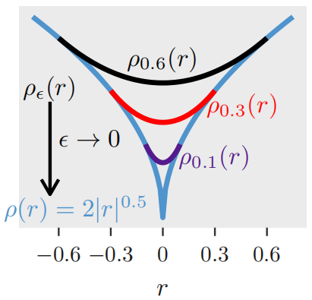
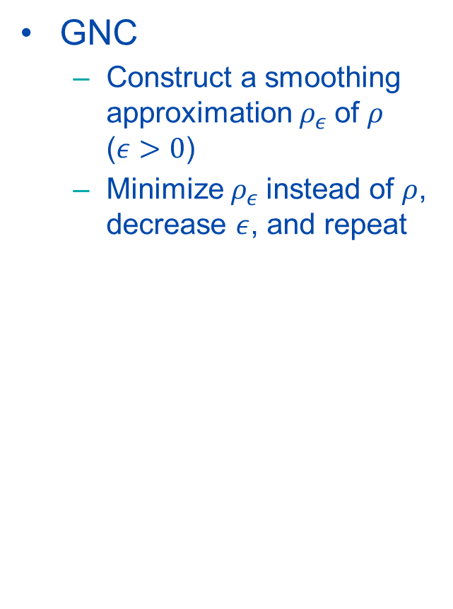
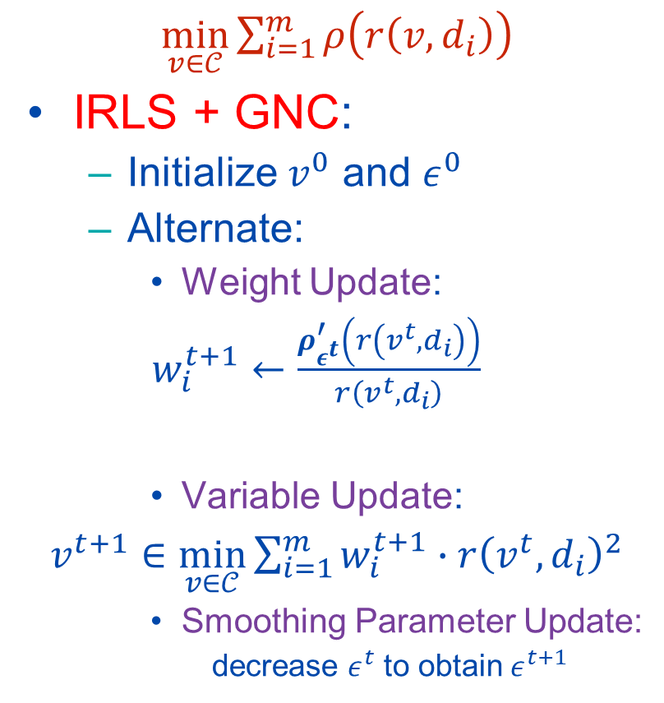
Graduated Non-Convexity
$\min_{v∈𝒞}{\sum_{i=1}^{m}{ρ\left(r\left(v,d_{i}\right)\right)}}$
IRLS + GNC:
Initialize $v^{0}$ and $ε^{0}$
Alternate:
Weight Update:
$w_{i}^{t+1}←\frac{ρ_{ε^{t}}^{′}\left(r\left(v^{t},d_{i}\right)\right)}{r\left(v^{t},d_{i}\right)}$
Variable Update:
$v^{t+1}∈\min_{v∈𝒞}{\sum_{i=1}^{m}{w_{i}^{t+1}∙{r\left(v^{t},d_{i}\right)}^{2}}}$
Smoothing Parameter Update:
decrease $ε^{t}$ to obtain $ε^{t+1}$
GNC
Construct a smoothing approximation $ρ_{ε}$of $ρ$ ($ε>0$)
Minimize $ρ_{ε}$instead of $ρ$, decrease $ε$, and repeat
Challenge: Proof of Convergence (Rates)!

Slide 9
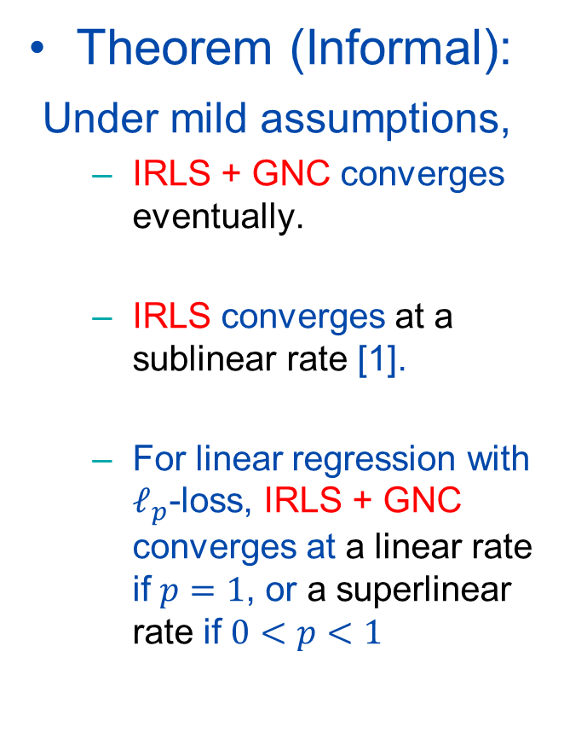
Main Results
$\min_{v∈𝒞}{\sum_{i=1}^{m}{ρ\left(r\left(v,d_{i}\right)\right)}}$
IRLS + GNC:
Initialize $v^{0}$ and $ε^{0}$
Alternate:
Weight Update:
$w_{i}^{t+1}←\frac{ρ_{ε^{t}}^{′}\left(r\left(v^{t},d_{i}\right)\right)}{r\left(v^{t},d_{i}\right)}$
Variable Update:
$v^{t+1}∈\min_{v∈𝒞}{\sum_{i=1}^{m}{w_{i}^{t+1}∙{r\left(v^{t},d_{i}\right)}^{2}}}$
Smoothing Parameter Update:
decrease $ε^{t}$ to obtain $ε^{t+1}$
Theorem (Informal):
Under mild assumptions,
IRLS + GNC converges eventually.
IRLS converges at a sublinear rate [1].
For linear regression with $ℓ_{p}$-loss, IRLS + GNC converges at a linear rate if $p=1$, or a superlinear rate if $0<p<1$
[1] L. Peng and R. Vidal. Block Coordinate Descent on Smooth Manifolds. arXiv:2305.14744 [math.OC] 2023.

Slide 10
More Information
Please Come to Our Poster Session
THU-AM-127
Vision Lab @ JHU http://www.vision.jhu.edu
Innovation in Data Engineering and Science (IDEAS) @ UPenn https://research.seas.upenn.edu/initiatives/data-science/
Thank You!

