Slide 1
KFC: Keypoints, Features and Correspondences
Traditional and Modern Perspectives
Liangzu Peng
5/7/2018

Slide 2
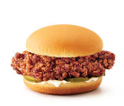
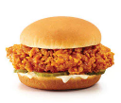
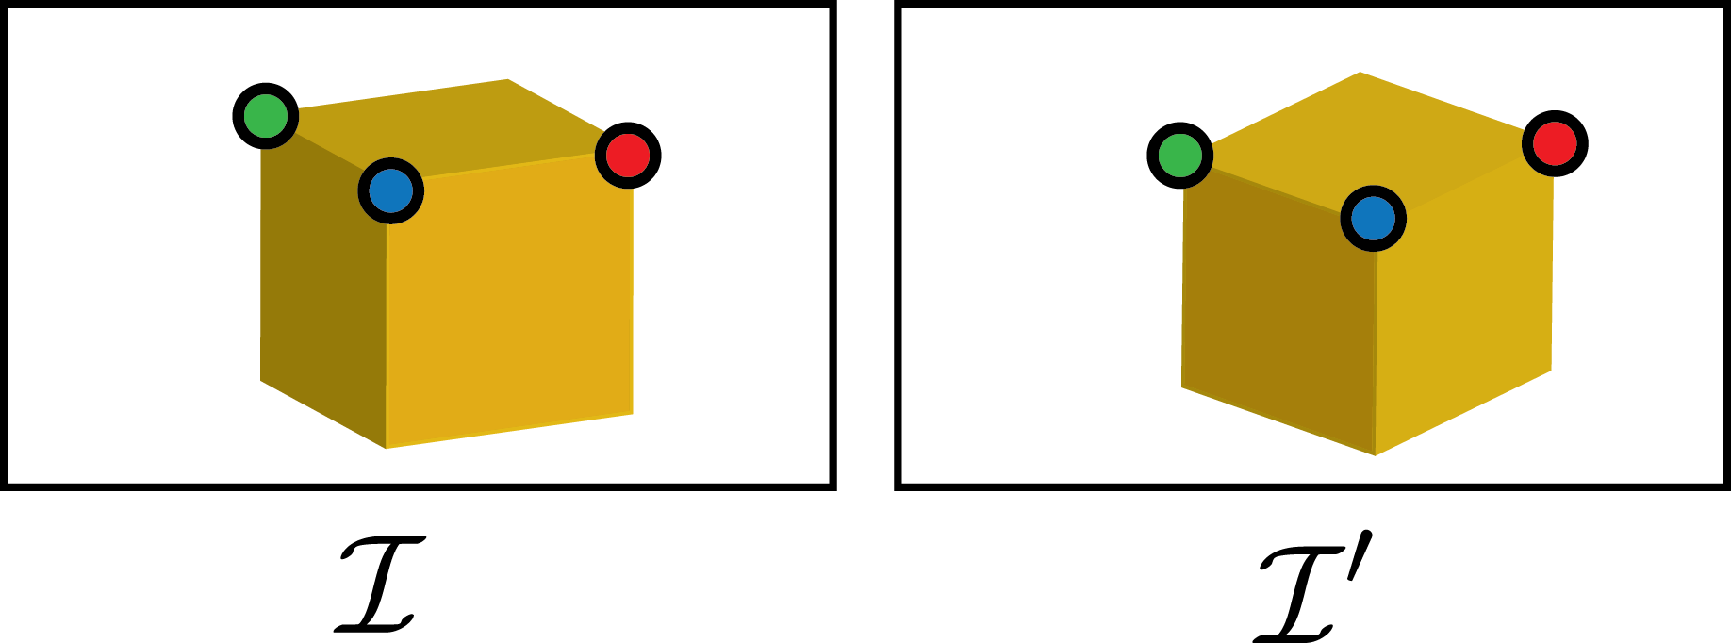
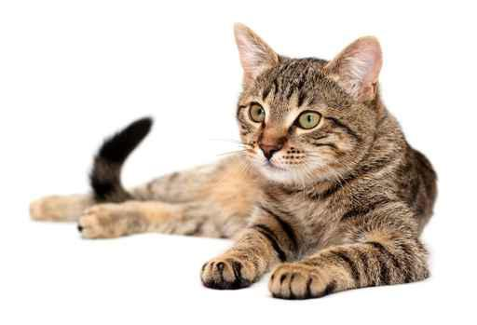
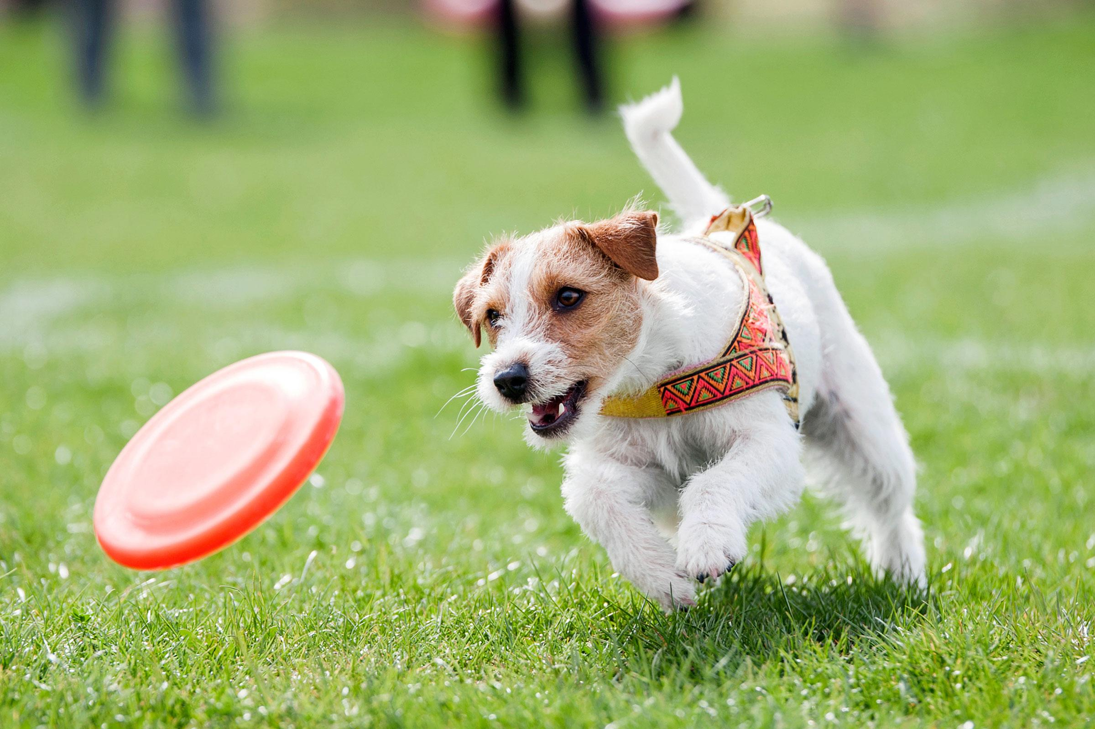


Correspondences
Goal: Matching points, patches, edges, or regions cross images.
Geometric Correspondences
Are points from different images the same point in 3D?
Semantic Correspondences
Are points from different images semantically similar?
Figure credit: Choy et al., Universal Correspondence Network, NIPS 2016

Slide 3
KFC prior to Deep Learning era
Wholeheartedly embracing Deep Learning! Why do we need to know traditional methods?
Terminologies remain (though techniques abandoned)
Abandoned techniques are sometimes insightful and illuminative
“…… Many time-proven techniques/insights in Computer Vision can still play important roles in deep-networks-based recognition” —— Kaiming He et al, Spatial Pyramid Pooling in Deep Convolutional Networks for Visual Recognition, ECCV 2014
A comparative study
Analyze pros and cons of both worlds, and combine their pros towards a better design.

Slide 4
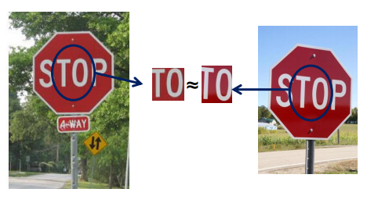
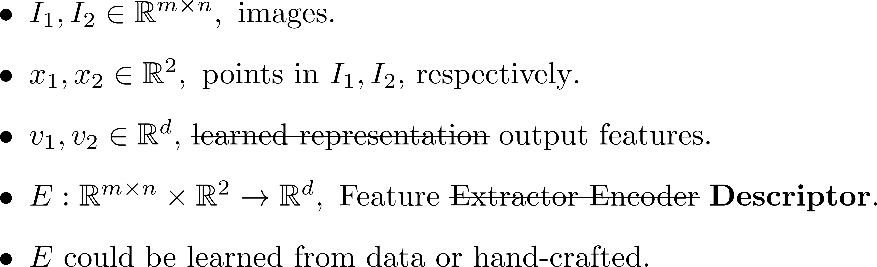
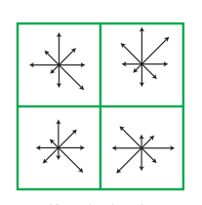
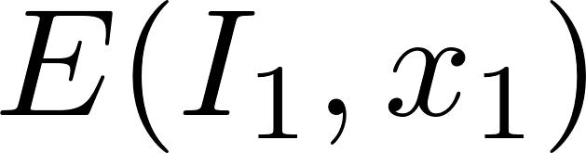
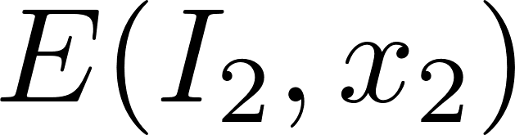
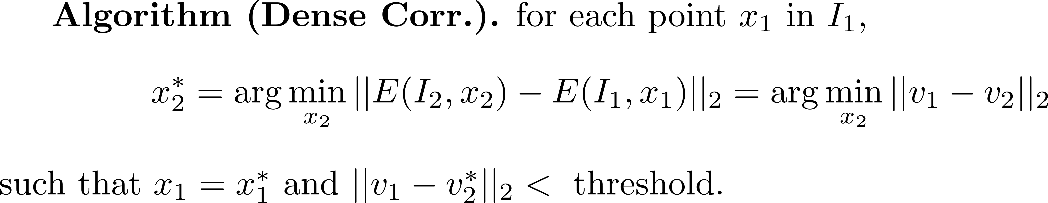
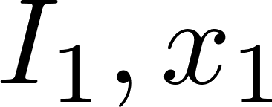

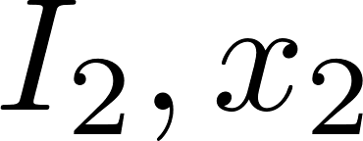
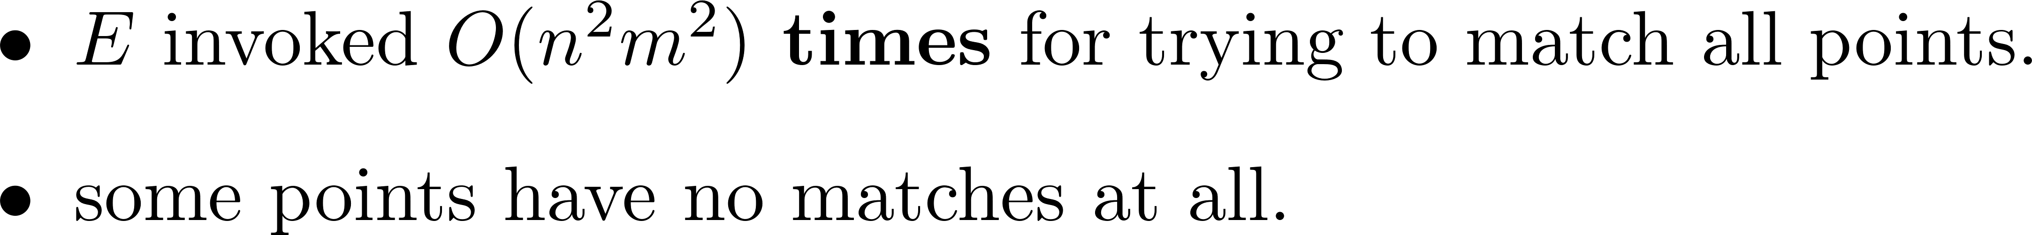
Correspondences
Expensive KFC: Hard to obtain ground truth for correspondences
Goal: Matching points, patches, edges, or regions cross images.
4
e.g, SIFT
Figure credit: https://cs.brown.edu/courses/csci1430/
Ineffectiveness calls for distinctiveness!
Ineffectiveness:
Distinctiveness
Only match distinctive points (called keypoints).
Sparse Correspondence.
Need an algorithm for keypoint detection.

Slide 5
Correspondences
Applications

Slide 6
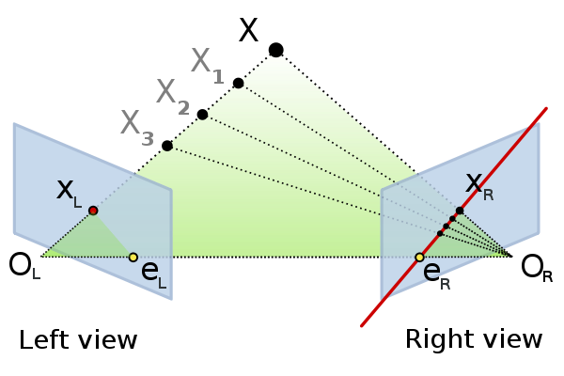
Correspondences
Applications
Epipolar Geometry
Figure credit: https://en.wikipedia.org/wiki/Epipolar_geometry

Slide 7
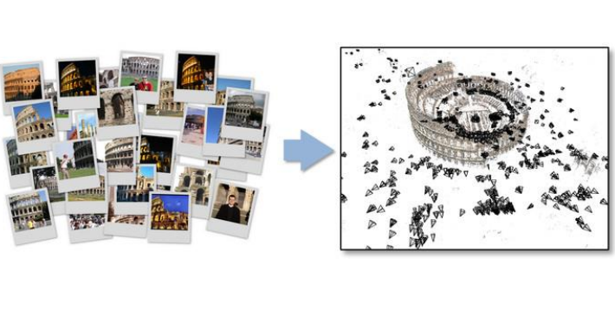
Correspondences
Applications
Epipolar Geometry,
Structure from Motion
Figure credit: https://cs.brown.edu/courses/csci1430/

Slide 8
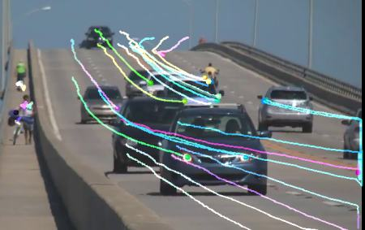
Correspondences
Applications
Epipolar Geometry,
Structure from Motion,
Optical Flow and Tracking
Figure credit: https://docs.opencv.org/3.3.1/d7/d8b/tutorial_py_lucas_kanade.html

Slide 9
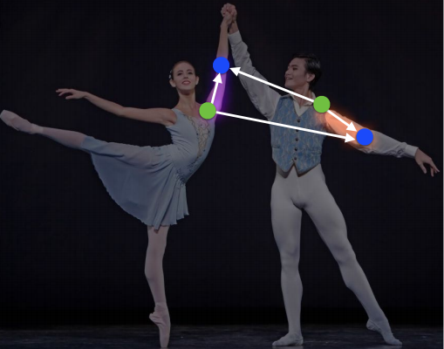
Correspondences
Applications
Epipolar Geometry
Structure from Motion
Optical Flow and Tracking,
Human Pose Estimation (Semantic Corr.)
Figure credit: Cao et al., Realtime Multi-Person 2D Pose Estimation using Part Affinity Fields, CVPR 2017

Slide 10
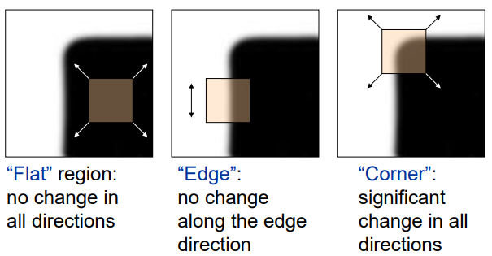
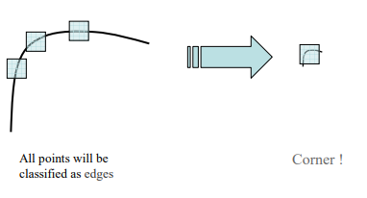
Keypoints Detection
Corners as distinctive keypoints
Harris Corner Detector
http://aishack.in/tutorials/harris-corner-detector/
.
Figure credit: https://cs.brown.edu/courses/csci1430/
Problems: Harris Corner Detector is not scale-invariant. This hurts repeatability (The same feature should be found in several images despite geometric and photometric transformations ).
Keypoints detector described in Lowe `2004 is scale-invariant.
Lowe, Distinctive Image Features from Scale-Invariant Keypoints, IJCV 2004

Slide 11

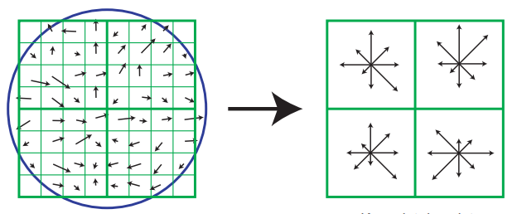
Image Features from Keypoints: Engineering
descriptor
SIFT
http://aishack.in/tutorials/sift-scale-invariant-feature-transform-introduction/
SIFT Descriptor:
(Gradient) Orientation assignment to each keypoints
Compute Histogram of Orientated Gradient (HOG)
Figure credit: Lowe, Distinctive Image Features from Scale-Invariant Keypoints, IJCV 2004

Slide 12
From Feature Engineering to Learning
Pros of hand-crafted features:
Information from images is explicitly imposed (e.g., gradient orientation) and thus well utilized.
This and that invariance.
Interpretability to some extent.
No need to train and ready to test.
category-agnostic: applicable to any images.
Learning from Engineered features:
Network architectures and loss functions to explicitly guide feature learning
Scale and rotation invariant network
Interpretability of deep networks (not in this talk)
Speed up the training (not in this talk)
Fast Learning and cheap fine-tuning

Slide 13
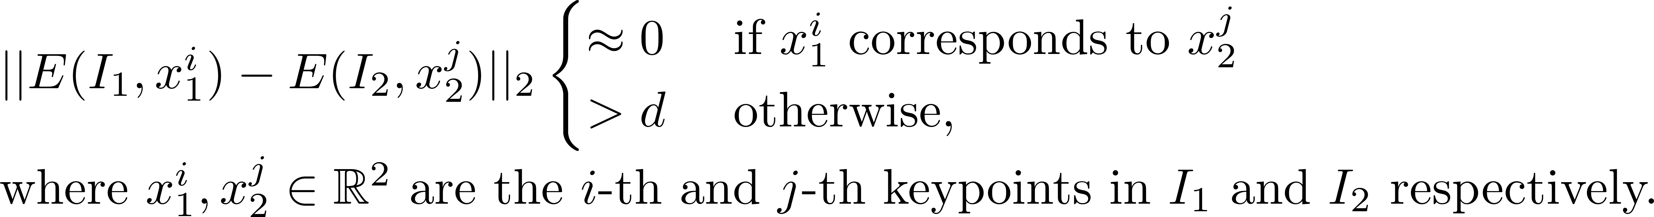
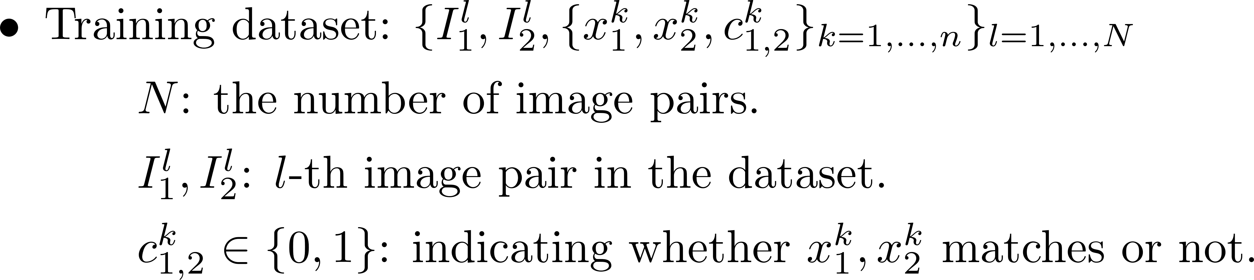
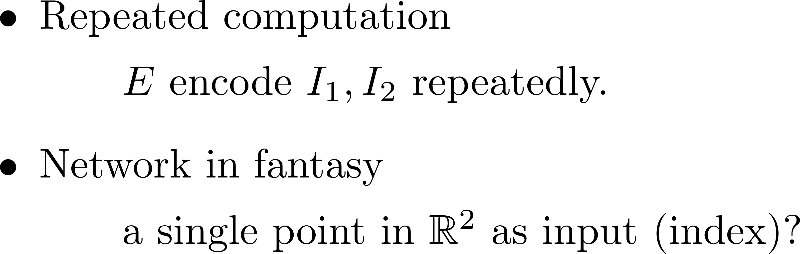
Learning Correspondences: Network
Q: Deep Addressing Mechanism?
Want to design a network E such that, once trained,
Observations

Slide 14
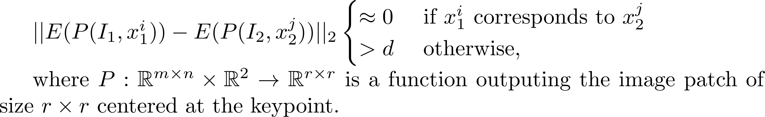
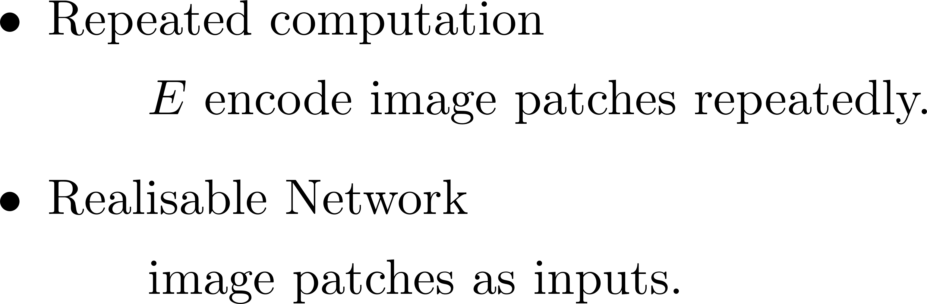
Learning Correspondences: Network
Network Design: image patches as inputs such that, once trained,
Observations

Slide 15
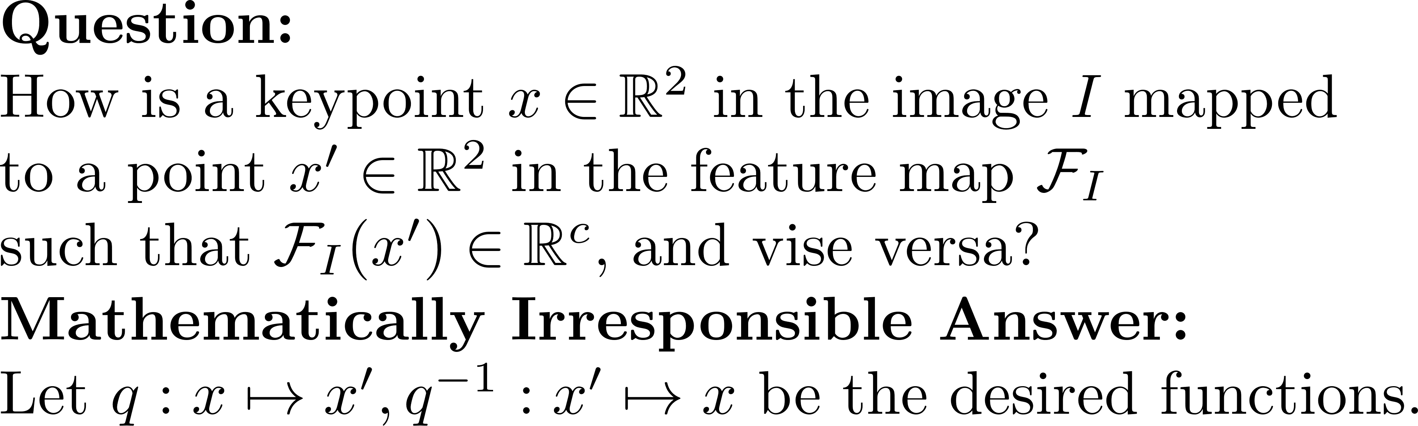


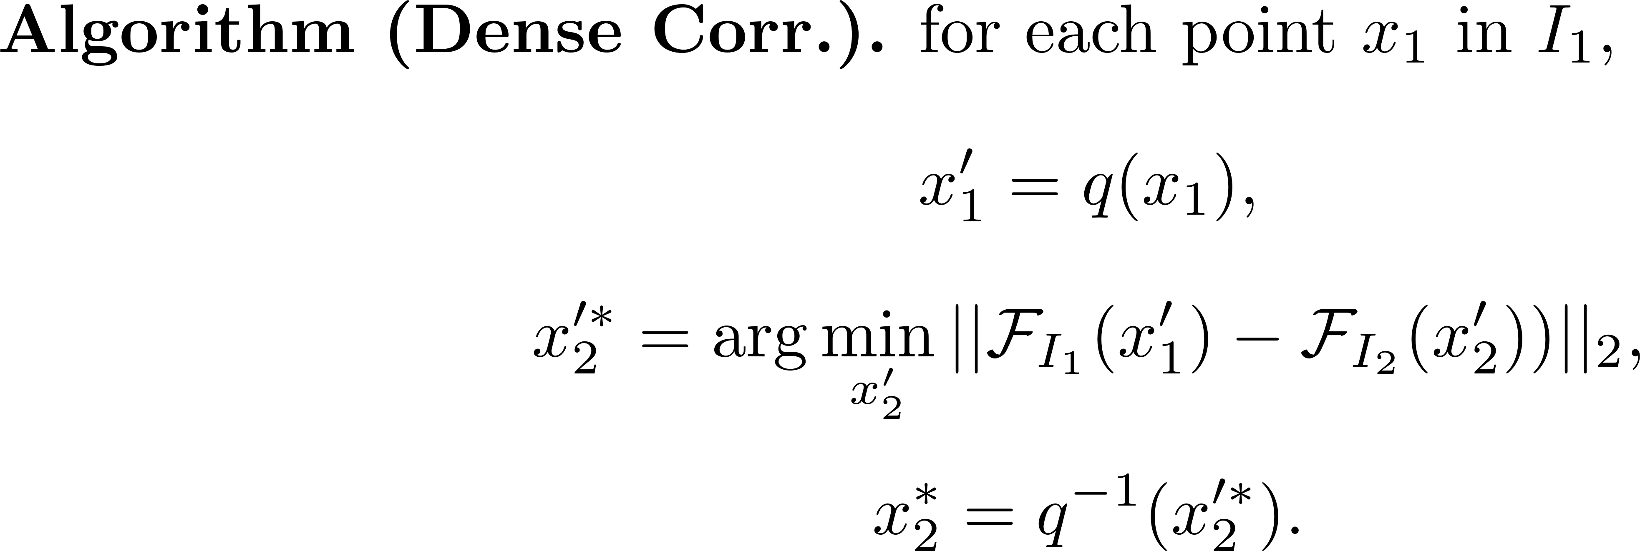
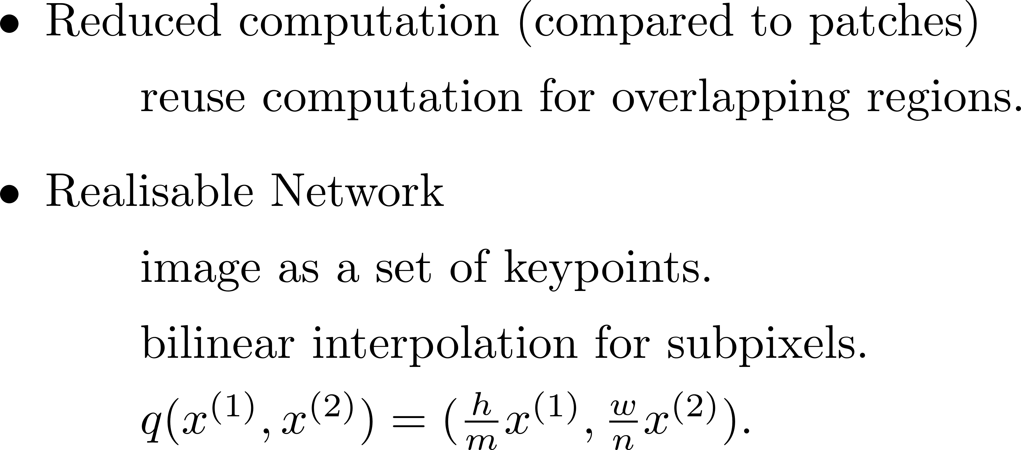
Learning Correspondences: Network
Choy et al., Universal Correspondence Network, NIPS 2016
Network Design: Fully Convolutional Network
Observations
Pros
good for dense correspondence.
Cons
wasted computation for sparse correspondence.

Slide 16
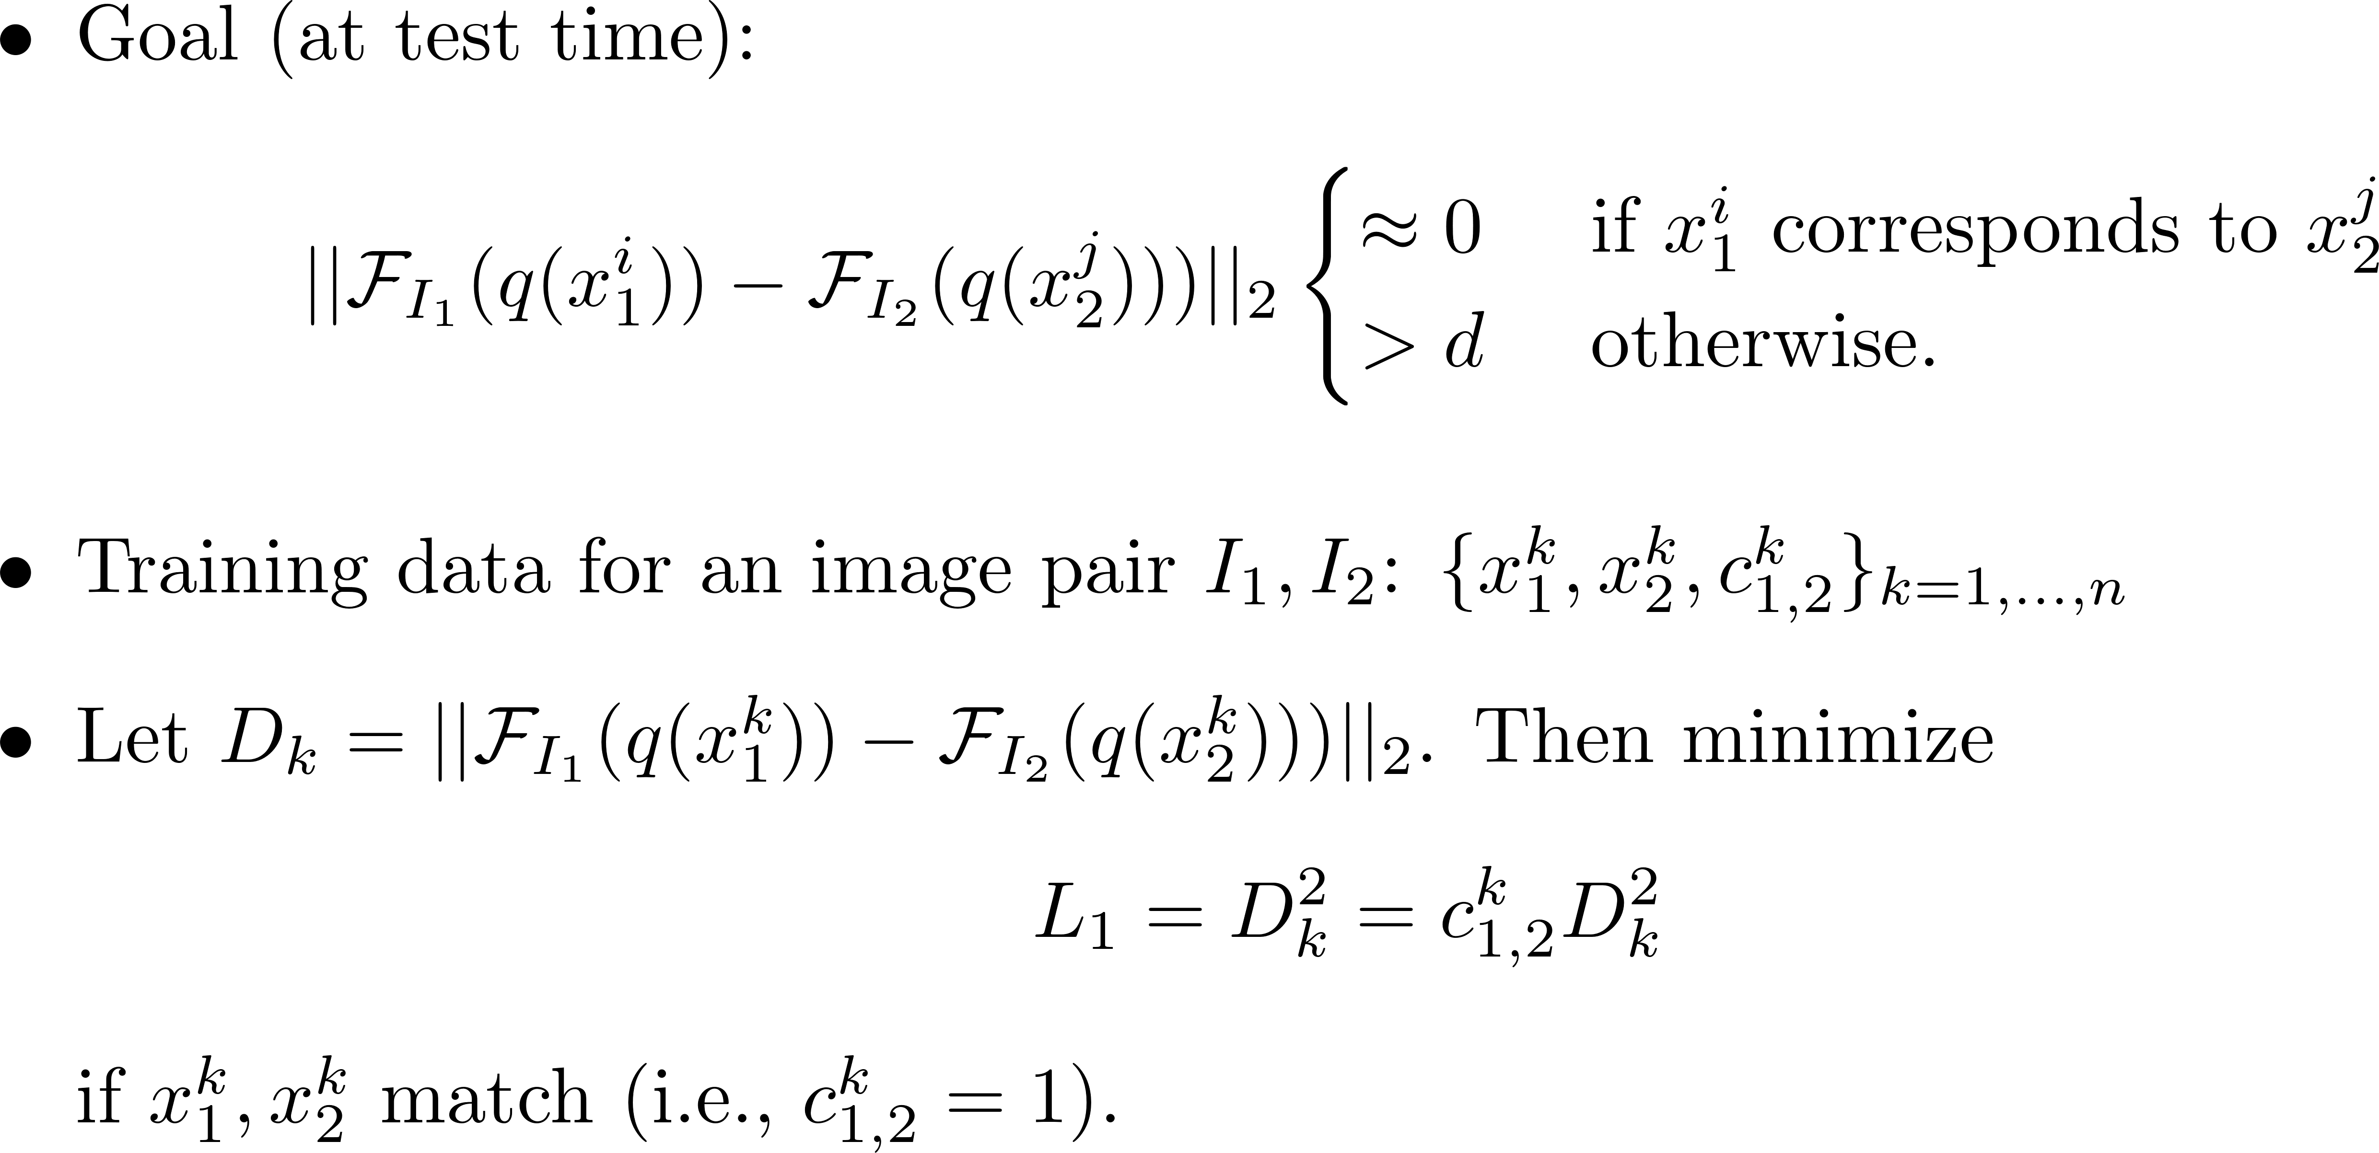
Learning Correspondences: Loss Function
Choy et al., Universal Correspondence Network, NIPS 2016

Slide 17
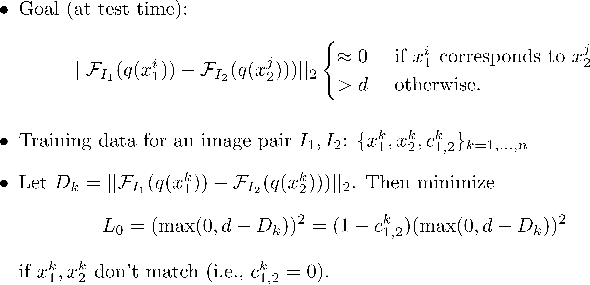
Learning Correspondences: Loss Function
Choy et al., Universal Correspondence Network, NIPS 2016

Slide 18
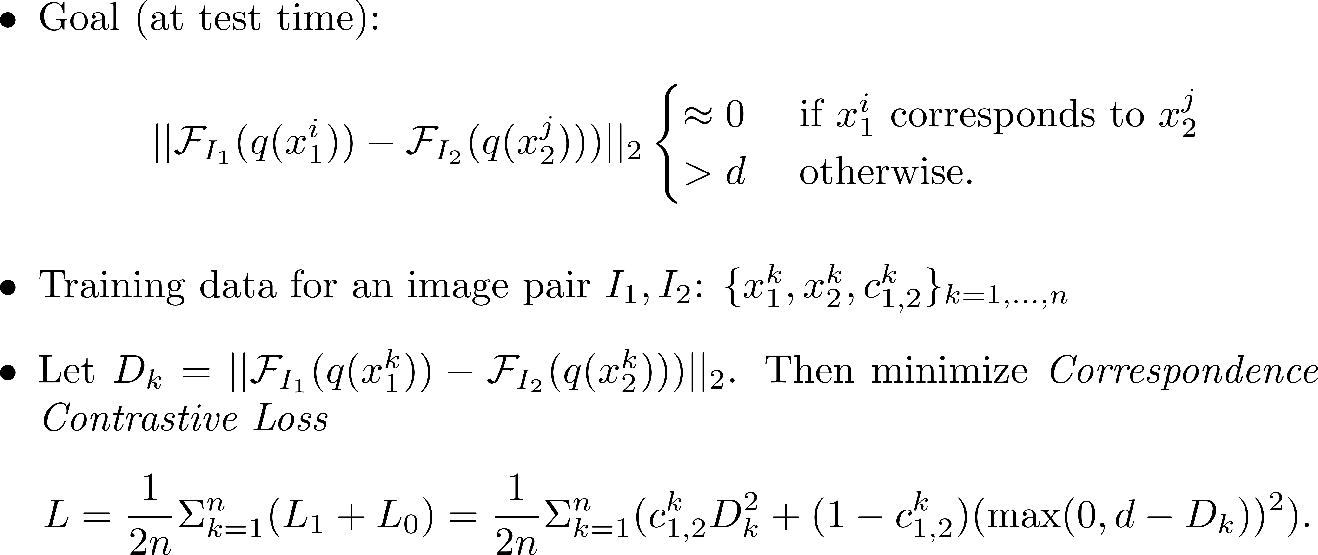
Learning Correspondences: Loss Function
Choy et al., Universal Correspondence Network, NIPS 2016

Slide 19
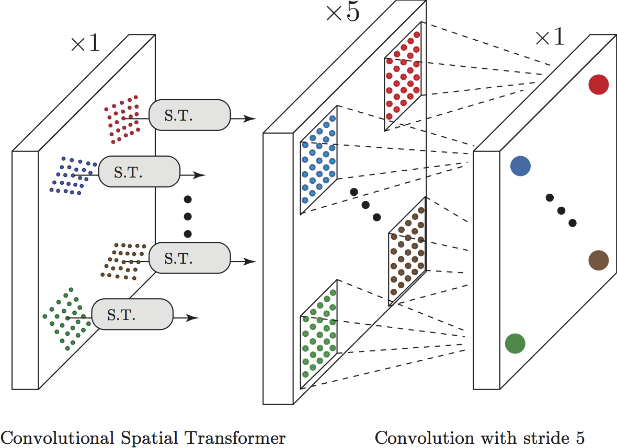
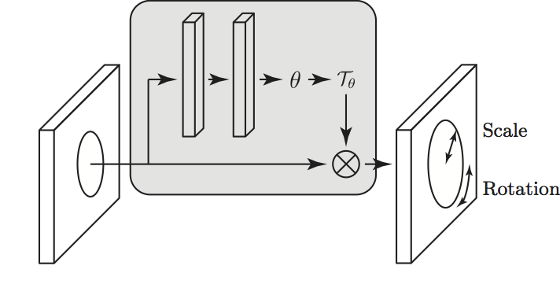
Learning Correspondence
Choy et al., Universal Correspondence Network, NIPS 2016
Rotation and Scale Invariance
Spatial Transformer Network
Unsupervised Learning
Adaptively apply transformation
UCN has to be fully conv.
Jaderberg et al., Spatial Transformer Network, NIPS 2015
Figure credit: Choy et al., Universal Correspondence Network, NIPS 2016

Slide 20
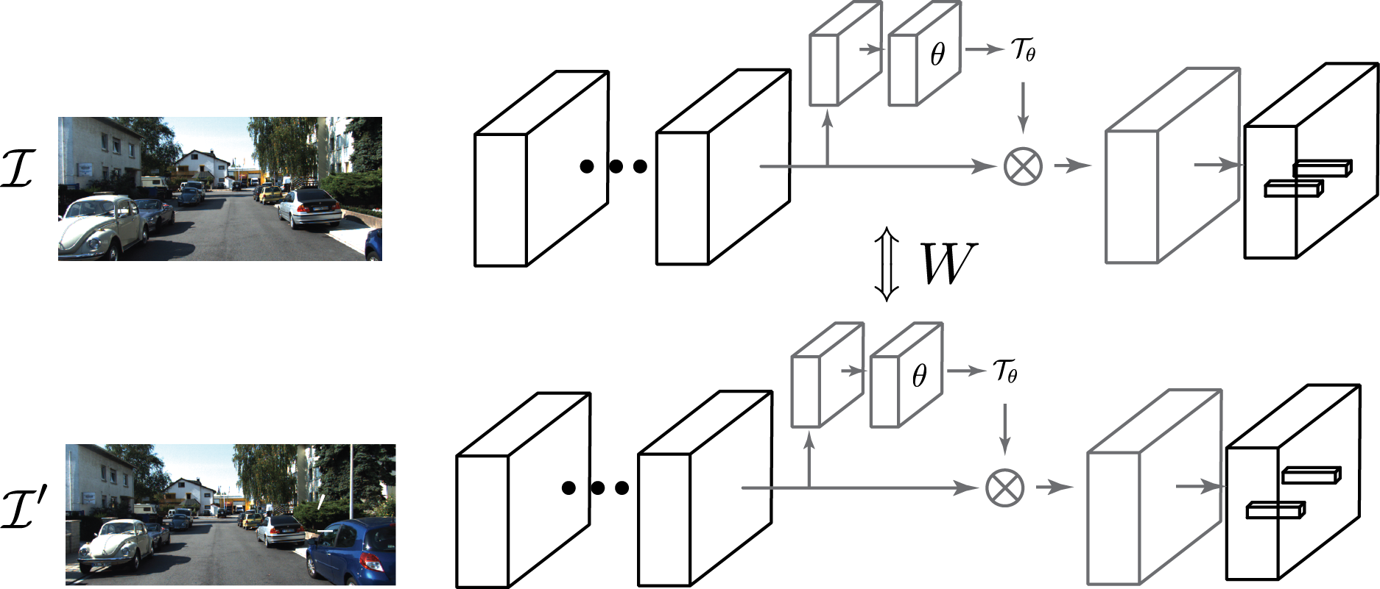
Learning Correspondence: Put it all together
Choy et al., Universal Correspondence Network, NIPS 2016
Pros
Reduced Computation
Corr. Contrastive Loss
X-invariant
Siamese Architecture (weight sharing)
Cons
Repeated Computation for Sparse Corr.
No Reason to Share All Weights
Only share weights for keypoints.
Local vs Global Features?
Category Specific
Fast Learning
Convolutional Spatial
Transformer
Fully ConvNets

Slide 21
Fast Learning and Cheap Fine-tuning
The trained correspondence model only applicable to the specific category and the instances appearing in training under that category.
How to fine-tune the model for a newly coming instance, as cheap as possible?
By cheap we mean that:
Less correspondence annotations (recall expensive KFC).
Less training/fine-tuning time.
Acceptable performance.

Slide 22
Experimental Results
Refer to the slides by Choy et al..

