Slide 1




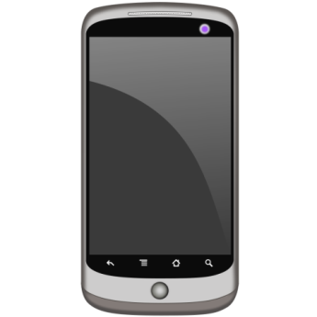

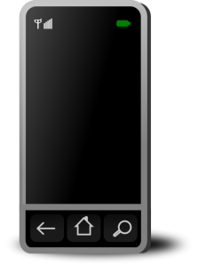
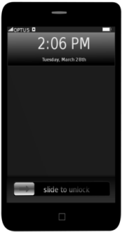



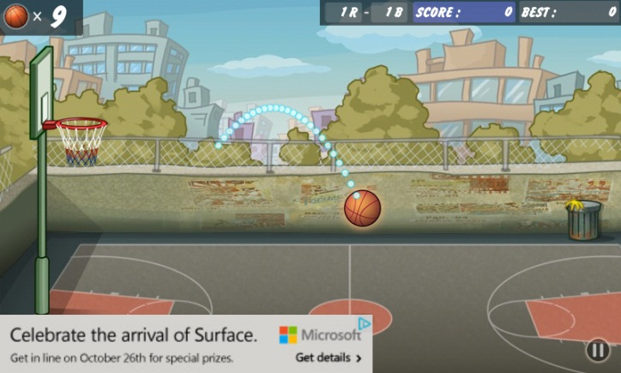









Meddle: Middleboxes for Increased Transparency and Control of Mobile Traffic
Ashwin Rao, David Choffnes, Justine Sherry, Arnaud Legout, Arvind Krishnamurthy, Walid Dabbous
Motivation
Opaque mobile ecosystem
Limited knowledge on the network usage of apps
No visibility into what ISPs are doing to traffic
Limited control
Locked down operating systems
ISPs solely control network policies
Goals
Transparency
Provide comprehensive view of mobile traffic regardless of device, OS, access technology, & ISP
Characterize network behavior of apps
Identify ISP policies
Control
Manipulate mobile traffic to enact arbitrary policies
Facilitate user-specific policy management
Coverage
Incentives for large scale adoption
Scale to support a large number of users
Supports user mobility
Easy to deploy (does not need OS modifications or ISP support)
System Architecture
Internet
DNS
Packet
Filter
Traffic
Monitors
Web Proxy
VPN Server
Meddlebox
Meddlebox
VPN Server
Open vSwitch
Meddle Server
Policy
Datastore
Meddle Server
Meddlebox
Example Applications
Device wide ad blocking
Transparent web proxy
Traffic compression
Visualize interaction between apps and trackers
Research Enabled by Meddle
Privacy and Security
Detect privacy invasive traffic
Malware detection and blocking
Characterization
Automatically detect ISP policies
Impact of network behavior of OS and apps
Exploring network optimizations
HTTP (Split-browser, SPDY push, etc.)
Proxying and caching
New protocols and communication models
Peer to Peer offloading
Transparent support for emerging technologies such as DNSSEC and IPv6
Routing, scalability, and management
Automatically and correctly compose multiple Meddleboxes
Performance and reliability in a cloud environment
Viability
Current implementation
Supports iPhone and Android, uses open source VPN server
Power consumption
Increases by about 10%
E.g., 24-hour charge now lasts 22 hours.
Data consumption
Increases by 8—12%
Offset this through ad blocking and compression
Network latency
Expected to increase by 3 ms to 13 ms
Insignificant portion of 3G latencies
ashwin.rao @ inria.fr ; choffnes @ cs.uw.edu ; justine @ eecs.berkeley.edu ; arnaud.legout @ inria.fr ; arvind @ cs.uw.edu ; walid.dabbous @ inria.fr

