Slide 1


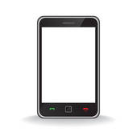


Meddle server
(1) Device requests page
(2) Insert tripwire
(3) Tripwire loads page through pigeonhole
Web server
Meddle-enabled device
Transparent proxy

