Slide 1


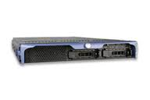

Mobile Carrier X
Egress X2
Mobile Carrier X
Egress X1
Mobile Carrier Y
Egress Y1
Core Internet
: Meddle server
: Meddle profile storage and redirector

