Slide 1


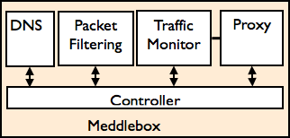
Replay server
VPN
proxy
Web proxy
Frontends
Meddle Server
Internet

