Slide 1



Online Retail Customer Segmentation
ML Group 4:
Brian Ssekalegga
Luis Curiel Rojas
Meisam Mofidi
Minling Lian
Notes:
Introduce the project, dataset, and high-level goal: segmenting customers using ML.

Slide 2

Project Overview
Unsupervised learning for customer segmentation
Utilize RFM features (Recency, Frequency, Monetary)
Goal: discover meaningful customer groups
Notes:
Explain how RFM ties into customer behavior analysis and why clustering is useful.

Slide 3

Project Methodology
The project applies machine learning clustering algorithms to identify customer segments based on purchasing behaviors from historical product quantities, unit prices, and the frequencies of customers transactions.
Notes:
Explain how RFM ties into customer behavior analysis and why clustering is useful.

Slide 4
Project Targets
The clustering results can guide the business to
allocate marketing and inventory resources more efficiently.
By identifying high-value segments, such as frequent buyers or high spenders, the company can focus promotions, loyalty rewards, and personalized offers on the customers who generate the greatest revenue.
At the same time, lower-value or infrequent customers can be targeted with re-engagement campaigns. This segmentation ensures optimized marketing spend, better inventory planning, and increased customer lifetime value, ultimately improving overall profitability.
Notes:
Explain how RFM ties into customer behavior analysis and why clustering is useful.

Slide 5
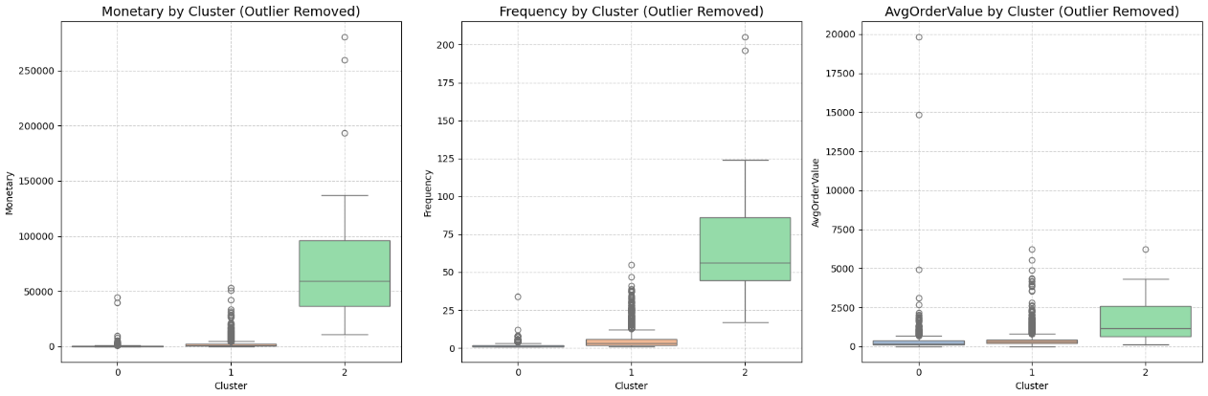
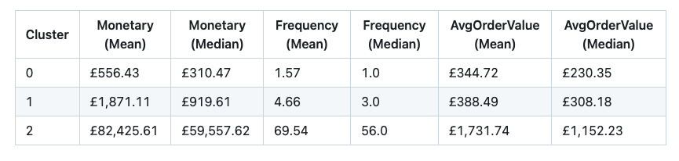
Model Results
Notes:
Explain how RFM ties into customer behavior analysis and why clustering is useful.

Slide 6
Business Application
Three clusters are identified to help the business tailor its strategy:
Cluster 0 (low-value customers): use low-cost marketing or re-engagement campaigns without overspending on acquisition.
Cluster 1 (moderate customers): target with promotions to increase spending and move them toward high-value status.
Cluster 2 (high-value customers): prioritize with loyalty rewards and personalized offers to maximize retention and revenue.
Together, these insights allow the company to optimize marketing budget, improve retention, and increase profitability.
Notes:
Explain how RFM ties into customer behavior analysis and why clustering is useful.

Slide 7
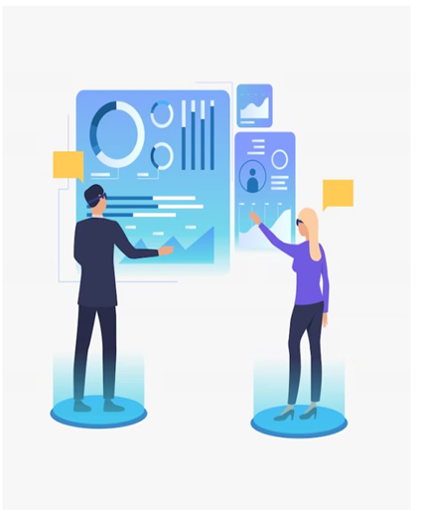
Future Work
Deploy model on AWS or GCP
Build dashboard for real-time insights
Explore supervised models for customer lifetime prediction
Notes:
Explain how RFM ties into customer behavior analysis and why clustering is useful.

Slide 8
Appendix

Slide 9

Dataset Overview
Online Retail dataset – UK-based gift retailer
2010–2011 transactions
~541K records
Key fields: InvoiceNo, StockCode, Quantity, Date, Price, Country, CustomerID
Notes:
Highlight that the data is transactional and requires aggregation into customer-level features.

Slide 10
Data Cleaning & Preprocessing
Removed cancellations & invalid transactions
Added Year, Month, Subtotal, Cancellation Flag
Handled missing CustomerID
Final dataset ~538K rows
Notes:
Explain why preprocessing is critical for reliable clustering. Mention handling outliers.

Slide 11
Exploratory Data Analysis
Top-selling products
Revenue by country
Quantity vs Price correlation plot
Notes:
Walk through data shape, trends, and initial observations.

Slide 12
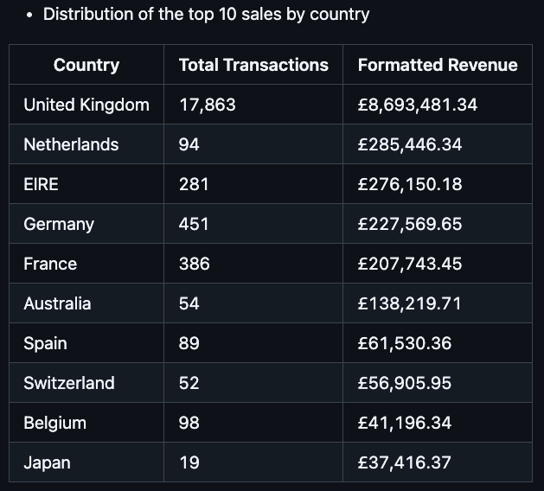
Revenue by country

Slide 13
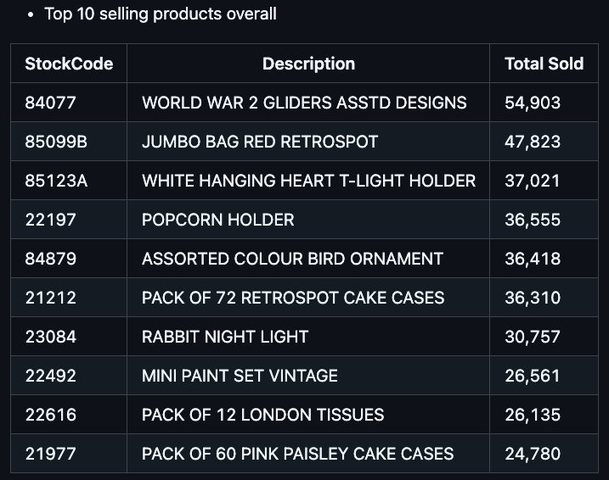
Top-selling products

Slide 14
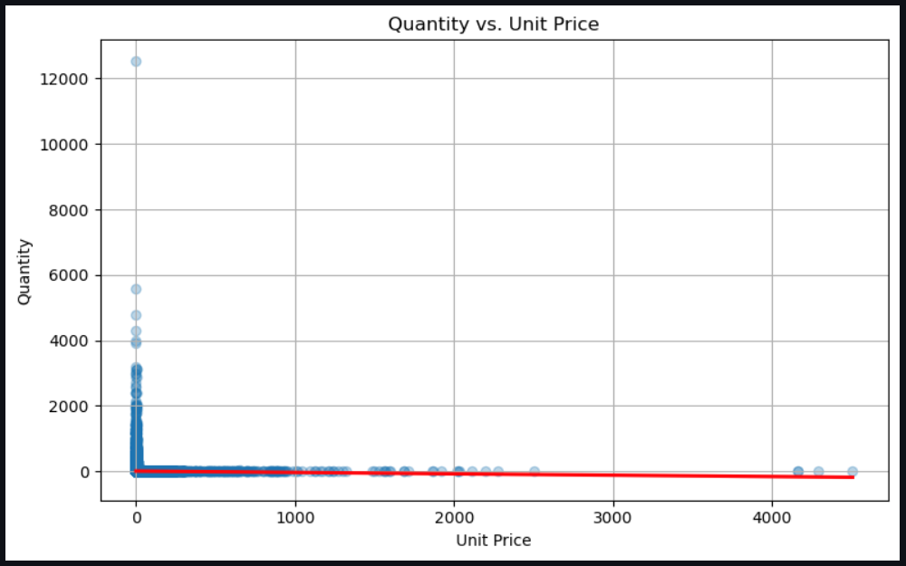
Top-selling products

Slide 15

RFM Feature Engineering
Customers are scored on 1–5 scale for each metric.
Recency – days since last purchase
Frequency – number of purchases
Monetary – total amount spent
Notes:
Explain that RFM is a standard method to quantify customer behavior. Mention why it works well for clustering.

Slide 16
RFM Distribution & Interpretation
Notes:
Discuss how different RFM groups highlight customer value differences.

Slide 17
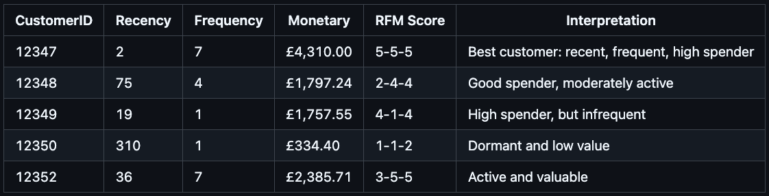

Recency represented: How long it’s been since the customer last made a purchase. Customers who bought something recently get higher scores: 5 = very recent, 1 = very old.
Frequency represented: How often the customer makes a purchase. People who buy more often get higher
scores: 5 = frequent buyer, 1 = rare.
Monetary represent: How much money the customer has spent in total. Customers who spend more get higher scores:
5 = high spender, 1 = low spender.
Notes:
Discuss how different RFM groups highlight customer value differences.

Slide 18
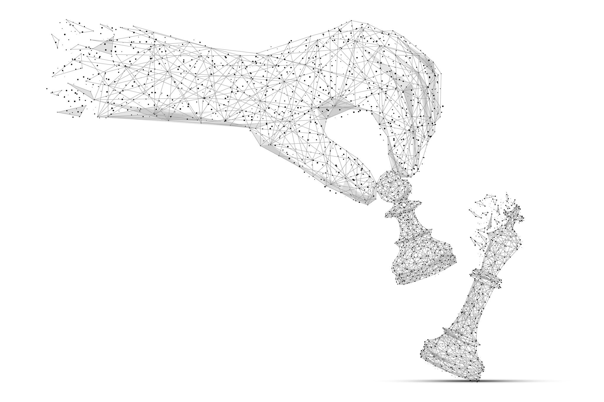
Algorithms Explored
K-Means clustering
DBSCAN clustering
Used both for comparison
    Elbow + Silhouette Score
Notes:
Explain the intuition behind each algorithm and why testing multiple approaches matters.

Slide 19


Outlier Impact
A customer 'guest-United Kingdom' had extreme values which distorted cluster boundaries and we removed it for cleaner segmentation
Notes:
Briefly explain how outliers affect K-Means (centroid distortion) and DBSCAN (core point density).

Slide 20

K-Means Results
Elbow plot
Silhouette plot
Cluster scatter plots
Notes:
Walk through improvements after removing outlier.

Slide 21
DBSCAN Results
Parameter tuning visuals
Silhouette or cluster map
Cluster distribution
Notes:
Discuss challenges such as parameter sensitivity.

Slide 22
Model Interpretation
PCA used to visualize clusters
Clusters reflect spending patterns
Identified high-value vs low-frequency customers
Notes:
Explain why PCA is useful for visualizing high-dimensional clustering.

Slide 23
Model Interpretation
📍 Insert PCA plots + cluster summary tables.
Cluster Characteristics (Placeholder)
Notes:
Explain why PCA is useful for visualizing high-dimensional clustering.

Slide 24

Conclusions
K-Means (after removing outlier) produced best segmentation
Clear cluster separation
Helps identify high-value customers
Supports targeted marketing
Notes:
Quickly summarize what worked best and why.

