Slide 1
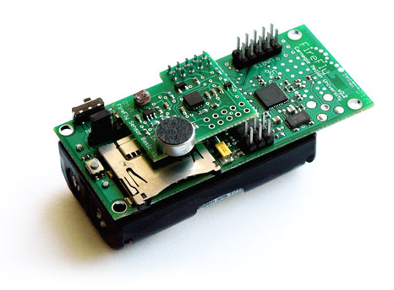
Sensor Data Platform Web Application with Play! Framework and Java
Arie Radilla Laureano
Isil Demir
Lyman Cao
Yazhisai Gowthaman
Advisor: Jia Zhang
Sponsor: Bob Iannucci

Slide 2
Roadmap
Introduction
Motivation
System Design
System Implementation
Demo
Analysis
Conclusion and Future Work

Slide 3
Introduction
Sensor Data Platform
Platform for end users to understand sensors and the information related to them
Easy access to information
Lowers learning curve for newcomers to the Sensor Data Service Platform

Slide 4
Motivation
Platform creates a feedback channel for users outside of CMU.
Provide platform for end users to work with sensors, retrieve information and envision new uses.
Goal: Make sensor platform available to a higher number of users.
Notes:
get other people to work in platform, get feedback on the platform, give convenient access for users

Slide 5

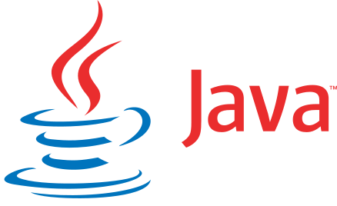

System Design
Web Application
Sensor Data Service Platform

Slide 6
System Design: Components: H2
Why H2?
A database to store user credentials and bug reports
H2: In-memory Java SQL database
Small footprint (1.5MB jar file)

Slide 7
System Design: Components: Java/Play
Why Java/Play?
Scalability, velocity Stateless, RESTful, non-blocking I/O
 | Play! | Spring | Rails (JRuby) | Grails
Pros | Heroku supports Both Play! 1.2.x and 2.x APIs are written in Java using the Play Framework for good reference Non-blocking IO for fast performance | Heroku supports Spring | Can leverage existing work in Rails and Ruby Heroku: Seems to support JRuby projects | Heroku supports Grails
Cons | Learning Curve | Code structure is different from the previous version written in RoR | Performance issue Existing Gems in use might not have JRuby support | Opinionated design, convention over configuration can hinder in customization.

Slide 8
System Implementation: Install
Play! Framework
Version: 2.2.0
Dependencies: JDK 6 or later.
Have java, javac commands in the current path
Download the standalone distribution for Play
H2 Database Engine
No need to install, default with Play
Notes:
1. Install Play Framework. Instruction can be found at http://www.playframework.com/documentation/2.2.x/Installing
2. Download the source code from https://github.com/robwblack/mercury
3. From the parent folder, run the command: 'play run'
4. Local App will available at localhost:9000

Slide 9
System Implementation: Build
Play! Framework
Detailed instructions
Extract the distribution package
Add the play script to your PATH:
export PATH=$PATH:/relativePath/to/play
H2 Database Engine
In Play Console, run the command: h2-browser
Web interface starts on localhost:8082
Run SQL commands as necessary
Notes:
1. Install Play Framework. Instruction can be found at http://www.playframework.com/documentation/2.2.x/Installing
2. Download the source code from https://github.com/robwblack/mercury
3. From the parent folder, run the command: 'play run'
4. Local App will available at localhost:9000

Slide 10
System Implementation: Run
SDS Web Application
Download the source code from github
To start the Play console, run the command: play
To start the web application: run 9000
Local app will start at localhost:9000
Notes:
1. Install Play Framework. Instruction can be found at http://www.playframework.com/documentation/2.2.x/Installing
2. Download the source code from https://github.com/robwblack/mercury
3. From the parent folder, run the command: 'play run'
4. Local App will available at localhost:9000

Slide 11
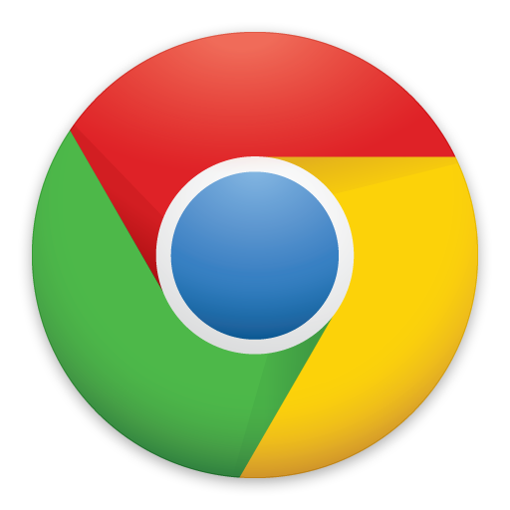
System Implementation
Scenario: View all sensors and create a new one
1. View sensors
Sensor Data Service
API
2. Get sensor
metadata
3. Display
content
1. Make API request
http://einstein.sv.cmu.edu/get_sensors/json

Slide 12
System Implementation
2. Create a sensor
Sensor Data Service
API
Create
sensor
Display
content
No
Is user
logged in?
Yes

Slide 13
Testing
Unit and Integration Testing
Unit testing ensures that the each model works correctly
Integration testing gives developers security to perform continuous integration
Testing done with JUnit and FluentLenium for integration testing.

Slide 14
<< DEMO PLACEHOLDER >>

Slide 15
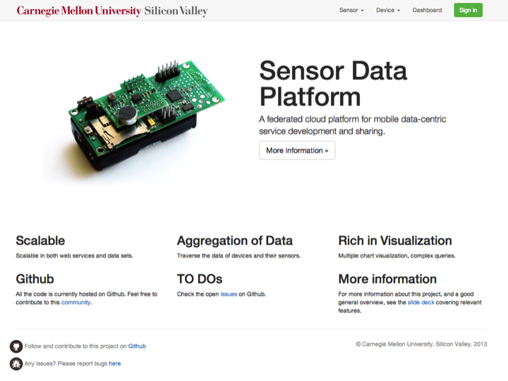
APPLICATION WALKTHROUGH

Slide 16
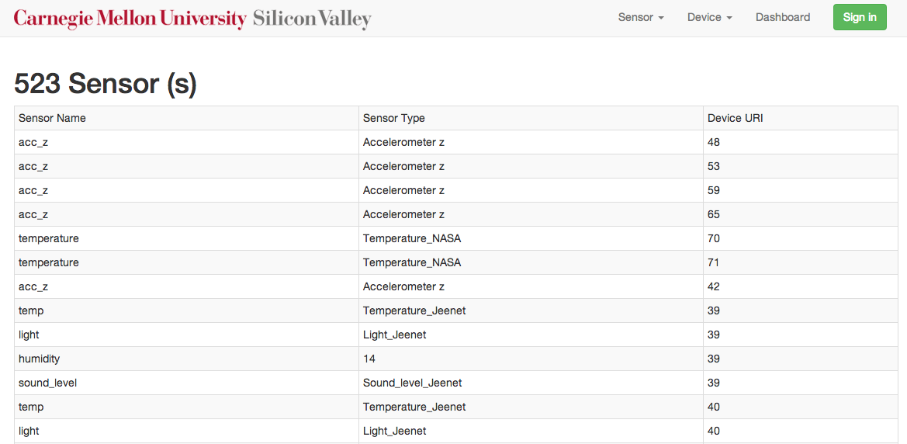
APPLICATION WALKTHROUGH

Slide 17
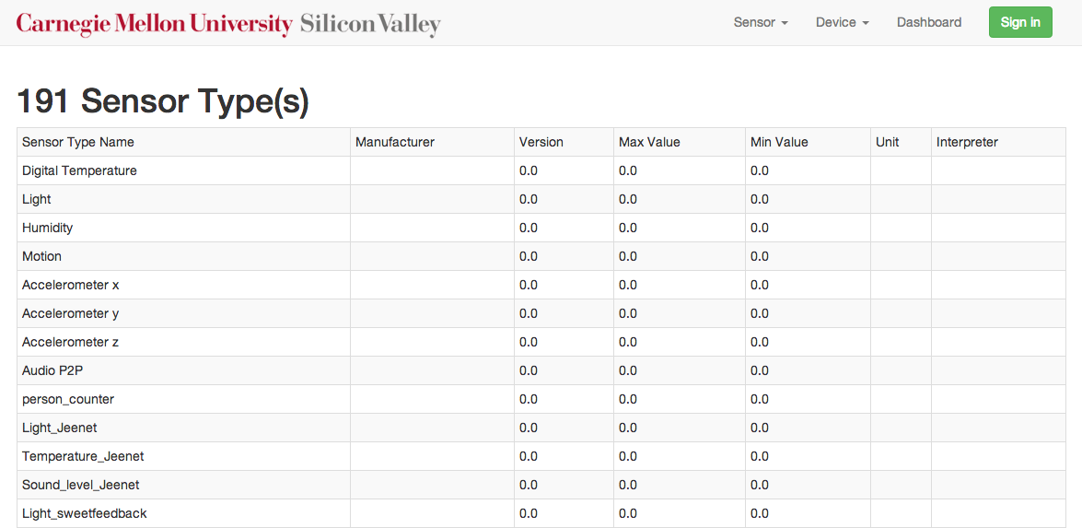
APPLICATION WALKTHROUGH

Slide 18
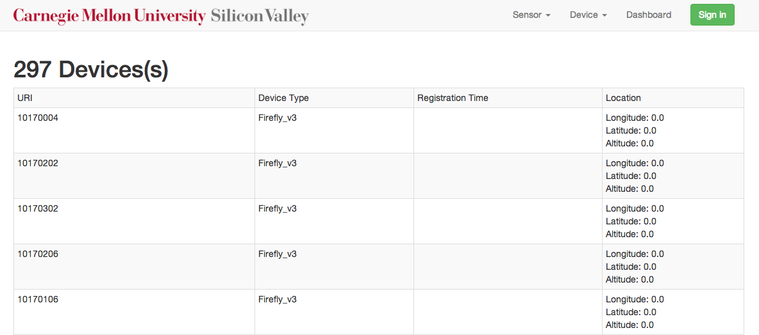
APPLICATION WALKTHROUGH

Slide 19
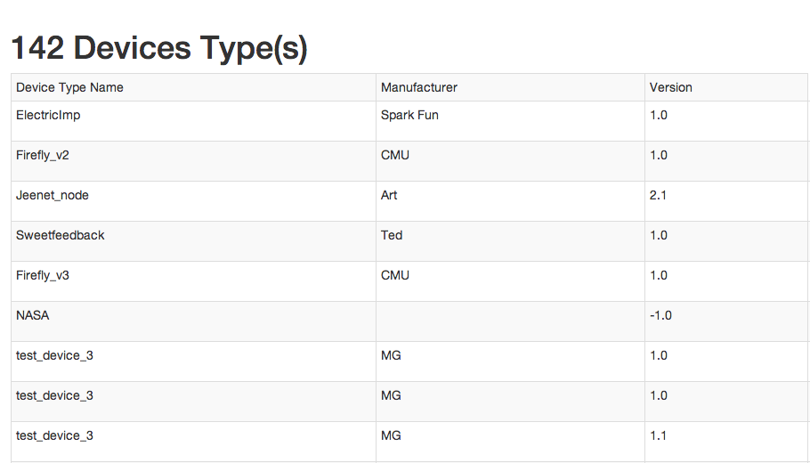
APPLICATION WALKTHROUGH

Slide 20
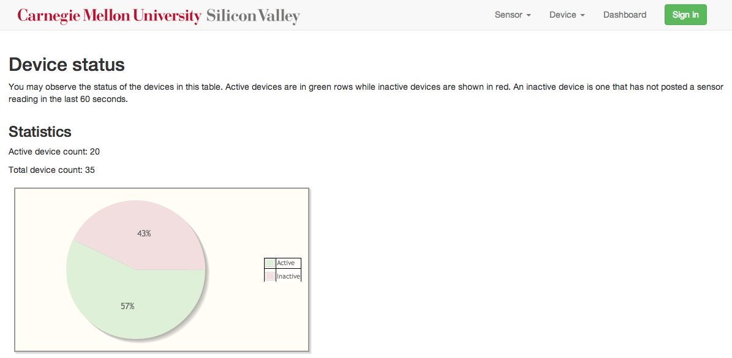
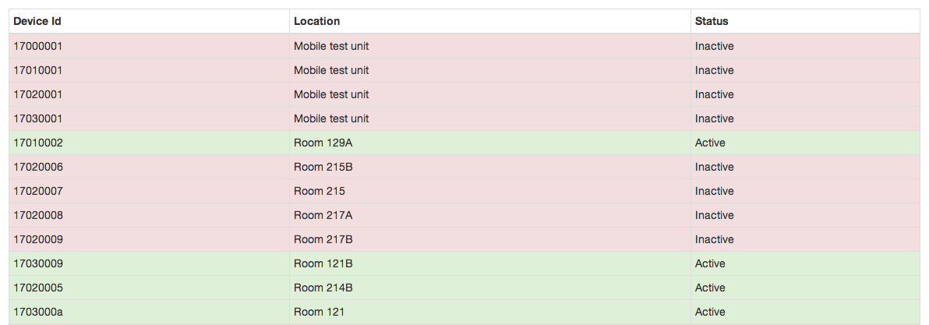
APPLICATION WALKTHROUGH

Slide 21
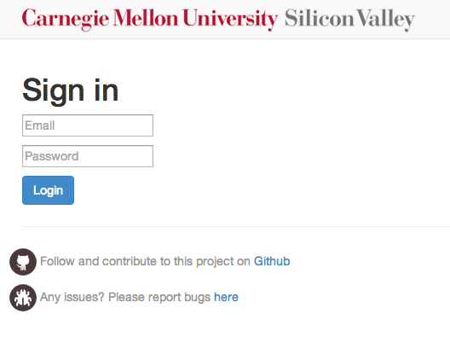

Slide 22
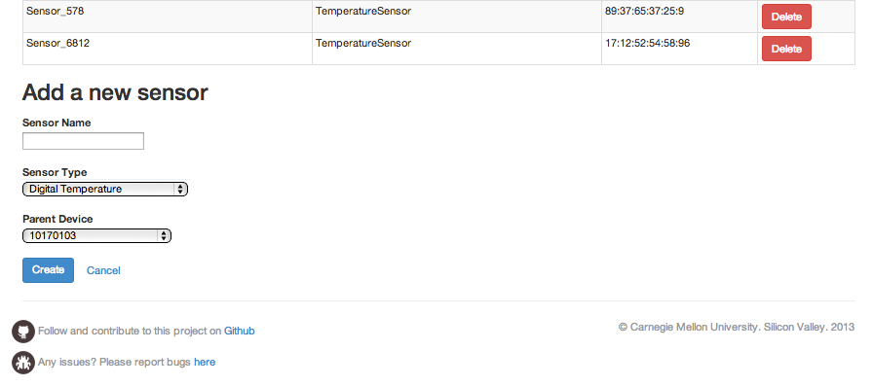
APPLICATION WALKTHROUGH

Slide 23
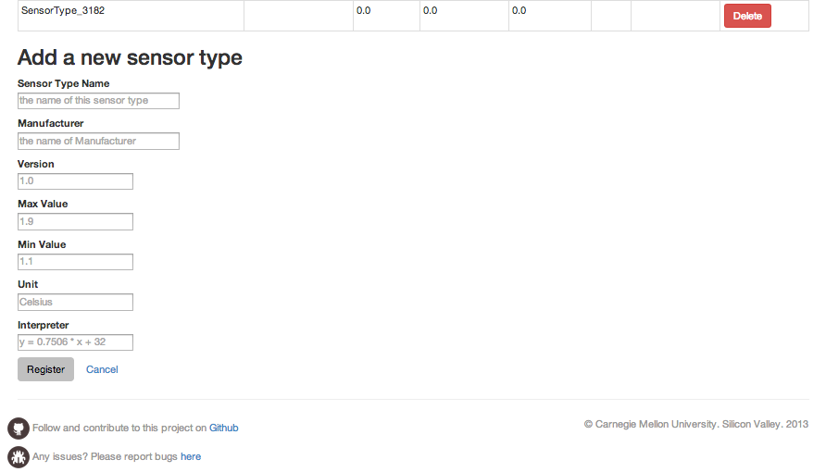
APPLICATION WALKTHROUGH

Slide 24
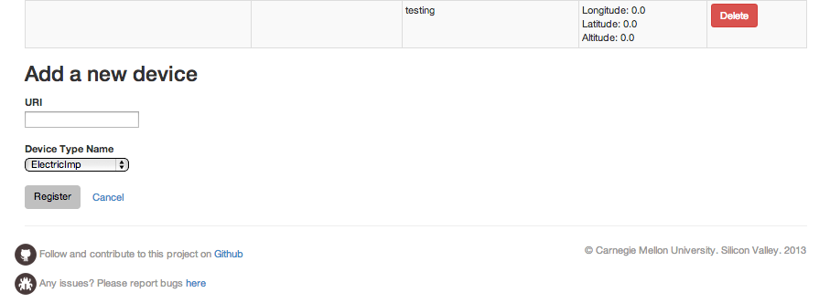
APPLICATION WALKTHROUGH

Slide 25
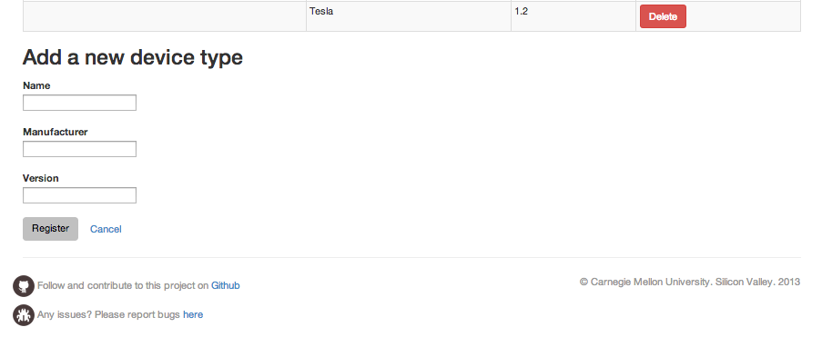
APPLICATION WALKTHROUGH

Slide 26
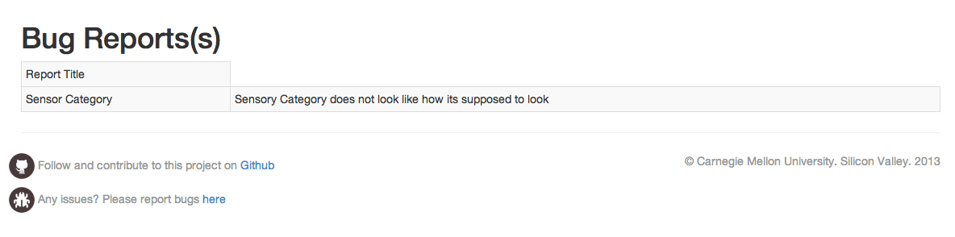
APPLICATION WALKTHROUGH

Slide 27
Technical Challenges
Historic data cannot be deleted due to inconsistency in the new data model and the old data model
Performance issues - when the retrieved data is huge, the application take a long time to load
Missing APIs - Some of the APIs like Edit APIs and Sensor Category are currently unavailable due to which these functionalities have not been implemented
Data Model Inconsistency

Slide 28
Future Work
Sensor Category – Once APIs are available
Integrate with API 1.3
Edit functionality for all components
Single point of access for the SDS platform
In the long term
Network of Sensors - publicly accessible

Slide 29
Try It!
Try the website at
https://github.com/cmusv-sc/ArchF2013-Project3-FT
Default Login Credentials
Username: admin@admin.com
Password: adminadmin

Slide 30




Contact Us
lyman.cao@sv.cmu.edu
650-933-7515
yazhisai.gowthaman@sv.cmu.edu
408-386-4243
arie.radilla.laureano@sv.cmu.edu
323-804-4349
isil.demir@sv.cmu.edu
650-996-1201

Slide 31
Thank You

