Slide 1
MEMBER B · ARCHITECTURE
System Architecture
Frontend
Backend
Database
React · User Interface
FastAPI · Business Logic
PostgreSQL · Supabase
RAG / Dify
AI Recipe Engine · Knowledge Base
AI Agent Workflow
① User Input
② Intent Parse
③ DB Query
④ RAG Search
⑤ Rank & Filter
⑥ LLM Generate
⑦ Output
Ingredients +
User Tags
Extract items
& preferences
Fridge stock
+ tag profile
Vector search
in Dify KB
Expiry-first
priority sort
GPT builds
personalised reply
Recipe +
calories shown
Member B · 6 / 15

Slide 2
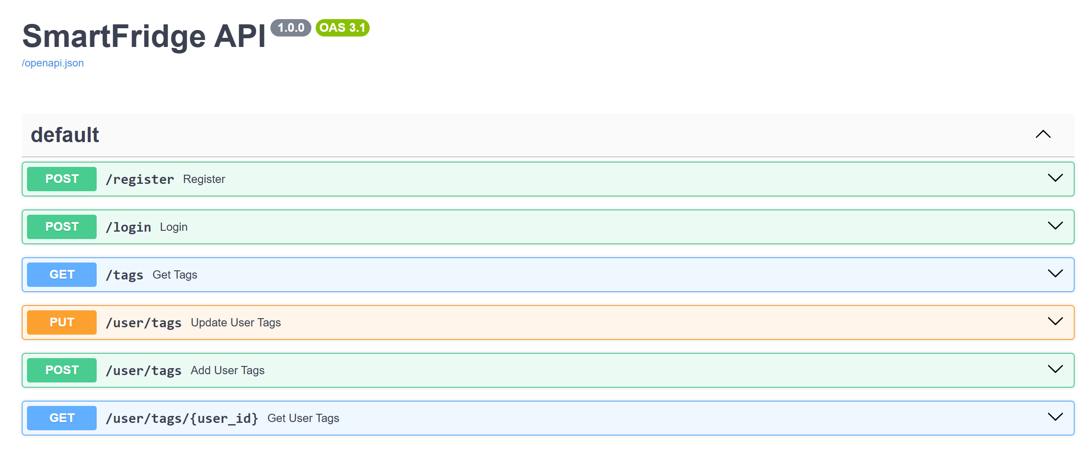
MEMBER B · TAG SYSTEM
User Registration & Tag System
All 6 Endpoints — User & Tag Module
1
POST /register
Goal Tags
Diet Tags
Region Tags
bcrypt hash → 201 / 409 on dup email
Muscle Gain
Low-Carb
Cantonese
2
POST /login
High-protein recipes
Keto-friendly options
Mild, steamed style
Verify password → JWT token (24h)
Fat Loss
Vegetarian
Sichuan
3
GET /tags
Low-cal, balanced macros
Plant-based only
Spicy, bold flavours
Returns goal / diet / region lists
Maintain
Light
HK Style
4
POST /user/tags
Balanced daily intake
Low-oil, steamed
Cha chaan teng fusion
Write USER_TAG · idempotent
Western
5
PUT /user/tags
Grilled & baked
Atomic: delete old → insert new
6
GET /user/tags/{user_id}
JOIN query → full tag details
🔐 bcrypt · JWT HS256 (24h) · 409 dup email · 401 unified · CORS for :3000 | Tables: USER · TAG · USER_TAG (SQLAlchemy ORM)
Member B · 7 / 15

