Slide 1

What data analysis is and how data analysis work
Methods to get valuable information.
What algorithm of Singular Value Decomposition (SVD) is.
What we get from matrix data by SVD
Test the accuracy of this SVD.

Slide 2
What is data analysis? and How does it work
Data analysis is a process of collecting, collating, processing and analyzing data purposely based on business purposes
First, refine data to remove unimportant data and get necessary data
Second, get valuable and latent information from the analysis of refined data
Third, give customers accurate service through valuable and latent information

Slide 3

Experiment for data analysis
For costumers. A man like cookies and sugared latte. who watched 80% humorous movies, 5% scared movies and 15% action movies from the history of google account. He prefer to eat food at home with friends.
For service industry
Analyze this, we found this person has high percentage of liking sugared food and humorous things.
So we should provide the customer with humorous activities and sugared food such as sugared milk.

Slide 4
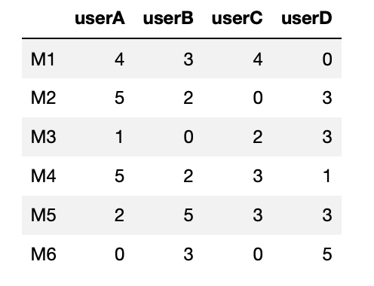
Methods to get valuable information from data of matrix type
Use Algorithm to decompose the data of type of matrix to get useful information.
Some useful algorithms:
Eigenvalue decomposition for M*M matrix as 3*3
Singular value decomposition (SVD)for N*M as 5*7 and M*M as 3*3
This is data about four users rated for six movies

Slide 5
What we get through this Data.
This is data about four users rated for six movies. 6x4
What we get through this Data.
Similarity of each users and each movies
Predicted Value of ratings of movies for users

Slide 6

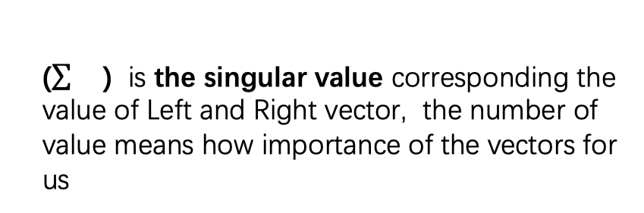
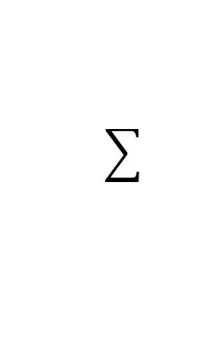
What is Singular value decomposition ?
SVD as a way of analysis data is practical and popular at present.
MxN
MxM
MxN
=
x
x
NxN
A
U
Vt
A is the data of matrix MxN
U is the left singular vector containing some information of the A that we need
Vt is the right singular vector containing some information of the A that we need
() is the singular value corresponding the value of Left and Right vector, the number of value means how importance of the vectors for us

Slide 7
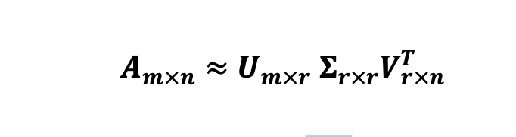
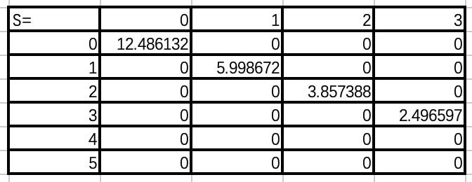
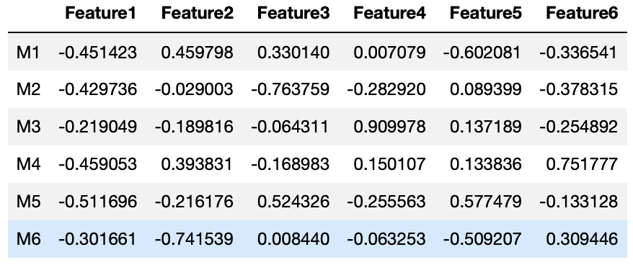
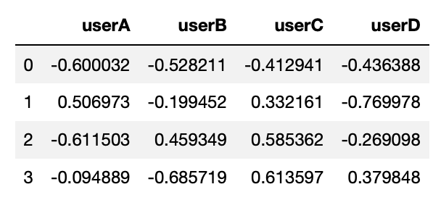
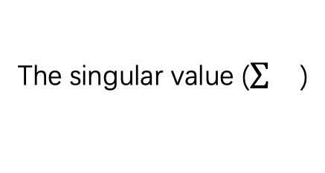
Refine and analysis data
A is decomposed by SVD
A is decomposed by SVD
6x4 = 6x6. 4x6 . 4x4
6x4 = 6x2. 2x2. 2x4
Vt is the right singular vector about users.
Vt is the right singular vector about users.
Here U is the left singular vector about Movies
Here U is the left singular vector about Movies
The singular value ()
The singular value ()

Slide 8


Examples for necessary information. How this woman looks like?

Slide 9
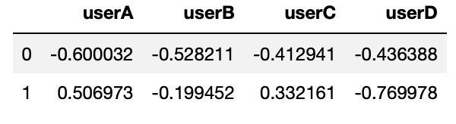
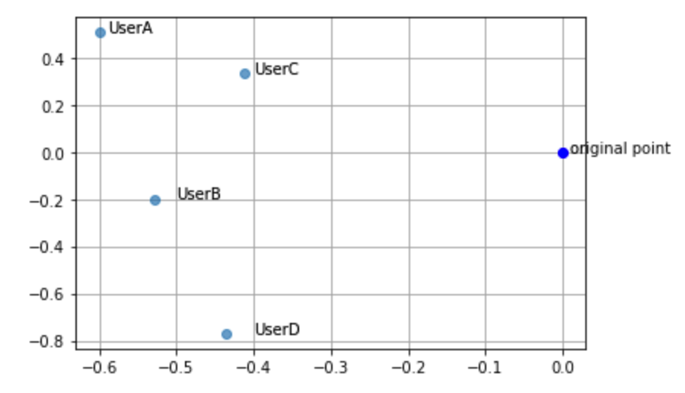

To get Similarity for each users, by using features from data analysis
Feature
Feature
Cosine similarity
⌀
0 row represents the x-coordinate of users
1 row represents the y-coordinate of users

Slide 10
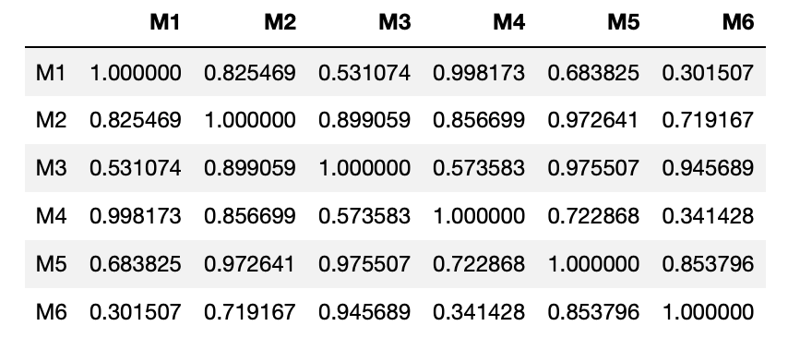
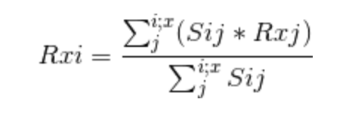
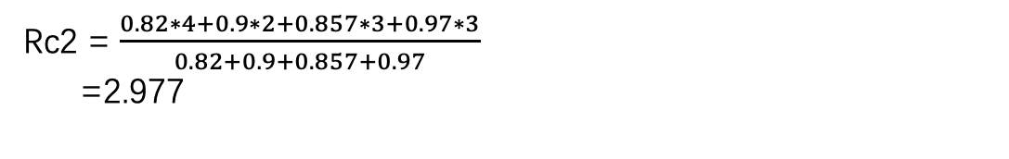
Similarity between movies
Get the predicted value of unrated movies for users
$\frac{\text{The} \text{values} \text{of} \text{rating} \text{movies}\text{ ∗ }\text{The} \text{similarity} \text{of} \text{M}\text{2 }\text{with} \text{each} \text{rated} \text{movie}}{The sum of similarity of m2 with each rated movie}$.
Rc2 = $\frac{0.82∗4+0.9∗2+0.857∗3+0.97∗3}{0.82+0.9+0.857+0.97}$
=2.977

Slide 11
The accuracy of this SVD for analysis Data
Separating the data of users rating on movies into two data for train and test. For example, the proportion of them is 70% and 30%.
Use RMSE and MAE to test the accuracy for this.
Core : The difference that comparing the predicted value from 70% train data with real value from the 30% data.

Slide 12
Introduction of RMSE And MAE
RMSE
Root Mean Square Error, is the square root of the ratio of the square of the deviation of the observed value from the true value to the number of observations m, is the deviation between a reasonable observation and the true value
MAE
Mean Absolute Error, is the maximum absolute error, can better reflect the actual situation of the prediction error.

Slide 13
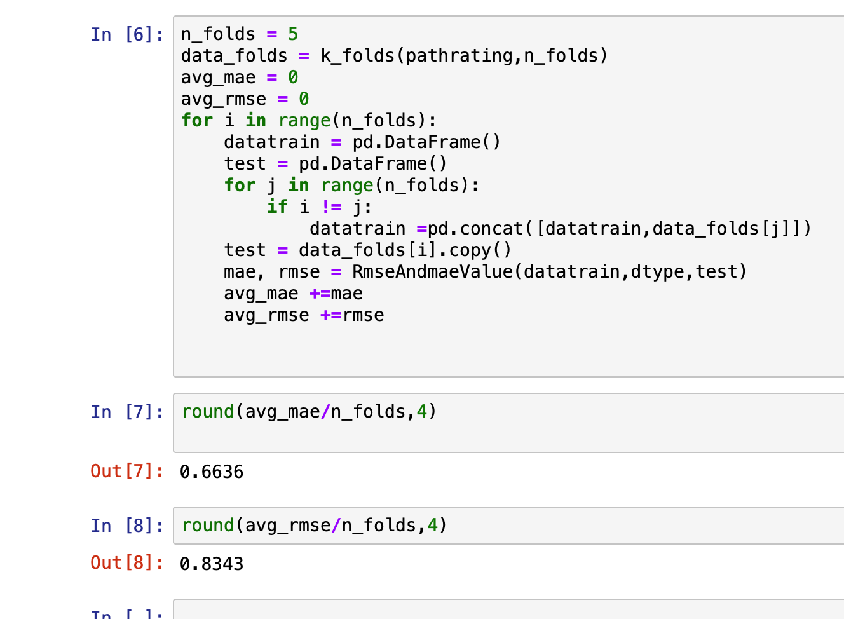
The real experiment of this two methods to test accuracy for SVD
I get the average Values of RMSEs and MAEs are 0.8343 and 0.6636 when I take 100 users and 15,448 ratings as data and set K as 5.

