Slide 1
Generate metabolic model
Metabolite ID conversion
Mapped to BIGG database via InChI Key (international chemical identifier)
270 out of 1511 metabolites are identified
Create Mega Medium profile
(identified by metabolomics) Metabolites present in MM in at least one experiment
(identified by protocol) Metabolites explicitly mentioned in the protocol
Eventually, we can identify 130 bigg ids
Run CarveMe to generate draft model
Gapfill to grow on MM
Customized gapfilling draft model using metabolomics
Use t-test to find metabolites with significant log2(fold change)
Add reactions from universal pool to fulfill minimum uptake or secretion fluxes

Slide 2
Three steps to identify fluxes given model
Caveat:
Fix growth rate to the observed value
For exchange reactions that show significant fluxes in data, try to force minimum fluxes through them
For other exchange reactions, try to turn them off as many as possible.

Slide 3
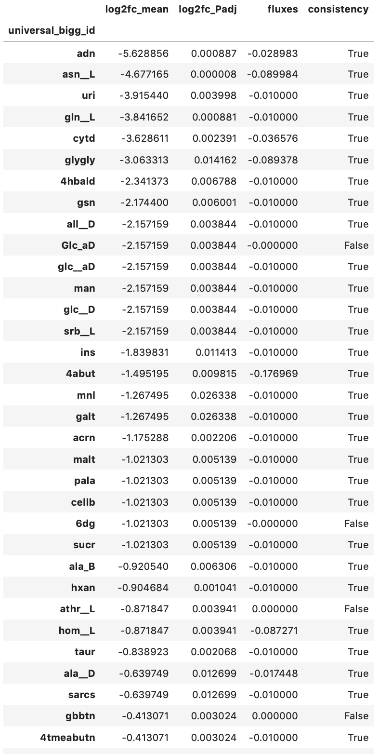
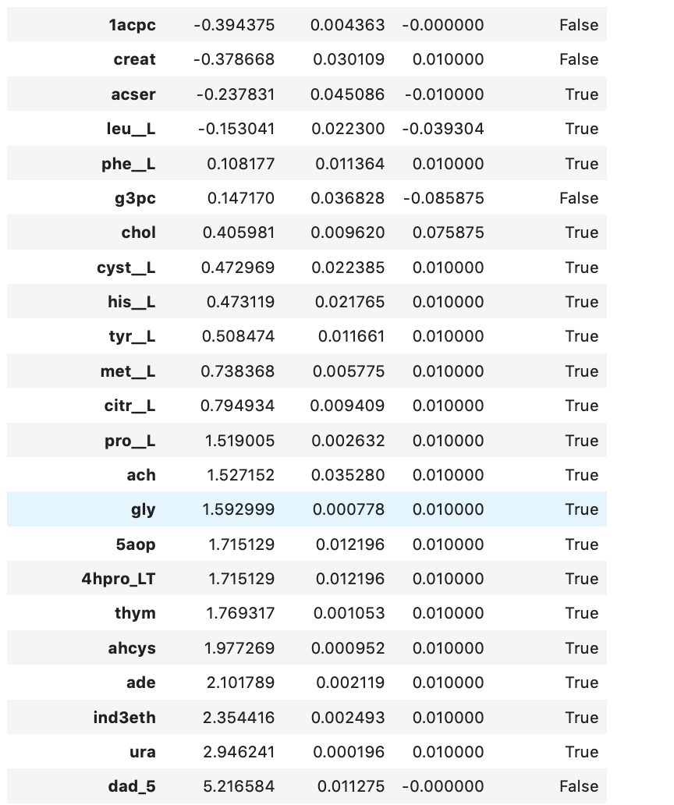
Bacteroides fragilis 3_1_12
8 out of 56 reactions are inconsistent

