Slide 1
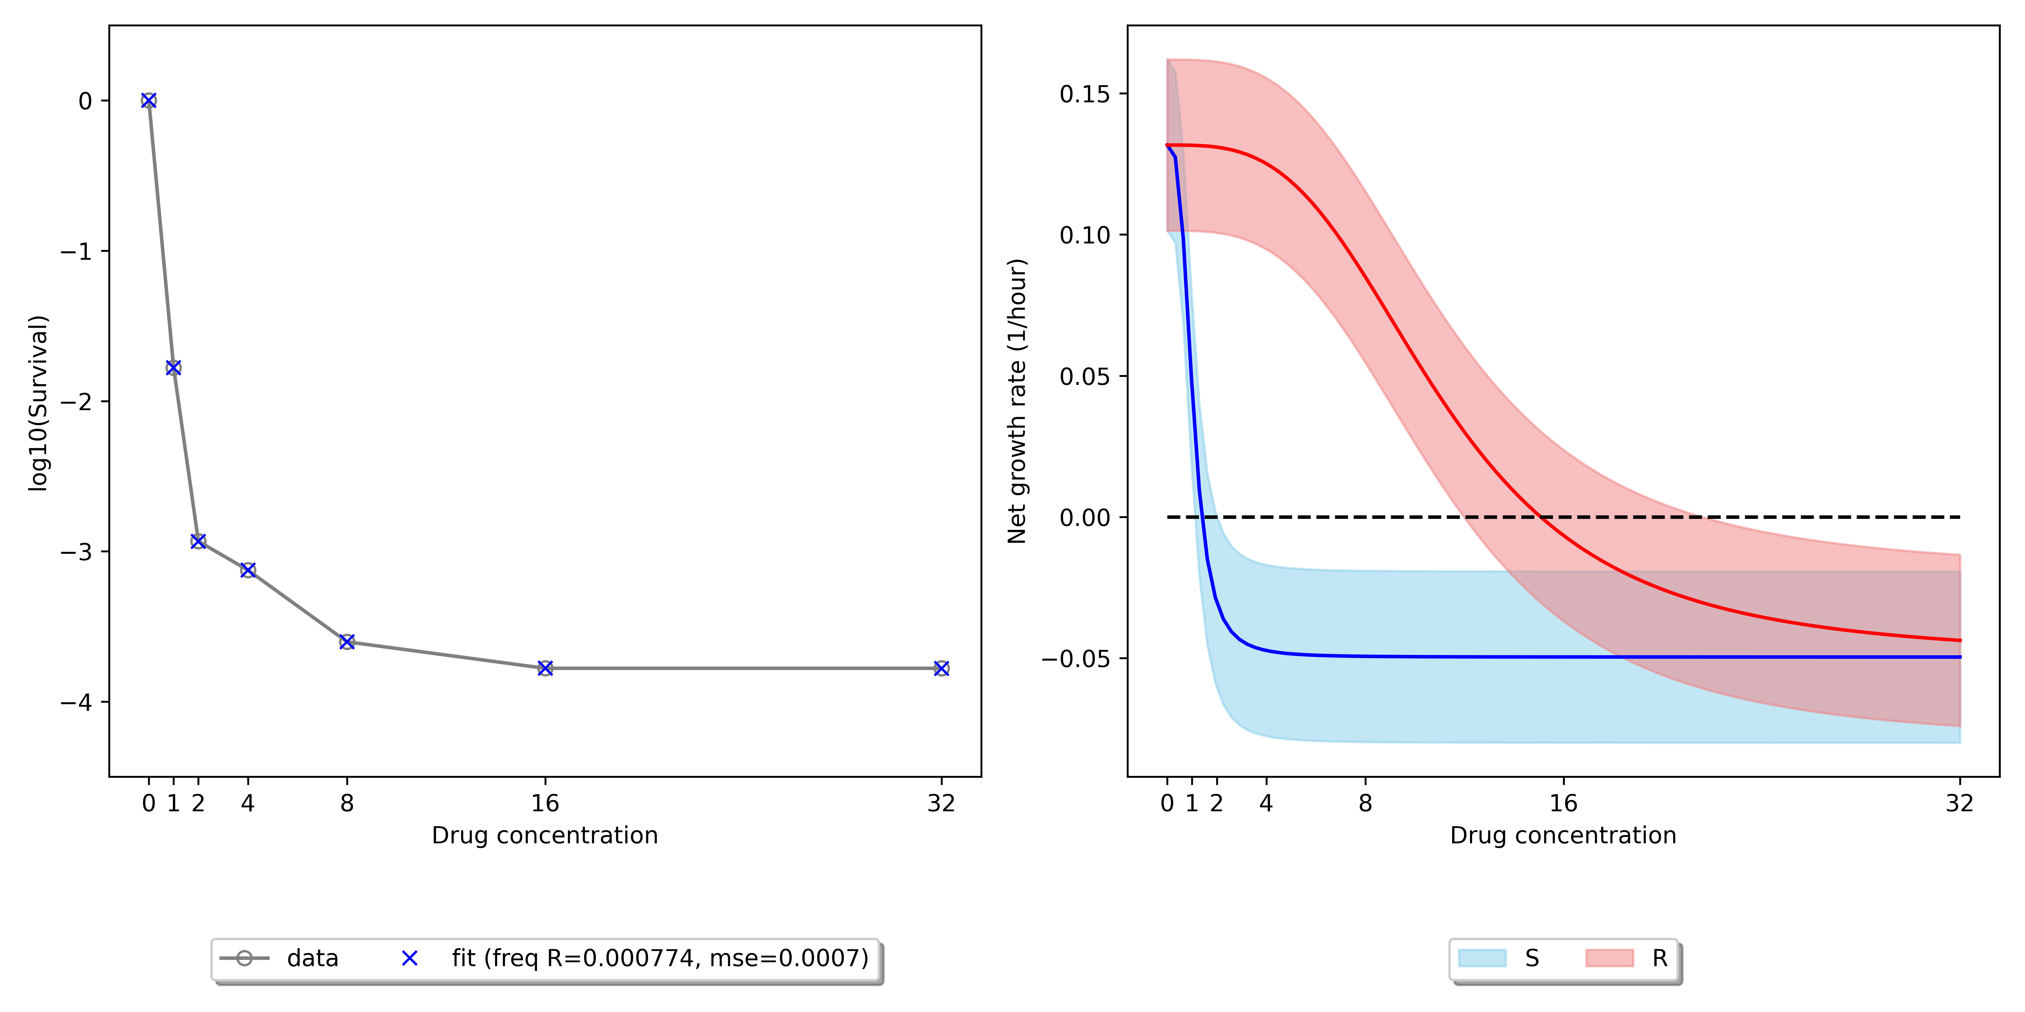
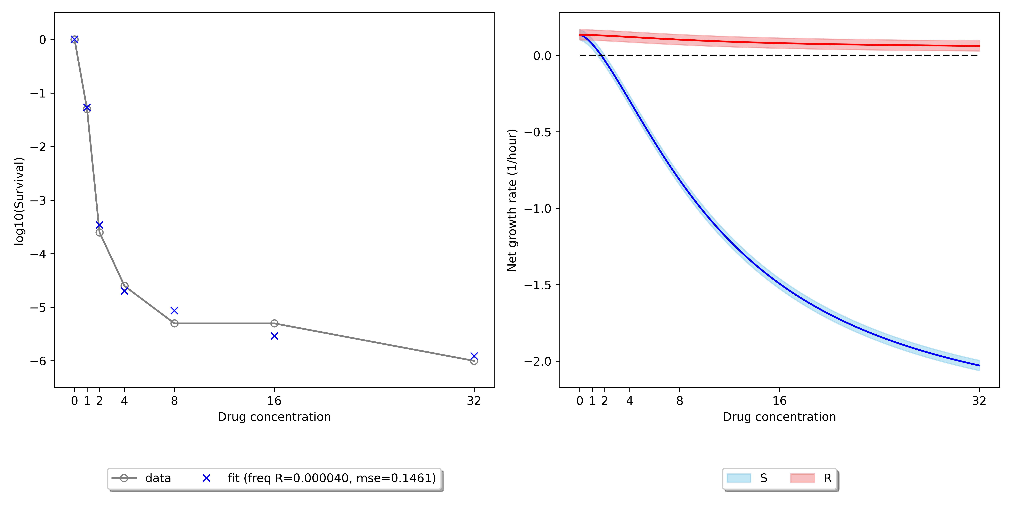

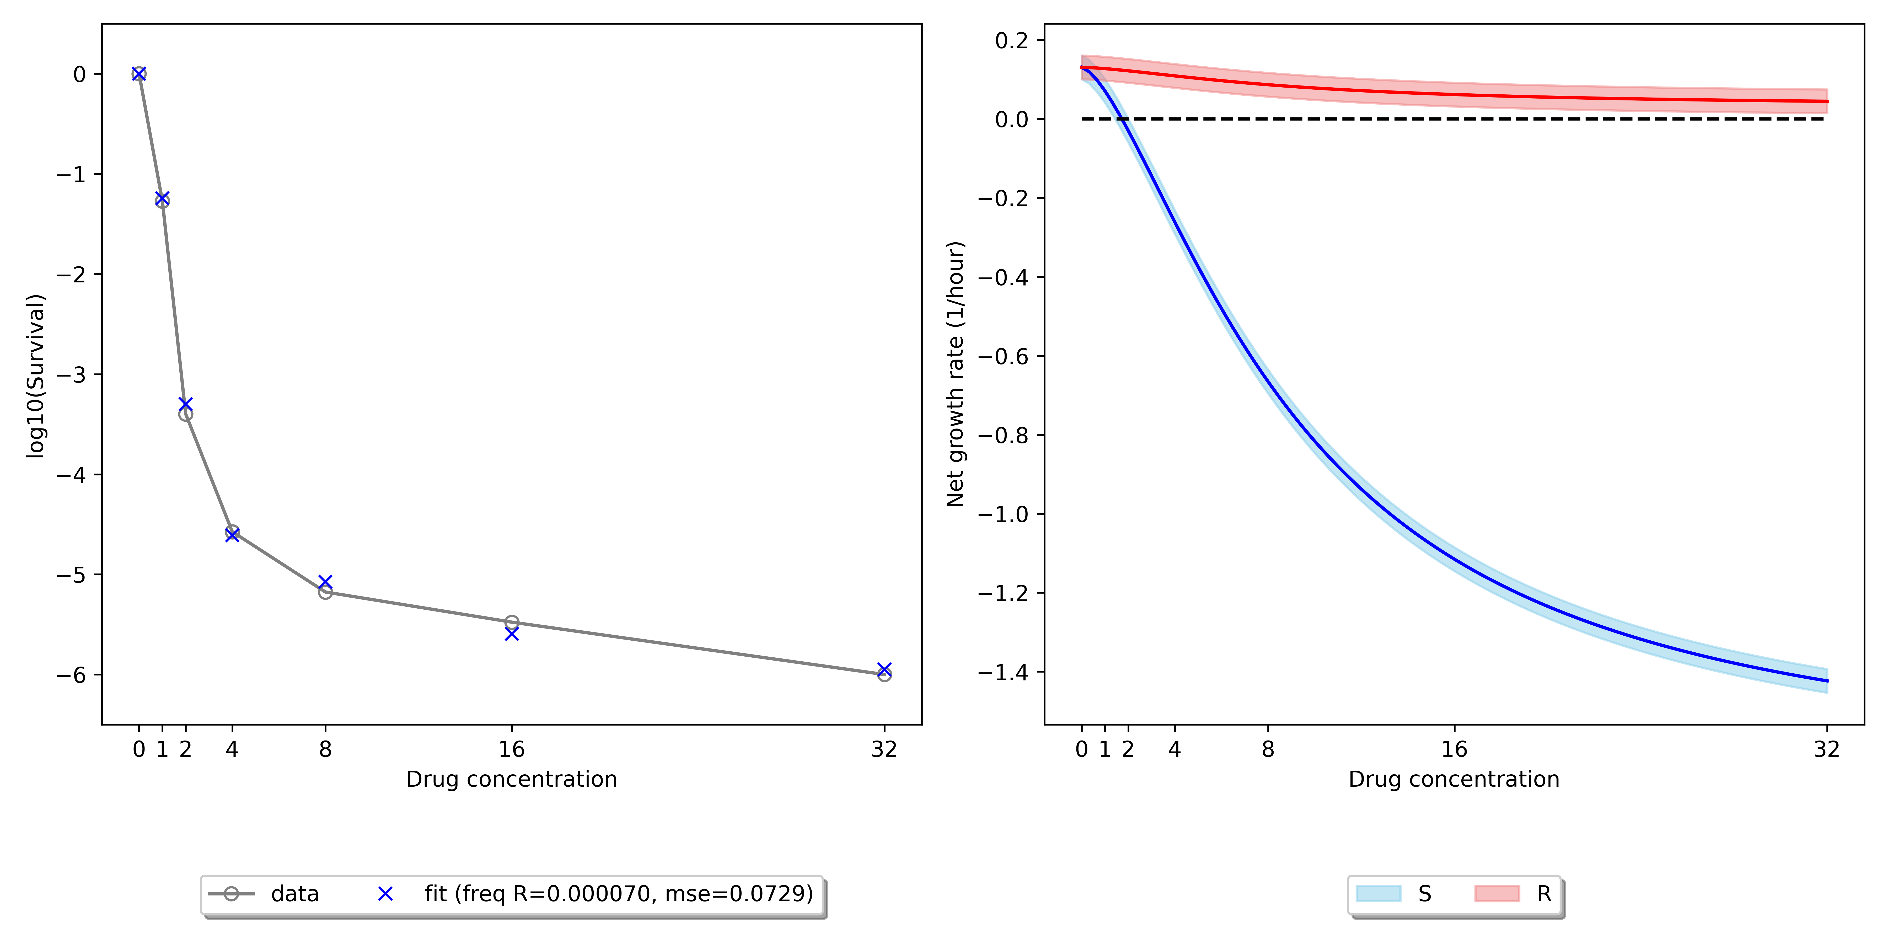
Repeat 1
Repeat 4
Repeat 3
Repeat 5
Repeat 1 and 3 are consistent, and repeat 4 and 5 are consistent
Compared to 1/3, repeats 4/5 have lower R frequency but its susceptible population has slightly higher MIC (~2, compared to 1.5). Despite higher MIC, repeat 4/5’s susceptible population is less tolerant. This explains why 4/5 have higher survival ratio at MIC=1 but lower ratio at MIC>=2.

