Slide 1
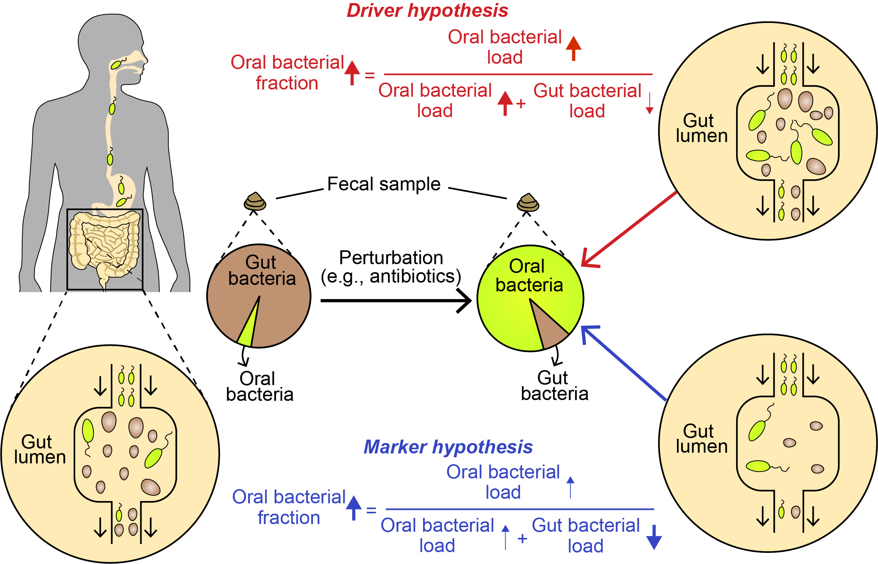
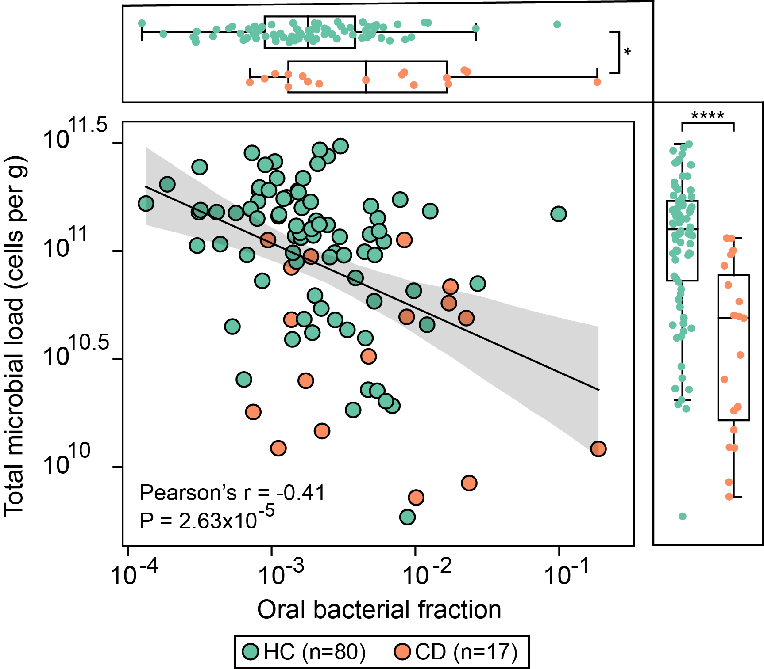
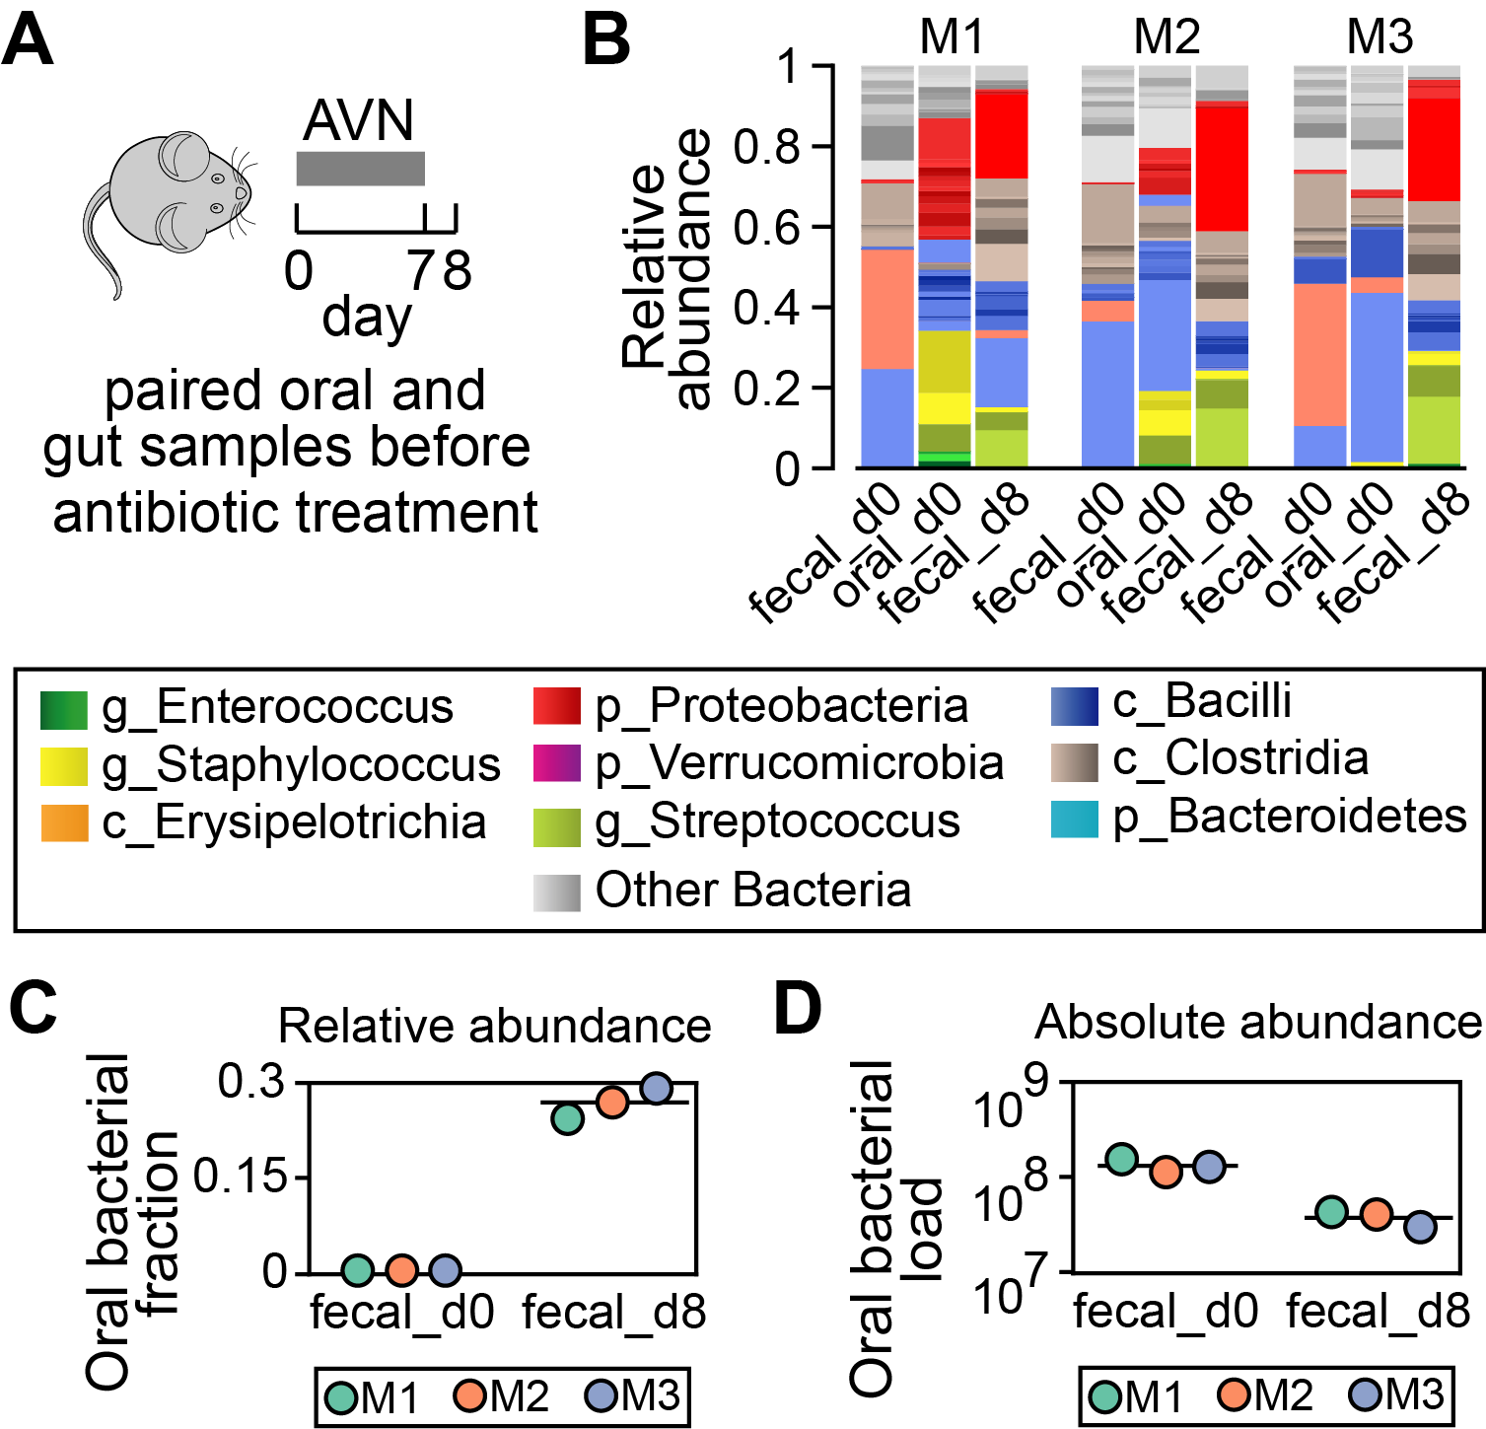
Relative enrichment of oral bacteria in feces: The Driver vs. Marker hypothesis
Chen Liao¹, Thierry Rolling^{1,2}, Ana Djukovic¹, Hongbing Liu³, Lei Dai³, Bing Zhai^{1,3}, Jonathan U. Peled^{1,4}, Marcel R.M. van den Brink^{1,4}, Tobias M. Hohl^{1,4}, and Joao Xavier¹
¹MSKCC, NY; ²University Medical Center Hamburg-Eppendorf, Germany; ³Shenzhen Institute of Synthetic Biology, China; ⁴Weill Cornell Medical College, NY
Background: increased relative abundance of oral bacteria in human feces is a robust biomarker of intestinal disorders
Evidence: human receicing allogeneic hematopeitic stem cell transplantation
An average person swallows ~10¹¹ of oral bacteria cells per day but oral bacteria remain rare in the healthy gut. Gastric acids, alkaline biles and antimicrobial peptides kill many of those, and the few survivors must overcome the commensal microbiome’s ability to resist colonization. As a result, compositional sequencing data shows typically <2% of DNA from oral bacteria in the feces of healthy people. Antibiotics, diet, aging and gut inflammation can cause disrupt the oral-gut barrier and cause relative enrichment of oral-associated bacteria in the the feces. The enrichment has been repeatedly observed in patients with a variety of diseases, including Crohn’s diseases, ulcerative colitis, colorectal cancer, liver cirrhosis, etc. However, nearly all the associations were obtained from compositional data, which gives relative abundance that—by itself—can neither determine if there was an expansion of oral bacteria in absolute numbers nor reveal the true causse of human disorders.
Question: which of the driver or marker hypotheese is true?
Simple mathematics leads to two alternate explanations (Fig. 1): In the driver hypothesis, the relative abundance informs absolute abundance, and the relative enrichment reflects active expansion of oral bacterial population in the gut. When the oral population reaches sufficiently high density, they may cause the disorders. By contrast, the relative enrichment is driven by loss of gut commensals in the marker hypothesis, and it is this bacterial loss that causes the disorders. Determining which hypothesis is true has implications for our understanding of human health and pathologies.
The marker hypothesis unifies competing microbiome biomarkers of IBD
Evidence: paired oral-gut samples from mouse experiments receiving antibiotic cocktail
Our findings support the marker hypothesis, i.e., the relative enrichment of oral bacteria in feces indicates loss of gut commensals and it is the bacterial loss that impacts host health. Recognizing that the increased relative abundance of oral bacteria in the gut does not reflect an ectopic bloom will critically inform the interpretation of microbiome compositional data and future microbiome-based interventions to treat intestinal disorders.

