Slide 1


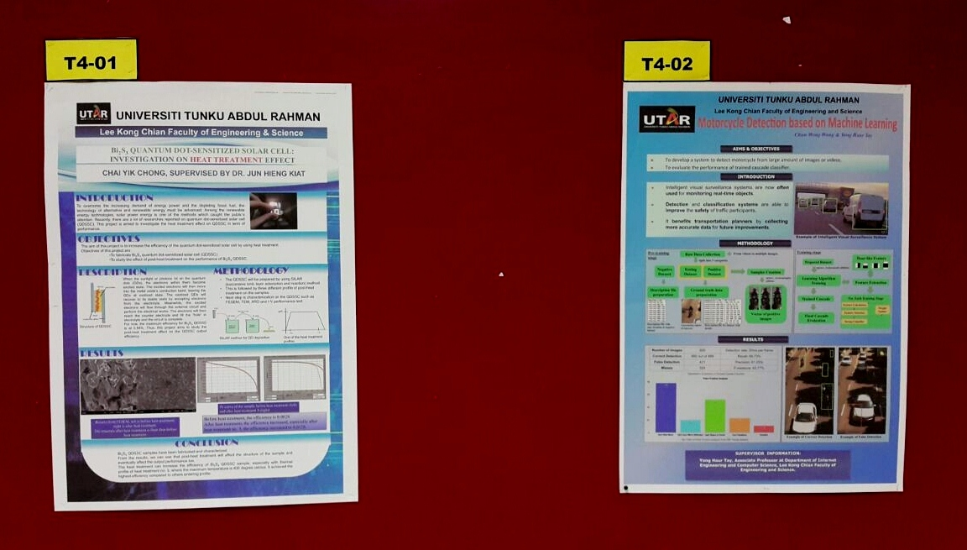
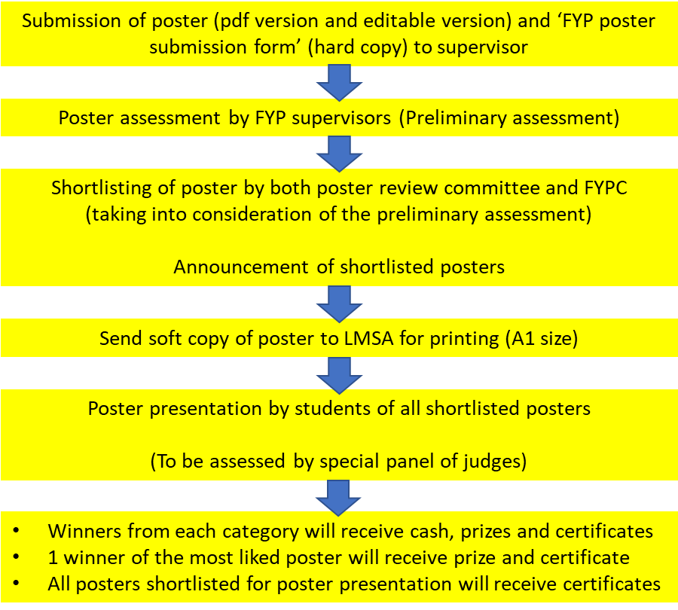
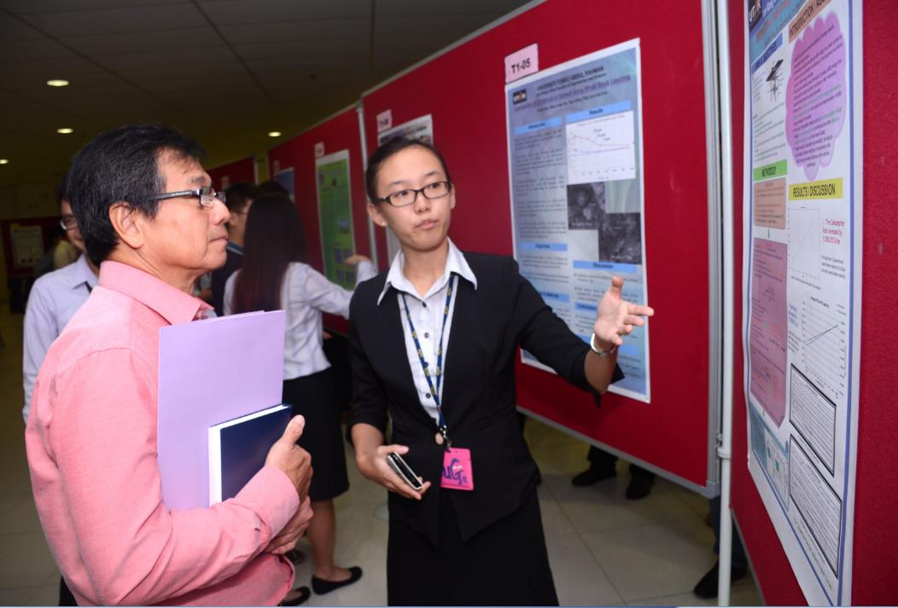
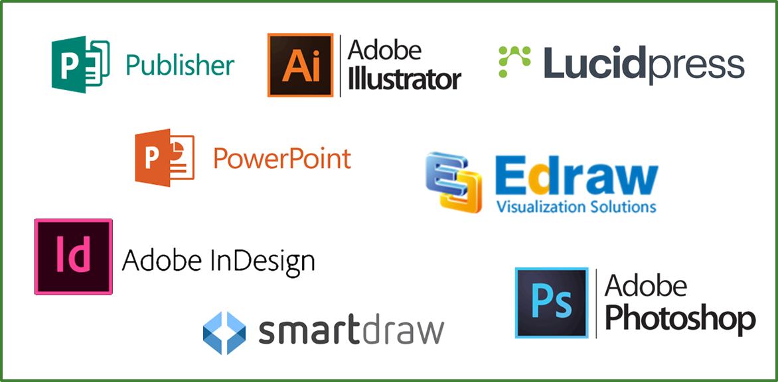
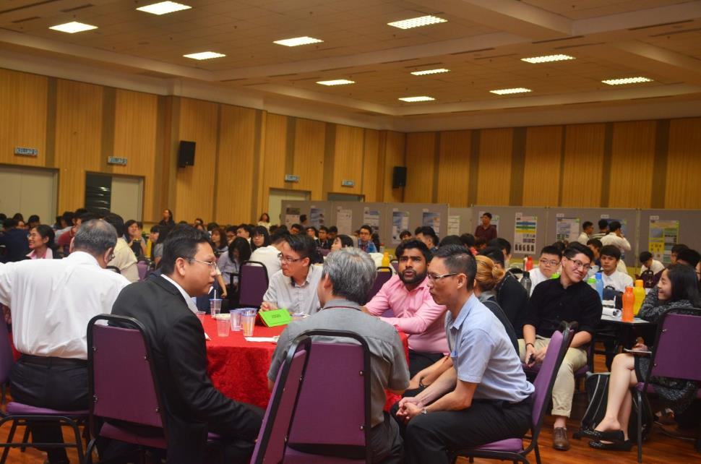
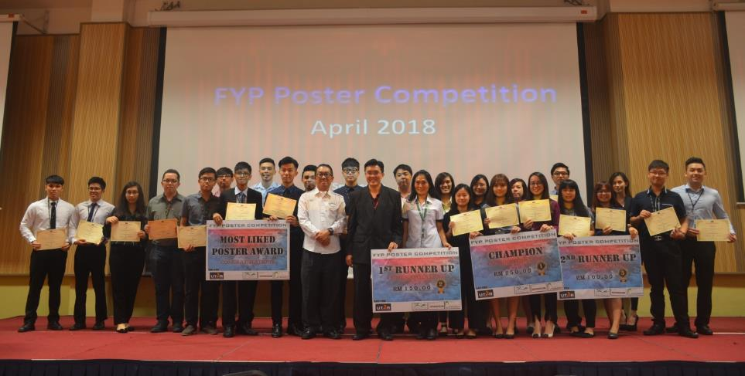
UNIVERSITI TUNKU ABDUL RAHMAN
Lee Kong Chian Faculty of Engineering and Science
The Title of the Poster, in Bold Letters
Student name, Supervisor name and Co-supervisor name
ABSTRACT
The title must accurately reflect the subject matters, while the purpose and objective must be clearly and accurately explained. The Introduction/Abstract should provide a clear overview of the project. It must describe accurately without any lacking of content. The information should be relevant to the stated area/track .
(You are free to change the font, text size, arrangement and number of figures/tables in the template. When inserting graphics or equations, keep the resolution high. You are also free to use coloured backgrounds, but they generally reduce readability)
OBJECTIVES
Figure 1: Example of poster on the board during competition
This template provides a guideline for the preparation of posters for LKC FES FYP poster competition.
The poster must be saved in Portrait A1 (594 mm × 841 mm) format.
METHODOLOGY
Method must be very well stated. The graphics and visuals should convey the intended information which improve understanding of the content. The content should be clear, easy to understand and convey the intend without verbal explanation. Besides, it should be well organized and convey the intend without any narration.
(You may refer to some of the attached examples for reference.
Figure 2: SOP for FYP Poster Competition
RESULTS & DISCUSSION
Table 1: May 2021 FYP Poster Submission Details
T
DONT FORGET TO ADD
MORE GRAPHICS/ VISUALS IF NEEDED.
REMOVE ALL THE EXTRA /UNWANTED PART(S).
Item | Details
Submission Deadine | 27 August 2021
Poster Tracks | Categorized by department
Poster Design Reference | How to create a better research poster in less time? http://tiny.cc/usmj9y
Figure 4: Student presenting her FYP Poster.
Figure 3: Software and tools for poster design
Most Liked Poster Award: Vote for your favourite poster between 9-16 Sept 2021 (9am). Log on to LKCFES FYP Website for the voting link in week-14.
Figure 5: Winners of 201801
Figure 6: Prize giving ceremony.
ADD
MORE
GRAPHICS

