Slide 1


论文阅读
考生姓名
汇报人
穆文博
汇报时间
2025.10.24

Slide 2
01
Simba: Scaling Deep-Learning Inference with Chiplet-Based Architecture (2019 MICRO, NVIDIA)
目 录
02
Gemini: Mapping and Architecture Co-exploration for Large-scale DNN Chiplet Accelerators (2024 HPCA, Jingwei Cai, Tsinghua University)
CONTENS
03
THERMOS: Thermally-Aware Multi-Objective Scheduling of AI Workloads on Heterogeneous Multi-Chiplet PIM Architectures (2025 TECS)

Slide 3
01
Simba: Scaling Deep-Learning Inference with Chiplet-Based Architecture
Part one

Slide 4

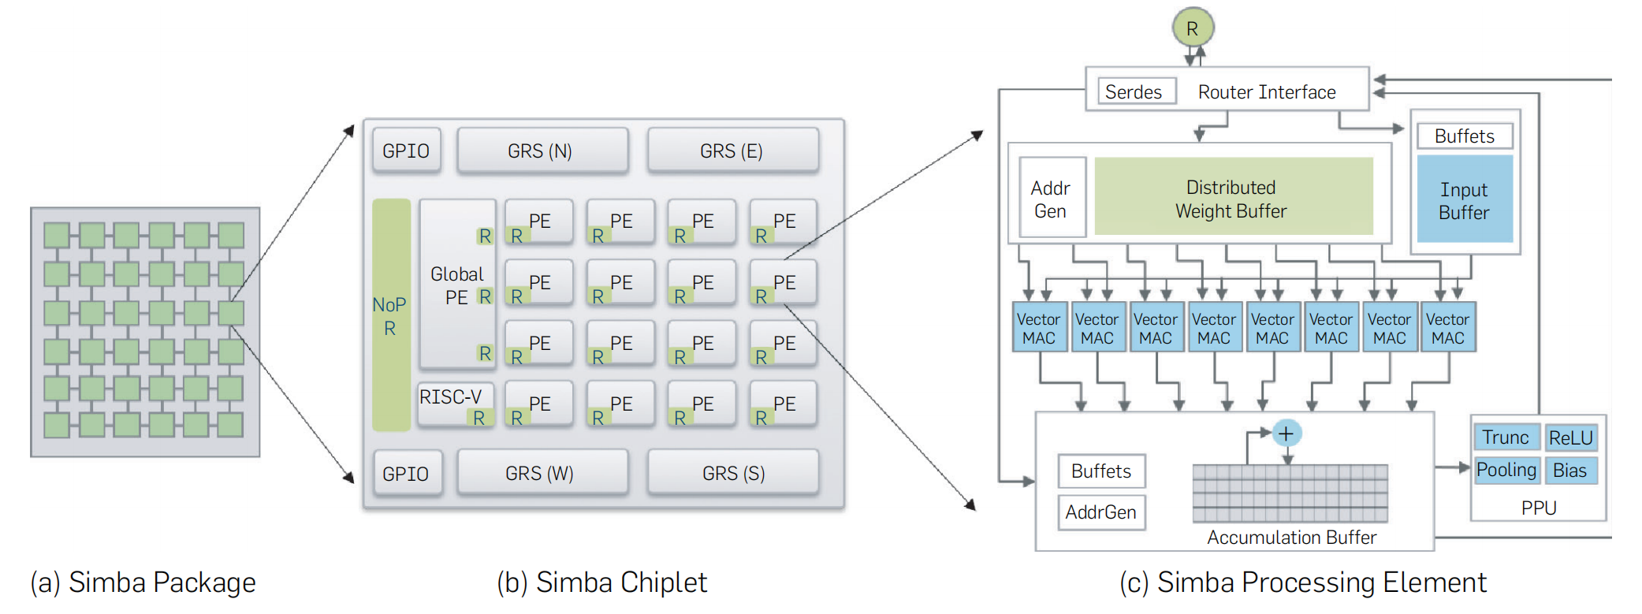
Simba: Scaling Deep-Learning Inference with Chiplet-Based Architecture
Simba 架构
Part 1

Slide 5
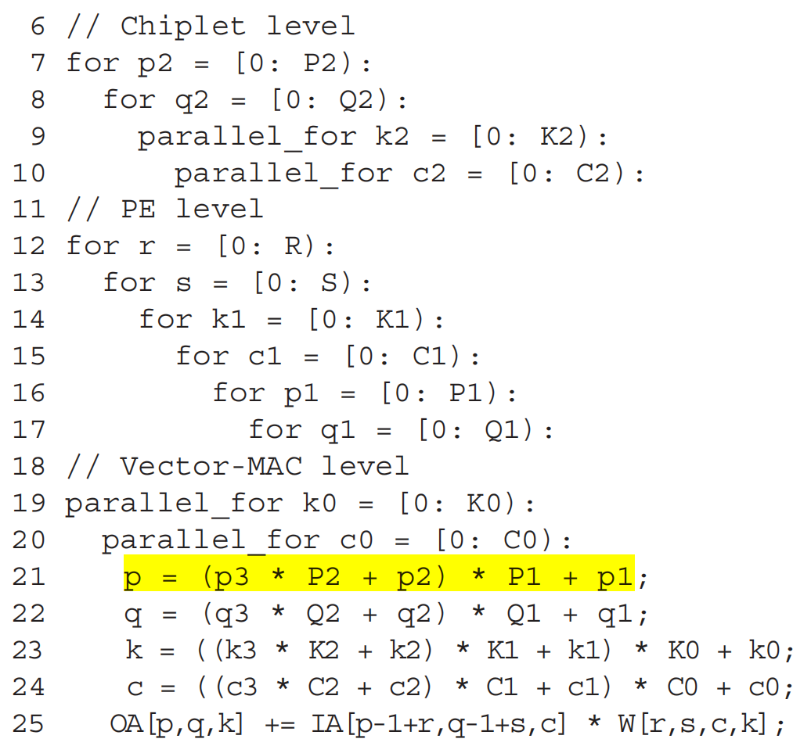
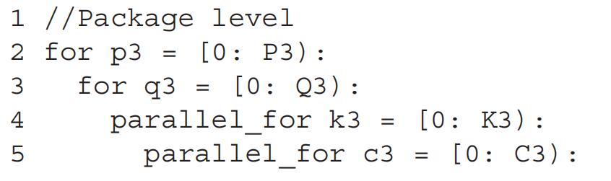
Simba: Scaling Deep-Learning Inference with Chiplet-Based Architecture
Baseline DNN 映射策略：均匀分块 (Uniform Tiling)
DNN 层的每个维度 (如 C, K, P, Q) 可以在系统的每个层级 (Package, Chiplet, PE, Vector-MAC) 上进行时间或空间分块。
默认数据流：在输入通道 (C) 和输出通道 (K) 维度上均匀划分权重，以利用并行性。
Part 1

Slide 6
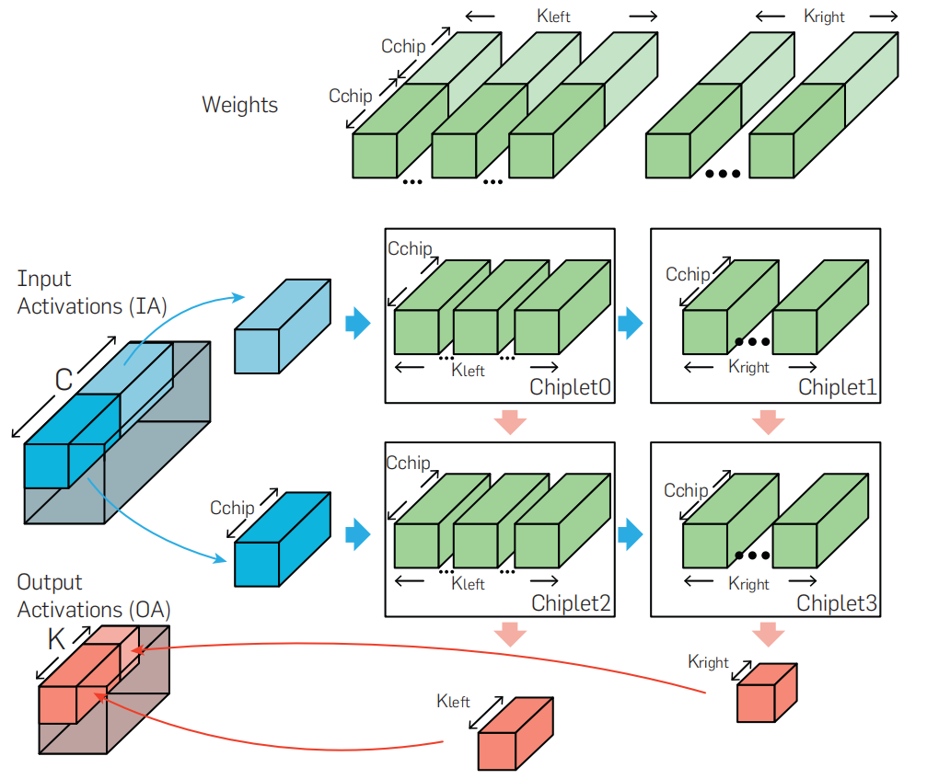
Simba: Scaling Deep-Learning Inference with Chiplet-Based Architecture
Mapping优化方法1：非均匀工作分区 (Nonuniform Work Partitioning)
目标：
解决由不同通信延迟引起的尾延迟问题。
Part 1

Slide 7
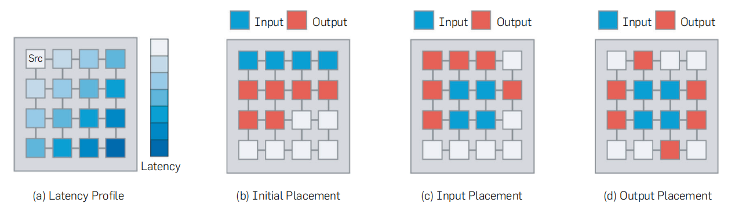
Simba: Scaling Deep-Learning Inference with Chiplet-Based Architecture
优化方法2：通信感知的数据布局 (Communication-Aware Data Placement)
目标：数据的物理存放位置对通信延迟高度敏感。
将需要多播的 IA 数据块放置在封装的中心位置，以最小化到所有 chiplet 的聚合多播跳数；
将 OA 数据块放置在封装的外围区域，以最小化OA通信延迟。
贪心算法 (greedy algorithm)
Part 1

Slide 8
02
Gemini: Mapping and Architecture Co-exploration for Large-scale DNN Chiplet Accelerators
Part two

Slide 9
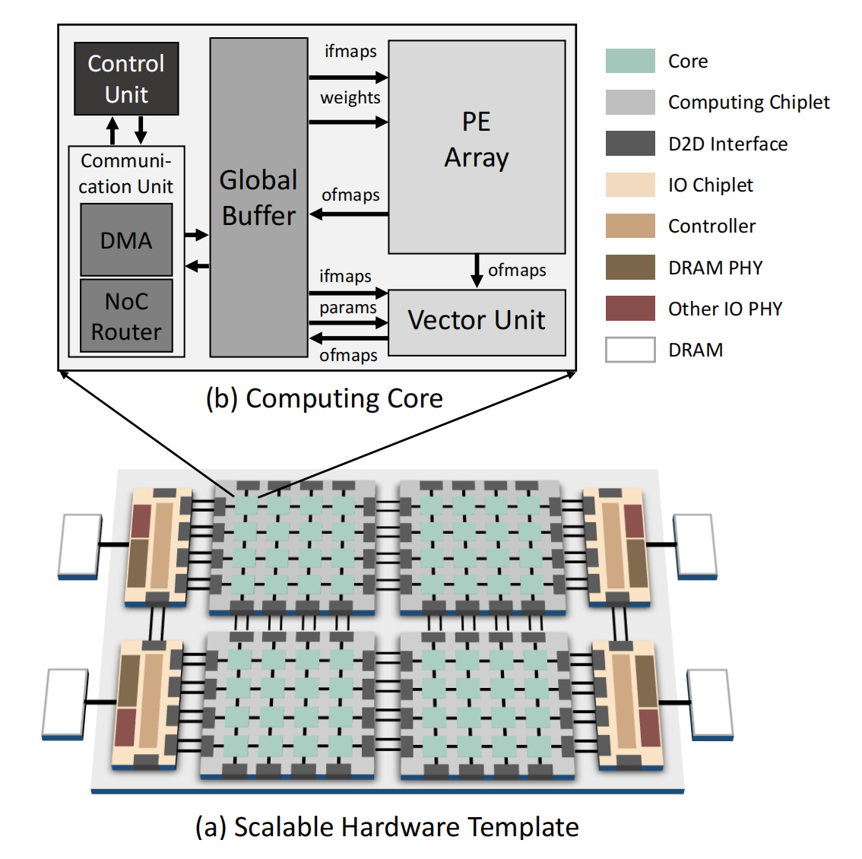
Gemini: Mapping and Architecture Co-exploration for Large-scale DNN Chiplet Accelerators
Gemini 架构
Part 2

Slide 10
Gemini: Mapping and Architecture Co-exploration for Large-scale DNN Chiplet Accelerators
Mapping
Tangram：不同层分组
Layer-Pipeline (LP) spatial mapping scheme：每组具体的映射
Simulated Annealing (SA) algorithm：探索映射空间
Part 2

Slide 11
THERMOS: Thermally-Aware Multi-Objective Scheduling of AI Workloads on Heterogeneous Multi-Chiplet PIM Architectures
03
Part three

Slide 12
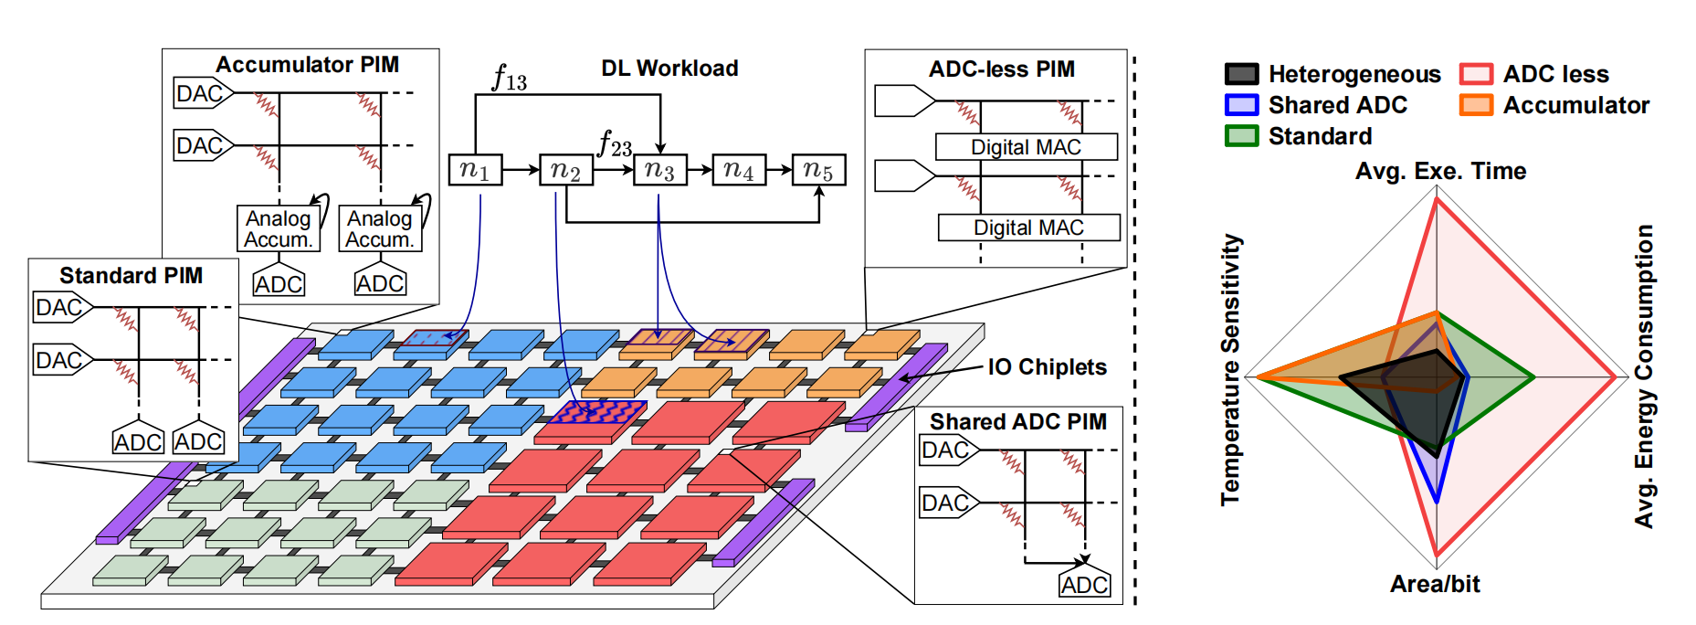
THERMOS: Thermally-Aware Multi-Objective Scheduling of AI Workloads on Heterogeneous Multi-Chiplet PIM Architectures
THERMOS 架构
Standard (ReRAM)：4mm²，Accumulator (ReRAM)：4mm²，温度阈值：330K
Shared ADC (SRAM)：9mm²，ADC-less (SRAM，全数字)：4mm²，温度阈值：358K
(Simba Chiplet：6nm2)
Part 3

Slide 13
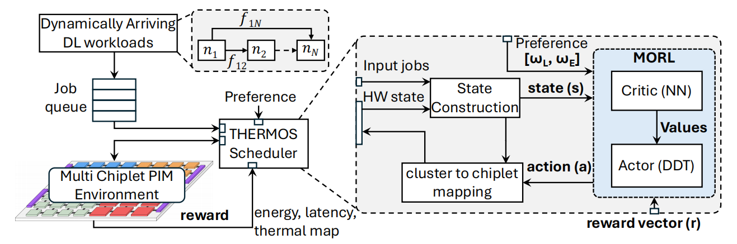
THERMOS: Thermally-Aware Multi-Objective Scheduling of AI Workloads on Heterogeneous Multi-Chiplet PIM Architectures
核心内容
两级调度方法：
Level 1 (重点): 多目标强化学习 (MORL) 策略：选哪种类型的PIM
Level 2: 邻近驱动算法 (Proximity-driven)：映射到具体的Chiplet上
热约束：阈值限流 (暂停该芯片上正在运行的任务，并阻止分配新任务)
THERMOS 框架
Part 3

Slide 14
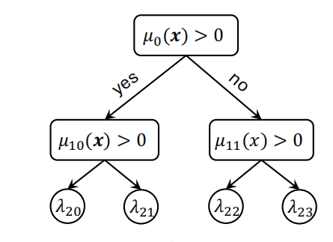
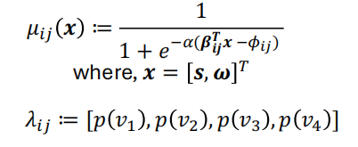



THERMOS: Thermally-Aware Multi-Objective Scheduling of AI Workloads on Heterogeneous Multi-Chiplet PIM Architectures
(Level1) MORL训练机制
问题被定义为马尔可夫决策 (MDP)：元组 (S状态，A动作，P转移概率，R奖励函数，y折扣因子)
模型：Actor-Critic，训练算法：近端策略优化 (PPO)
Actor ($π$): DDT 决策树，负责动作选择 (选簇)
Critic (V): 3层 fc 网络，负责评估 Actor 动作的价值
奖励机制：主要、次要，两次奖励
Part 3
“为高效训练多项目标，我们采用多线程技术并行运行三种偏好设置（最小执行时间、最小能耗以及平衡两者）。每个进程与各自的环境副本进行交互，并收集符合其特定偏好的（S、A、R）元组形式轨迹。在训练周期结束时，这些轨迹将通过公式（4）和（5）所述的损失函数来更新 Actor-Critic 模型”

Slide 15
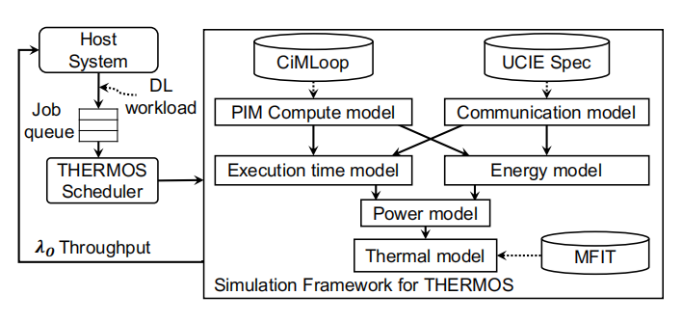
THERMOS: Thermally-Aware Multi-Objective Scheduling of AI Workloads on Heterogeneous Multi-Chiplet PIM Architectures
仿真框架
Part 3

Slide 16
THERMOS: Thermally-Aware Multi-Objective Scheduling of AI Workloads on Heterogeneous Multi-Chiplet PIM Architectures
Baseline 调度算法
Simba：主要调度物理位置相邻的连续层以减少通信开销
Big-Little (单一类型PIM、不同大小阵列尺寸)：工作负载分配给利用率最高的小Chiplet
RELMAS：与Simba类似的架构 + 基于RL的调度算法
Part 3

Slide 17
Thanks!
考生姓名
汇报人
穆文博
汇报时间
2025.10.24

