Slide 1


10.10汇报
考生姓名
汇报人
李旭蕤
汇报时间
2025.10.10

Slide 2
01
Hecaton: Training Large Language Models with Scalable Waferscale Chiplet Systems （THU）
目 录
CONTENS

Slide 3
Hecaton: Training Large Language Models with Scalable Waferscale Chiplet Systems
01
Part one

Slide 4

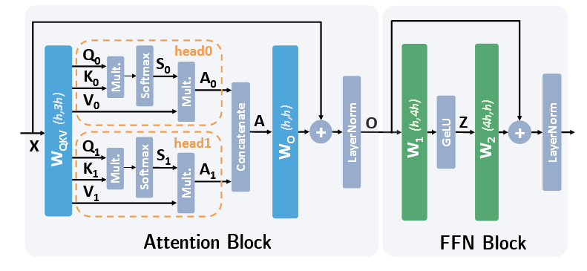
1 Hecaton: Training Large Language Models with Scalable Waferscale Chiplet Systems
1.1 intro
是第一篇系统讨论如何使用 Chiplet 训练LLM的工作
减少通信量：将全芯片全局通信简化为 “列内 /all-gather + 行内 /reduce-scatter”，仅局部通信，NoP 开销降低。
Part 1

Slide 5
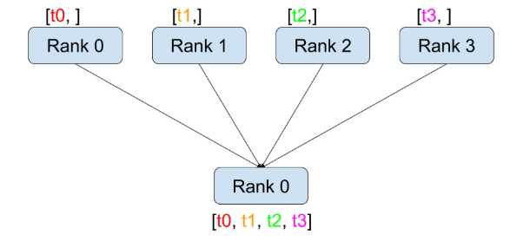
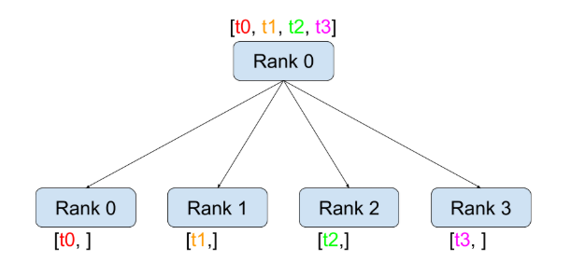
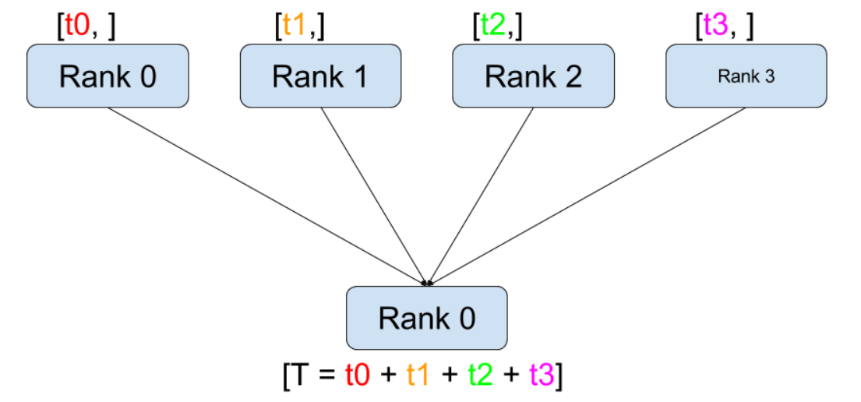
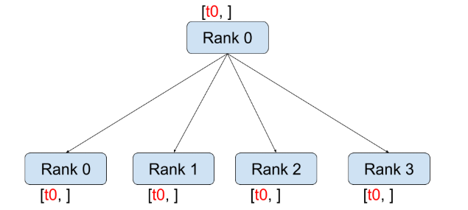
1 Hecaton: Training Large Language Models with Scalable Waferscale Chiplet Systems
1.1 intro
scatter
gather
Part 1
broadcast
reduce

Slide 6
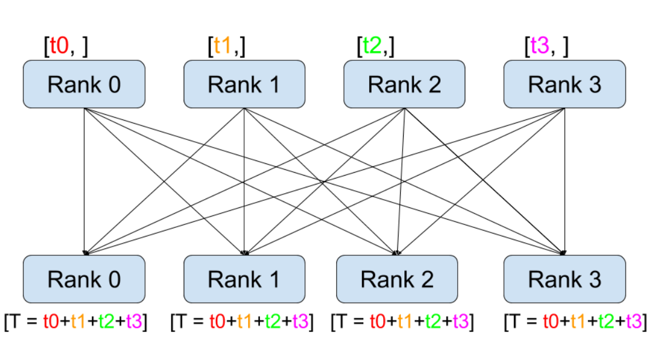
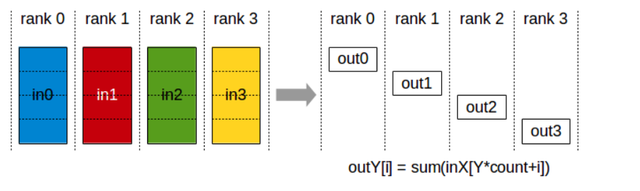
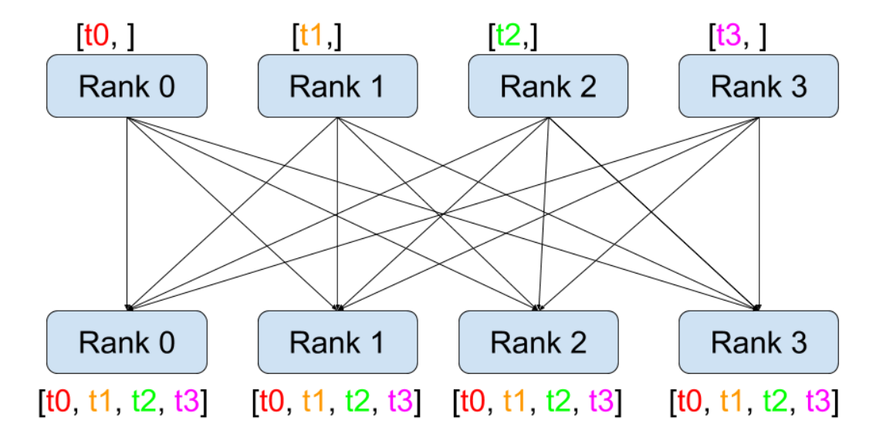
1 Hecaton: Training Large Language Models with Scalable Waferscale Chiplet Systems
all-reduce ：reduce + broadcast
reduce-scatter ：先 reduce + 再 scatter
Part 1
all gather ：gather + broadcast

Slide 7
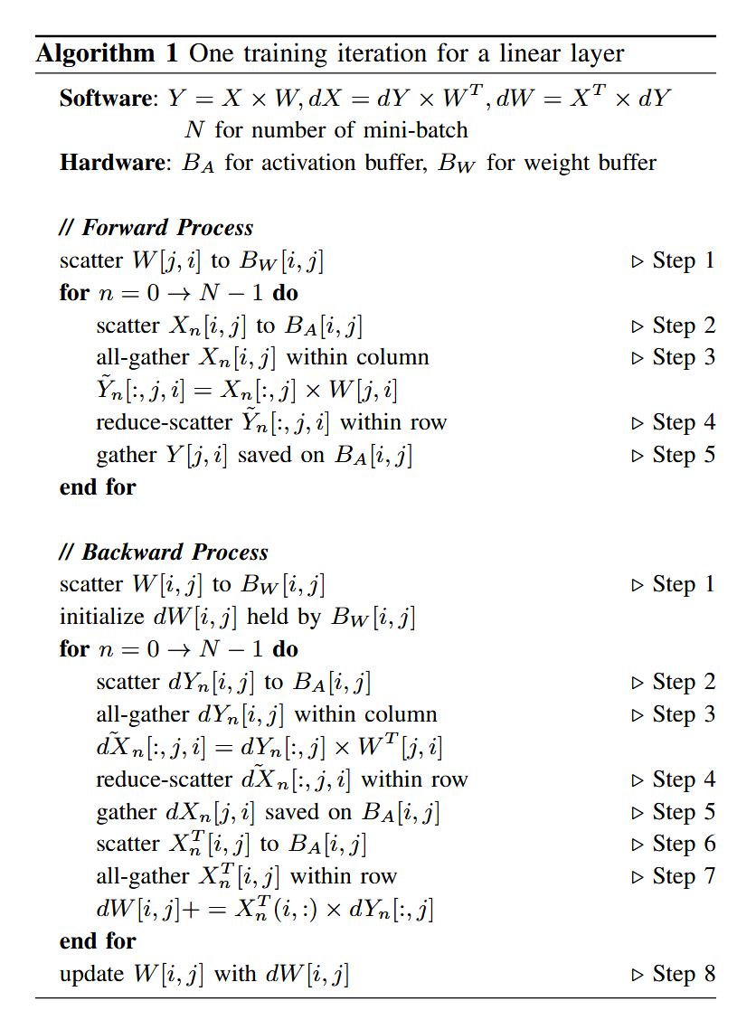
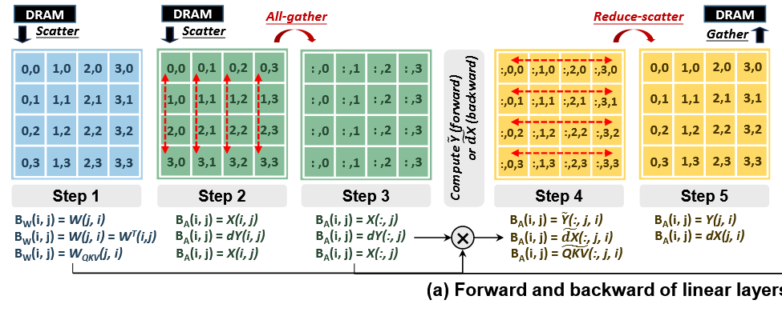
1 Hecaton: Training Large Language Models with Scalable Waferscale Chiplet Systems
Part 1

Slide 8
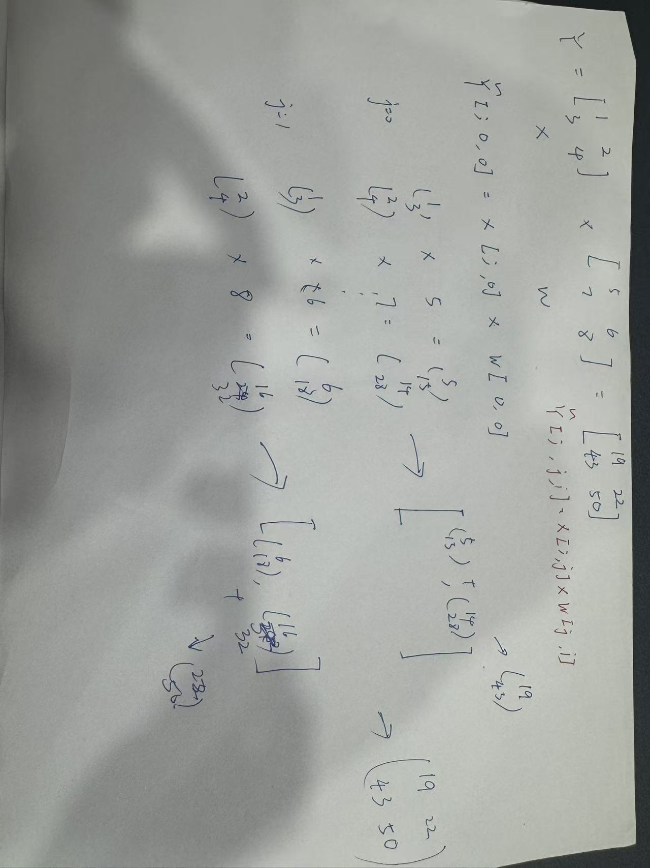
1 Hecaton: Training Large Language Models with Scalable Waferscale Chiplet Systems
reduce
Part 1
Scatter

Slide 9
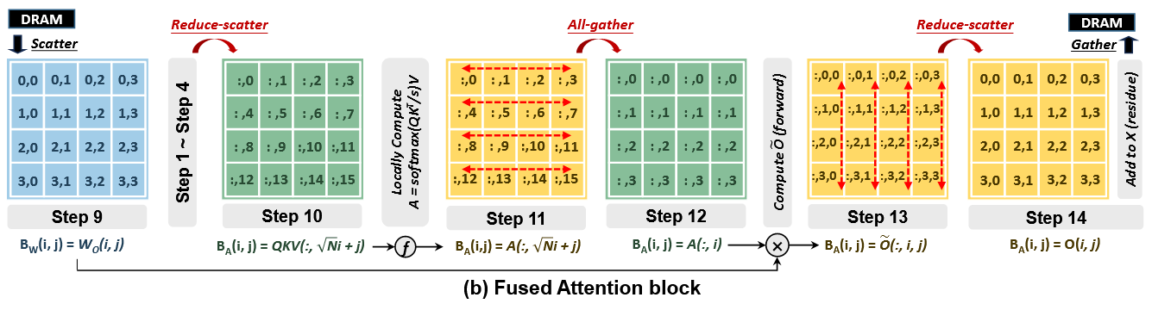
1 Hecaton: Training Large Language Models with Scalable Waferscale Chiplet Systems
Part 1
确保同一注意力头的数据在同一芯片处理，避免跨芯片通信

