Slide 1
General Method of Obstacle Detection and Avoidance Using GoPiGo
Undergraduate Research 4000
Junjie Liao
Dr.DeWitt
Notes:
Decribe what a gopigo is

Slide 2
Goal
Make GoPiGo move forward and avoid obstacles by turning around them.
Using face detection to detect obstacles
Avoidance with turning

Slide 3
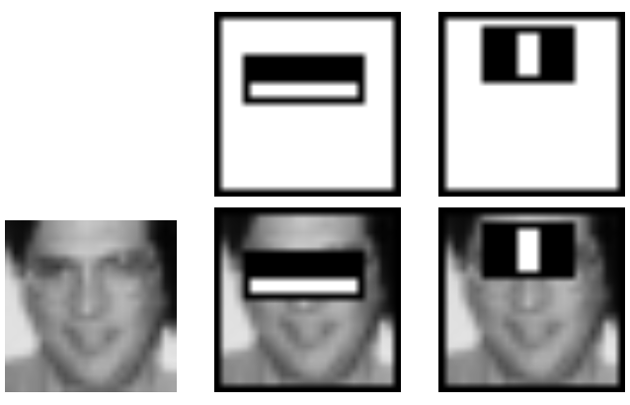
Face Detection
Viola-Jones algorithm
OpenCV
(Opencv.org)
Notes:
Describe what’s doing: like filtering, one pattern is eyes are dark and the cheeks are light;
Light bridge and dark eyes for the second one

Slide 4
Motions of GoPiGo
Moving straight
Turning with specified speed, radius, angle

Slide 5
Moving Straight
Calibration of two motors
Convert a given linear speed into a motor parameter
set_left_speed(parameter)
set_right_speed(parameter)
Parameter: 0 - 255
Notes:
Parameter is just the function from gopigo library

Slide 6
Calibration

Slide 7
Turning Strategy
Needs to find out the distance between the GoPiGo and obstacles first
Two methods of turning were explored:
Adjust the speed difference between two motors to make it turn with specified radius, speed and angle
Using polygons to approximate a circle
Turning through a given angle

Slide 8
Approximate The Distance To GoPiGo
Actual_width
Actual distance
lens
d
Image_width
Notes:
D: is the distance between the lens and image censor, which has to be calibrated for further use

Slide 9
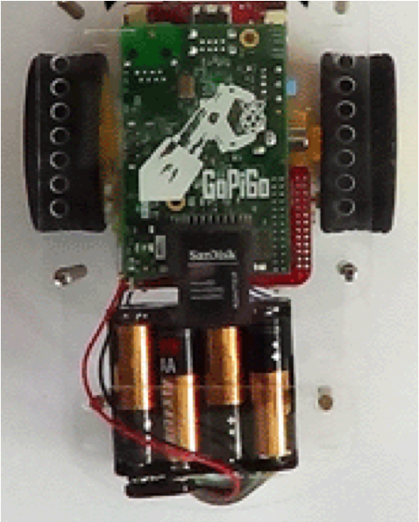
First Turning Method
V_outer
V_inner
R
w
V_outer = (R+w/2)/(R-w/2)*V_inner
Notes:
Talk about the issue which is the sliding, slipping

Slide 10
Second Turning Method
Move forward for t_fwd
R
Turn left/right for t_turn
Notes:
Points out gopigo has built-in function for it to stop and turns, and that’s cause the sharp corner

Slide 11
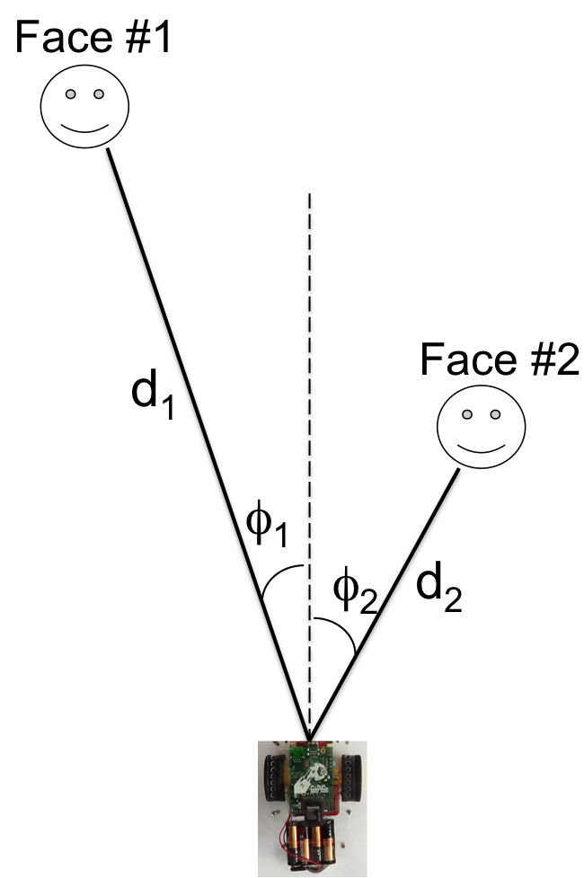
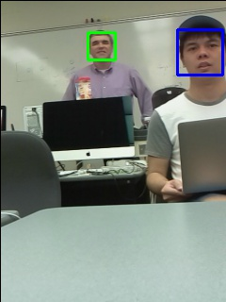
Prioritizing Obstacle
Notes:
Talks about a about 1-2 second delay, kinds of slow

Slide 12
Problems
Even after calibration, GoPiGo still does not move in a straight line – seems to be affected by the surface of the paths
Avoidance strategy only based on the closest obstacle, but we want to find the best path that takes into account all obstacles
Face detection isn’t a 100% accurate, for example white board will be detected occasionally; besides, only frontal face will be detected
Takes a little more than one second to do the image analysis, which is slow
Notes:
Might needs to talk about the board issue by drawing sth on it

Slide 13
Future Work
A better response mechanism for motors in order to move forward in a more straight line
Make it able to go automatically with a given goal location using fictitious force model
Notes:
Might need to draw it out on the board

Slide 14
Acknowledgements
High Point University Physics Department
Dr.DeWitt

Slide 15
Work Cited
opencv.org

