Slide 1

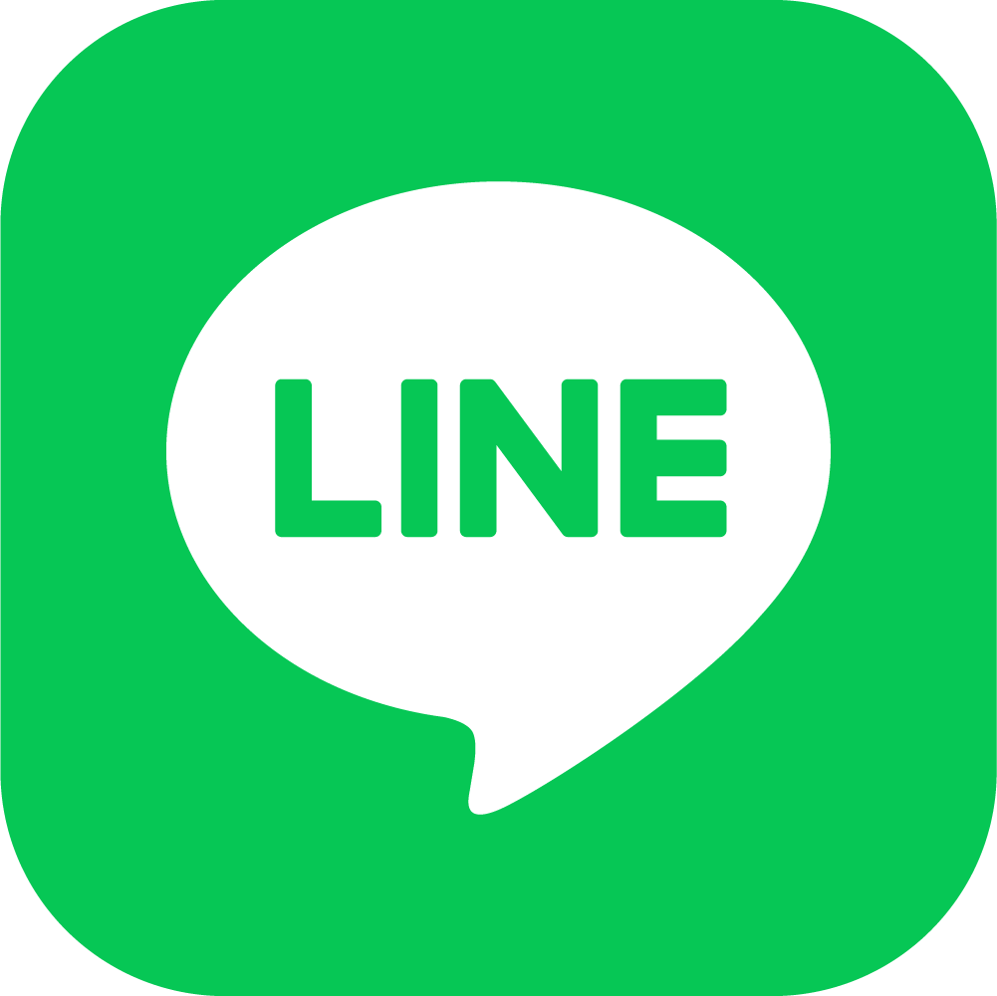
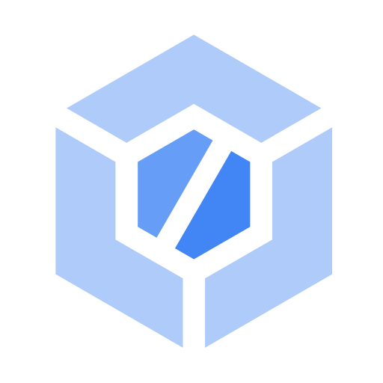



Deploy
Cloud Run
Cloud Build
LINE Messaging API
Continuous
Deployment
User
MongoDB Atlas
GitHub
Google Cloud asia-east-1

