Slide 1
Swift Retrospect
Jinxing Liao @ LinkedIn

Slide 2
Agenda
Swift re-evaluation
Swift benefits
Swift issues
Workarounds for Swift issues
Build performance
App launch time
Binary size
What’s new in Swift 4?
Language
Apple tools

Slide 3
Questions
Why do we prefer struct to class?
What’s WMO(whole module optimization)?
Why remove VoyagerAPI module?
What happen before the main() function gets control?
Why Resource bundle?
…

Slide 4
Swift Re-evaluation

Slide 5
Swift benefits
Productivity

Slide 6
Productivity
Modern, compact and clean syntax
Swift allows for designing of cleaner and more flexible APIs
generic types
powerful struct and enum
protocol
functional programming
easier access control
…

Slide 7
Swift benefits
Productivity
Run-time stability

Slide 8
Run-time stability
Optional type and strict type safety check
Reduction in casting or unexpected type errors and crashes
Ease of setting up initial constraints and expectations thanks to the guard statement

Slide 9
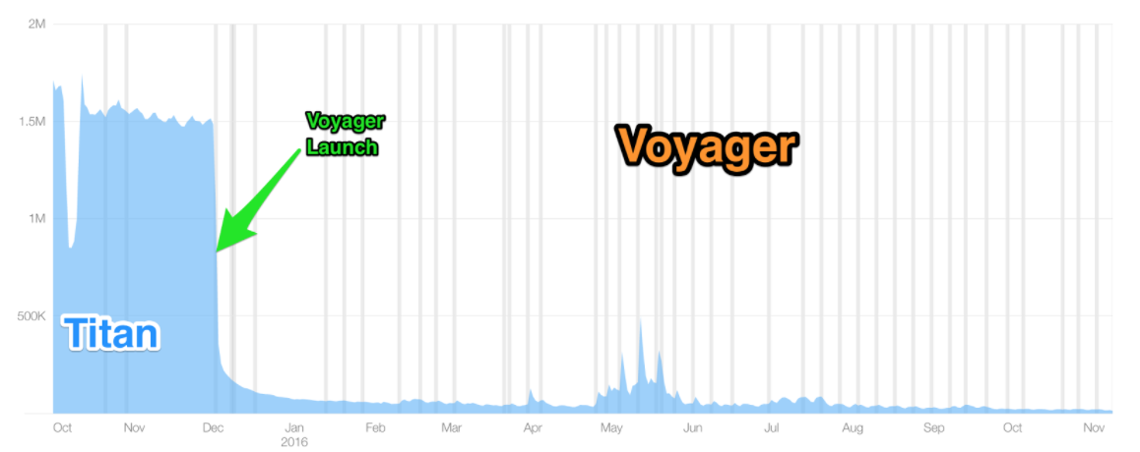
Run-time stability

Slide 10
Swift benefits
Productivity
Run-time stability
Run-time performance

Slide 11
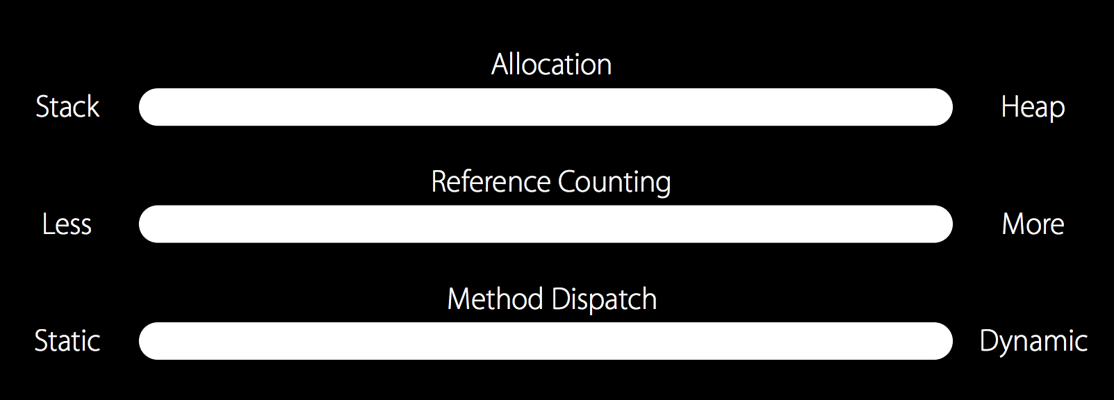
Run-time performance

Slide 12
Swift benefits
Productivity
Run-time stability
Run-time performance
Future-proof

Slide 13
Swift issues
Tools support
Build performance

Slide 14
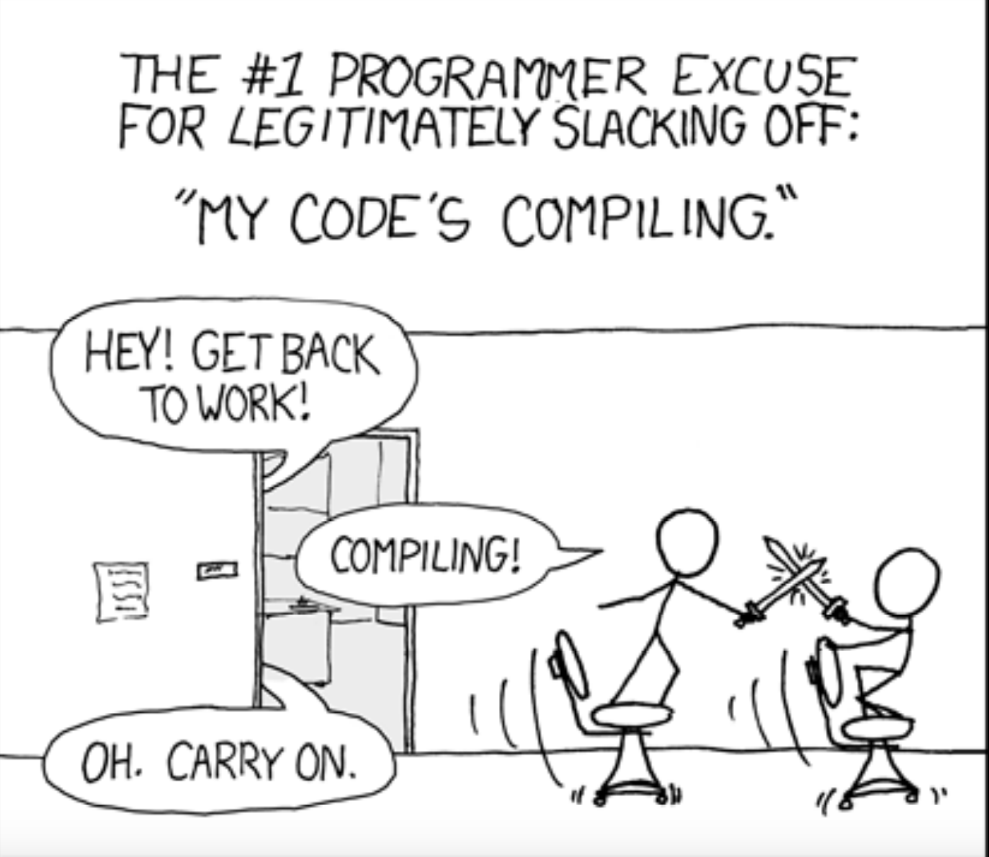

Slide 15
Swift issues
Tools support
Build performance
App launch time
Binary size
Migration cost

Slide 16
Workarounds for Swift issues

Slide 17
Improve Build Performance
Less implicit type inference
Modularize: break project into multiple modules

Slide 18
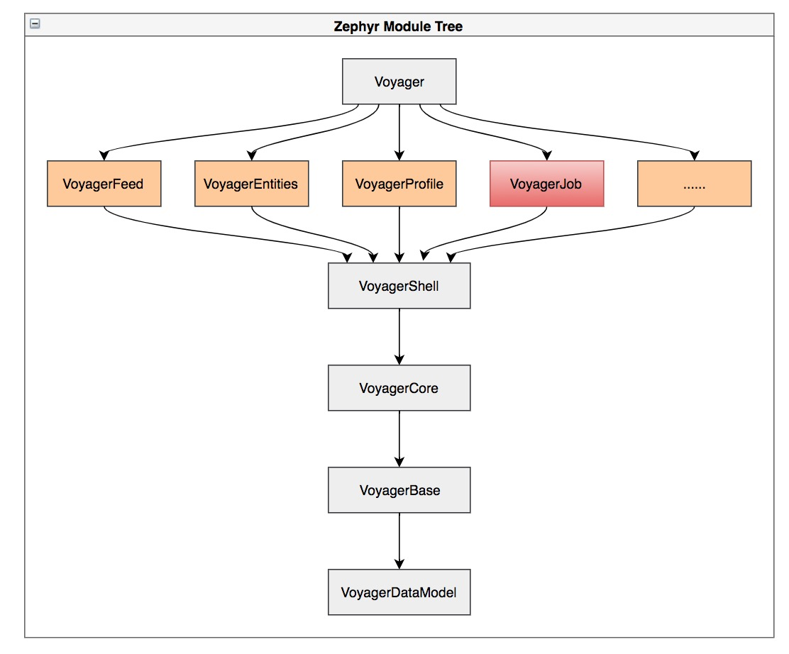
Improve Build Performance

Slide 19
Improve Build Performance
Less implicit type inference
Modularize: break project into multiple modules
Switched generated data models to ObjC (to reduce Swift files)
Build cache

Slide 20
Shorten app launch time
pre-main time
post-main time
launch time
What happened in pre-main phase?
Dynamic libraries loading
Rebase and binding
Obj-C setup
Initialization
93% of pre-main time spent on dynamic libraries loading

Slide 21
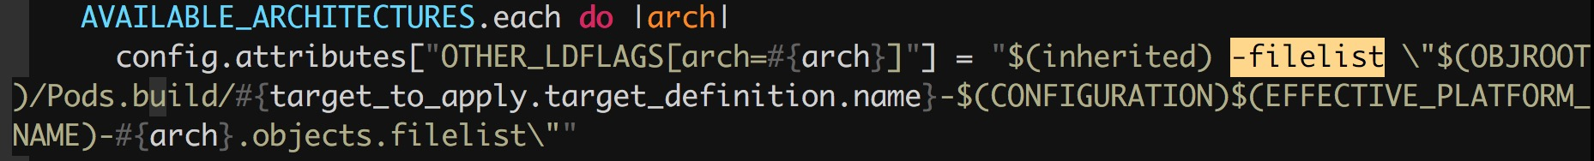
Static linking
Static linking scripts in post-install pod phase
From `-framework` to `-filelist`

Slide 22
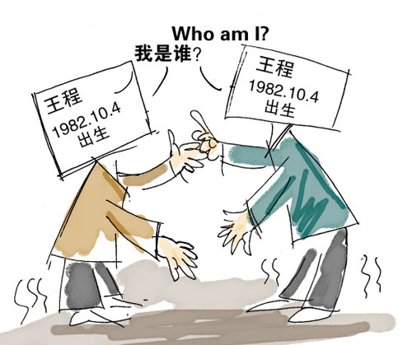
Static linking
Why resource bundle?
To keep the namespace of resources

Slide 23
Binary Size
Why Swift makes binary size larger?
Swift runtime
Language features
Optional
Generic specialization
…

Slide 24
Binary Size
Resource
code
App
What can we do?
Build setting (WMO)
Resource optimization (cleanup + dynamic loading + compress)
Code optimization
Enhance code reusability
Cleanup unused codes, especially fully ramp lixes

Slide 25
Binary Size
How to find unused codes?
Text searching
otool
AST (Abstract syntax tree)

Slide 26
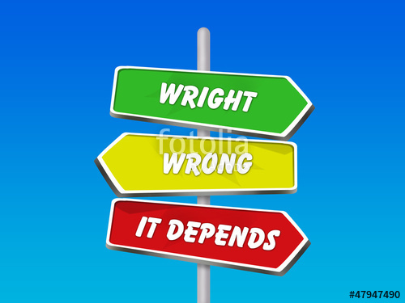
Swift or Objective-C?

Slide 27
What’s new in Swift 4?

Slide 28
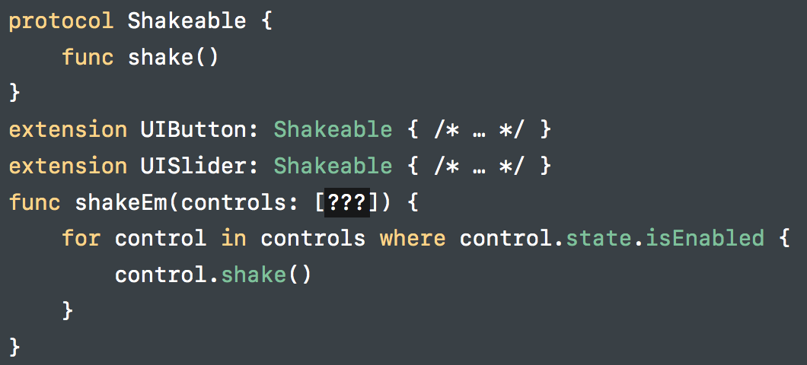
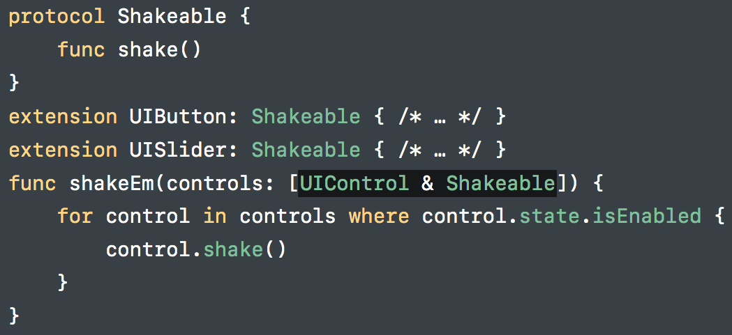
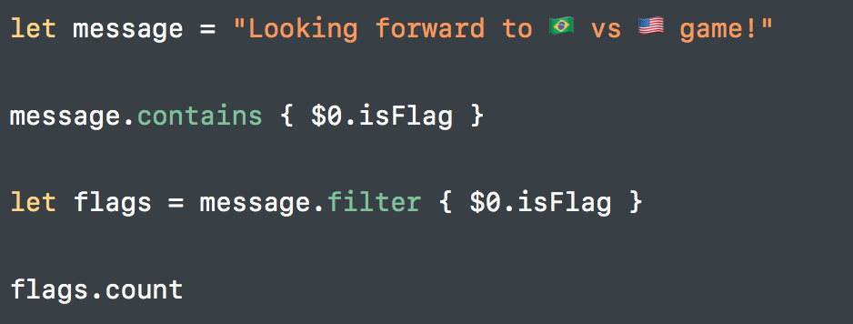
Language refinements and additions
’private’ access control
Composing class and protocol
Use String as a collection
Encoding and Decoding
…
Notes:
Substring, encoder/decoder,

Slide 29
Source compatibility
Swift 3.2 and Swift 4 can coexist!
Migrate one target at a time
No need to migrate in dependency order

Slide 30
Binary Size
Unused conformance removal
Only infers @objc when it’s needed
Overriding an Objective-C method
Conforming to an Objective-C protocol
Strip Swift symbols

Slide 31
Build performance improvement
New build system
Lower overhead, especially for large projects
Precompiled bridging headers

Slide 32
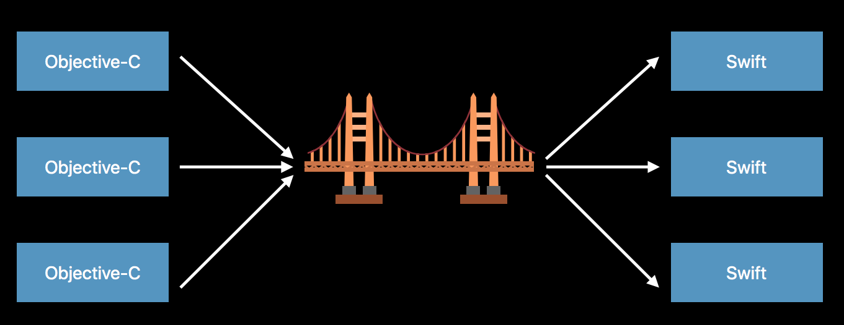
Build performance improvement

Slide 33
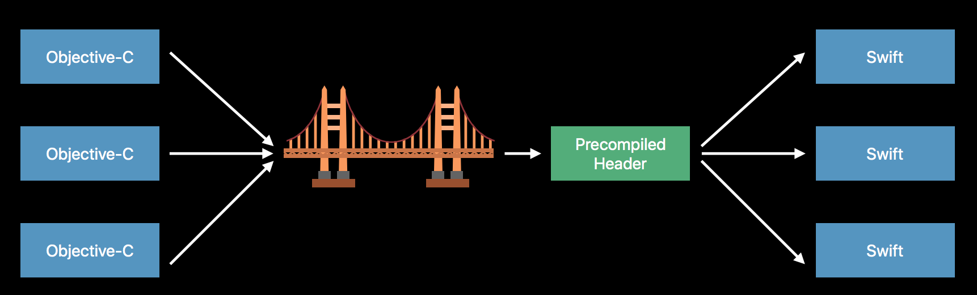
Build performance improvement

Slide 34
Build performance improvement
New build system
Lower overhead, especially for large projects
Precompiled bridging headers
Indexing while Building

Slide 35
Reference
https://www.skilled.io/u/swiftsummit/swift-with-a-hundred-engineers
https://docs.google.com/document/d/17GOr50jNag6qd-RWbHtOXp5-bf8kklH8qtlDePUEU8k/edit#heading=h.rw8ldihc55qu
https://docs.google.com/document/d/1erv6Jm_HbwTBnBpWzFlzTCmK8EnXQhkU3hwaW3VTro4/edit
https://docs.google.com/document/d/113G7AnHaQc4Sn_JHdyeSEnr9otryUZjYMCkqieHGKT4/edit#
https://www.slideshare.net/KyleSherman/swift-at-linkedin
https://engineering.linkedin.com/ios/our-swift-experience-slideshare
https://developer.apple.com/videos/play/wwdc2016/416/
https://developer.apple.com/videos/play/wwdc2017/402/
https://swift.org/blog/bridging-pch/

Slide 36


