Slide 1
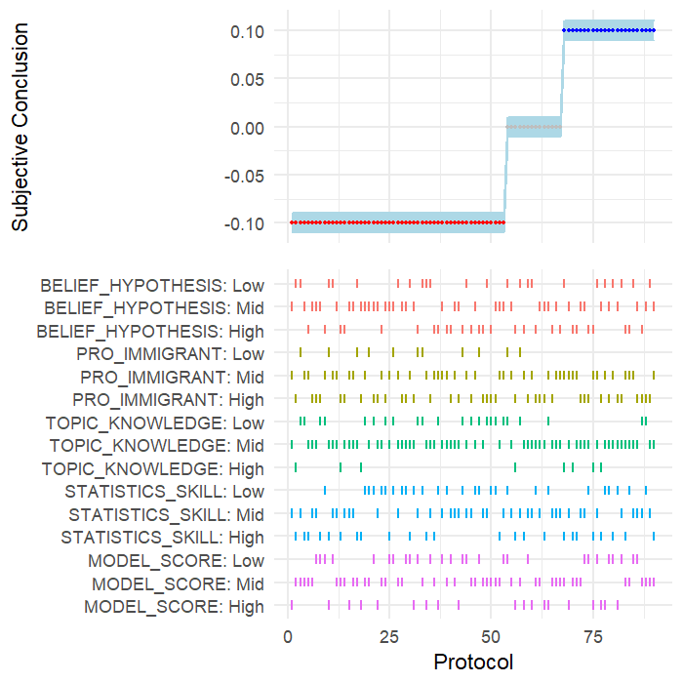
Support H
Support H
Not testable
Support H
Reject H

