Slide 1
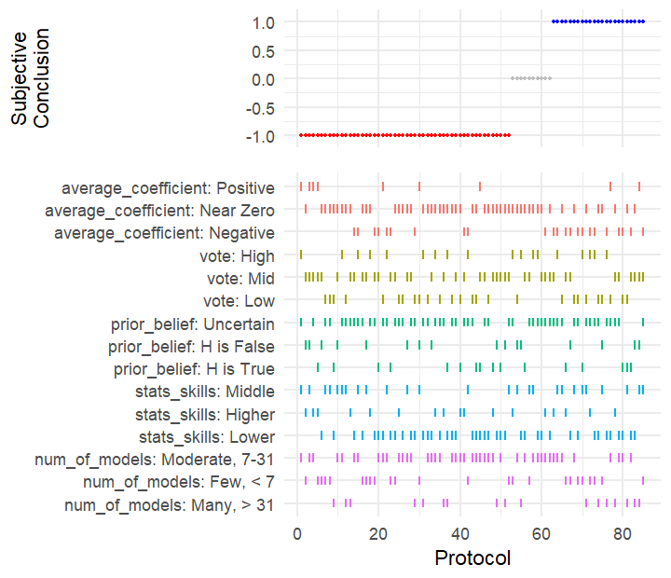
Support Hypothesis
Not Testable
Reject Hypothesis
Results by Team

