Slide 1
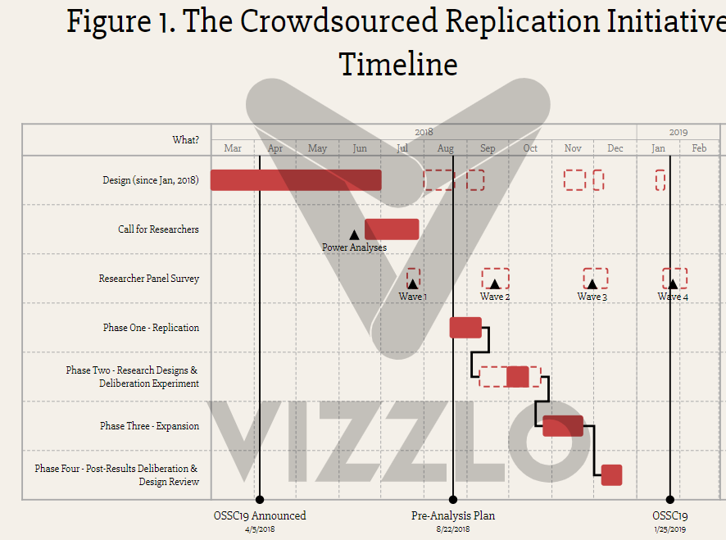
2018
2019
Mar
Mar
Mar
Mar
Mar
Mar
Mar
Mar
Mar
Mar
Mar
Mar
Design (since Jan, 2018)
Call for Researchers
Power Analyses
Panel Survey
Phase I - Replication
Phase II – Research Designs & Deliberation Experiment
Phase III - Expansion
Phase IV – Post-Result Deliberation & Peer Review
OSSC19 Announced
4/5/2018
Pre-analysis Plan
8/22/2018
OSSC19
1/25/2019

Slide 2
Figure 1. Crowdsourced Replication Initiative Timeline
2018
2019
Jan..
..Apr
May
Jun
Jul
Aug
Sep
Oct
Nov
Dec
Jan
Feb
Design
Power analyses
Call for Researchers
- - - - - - - - - - - - - Design updating - - - - - - - - - - - - -
Panel Survey
W1
W2
W3
W4
Phase I
Replication
Research Designs &
Deliberation Experiment
Original authors
informed
Phase II
Final decision
to replicate
Brady & Finnigan (2014)
Phase III
Expansion
Phase IV
Post Deliberation &
Peer Review
OSSC19 Announced
4/5/2018
1st PAP
8/22/2018
2nd PAP
11/24/2018
OSSC19
1/25/2019

Slide 3
Figure 2. CRI Participation Rate
Number of Teams
Number of
Researchers
50
55
60
65
70
75
80
85
90
95
100
105
Call for Researchers
215
Survey Wave 1
187
Replication
186
Expansion
163
Post-Results Deliberation
136ª
ª ‘Full Participation’ required completion of the Replication and Expansion, not necessarily the Deliberation

Slide 4
2018
2019
2020
Jan..
..Apr
May
Jun
Jul
Aug
Sep
Oct
Nov
Dec
Jan
Feb..
..Nov
Design
Power analyses
Design updating
Call for Researchers
Panel Survey
W1
W2
W3
W4
Phase I
Replication
Research Designs &
Deliberation Experiment
Original authors
informed
Phase II
Final decision
to replicate
Brady & Finnigan (2014)
Phase III
Expansion
Phase IV
Post Deliberation &
Peer Review
Analyzing Results
OSSC19 Announced
4/5/2018
1st PAP
8/22/2018
2nd PAP
11/24/2018
OSSC19
1/25/2019

