Slide 1
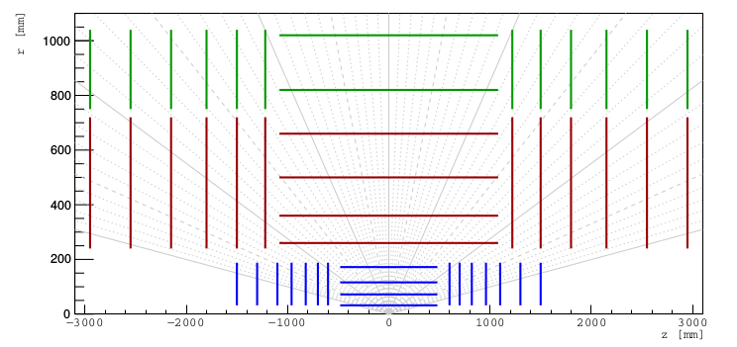
TripletNet
p = probability (all points are from the same track)
(x0,y0,z0,x1,y1,z1,x2,y2,z2)
[ 1. used as seeding ]
- consider layer2,4,6
- for all triplets, use TripleNet to classify them

Slide 2
[ 2. used as extension ]
- consider a pair, make all possible triple extensions to a new layer
- for all triplets, use TripleNet to classify them

Slide 3

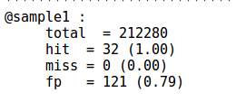
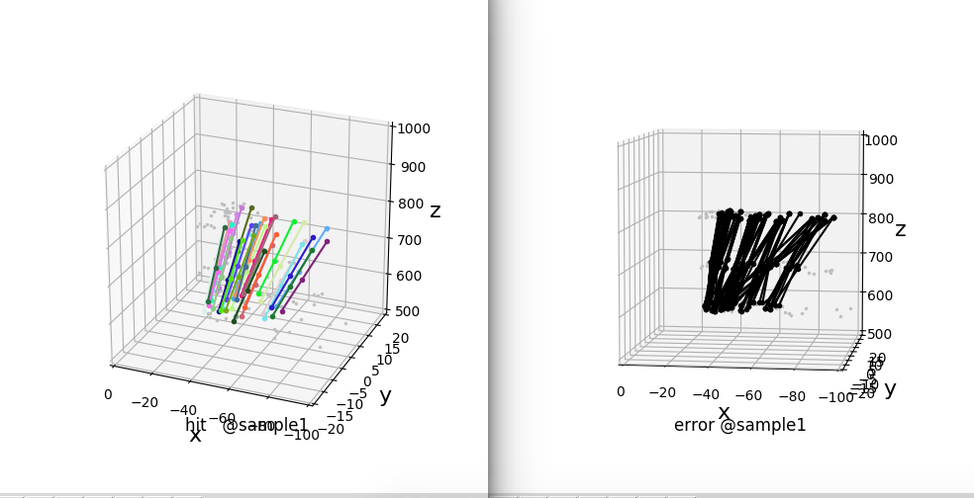
[ 3. sample results ]
- used as seeding. detectors = volume_id=9, layer_id={2,4,6}, module_id=1
*
*
total = all possible triplets
fp= false postive. e.g of all estimated tracklets, 79% are fp
hit
fp = black
miss = red (None here)

Slide 4
