Slide 1
VMD→IMF
N-BEATS + LSTM model

Slide 2
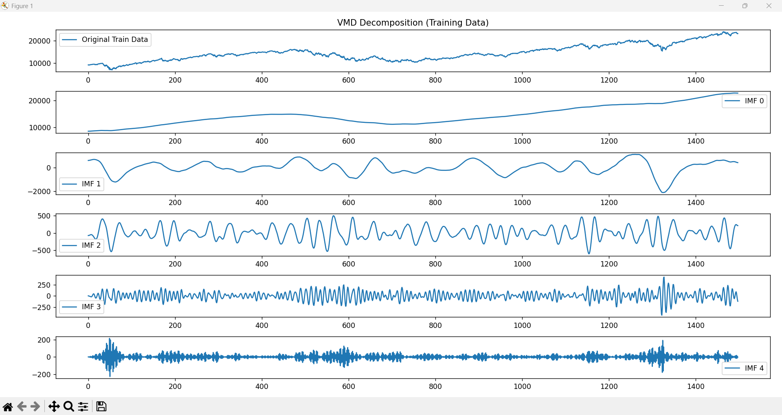

Slide 3
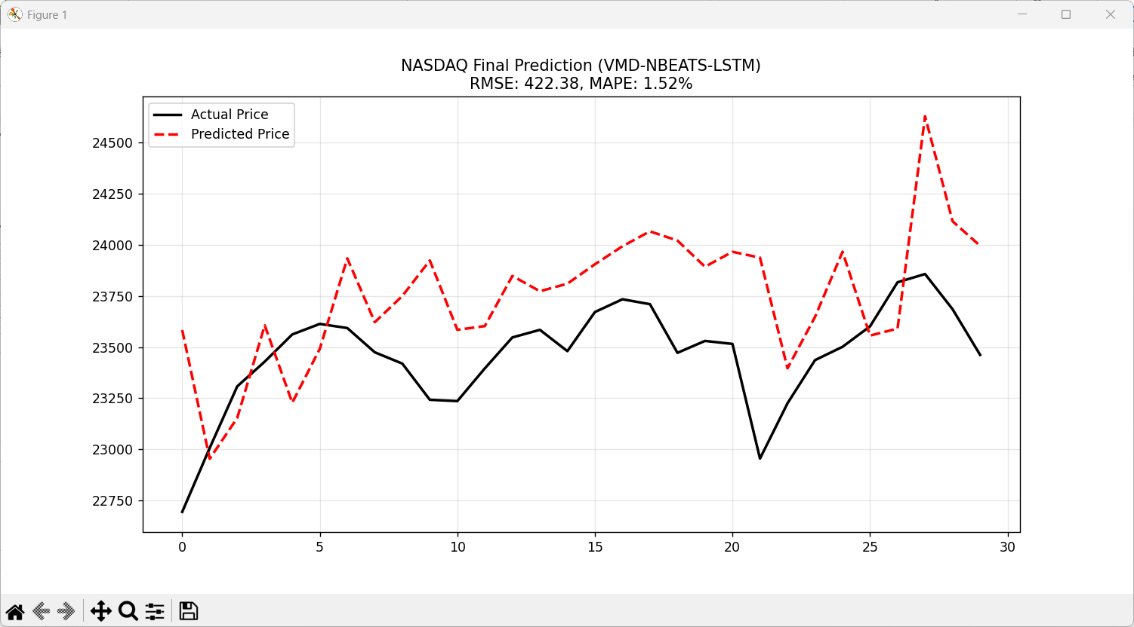

Slide 4
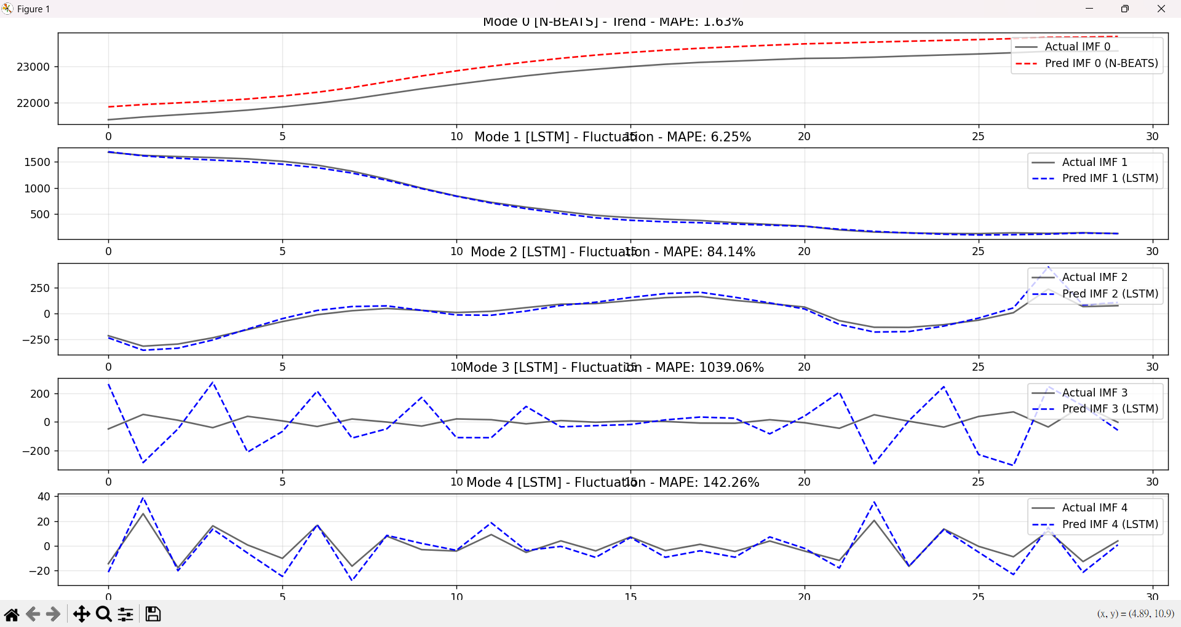

Slide 5
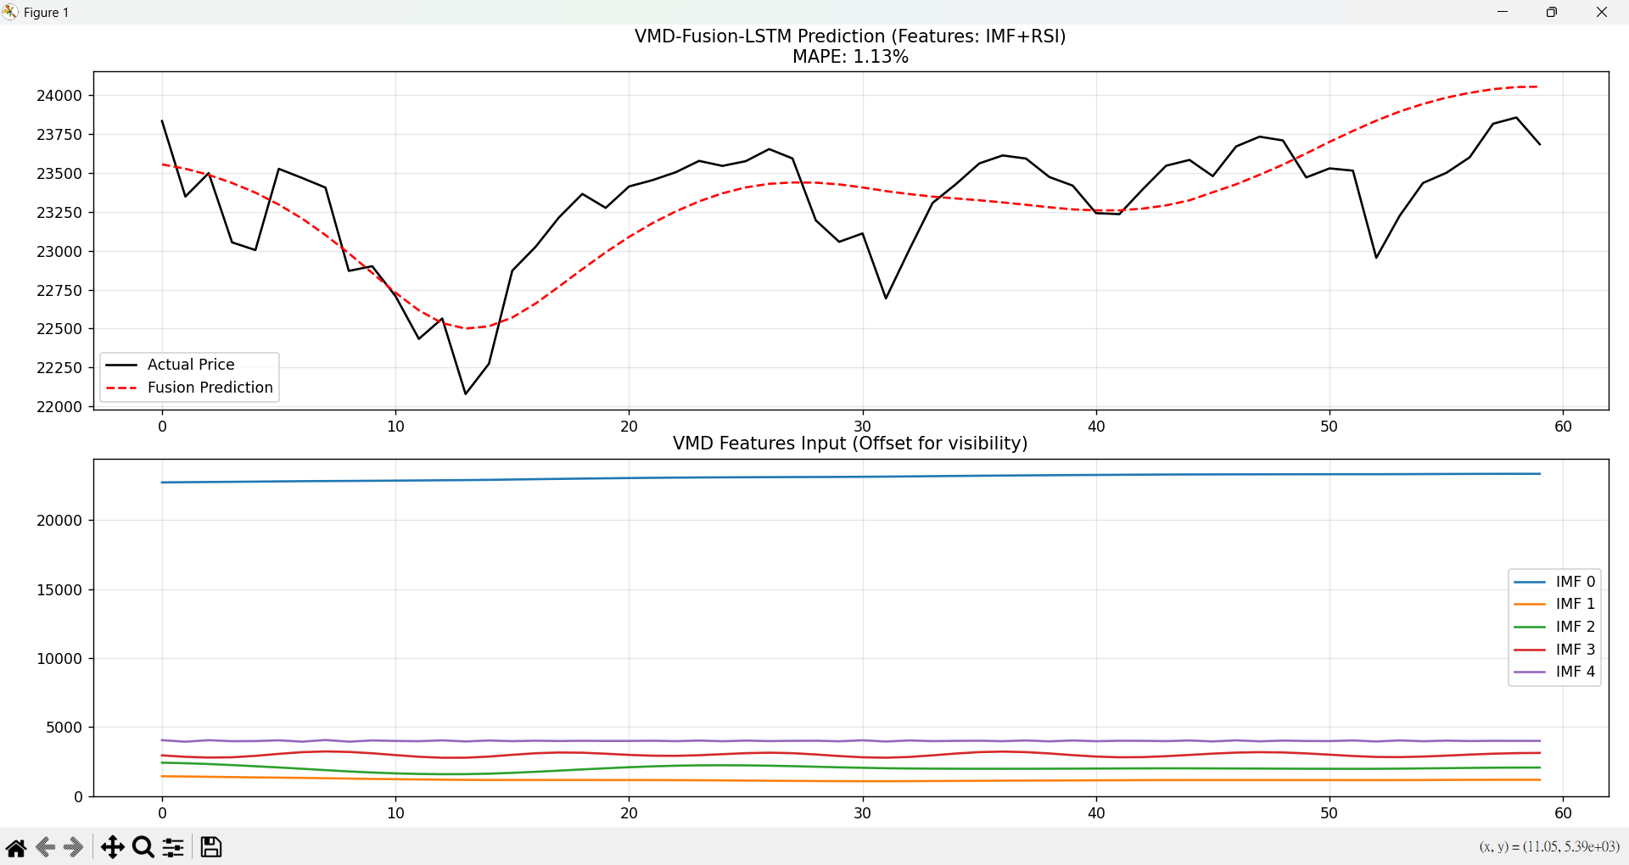
Notes:
Use RSI IMF as feature to predict

