Slide 1


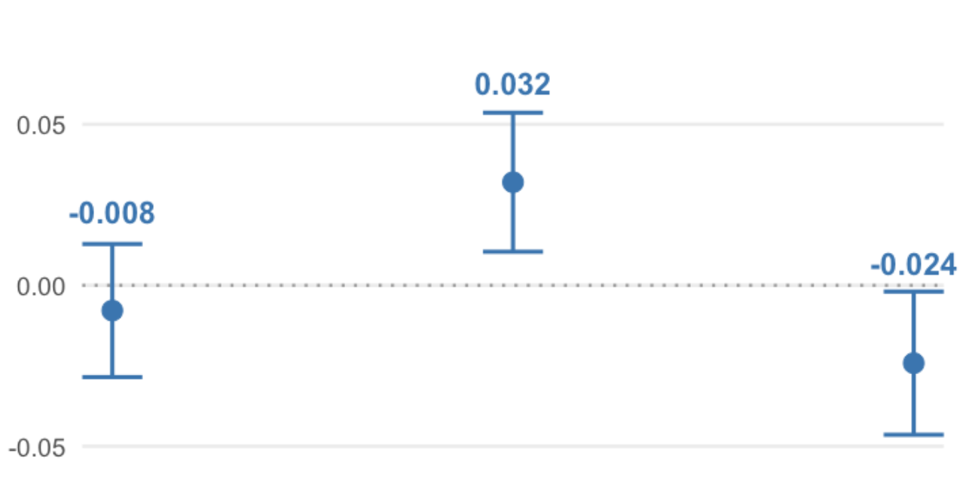
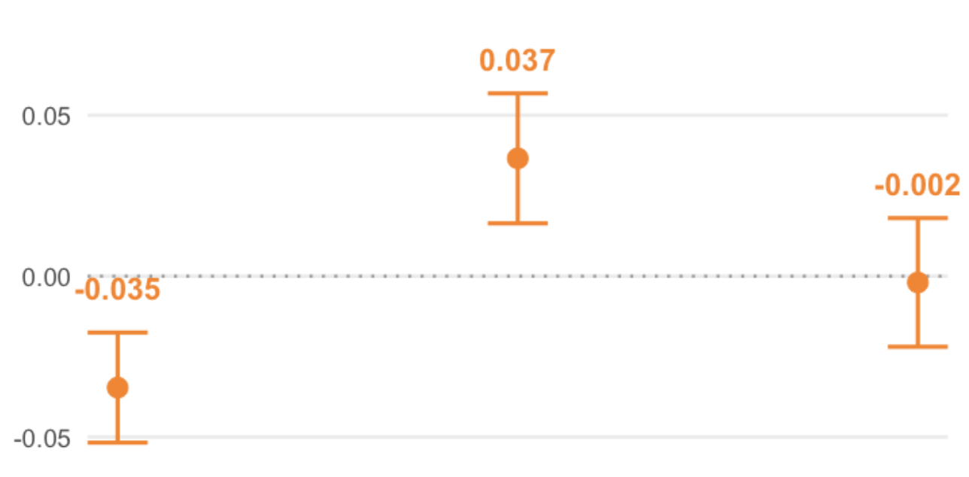
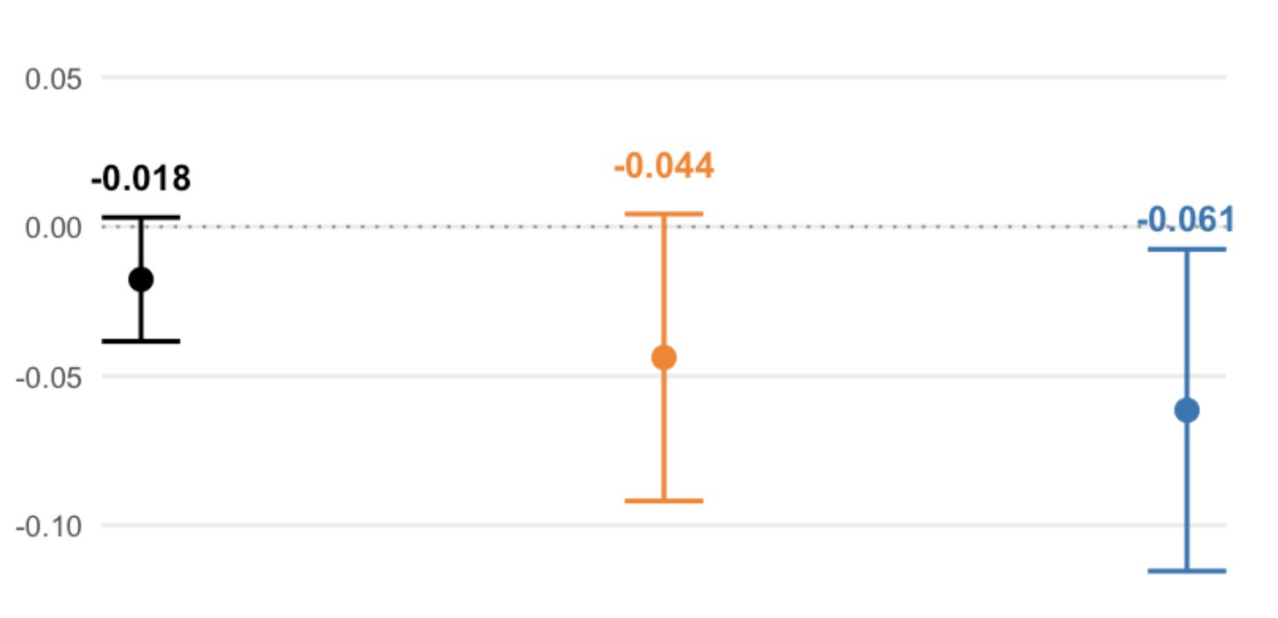
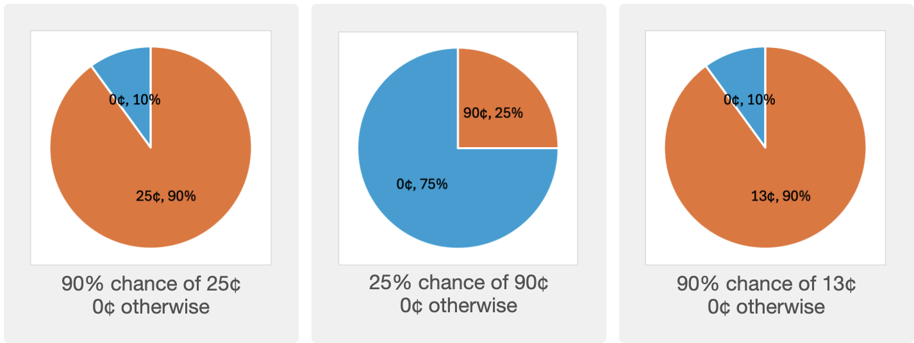
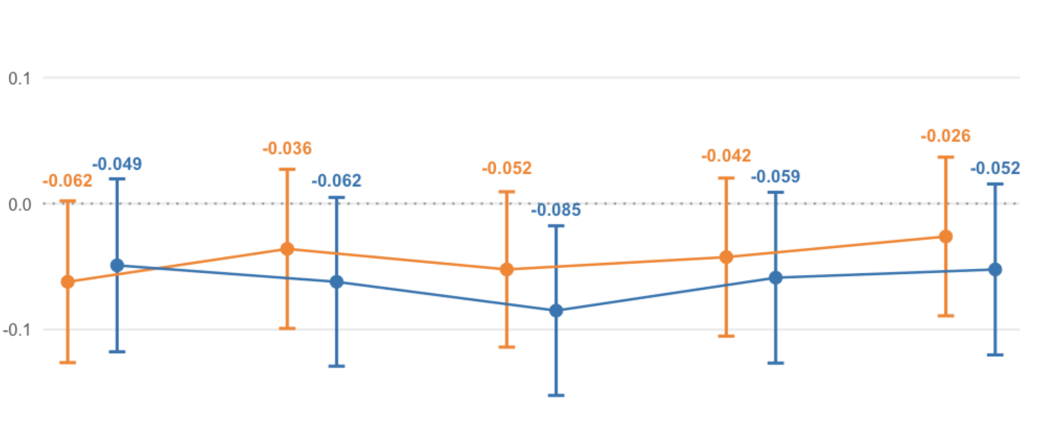
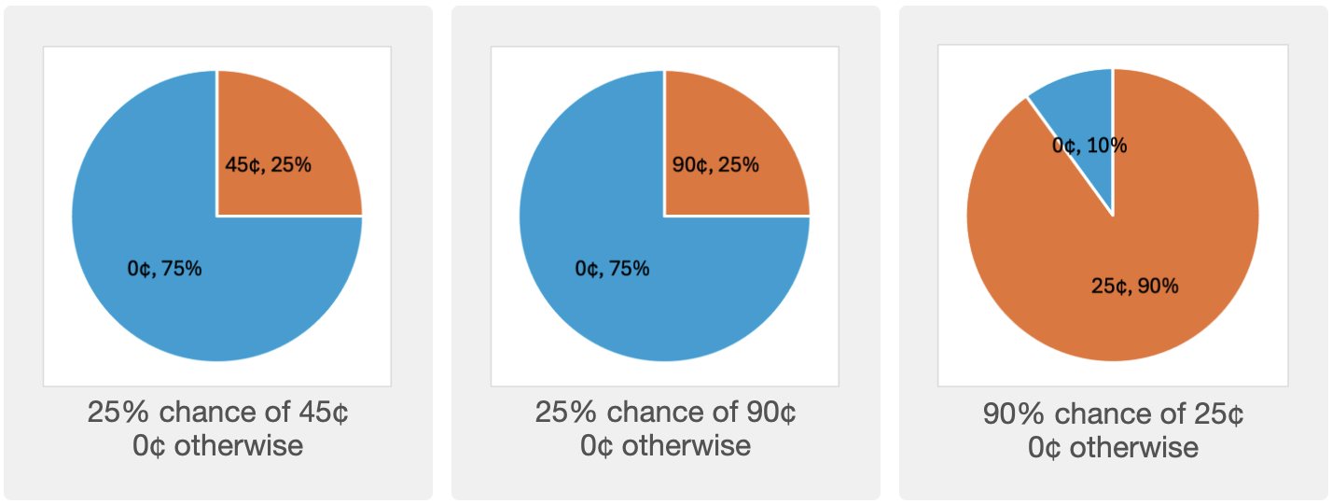
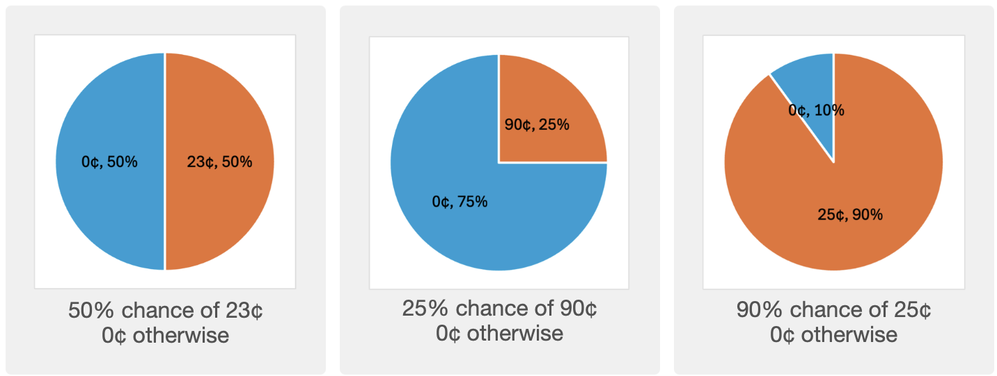
Reversed Reversal Preference in Attraction effect
Dominated prospects fail to shift risk preference
Yi-tsen, Liao
Summary
Study 1
Discussion
Sample: 600 Prolific participants
Within-subject treatment:
- 10 trails of lottery decision
- 5 unique pairs of Focal and Non-focal lotteries
- Along with either a Treatment or a Control Decoy
Effect of having a decoy that is similar but worse
Control decoy is dominated by Safe lottery in both attributes
Control decoy inadvertently makes Safe lottery attractive
Control decoy is still chosen at some rate despite being strictly dominated
Treatment decoy that targets Risky lottery reduces the proportion of decoy being chosen
Treatment decoy that targets Safe lottery instead decreases the proportion of Safe lottery being chosen
Treatment Safe Decoy v.s. Control Decoy
Treatment Risky Decoy v.s. Control Decoy
Experimental Design
P(Chosen | Treatment) – P(Chosen | Control)
Sample: 600 Prolific participants
Within-subject treatment:
- 10 trails of lottery decision
- 5 unique pairs of Risky and Safe lotteries
- Along with either a Treatment or a Control Decoy
Between-subject condition:
- Risk-seeking: treatment decoy targets risky lottery
- Risk-averse: treatment decoy targets safe lottery
Decisions are incentivized
Exclude participants who choose the decoy more than 5 times
*Pre-registrated on AsPredicted
Decoy
Risky lottery
Safe lottery
Decoy
Risky lottery
Safe lottery
47% of winning $23
v.s.
19% of winning $57
Hard to determine which one has a higher EV
Decoy 19% of winning $28 may work well in this case
It helps eliminate the worst possible option
Ambiguity in the lower order decision criteria (EV)
C 50% of 38¢
T 95% of 10¢
20% of 95¢
95% of 20¢
C 50% of 38¢
T 20% of 47.5¢
20% of 95¢
95% of 20¢
Preference Reversal: Safe Decoy v.s. Risky Decoy
47% of winning $23
v.s.
23% of winning $47
Hold EV the same, risk preference makes the call
Decoy 23% of winning $23 may not work in this case
Since the decision has already been made
Objectively equivalent options
Decoy works in resolving the “tie” by avoiding the worst option!
P(Chosen | Focal) – P(Chosen | Non-Focal)
Conclusion
Lottery Design
Visual representation significantly inhibits the attraction effect
Attraction effect may not be robust to options that are objectively equivalent
Decoy may work by avoiding the worst option rather than making the option more attractive
Test the attraction effect in ways other than single choice
Elicit the WTP of the lotteries in the presence/absence of the decoy
Ask for the ranking of the lotteries
Allow for multiple choices
Choose among three lotteries
- Risky & Safe lotteries are symmetric
- Treatment decoy: same winning prob of half of the payoff
- Control decoy: 50% of the same EV as treatment decoy
Various level of difference in Certainty Equivalent
Lotteries are presented both visually and numerically
Decoy
Risky lottery
Safe lottery
S’ 95% of 10¢
R’ 20% of 47.5¢
20% of 95¢
95% of 20¢
Heterogeneity in Preference Reversal Across Pair Characteristics
47% of winning $23
19% of winning $57
19% of winning $28
63% of winning $17
It’s doubtful that if B will still be chosen if participants are allowed to choose two lotteries
Treatment decoy targets safe lottery
P(Chosen | Focal) – P(Chosen | Non-Focal)
References
Treatment decoy targets risky lottery
Most dissimilar in risk
Most similar in risk
Control decoy
S 95% of 20¢
R 20% of 95¢
Difference in Certainty Equivalence
S 75% of 40¢
R 40% of 75¢
Author thanks HKUST Econ dept for funding the experiment as her UG thesis.

