Slide 1
Plate Recognition
2018053299 – Liao Yue

Slide 2
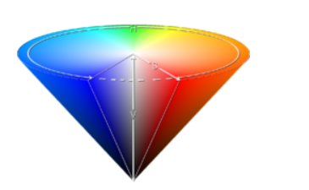
Introduction
HSV model describes an image in terms of colour, depth, and lightness.
H is hue(Colour)
S is the depth, when S = 0, only gray
V is about brightness, indicating the brightness of the color,
but has no direct relationship with light intensity

Slide 3
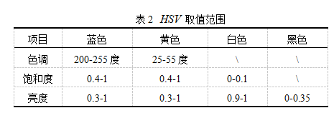
Introduction
p=[0.56 0.71 0.4 1 0.3 1 0];
for i = 1 : y
for j = 1 : x
hij = I(i, j, 1); %hue
sij = I(i, j, 2); %Saturation
vij = I(i, j, 3); %value
%determination of blue pixels
%background colour of chinese plate is blue
if (hij>=p(1) && hij<=p(2)) &&( sij >=p(3)&& sij<=p(4))&&...
(vij>=p(5)&&vij<=p(6))
%use the number of blue pixels on every row
%to determine upper and lower bound of plate
Blue_y(i, 1) = Blue_y(i, 1) + 1;
end
end
end

Slide 4
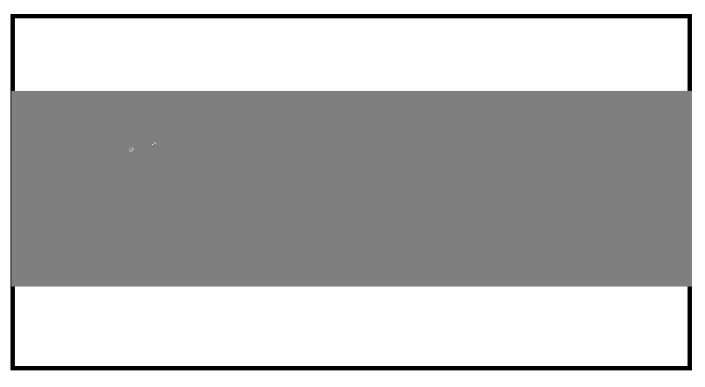
Introduction
[~, MaxY] = max(Blue_y); %represents the row that contains the most blues pixels
Th = p(7); % p(7) = 0
PY1 = MaxY;
while ((Blue_y(PY1,1)>Th) && (PY1>0))
PY1 = PY1 - 1; % fine the upper bound of plate
end
PY2 = MaxY;
while ((Blue_y(PY2,1)>Th) && (PY2<y))
PY2 = PY2 + 1; % fine the lower bound of plate
end

Slide 5

Introduction
[~, MaxX] = max(Blue_x);
Th = p(7);
PX1 = MaxX;
while ((Blue_x(1,PX1)>Th) && (PX1>0)) % find the leftmost bound
PX1 = PX1 - 1;
end
PX2 = MaxX;
while ((Blue_x(1,PX2)>Th) && (PX2<x1)) % find the rightmost bound
PX2 = PX2 + 1;
end

Slide 6
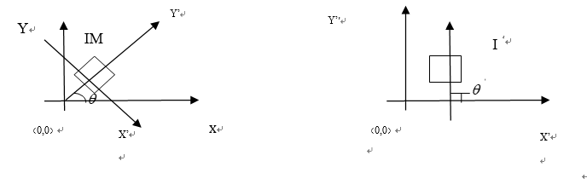
Introduction
Radon algorithm : An algorithm that uses fixed-direction projection and superposition to find the angle of the maximum projection value to determine the image tilt angle.
The specific process is shown below
I=edge(I);
theta = 1:180;
[R,xp] = radon(I,theta);
[I,J] = find(R>=max(max(R)));
angle=90-J;%J means the slope of picture
picture=imrotate(bw,angle,'bilinear','crop');

Slide 7
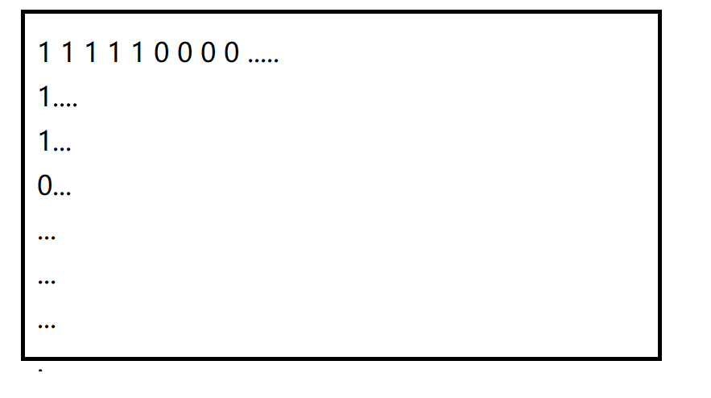
Introduction
[y,x]=size(picture_10);%obtain black/white pixels, 1 for white and 0 forblack
bw = picture_10;
[y,x] = size(bw);
%experimental values
dd = fix(x/40);
ddd = fix(x/30);
%get rid of the plate'frame
dd = x - dd;
bw = bw(:,ddd:dd);
figure('NumberTitle','off','Name',‘frame_removal'),imshow(bw),title frame_removal ');

Slide 8
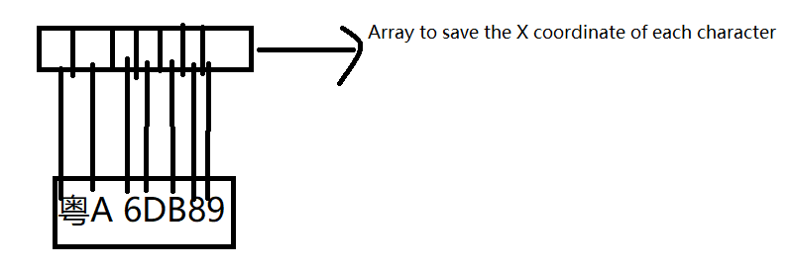
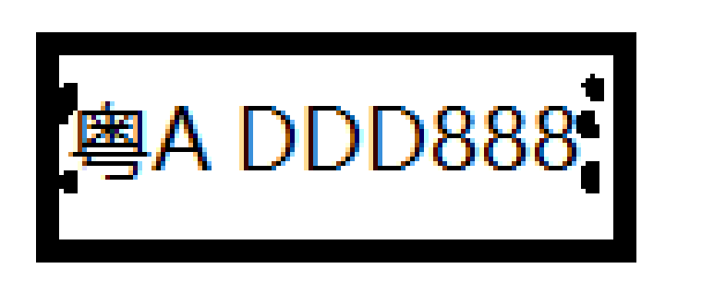
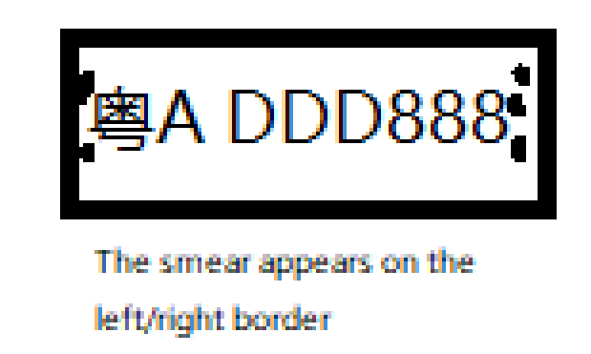
Introduction
for i = 1:x-1
if a(i)==0&&a(i+1)~=0
j = i;
end
if a(i)~=0&&a(i+1)==0
kk=i;
else
kk =0;
end
if kk~=0
m = m+1;
%Array that saved left border of each characters.
p(m) = j;
q(m) = kk;
end
end
for i = 1:m
%remove the irrelevant dots
if p(i)<fix(x/8)
p(i)=p(1);
end
end

Slide 9
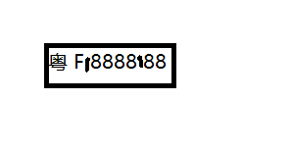
Introduction
But what if the smear appears on the middle?
See the left picture. Two smears among the characters.
We should come up with an idea which can detect the smear and remove it.
Here is how it works:
Traverse the array, remove those characters with narrow width
for i = 1:m
if (q(i) - p(i))>(fix(x/10))
gg(k) = q(i);
ggg(k) = p(i);
k = k+1;
end
end

Slide 10
Introduction
liccode=char(['0':'9' 'A':'Z' '贵桂京鲁陕苏渝豫粤']); Dataset
for i=1:y
for j=1:x
if tu(i,j)==bw(i,j,k2)%calculate the pixels(1||0)
sum=sum+1;
end
end
end

