Slide 1

Principles of Economics
Thirteenth Edition
Chapter 10
Input Demand: The Labor and Land Markets
Copyright © 2020, 2016, 2011 Pearson Education, Inc. All Rights Reserved
Notes:
If this PowerPoint presentation contains mathematical equations, you may need to check that your computer has the following installed:
1) MathType Plugin
2) Math Player (free versions available)
3) NVDA Reader (free versions available)

Slide 2
Chapter Outline and Learning Objectives (1 of 2)
10.1 Input Markets: Basic Concepts
Define the basic concepts of input markets.
10.2 Labor Markets
Discuss the conditions that affect supply and demand in labor markets.
10.3 Land Markets
Describe the relationship between supply and demand in land markets.

Slide 3
Chapter Outline and Learning Objectives (2 of 2)
10.4 Input Demand Curves
Identify factors that trigger shifts in factor demand curves.
10.5 The Firm’s Profit-Maximizing Condition in Input Markets
Understand how the prices of the different inputs relate to their relative productivity.
Looking Ahead

Slide 4
Chapter 10 Input Demand: The Labor and Land Markets
We will find out what determines the prices in the markets for inputs.
This chapter sets out a framework for labor and land.
Chapter 11 will tackle the more complicated topic of capital and investment.

Slide 5
Input Markets: Basic Concepts (1 of 2)
Demand for Inputs: A Derived Demand
derived demand The demand for resources (inputs) that is dependent on the demand for the outputs those resources can be used to produce.
Inputs are demanded by a firm if and only if households demand the good or service provided by that firm.
productivity of an input The amount of output produced per unit of that input.

Slide 6

Input Markets: Basic Concepts (2 of 2)
Marginal Revenue Product
marginal product of labor (MP_{L}) The additional output produced by one additional unit of labor.
marginal revenue product (MRP) or value of marginal product (VMP) The additional revenue a firm earns by employing 1 additional unit of input, ceteris paribus.

Slide 7

Economics In Practice (1 of 4)
Do Managers Matter?
Managers can affect the productivity of the people who work for them.
In a field experiment, researchers randomly divided Indian textile firms into two groups. In the treatment group, firm managers were taught a range of operational practices that might be effective. A second group, a control group, received no training.
The results? Within the first year after treatment, productivity in the treated firms increased by 17%.
CRITICAL THINKING
Many of the firms treated had multiple plants. After the researchers left, what do you think they did about training in their other plants?

Slide 8
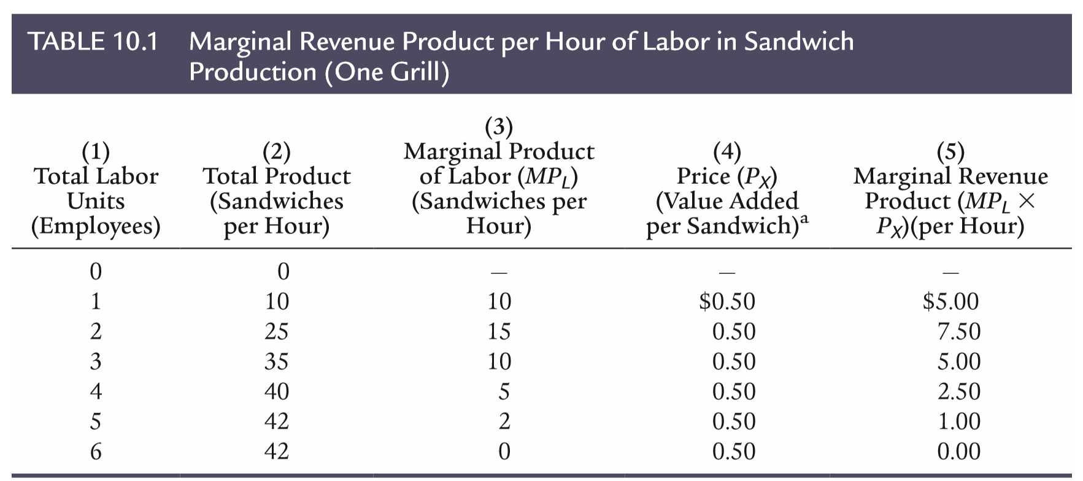
Table 10.1 Marginal Revenue Product per Hour of Labor in Sandwich Production (One Grill)
ªThe “price” is essentially profit per sandwich; see discussion in text.

Slide 9
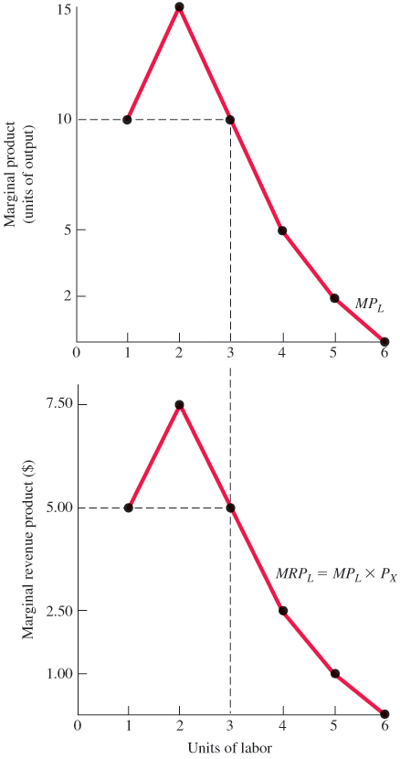
Figure 10.1 Deriving a Marginal Revenue Product Curve from Marginal Product
The marginal revenue product of labor is the price of output, P_{X}, times the marginal product of labor, MP_{L}.

Slide 10
Labor Supply
The labor supply curve traces the relationship between wage rates and the number of hours workers are willing to supply, holding other things constant.
market labor supply curve The horizontal aggregation of the individual labor supply curves for workers in an area.

Slide 11

Economics In Practice (2 of 4)
How Much Is Flexibility Worth?
Alex Mas and Amanda Pallais surveyed job applicants at a call center and found that most people were not willing to give up wages to get flexible work hours.
However, a small group of workers, especially those involved with raising a family, were willing to give up 20 percent of their wages to avoid employer discretion in hours.
CRITICAL THINKING
What characteristics of a company do you think influence it to use flex time with its workers versus one which has employer-directed irregular hours?

Slide 12
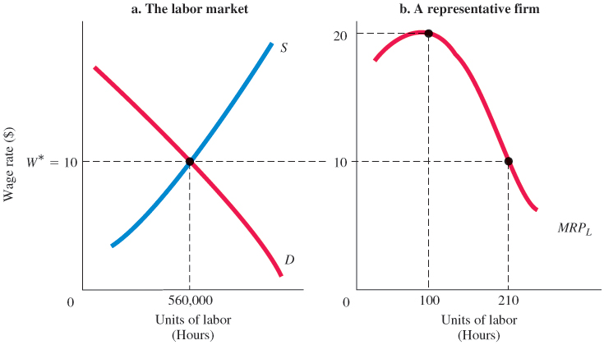
Figure 10.2 Marginal Revenue Product and Factor Demand for a Firm Using One Variable Input (Labor)
A competitive firm using only one variable factor of production will use that factor as long as its marginal revenue product exceeds its unit cost.
A perfectly competitive firm will hire labor as long as MRP_{L} is greater than the going wage, W*. The hypothetical firm will demand 210 units of labor.

Slide 13
The Firm’s Labor Market Decision
Comparing Marginal Revenue and Marginal Cost to Maximize Profits
In Chapter 8, a firm compares the marginal revenues and costs of producing one more unit of output.
Here the firm compares the marginal revenues and costs of employing another unit of input.
In both cases, the firm is comparing the cost of production with potential revenues from the sale of product at the margin.

Slide 14

Economics In Practice (3 of 4)
The National Football League Predicts Marginal Products
Each year football teams recruit college players under the draft of the National Football League. Teams can trade their draft numbers.
Two economists found that teams tend to “overpay” for the top pick in terms of the trade they make, reflecting overconfidence in predicting skill differences between closely ranked players.
CRITICAL THINKING
How would you measure the marginal productivity of one professional football player versus another?

Slide 15
Many Labor Markets
Each market has a set of skills associated with it and a supply of people with the requisite skills.
If labor markets are competitive, the wages in those markets are determined by the interaction of supply and demand.
As we have seen, firms will hire workers only as long as the value of their product exceeds the relevant market wage.
This is true in all competitive labor markets.

Slide 16
Land Markets
demand-determined price The price of a good that is in fixed supply; it is determined exclusively by what households and firms are willing to pay for the good.
pure rent The return to any factor of production that is in fixed supply.

Slide 17
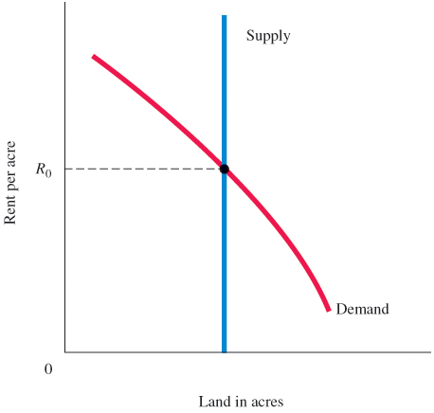
Figure 10.3 The Rent on Land Is Demand Determined
Because land in general (and each parcel in particular) is in fixed supply, its price is demand determined.
Graphically, a fixed supply is represented by a vertical, perfectly inelastic supply curve. Rent, R₀, depends exclusively on demand—what people are willing to pay.

Slide 18
Rent and the Value of Output Produced on Land (1 of 2)
A firm will pay for and use land as long as the revenue earned from selling the product produced on that land is sufficient to cover the price of the land.
Stated in equation form, the firm will use land up to the point at which MRP_{A} = P_{A}, where A is land (acres).
The allocation of a given plot of land among competing uses thus depends on the trade-off between competing products that can be produced there.

Slide 19
Rent and the Value of Output Produced on Land (2 of 2)
One final word: Because land cannot be moved physically, the value of any one parcel depends to a large extent on the uses to which adjoining parcels are put.

Slide 20

Economics In Practice (4 of 4)
Where Do You Want to Live?
Your local newspaper may have an article comparing the cost of living in your town or city to other places in the United States. The range in size and quality of houses is quite large, but construction costs are actually similar.
Housing price differences are driven much more by differences in land costs. Land in a particular location is inelastically supplied.
Price differences are demand determined, given the fixed supply.
CRITICAL THINKING
Europe has been expanding its range of high-speed trains. What do you think this might do to land prices in the areas served by these trains?

Slide 21

Input Demand Curves
Shifts in Factor Demand Curves
The Demand for Outputs
In case of labor (L):
If product demand increases, product price will rise and marginal revenue product (factor demand) will increase; the MRP curve will shift to the right.
If product demand declines, product price will fall and marginal revenue product (factor demand) will decrease; the MRP curve will shift to the left.

Slide 22
Shifts in Factor Demand Curves (1 of 2)
The Quantity of Complementary and Substitutable Inputs
The production and use of capital enhances the productivity of labor and normally increases the demand for labor and drives up wages.
The Prices of Other Inputs
When a firm has a choice among alternative technologies, the choice it makes depends to some extent on relative input prices.

Slide 23
Shifts in Factor Demand Curves (2 of 2)
Technological Change
technological change The introduction of new methods of production or new products intended to increase the productivity of existing inputs or to raise marginal products.

Slide 24
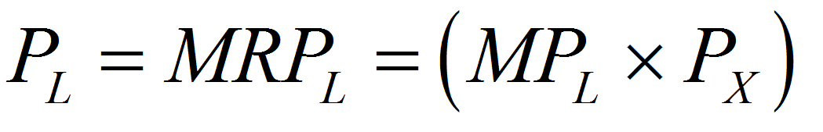
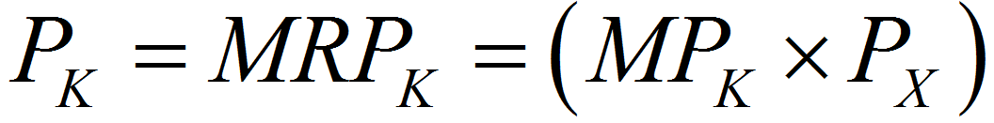
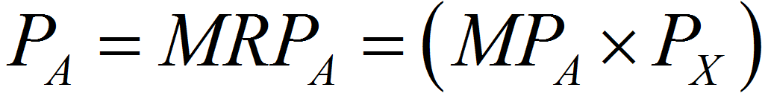
Profit-Maximizing Condition in Input Markets (1 of 2)
The profit-maximizing condition for the perfectly competitive firm is:
where L is labor, K is capital, A is land (acres), X is output, and P_{X} is the price of that output.

Slide 25
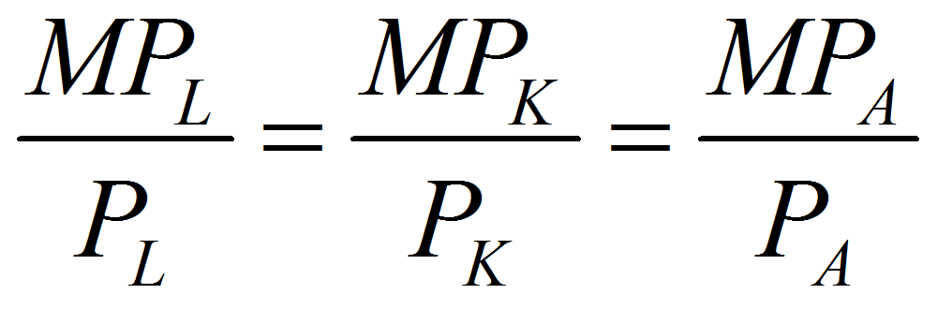
Profit-Maximizing Condition in Input Markets (2 of 2)
If all the conditions hold at the same time, it is possible to rewrite them another way:

Slide 26
Looking Ahead
We now have a complete, but simplified picture of household and firm decision making.
We derived the supply curve of a competitive firm in the short run and discussed output market adjustments in the long run.
The next chapter takes up the complexity of what we have been loosely calling the “capital market.”

Slide 27

Review Terms and Concepts
demand-determined price
derived demand
marginal product of labor (MP_{L})
marginal revenue product (MRP)
market labor supply curve
productivity of an input
pure rent
technological change
Equation:

Slide 28
Copyright
This work is protected by United States copyright laws and is provided solely for the use of instructors in teaching their courses and assessing student learning. Dissemination or sale of any part of this work (including on the World Wide Web) will destroy the integrity of the work and is not permitted. The work and materials from it should never be made available to students except by instructors using the accompanying text in their classes. All recipients of this work are expected to abide by these restrictions and to honor the intended pedagogical purposes and the needs of other instructors who rely on these materials.

