Slide 1

Principles of Economics
Thirteenth Edition
Chapter 12
General Equilibrium and the Efficiency of Perfect Competition
Copyright © 2020, 2016, 2011 Pearson Education, Inc. All Rights Reserved
Notes:
If this PowerPoint presentation contains mathematical equations, you may need to check that your computer has the following installed:
1) MathType Plugin
2) Math Player (free versions available)
3) NVDA Reader (free versions available)

Slide 2
Chapter Outline and Learning Objectives
12.1 Market Adjustment to Changes in Demand
Discuss the relationship between general equilibrium and demand shifts.
12.2 Allocative Efficiency and Competitive Equilibrium
Explain the principles of economic efficiency.
12.3 The Sources of Market Failure
Describe four sources of market failure.
12.4 Evaluating the Market Mechanism
Understand the way that market imperfections may interfere with the ability of the market to achieve efficiency.

Slide 3
Chapter 12 General Equilibrium and the Efficiency of Perfect Competition (1 of 3)
Our discussion has revolved around the two fundamental decision-making units (households and firms) that interact in two basic markets (input and output markets).
Input and output markets cannot be considered as if they were separate entities or as if they operated independently.
Although it is important to understand the decisions of individual firms and households and the functioning of individual markets, we now need to add it all up so we can look at the operation of the system as a whole.

Slide 4
Chapter 12 General Equilibrium and the Efficiency of Perfect Competition (2 of 3)
In talking about general equilibrium, we continue our exercise in positive economics. Later in the chapter, we turn to normative economics, as we begin to judge the economic system.
partial equilibrium analysis The process of examining the equilibrium conditions in individual markets and for households and firms separately.
general equilibrium The condition that exists when all markets in an economy are in simultaneous equilibrium.

Slide 5
Chapter 12 General Equilibrium and the Efficiency of Perfect Competition (3 of 3)
In judging the performance of any economic system, we use two criteria: efficiency and equity (fairness).
efficiency The condition in which the economy is producing what people want at least possible cost.

Slide 6
Market Adjustment to Changes in Demand
All economies, particularly market systems, are dynamic.
Markets experience shifts of demand, costs and technology change, and prices and output change.
Our discussion begins with the more general case of market connections.

Slide 7
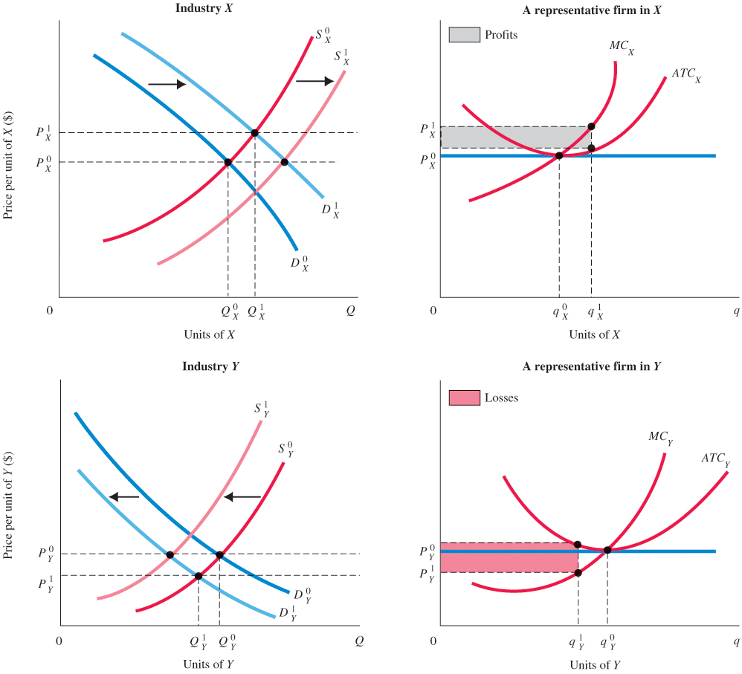
Figure 12.1 Adjustment in an Economy with Two Sectors
Initially, demand for X shifts from D⁰_{X} to D¹_{X}. This shift pushes the price of X up to P¹_{X}, creating profits.
Demand for Y shifts down from D⁰_{Y} to D¹_{Y}, pushing the price of Y down to P¹_{Y} and creating losses. Firms have an incentive to leave sector Y and an incentive to enter sector X.
Exiting sector Y shifts supply in that industry to S¹_{Y}, raising price and eliminating losses.
Entry shifts supply in X to S¹_{X}, thus reducing and eliminating profits.

Slide 8
Allocative Efficiency and Competitive Equilibrium
Pareto Efficiency
Pareto efficiency or Pareto optimality A condition in which no change is possible that will make some members of society better off without making some other members of society worse off.
For a definition of efficiency to have practical meaning, we must answer two questions:
What do we mean by “better off”?
How do we account for changes that make some people better off and others worse off?

Slide 9
Pareto Efficiency
Example: Budget Cuts in Massachusetts
Several years ago, in an effort to reduce state spending, the budget of the Massachusetts Registry of Motor Vehicles was cut substantially by reducing the number of clerks in each office.
Estimates showed that taxpayers in Massachusetts saved about $80,000 per year by having fewer clerks at that office.

Slide 10

Economics In Practice
More Corn to Burn, Less to Eat
Until January 2012, U.S. refiners were given a government subsidy of $0.45 for every gallon of ethanol they blended into their fuel.
Refiners also face mandates requiring them to blend some corn-based ethanol into their fuel.
When corn is moved into fuel, the price of corn for food rises, affecting many people throughout the world.
CRITICAL THINKING
Use general equilibrium supply and demand analysis to show the impact of requiring more corn ethanol on the market for food. Treat corn as good X and all other foods as Y.

Slide 11
The Efficiency of Perfect Competition (1 of 6)
All societies answer these basic questions in the design of their economic systems:
What gets produced? What determines the final mix of output?
How is it produced? How do capital, labor, and land get divided up among firms? In other words, what is the allocation of resources among producers?
Who gets what is produced? What determines which households get how much? What is the distribution of output among consuming households?

Slide 12
The Efficiency of Perfect Competition (2 of 6)
Under perfect competition:
Resources are efficiently allocated among firms.
Final products are distributed efficiently among households.
The system produces the things that people want.

Slide 13
The Efficiency of Perfect Competition (3 of 6)
Efficient Allocation of Resources among Firms
The assumptions that factor markets are competitive and open, that all firms pay the same prices for inputs, and that all firms maximize profits lead to the conclusion that the allocation of resources among firms is efficient.
Each individual firm needs only to make decisions about which inputs to use by looking at its own labor, capital, and land productivity relative to prices.

Slide 14
The Efficiency of Perfect Competition (4 of 6)
Efficient Allocation of Resources among Firms
Because all firms face identical input prices, the market economy achieves efficient input use among firms.
Prices are the instrument of Adam Smith’s “invisible hand,” which allows for efficiency without explicit coordination or planning.

Slide 15
The Efficiency of Perfect Competition (5 of 6)
Efficient Distribution of Outputs among Households
People have different tastes and preferences, and they buy very different things in very different combinations.
As long as everyone shops freely in the same markets, no redistribution of final outputs among people will make them better off.
If you and I buy in the same markets and pay the same prices and I buy what I want and you buy what you want, we cannot possibly end up with the wrong combination of things.
Free and open markets are essential to this result.

Slide 16
The Efficiency of Perfect Competition (6 of 6)
Producing What People Want: The Efficient Mix of Output
The condition which ensures that the right things are produced is:
Society will produce the efficient mix of output if all firms equate price and marginal cost.

Slide 17
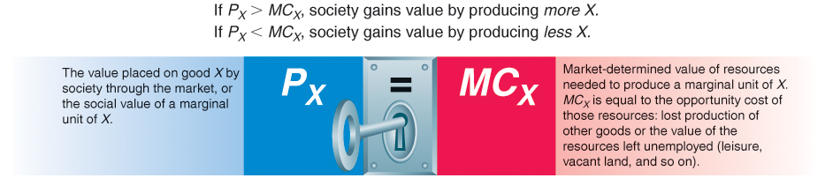
Figure 12.2 The Key Efficiency Condition: Price Equals Marginal Cost
If P_{X} > MC_{X}, society gains value by producing more X.
If P_{X} < MC_{X}, society gains value by producing less X.

Slide 18
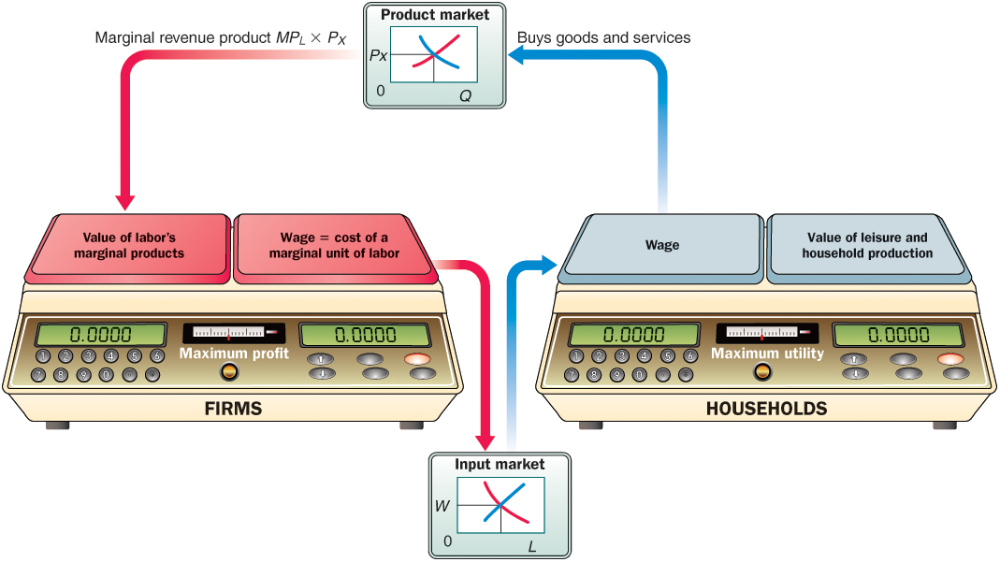
Figure 12.3 Efficiency in Perfect Competition Follows from a Weighing of Values by Both Households and Firms

Slide 19
Perfect Competition Versus Real Markets (1 of 2)
We have built a model of a perfectly competitive market system that produces an efficient allocation of resources, an efficient mix of output, and an efficient distribution of output.
The perfectly competitive model is built on a set of assumptions:
All firms and households are price-takers in input and output markets.
Firms and households have perfect information.
All firms maximize profits.

Slide 20
Perfect Competition Versus Real Markets (2 of 2)
These assumptions do not always hold in real-world markets.
When these assumptions do not hold, the conclusion breaks down that free, unregulated markets will produce an efficient outcome.

Slide 21
The Sources of Market Failure
market failure Occurs when resources are misallocated, or allocated inefficiently. The result is waste or lost surplus.
There are four important sources of market failure:
Imperfect market structure, or noncompetitive behavior
The existence of public goods
The presence of external costs and benefits
Imperfect information

Slide 22
Imperfect Competition
In imperfectly competitive markets, with fewer firms competing and limited entry by new firms, prices will not necessarily equal marginal costs.
As a consequence, in a market with firms that have some market power, where firms do not behave as price-takers, we are not guaranteed an efficient mix of output.

Slide 23
Public Goods
public goods, or social goods Goods and services that bestow collective benefits on members of society. Generally, no one can be excluded from enjoying their benefits. The classic example is national defense.

Slide 24
Externalities
externality A cost or benefit imposed or bestowed on an individual or a group that is outside, or external to, the transaction.

Slide 25
Imperfect Information
imperfect information The absence of full knowledge concerning product characteristics, available prices, and so on.

Slide 26
Evaluating the Market Mechanism
Freely functioning markets in the real world do not always produce an efficient allocation of resources, leading to a potential role for government in the economy.
However, many believe that government involvement in the economy creates more inefficiency than it cures.
In addition to the criterion of efficiency, economic systems and policies must be judged by many other criteria, such as equity, or fairness.
Indeed, some contend that the outcome of any free market is ultimately unfair.

Slide 27
Review Terms and Concepts
efficiency
externality
general equilibrium
imperfect information
market failure
Pareto efficiency or Pareto optimality
partial equilibrium analysis
public goods or social goods
Equation: key efficiency condition in perfect competition:

Slide 28
Copyright
This work is protected by United States copyright laws and is provided solely for the use of instructors in teaching their courses and assessing student learning. Dissemination or sale of any part of this work (including on the World Wide Web) will destroy the integrity of the work and is not permitted. The work and materials from it should never be made available to students except by instructors using the accompanying text in their classes. All recipients of this work are expected to abide by these restrictions and to honor the intended pedagogical purposes and the needs of other instructors who rely on these materials.

