Slide 1
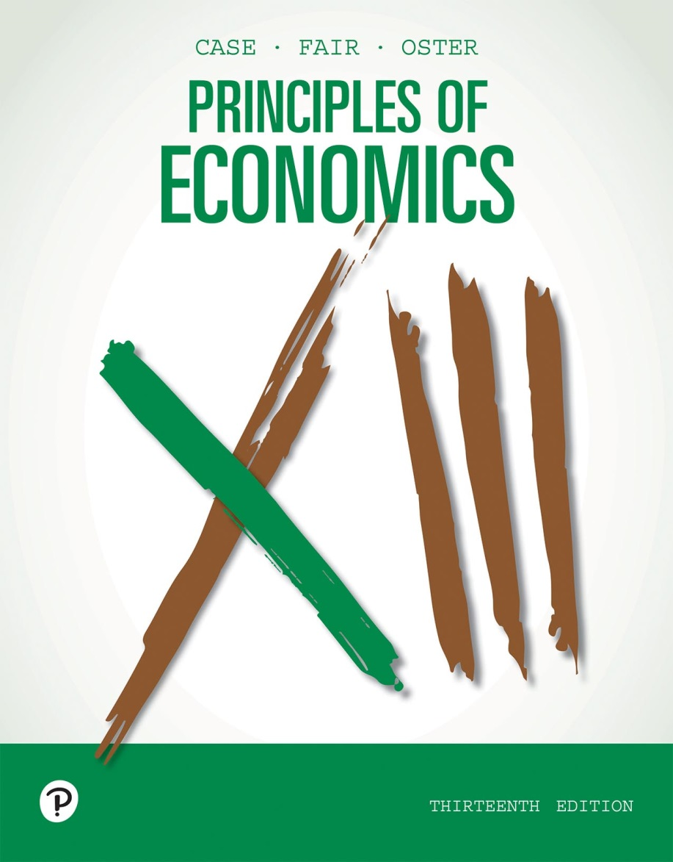
Principles of Economics (1 of 2)
Thirteenth Edition
Part III
Market Imperfections and The Role of Government
Copyright © 2020, 2016, 2011 Pearson Education, Inc. All Rights Reserved
Notes:
If this PowerPoint presentation contains mathematical equations, you may need to check that your computer has the following installed:
1) MathType Plugin
2) Math Player (free versions available)
3) NVDA Reader (free versions available)

Slide 2
Principles of Economics (2 of 2)
Thirteenth Edition
Chapter 13
Monopoly and Antitrust Policy
Copyright © 2020, 2016, 2011 Pearson Education, Inc. All Rights Reserved
Notes:
If this PowerPoint presentation contains mathematical equations, you may need to check that your computer has the following installed:
1) MathType Plugin
2) Math Player (free versions available)
3) NVDA Reader (free versions available)

Slide 3
Chapter Outline and Learning Objectives (1 of 2)
13.1 Imperfect Competition and Market Power: Core Concepts
Explain the fundamentals of imperfect competition and market power.
13.2 Price and Output Decisions in Pure Monopoly Markets
Discuss revenue and demand in monopolistic markets.
13.3 The Social Costs of Monopoly
Explain the source of the social costs for a monopoly.

Slide 4
Chapter Outline and Learning Objectives (2 of 2)
13.4 Price Discrimination
Discuss the conditions under which we find price discrimination and its results.
13.5 Remedies for Monopoly: Antitrust Policy
Summarize the functions and guidelines of federal antitrust laws.
Imperfect Markets: A Review and a Look Ahead

Slide 5
Chapter 13 Monopoly and Antitrust Policy
In 1911, the U.S. Supreme Court found that Standard Oil of New Jersey, the largest oil company in the United States, was a monopoly and ordered it be divided up.
In 1999, a U.S. court found that Microsoft had exercised monopoly power and ordered it to change its business practices.
This chapter focuses on monopoly markets in which competition is limited.

Slide 6
Imperfect Competition and Market Power: Core Concepts
imperfectly competitive industry An industry in which individual firms have some control over the price of their output.
market power An imperfectly competitive firm’s ability to raise price without losing all of the quantity demanded for its product.

Slide 7
Forms of Imperfect Competition and Market Boundaries (1 of 2)
A monopoly is an industry with a single firm in which the entry of new firms is blocked.
An oligopoly is an industry that has a small number of firms, each large enough so that its presence affects prices.
Firms that differentiate their products in industries with many producers and free entry are called monopolistic competitors.

Slide 8
Forms of Imperfect Competition and Market Boundaries (2 of 2)
pure monopoly An industry with a single firm that produces a product for which there are no close substitutes and in which significant barriers to entry prevent other firms from entering the industry to compete for profits.

Slide 9
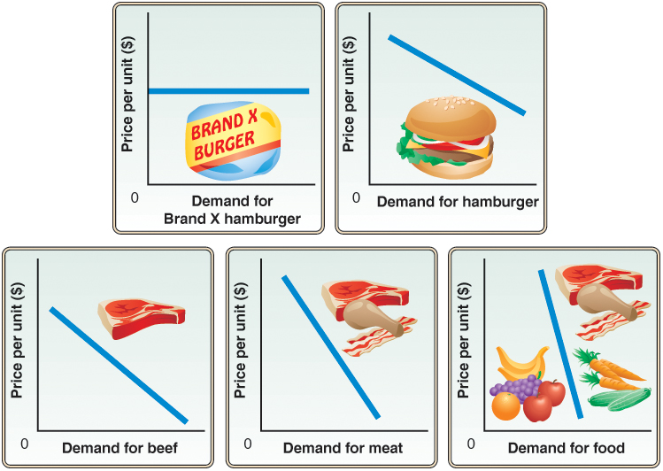
Figure 13.1 The Boundary of a Market and Elasticity
We can define an industry as broadly or as narrowly as we like. The more broadly we define the industry, the fewer substitutes there are; thus, the less elastic the demand for that industry’s product is likely to be.
A monopoly is an industry with one firm that produces a product for which there are no close substitutes. Therefore, monopolies face relatively inelastic demand curves.
The producer of Brand X hamburger cannot properly be called a monopolist because this producer has no control over market price, and there are many substitutes for Brand X hamburger.

Slide 10
Price and Output Decisions in Pure Monopoly Markets
Demand in Monopoly Markets
A monopolist does not constitute a small part of the market; it is the market.
The monopolist sets the market price by looking at the trade-off in terms of profit earned between getting more money for each unit sold and selling fewer units.

Slide 11

Economics In Practice (1 of 4)
Figuring Out the Right Price
How does an entrepreneur figure out what people are willing to pay for a completely new product?
One approach is trial and error, or “test marketing.”
Another approach is to learn about the demand of potential customers, by using “focus groups.”
Yet another approach is to use “benchmark” pricing by looking at similar products.
CRITICAL THINKING
What kind of benchmarks do you think were used in the pricing of the Kindle when it was first brought to market?

Slide 12
Demand in Monopoly Markets (1 of 3)
Marginal Revenue and Market Demand
When the demand curve is a straight line, and quantity is continuous:
MR = P + (ΔP/ ΔQ) × Q
where ΔP/ ΔQ is the slope of the inverse demand curve.
The demand curve slopes down, so ΔP/ ΔQ must be negative.
This tells us that the marginal revenue for the monopolist lies below the price.

Slide 13
Figure 13.1 Marginal Revenue Curve Facing a Monopolist
(1) Quantity | (2) Price | (3) Total Revenue | (4) Marginal Revenue
0 | $11 | 0 | -
1 | 10 | $10 | $10
2 | 9 | 18 | 8
3 | 8 | 24 | 6
4 | 7 | 28 | 4
5 | 6 | 30 | 2
6 | 5 | 30 | 0
7 | 4 | 28 | −2
8 | 3 | 24 | −4
9 | 2 | 18 | −6
10 | 1 | 10 | −8

Slide 14
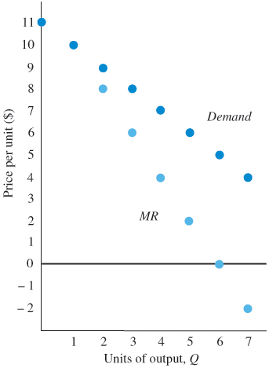
Figure 13.2 Marginal Revenue Curve Facing a Monopolist
At every level of output except 1 unit, a monopolist’s marginal revenue (MR) is below price.
This is so because (1) we assume that the monopolist must sell all its product at a single price (no price discrimination) and (2) to raise output and sell it, the firm must lower the price it charges.
Selling the additional output will raise revenue, but this increase is offset somewhat by the lower price charged for all units sold. Therefore, the increase in revenue from increasing output by 1 (the marginal revenue) is less than the price.

Slide 15
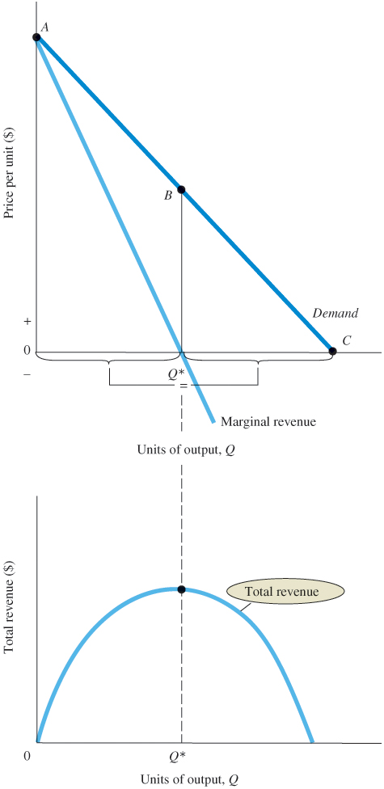
Figure 13.3 Marginal Revenue and Total Revenue
A monopoly’s marginal revenue curve bisects the quantity axis between the origin and the point where the demand curve hits the quantity axis.
A monopoly’s MR curve shows the change in total revenue that results as a firm moves along the segment of the demand curve that lies exactly above it.

Slide 16
Demand in Monopoly Markets (2 of 3)
From Figure 13.3, we know that:
We can substitute in for the value of P and the slope of the demand curve to give us:
which gives us

Slide 17
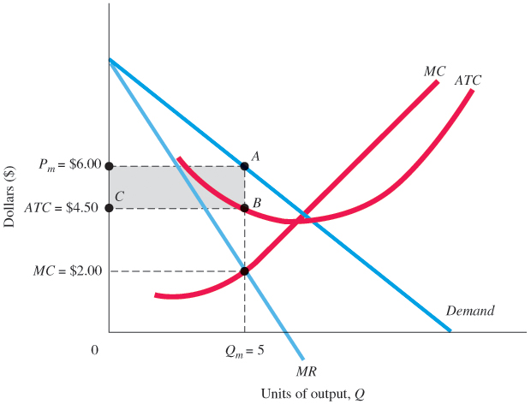
Figure 13.4 Price and Output Choice for a Profit-Maximizing Monopolist
A profit-maximizing monopolist will raise output as long as marginal revenue exceeds marginal cost.
Maximum profit is at an output of 5 units per period and a price of $6.
Above 5 units of output, marginal cost is greater than marginal revenue.
Increasing output beyond 5 units would reduce profit. At 5 units, TR = P_{m}AQ_{m}0, TC = CBQ_{m}0, and profit = P_{m}ABC.

Slide 18
Demand in Monopoly Markets (3 of 3)
The Absence of a Supply Curve in Monopoly
A monopoly firm has no supply curve that is independent of the demand curve for its product.
A monopolist sets both price and quantity, and the amount of output that it supplies depends on its marginal cost curve and the demand curve that it faces.

Slide 19
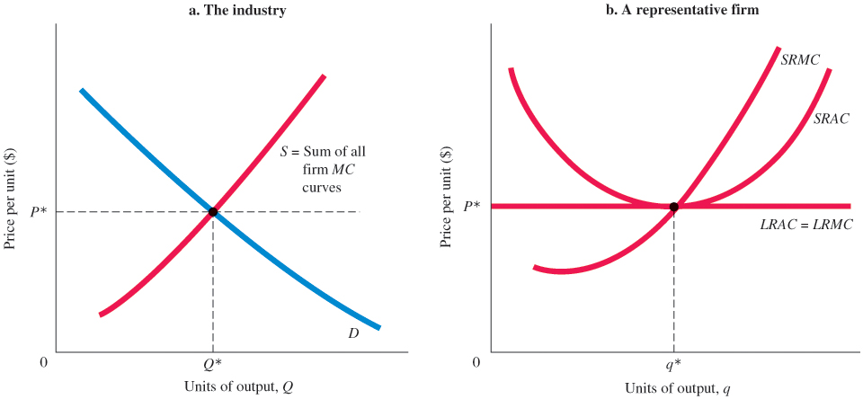
Perfect Competition and Monopoly Compared
Figure 13.5 A Perfectly Competitive Industry in Long-Run Equilibrium
In a perfectly competitive industry in the long run, price will be equal to long-run average cost. The market supply curve is the sum of all the short-run marginal cost curves of the firms in the industry.
Here we assume that firms are using a technology that exhibits constant returns to scale: LRAC is flat. Big firms enjoy no cost advantage.

Slide 20
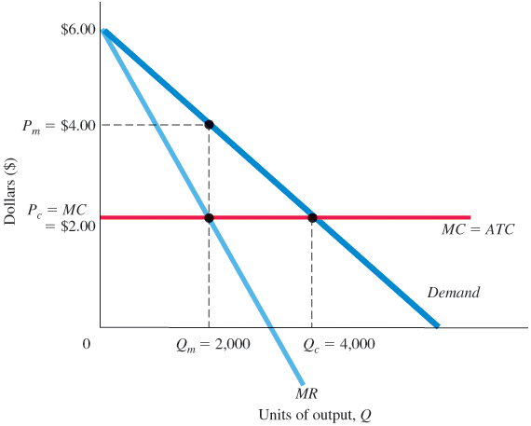
Figure 13.6 Comparison of Monopoly and Perfectly Competitive Outcomes for a Firm with Constant Returns to Scale
In the newly organized monopoly, the marginal cost curve is the same as the supply curve that represented the behavior of all the independent firms when the industry was organized competitively.
Quantity produced by the monopoly will be less than the perfectly competitive level of output, and the monopoly price will be higher than the price under perfect competition.
Under monopoly, P = P_{m} = $4 and Q = Q_{m} = 2,000.
Under perfect competition, P = Pc = $2 and Q = Q_{c} = 4,000.

Slide 21
Monopoly in the Long Run: Barriers to Entry (1 of 3)
barriers to entry Factors that prevent new firms from entering and competing in imperfectly competitive industries.
Economies of Scale
natural monopoly An industry that realizes such large economies of scale that single-firm production of that good or service is most efficient.

Slide 22
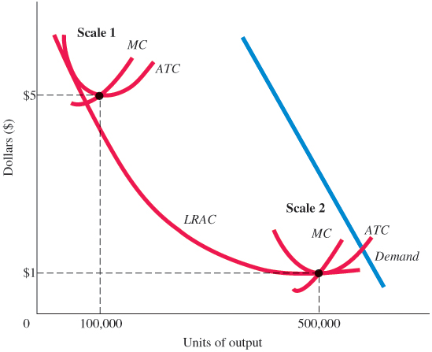
Figure 13.7 A Natural Monopoly
A natural monopoly is a firm in which the most efficient scale is very large.
Here, average total cost declines until a single firm is producing nearly the entire amount demanded in the market.
With one firm producing 500,000 units, average total cost is $1 per unit.
With five firms each producing 100,000 units, average total cost is $5 per unit.

Slide 23

Economics In Practice (2 of 4)
Patents and the Location of Multinational Corporations
Patenting creates a monopoly but it also encourages innovation through intellectual property protection.
A recent paper by Kamran Bilir suggests that multinational corporations, especially those with long product cycles so that potential imitators pose more of a risk, tend to move to countries with strong patent policies.
CRITICAL THINKING
China has relatively weak intellectual property protection. What types of multinational company activity would you expect to see in China?

Slide 24
Monopoly in the Long Run: Barriers to Entry (2 of 3)
Patents
patent A barrier to entry that grants exclusive use of the patented product or process to the inventor.
Government Rules
In some cases, governments impose entry restrictions on firms as a way of controlling activity.

Slide 25
Monopoly in the Long Run: Barriers to Entry (3 of 3)
Ownership of a Scarce Factor of Production
If production requires a particular input and one firm owns the entire supply of that input, that firm will control the industry.
Network Effects
network externalities The value of a product to a consumer increases with the number of that product being sold or used in the market.

Slide 26
The Social Costs of Monopoly
Inefficiency and Consumer Loss
deadweight loss or excess burden of a monopoly The social cost associated with the distortion in consumption from a monopoly price.

Slide 27
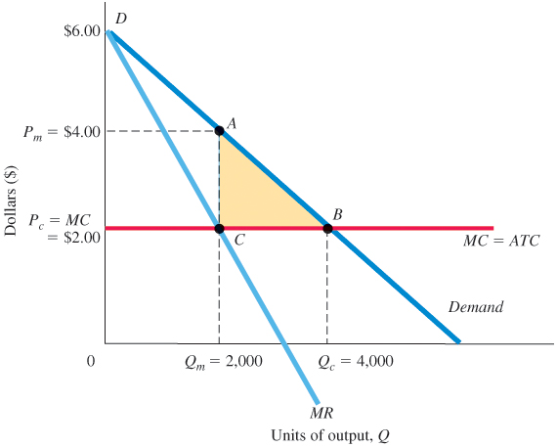
Figure 13.8 Welfare Loss from Monopoly
A demand curve shows the amounts that people are willing to pay at each potential level of output. Thus, the demand curve can be used to approximate the benefits to the consumer of raising output above 2,000 units.
MC reflects the marginal cost of the resources needed.
The triangle ABC roughly measures the net social gain of moving from 2,000 units to 4,000 units (or the loss that results when monopoly decreases output from 4,000 units to 2,000 units).

Slide 28
Rent-Seeking Behavior
rent-seeking behavior Actions taken by households or firms to preserve economic profits.
government failure Occurs when the government becomes the tool of the rent seeker and the allocation of resources is made even less efficient by the intervention of government.

Slide 29
Price Discrimination
price discrimination Charging different prices to different buyers for identical products, where these price differences are not an inflection of cost differences.
perfect price discrimination Occurs when a firm charges the maximum amount that buyers are willing to pay for each unit.

Slide 30
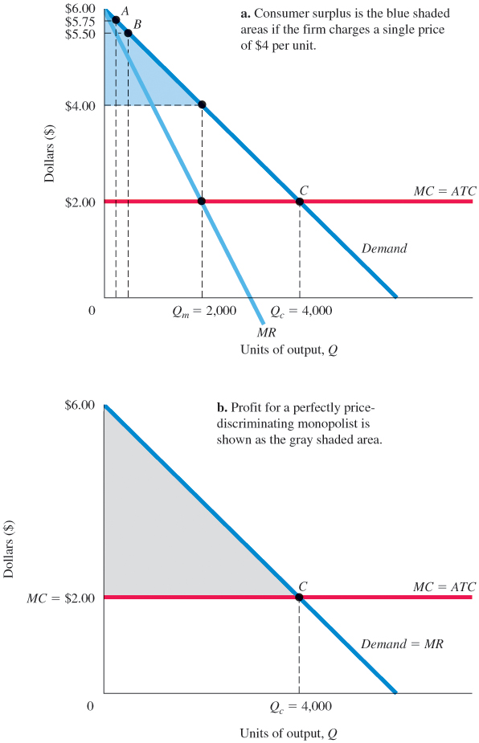
Figure 13.9 Price Discrimination
In panel (a), consumer A is willing to pay $5.75. If the price-discriminating firm can charge $5.75 to A, profit is $3.75.
A monopolist who cannot price discriminate would maximize profit by charging $4.
At a price of $4.00, the firm makes $2.00 in profit, and consumer A enjoys a consumer surplus of $1.75.
In panel (b), for a perfectly price-discriminating monopolist, the demand curve is the same as marginal revenue.
The firm will produce as long as MR > MC, up to Q_{c}.
At Q_{c}, profit is the entire shaded area, and consumer surplus is zero.

Slide 31
Examples of Price Discrimination
Movie theaters, hotels, and many other industries routinely charge lower prices for children and elderly people than for others.
With price discrimination, the objective of the firm is to segment the market into different identifiable groups, with each group having a different elasticity of demand.
The optimal strategy for a firm that can sell in more than one market is to charge higher prices in markets with low demand elasticities.
no arbitrage condition To effectively price discriminate firms must prevent customers from reselling.

Slide 32
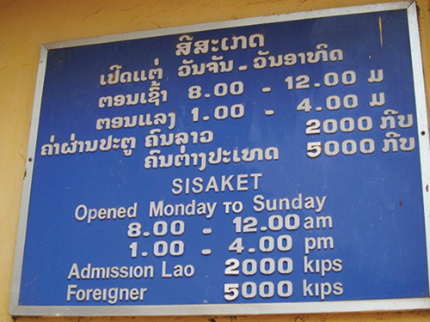

Economics In Practice (3 of 4)
Price Discrimination at Work: Laos’s Wat Si Saket
In Laos, foreigners pay 2.5 times the price Laotians pay to enter a temple.
Is this price discrimination fair?
Foreign visitors are typically much richer than local Laotians, and thus they are less elastic buyers.
Tourists also enter the temple as a single event, while local visitors are likely to make multiple visits.
CRITICAL THINKING
Many countries follow the local/foreigner price discrimination strategy. Why do you think it is unusual in the United States?

Slide 33
Remedies for Monopoly: Antitrust Policy
Major Antitrust Legislation
The Sherman Act of 1890
The substance of the Sherman Act is contained in two short sections:
Section 1. Every contract, combination in the form of trust or otherwise, or conspiracy, in restraint of trade or commerce among the several States, or with foreign nations, is hereby declared to be illegal....

Slide 34
Major Antitrust Legislation (1 of 3)
The Sherman Act of 1890
Section 2. Every person who shall monopolize, or attempt to monopolize, or combine or conspire with any other person or persons, to monopolize any part of the trade or commerce among the several States, or with foreign nations, shall be deemed guilty of a misdemeanor, and, on conviction thereof, shall be punished by fine not exceeding five thousand dollars, or by imprisonment not exceeding one year, or by both said punishments, in the discretion of the court.

Slide 35
Major Antitrust Legislation (2 of 3)
rule of reason The criterion introduced by the Supreme Court in 1911 to determine whether a particular action was illegal (“unreasonable”) or legal (“reasonable”) within the terms of the Sherman Act.

Slide 36
Major Antitrust Legislation (3 of 3)
The Clayton Act and the Federal Trade Commission, 1914
Clayton Act Passed by Congress in 1914 to strengthen the Sherman Act and clarify the rule of reason, the act outlawed specific monopolistic behaviors such as tying contracts, price discrimination, and unlimited mergers.
Federal Trade Commission (FTC) A federal regulatory group created by Congress in 1914 to investigate the structure and behavior of firms engaging in interstate commerce, to determine what constitutes unlawful “unfair” behavior, and to issue cease-and-desist orders to those found in violation of antitrust law.

Slide 37

Economics In Practice (4 of 4)
An Economist Tweets about Price Discrimination
Recently an economist complained to an airline staff about buying a “basic economy” ticket without knowing it and he wish he could have paid more for a better service.
The airline staff responded that the Basic Economy fare was for customers who might be more price sensitive.
CRITICAL THINKING
Do you agree with the airline that it is not the intention of the Basic Economy fare to encourage some passengers to pay a bit more?

Slide 38
Imperfect Markets: A Review and a Look Ahead (1 of 2)
A firm has market power when it exercises some control over the price of its output or the prices of the inputs that it uses.

Slide 39
Imperfect Markets: A Review and a Look Ahead (2 of 2)
Our focus in this chapter on pure monopoly has served a number of purposes:
The monopoly model describes a number of industries quite well.
The monopoly case shows that imperfect competition leads to an inefficient allocation of resources.
The analysis of pure monopoly offers insights into the more commonly encountered market models of monopolistic competition and oligopoly, which we will discuss in detail in the next two chapters.

Slide 40
Review Terms and Concepts
barriers to entry
Clayton Act
deadweight loss or excess burden of a monopoly
Federal Trade Commission (FTC)
government failure
imperfectly competitive industry
market power
natural monopoly
network externalities
no-arbitrage condition
patent
perfect price discrimination
price discrimination
pure monopoly
rent-seeking behavior
rule of reason

Slide 41
Copyright
This work is protected by United States copyright laws and is provided solely for the use of instructors in teaching their courses and assessing student learning. Dissemination or sale of any part of this work (including on the World Wide Web) will destroy the integrity of the work and is not permitted. The work and materials from it should never be made available to students except by instructors using the accompanying text in their classes. All recipients of this work are expected to abide by these restrictions and to honor the intended pedagogical purposes and the needs of other instructors who rely on these materials.

