Slide 1
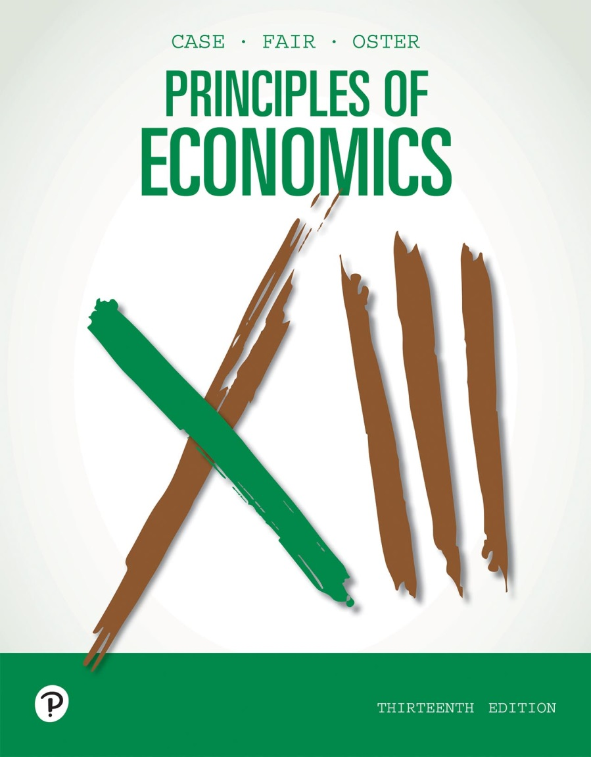
Principles of Economics
Thirteenth Edition
Chapter 15
Monopolistic Competition
Copyright © 2020, 2016, 2011 Pearson Education, Inc. All Rights Reserved
Notes:
If this PowerPoint presentation contains mathematical equations, you may need to check that your computer has the following installed:
1) MathType Plugin
2) Math Player (free versions available)
3) NVDA Reader (free versions available)

Slide 2
Chapter Outline and Learning Objectives (1 of 2)
15.1 Industry Characteristics
Identify the characteristics of a monopolistically competitive industry.
15.2 Product Differentiation and Advertising
Discuss the methods and implications of product differentiation and advertising in monopolistically competitive industries.

Slide 3
Chapter Outline and Learning Objectives (2 of 2)
15.3 Price and Output Determination in Monopolistic Competition
Discuss price and output determination for monopolistically competitive firms.
15.4 Economic Efficiency and Resource Allocation
Summarize the economic advantages and disadvantages of monopolistic competition.

Slide 4
Chapter 15 Monopolistic Competition
As with perfect competition, a monopolistically competitive industry is an industry in which entry is easy and many firms are the norm.
Unlike with perfectly competitive firms, firms in a monopolistically competitive industry do not produce homogeneous goods.
With some market power, a firm can charge a higher price than a competitor without losing all its customers.

Slide 5
Figure 15.1 Characteristics of Different Market Organizations
 | Number of firms | Products differentiated or homogeneous | Price a decision variable | Easy entry | Distinguished by | Examples
Perfect Competition | Many | Homogeneous | No | Yes | Market sets price | Wheat farmer Textile firm
Monopoly | One | One version or many versions of a product | Yes | No | Still constrained by market demand | Public utility Patented drug
Monopolistic Competition | Many | Differentiated | Yes, but limited | Yes | Price and quality competition | Restaurants Hand soap
Oligopoly | Few | Either | Yes | Limited | Strategic behavior | Automobiles Aluminum

Slide 6
Industry Characteristics
monopolistic competition A common form of industry (market) structure characterized by a large number of firms, no barriers to entry, and product differentiation.
Characteristics of a monopolistically competitive industry:
A large number of firms
No barriers to entry
Product differentiation

Slide 7
Table 15.1 Percentage of Value of Shipments Accounted for by the Largest Firms in Selected Industries, 2007
Industry Designation | Four Largest Firms | Eight Largest Firms | Twenty Largest Firms | Number of Firms
Travel trailers and campers | 40 | 50 | 63 | 756
Games, toys | 34 | 48 | 62 | 721
Wood office furniture | 40 | 52 | 65 | 438
Book printing | 42 | 54 | 66 | 558
Fresh or frozen seafood | 28 | 41 | 60 | 481
Source: U.S. Department of Commerce, Bureau of the Census, 2007 Census of Manufacturers, Concentration Ratios in Manufacturing. SubjectECO731SR12, May 2009.

Slide 8
Product Differentiation and Advertising
product differentiation A strategy that firms use to achieve market power, accomplished by producing goods that differ from others in the market.

Slide 9
How Many Varieties?
In well-working markets, the level of product variety reflects the underlying heterogeneity of consumers’ tastes in that market, the gains (if any) from coordination, and cost economies due to standardization.
In industries that are monopolistically competitive, differences in consumer tastes, lack of need for coordination, and modest or no scale economies from standardization give rise to a large number of firms, each with a different product.
Even within this industry structure, however, these same forces play a role in driving levels of variety.

Slide 10
How Do Firms Differentiate Products? (1 of 2)
horizontal differentiation Products differ in ways that make them better for some people and worse for others.
vertical differentiation A product difference that, from everyone’s perspective, makes a product better than rival products.
behavioral economics A branch of economics that uses the insights of psychology and economics to investigate decision making.

Slide 11
How Do Firms Differentiate Products? (2 of 2)
Researchers in behavioral economics have found that people highly value some choice, but too much choice can reduce purchases.
commitment device Actions that individuals take in one period to try to control their behavior in a future period.
Some consumers try to control their own purchasing behavior by, for example, buying memberships to health clubs as an incentive to work out.

Slide 12

Economics In Practice (1 of 3)
Measuring the Benefits from Variety: How Many Different Pairs of Sandals Do You Need?
Online shoe retailers like Zappos carry substantially more varieties of shoes than do brick-and-mortar stores.
Two economists find a lot of variety in consumer tastes across the country: The top 1,000 products account for 56.5% of online shoe sales in one state but only 11.3% of the sales across the country.
CRITICAL THINKING
How would you expect a profit-maximizing retailer to choose which shoes to stock in his or her store?

Slide 13
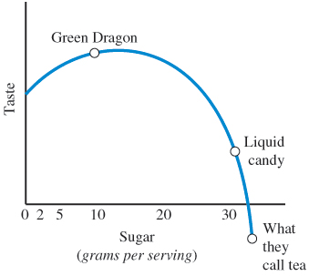
Economics In Practice (2 of 3)
An Economist Makes Tea
Despite the higher price of Honest Tea, some consumers choose it over the alternatives.
An economist used economic theory to differentiate his tea from others in the industry.
He discovered that sugar beyond some point adds little taste yet comes at a health cost—more calories.
Given consumers’ new awareness of healthy and natural foods, Honest Tea became a success.
CRITICAL THINKING
What would you expect to see happen to the placement of Green Dragon Tea if we discovered sugar was good for us?

Slide 14
Advertising (1 of 4)
One role advertising plays is to inform people about the real differences that exist among products.
Advertising can also create or contribute to product differentiation, creating a brand image for a product that has little to do with its physical characteristics.

Slide 15
Advertising (2 of 4)
The Case for Advertising
Differentiated products and advertising give the market system its vitality and are the basis of its power.
Product differentiation helps to ensure high quality and variety, and advertising provides consumers with valuable information on product availability, quality, and price that they need to make efficient choices in the marketplace.

Slide 16
Advertising (3 of 4)
The Case against Product Differentiation and Advertising
Critics argue that product differentiation and advertising are wasteful and inefficient.
Enormous sums are spent to create meaningless and possibly nonexistent differences among products.
Advertising raises the cost of products and frequently contains very little information. Often, it is merely an annoyance.
Advertising can lead to unproductive warfare and may serve as a barrier to entry, thus reducing real competition.

Slide 17
Advertising (4 of 4)
Open Questions
There are strong arguments on both sides of the advertising debate, and even the empirical evidence yields conflicting conclusions.
Some studies show that advertising leads to concentration and positive profits. Other studies show that advertising improves the functioning of the market.

Slide 18

Economics In Practice (3 of 3)
Oprah Winfrey’s Celebrity Endorsements Sell Books!
Do celebrity endorsements really increase sales?
An economist at Northwestern University finds that an endorsement by Oprah Winfrey’s book club raises book sales from the endorsed author, but there is no increase in demand for the book category as a whole.
CRITICAL THINKING
Do you think the Oprah effect is likely to be similar to the endorsement effect of Theron or Harris?

Slide 19
Price and Output Determination in Monopolistic Competition
Product Differentiation and Demand Elasticity
When a firm can distinguish its product from all others in the minds of consumers, it can raise its price without losing all quantity demanded.

Slide 20
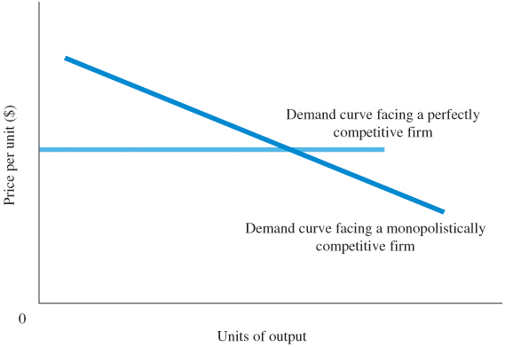
Figure 15.2 Product Differentiation Reduces the Elasticity of Demand Facing a Firm
The demand curve that a monopolistic competitor faces is likely to be less elastic than the demand curve that a perfectly competitive firm faces.
Demand is more elastic than the demand curve that a monopolist faces because close substitutes for the products of a monopolistic competitor are available.

Slide 21
Price/Output Determination in the Short Run
A profit-maximizing monopolistically competitive firm behaves much like a monopolist in the short run.
Marginal revenue is not equal to price.
The monopolistic competitor’s MR curve lies below its demand curve, intersecting the quantity axis midway between the origin and the point at which the demand curve intersects it.
The firm chooses the output/price combination that maximizes profit.

Slide 22
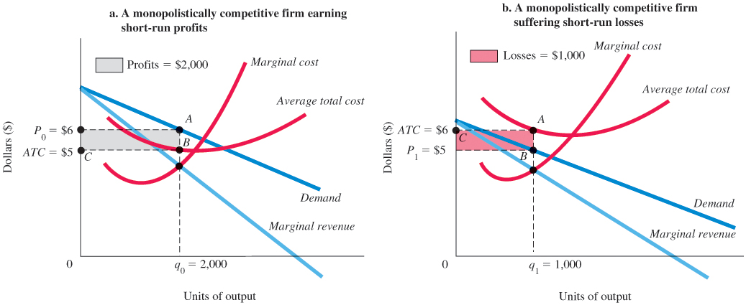
Figure 15.3 Monopolistic Competition in the Short Run
In the short run, a monopolistically competitive firm will produce up to the point MR = MC.
At q₀ = 2,000 in panel (a), the firm is earning short-run profits equal to P₀ ABC = $2,000.
In panel (b), another monopolistically competitive firm with a similar cost structure is shown facing a weaker demand and suffering short-run losses at q₁ that are equal to CABP₁ = $1,000.

Slide 23
Price/Output Determination in the Long Run
Entry and exit are easy in the long run under monopolistic competition.
Profits provide an incentive for new firms to enter the industry, and firms that suffer losses can go out of business.

Slide 24
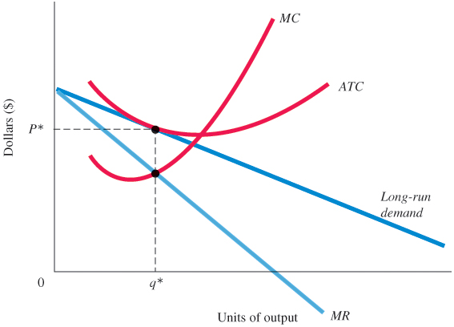
Figure 15.4 Monopolistically Competitive Firm at Long-Run Equilibrium
As new firms enter a monopolistically competitive industry in search of profits, the demand curves of existing profit-making firms begin to shift to the left, pushing marginal revenue with them as consumers switch to the new close substitutes.
This process continues until profits are eliminated, which occurs for a firm when its demand curve is just tangent to its average total cost curve.

Slide 25
Economic Efficiency and Resource Allocation (1 of 2)
Because entry is easy and economic profits are eliminated in the long run, monopolistic competition is efficient.
However, there are two problems:
Once a firm achieves any degree of market power by differentiating its product, its profit-maximizing strategy is to hold down production and charge a price above marginal cost.
The equilibrium in a monopolistically competitive firm is necessarily to the left of the low point on its average total cost curve, which means a typical firm will not realize all the economies of scale available.

Slide 26
Economic Efficiency and Resource Allocation (2 of 2)
Nonetheless, if product differentiation leads to the introduction of new products, improvements in old products, and greater variety, an important gain in economic welfare may at least counteract those problems.

Slide 27
Review Terms and Concepts
behavioral economics
commitment device
horizontal differentiation
monopolistic competition
product differentiation
vertical differentiation

Slide 28
Copyright
This work is protected by United States copyright laws and is provided solely for the use of instructors in teaching their courses and assessing student learning. Dissemination or sale of any part of this work (including on the World Wide Web) will destroy the integrity of the work and is not permitted. The work and materials from it should never be made available to students except by instructors using the accompanying text in their classes. All recipients of this work are expected to abide by these restrictions and to honor the intended pedagogical purposes and the needs of other instructors who rely on these materials.

