Slide 1
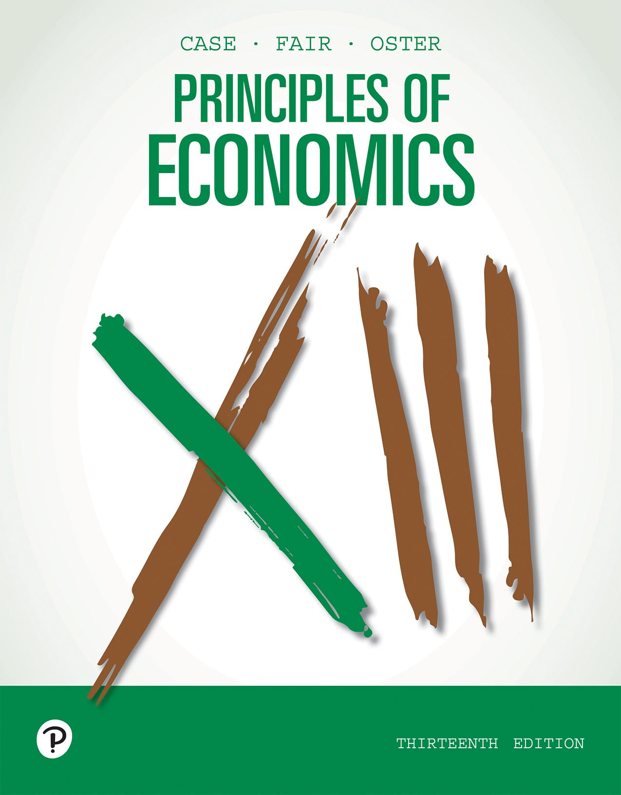
Principles of Economics
Thirteenth Edition
Chapter 2
The Economic Problem: Scarcity and Choice
Copyright © 2020, 2016, 2011 Pearson Education, Inc. All Rights Reserved
Notes:
If this PowerPoint presentation contains mathematical equations, you may need to check that your computer has the following installed:
1) MathType Plugin
2) Math Player (free versions available)
3) NVDA Reader (free versions available)

Slide 2
Chapter Outline and Learning Objectives
2.1 Scarcity, Choice, and Opportunity Cost
Understand why even in a society in which one person is better than a second at all tasks, it is still beneficial for the two to specialize and trade.
2.2 Economic Systems and the Role of Government
Understand the central difference in the way command economies and market economies decide what is produced.
Looking Ahead

Slide 3
Chapter 2 The Economic Problem: Scarcity and Choice (1 of 2)
On the surface, economic issues seem quite different from one another.
But the fundamental concern is choice in a world of scarcity.
Individuals’ choices determine three key features of society:
What gets produced?
How is it produced?
Who gets what is produced?

Slide 4
Chapter 2 The Economic Problem: Scarcity and Choice (2 of 2)
capital Things that are produced and then used in the production of other goods and services.
factors of production (or factors) The inputs into the process of production. Another term for resources.
production The process that transforms scarce resources into useful goods and services.
inputs or resources Anything provided by nature or previous generations that can be used directly or indirectly to satisfy human wants.
outputs Goods and services of value to households.

Slide 5
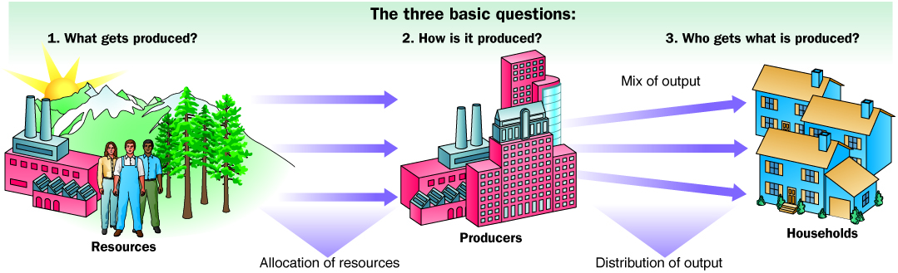
Figure 2.1 The Three Basic Questions
Every society has some system or process that transforms its scarce resources into useful goods and services.
In doing so, it must decide what gets produced, how it is produced, and to whom it is distributed.
The primary resources that must be allocated are land, labor, and capital.

Slide 6
Scarcity, Choice, and Opportunity Cost
Scarcity and Choice in a One-Person Economy
Nearly all the same basic decisions that characterize complex economies must also be made in a simple economy.
A person must decide what to produce and how and when to produce it.

Slide 7
Scarcity and Choice in a One-Person Economy
Opportunity Cost
The concepts of constrained choice and scarcity are central to the discipline of economics.
opportunity cost The best alternative that we give up, or forgo, when we make a choice or decision.

Slide 8

Economics In Practice (1 of 2)
Frozen Foods and Opportunity Costs
The growth of the frozen dinner entrée market in the last 50 years is a good example of the role of opportunity costs in our lives.
Many entrepreneurs find that the simple tools of economics—like the idea of opportunity costs—help them anticipate what products will be profitable for them to produce in the future.
CRITICAL THINKING
Many people think that soda consumption also leads to increased obesity. Many schools have banned the sale of soda in vending machines. Use the idea of opportunity costs to explain why some people think these bans will reduce consumption. Do you agree?

Slide 9
Scarcity and Choice in an Economy of Two or More (1 of 2)
Specialization, Exchange, and Comparative Advantage
theory of comparative advantage Ricardo’s theory that specialization and free trade will benefit all trading parties, even those that may be “absolutely” more efficient producers.
absolute advantage A producer has an absolute advantage over another in the production of a good or service if he or she can produce that product using fewer resources (a lower absolute cost per unit).
comparative advantage A producer has a comparative advantage over another in the production of a good or service if he or she can produce that product at a lower opportunity cost.

Slide 10
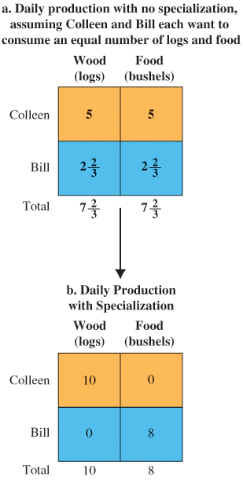
Figure 2.2 Comparative Advantage and the Gains from Trade
Panel (a) shows the best Colleen and Bill can do each day, given their talents and assuming they each wish to consume an equal amount of food and wood.
Notice that Colleen produces by splitting her time equally during the day, while Bill must devote two-thirds of his time to wood production if he wishes to equalize his amount produced of the two goods.
Panel (b) shows what happens when both parties specialize. Notice that more units of each good are produced.

Slide 11
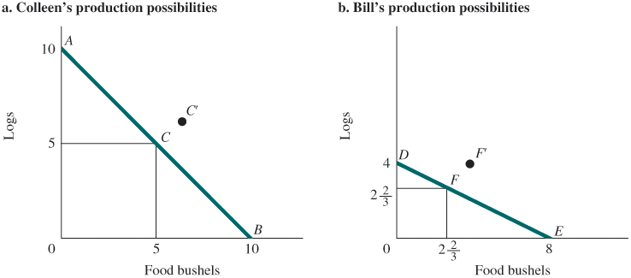
Figure 2.3 Production Possibilities with and without Trade
This figure shows the combinations of food and wood that Colleen and Bill can each generate in one day of labor, working by themselves. Colleen can achieve independently any point along line ACB, while Bill can generate any combination of food and wood along line DFE.
Specialization and trade would allow both Bill and Colleen to move to the right of their original lines, to points like C′ and F′. In other words, specialization and trade allow both people to be better off than they were acting alone.

Slide 12
Scarcity and Choice in an Economy of Two or More (2 of 2)
Weighing Present and Expected Future Costs and Benefits
We trade off present and future benefits in small ways all the time.
Capital Goods and Consumer Goods
consumer goods Goods produced for present consumption.
investment The process of using resources to produce new capital.

Slide 13
The Production Possibility Frontier (1 of 7)
production possibility frontier (ppf) A graph that shows all the combinations of goods and services that can be produced if all of society’s resources are used efficiently.

Slide 14
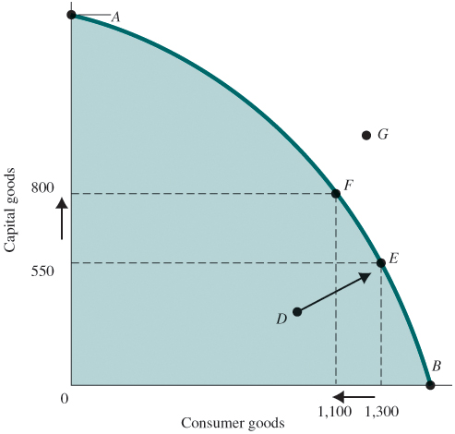
Figure 2.4 Production Possibility Frontier
The ppf illustrates a number of economic concepts. One of the most important is opportunity cost.
The opportunity cost of producing more capital goods is fewer consumer goods.
Moving from E to F, the number of capital goods increases from 550 to 800, but the number of consumer goods decreases from 1,300 to 1,100.

Slide 15
The Production Possibility Frontier (2 of 7)
Negative Slope and Opportunity Cost
marginal rate of transformation (MRT) The slope of the production possibility frontier (ppf).
The negative slope tells us how much society has to give up of one output to get a unit of another output.

Slide 16
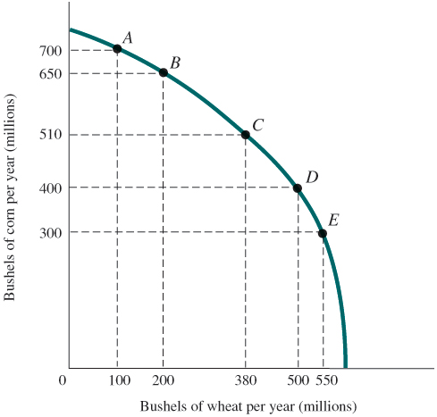
The Production Possibility Frontier (3 of 7)
The Law of Increasing Opportunity Cost
FIGURE 2.5 Corn and Wheat Production in Ohio and Kansas
The ppf illustrates that the opportunity cost of corn production increases as we shift resources from wheat production to corn production. Moving from point E to D, we get an additional 100 million bushels of corn at a cost of 50 million bushels of wheat.
Moving from point B to A, we get only 50 million bushels of corn at a cost of 100 million bushels of wheat. The cost per bushel of corn—measured in lost wheat—has increased.

Slide 17
Table 2.1 Production Possibility Schedule for Total Corn and Wheat Production in Ohio and Kansas
Point on ppf | Total Corn Production (Millions of Bushels Per Year) | Total Wheat Production (Millions of Bushels Per Year)
A | 700 | 100
B | 650 | 200
C | 510 | 380
D | 400 | 500
E | 300 | 550
The ppf illustrates that the opportunity cost of corn production increases as we shift resources from wheat production to corn production. Moving from point E to D, we get an additional 100 million bushels of corn at a cost of 50 million bushels of wheat.
Moving from point B to A, we get only 50 million bushels of corn at a cost of 100 million bushels of wheat. The cost per bushel of corn—measured in lost wheat—has increased.

Slide 18
The Production Possibility Frontier (4 of 7)
Unemployment
During economic downturns or recessions, industrial plants run at less than their total capacity.
When there is unemployment of labor, we are not producing all that we can.

Slide 19
The Production Possibility Frontier (5 of 7)
Inefficiency
Waste and mismanagement are the results of a firm operating below its potential.
Sometimes inefficiency results from mismanagement of the economy instead of mismanagement of individual private firms.

Slide 20
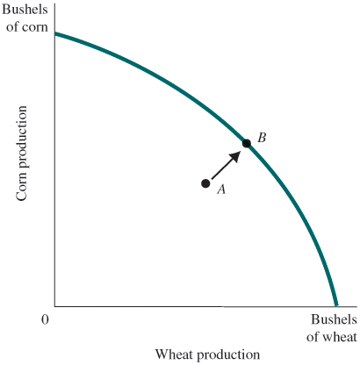
Figure 2.6 Inefficiency from Misallocation of Land in Farming
Inefficiency always results in a combination of production shown by a point inside the ppf, like point A.
Increasing efficiency will move production possibilities toward a point on the ppf, such as point B.

Slide 21
The Production Possibility Frontier (6 of 7)
The Efficient Mix of Output
To be efficient, an economy must produce what people want.
Output efficiency occurs when the economy is operating at the “right” point on the ppf.

Slide 22
The Production Possibility Frontier (7 of 7)
Economic Growth
economic growth An increase in the total output of an economy. Growth occurs when a society acquires new resources or when it learns to produce more using existing resources.
Growth shifts the ppf up and to the right.

Slide 23
Table 2.2 Increasing Productivity in Corn and Wheat Production in the United States, 1935–2017
Blank | Corn | Wheat
Blank | Yield per Acre (Bushels) | Yield per Acre (Bushels)
1935–1939 | 26.1 | 13.2
1945–1949 | 36.1 | 16.9
1955–1959 | 48.7 | 22.3
1965–1969 | 78.5 | 27.5
1975–1979 | 95.3 | 31.3
1981–1985 | 107.2 | 36.9
1985–1990 | 112.8 | 38.9
1990–1995 | 120.6 | 38.1
1998 | 134.4 | 43.2
2001 | 138.2 | 43.5
2006 | 145.6 | 42.3
2007 | 152.8 | 40.6
2008 | 153.9 | 44.9
2009 | 164.9 | 44.3
2010 | 152.8 | 46.4
2011 | 147.2 | 43.7
2012 | 123.4 | 46.3
2013 | 158.8 | 47.2
2014 | 171.0 | 43.7
2015 | 168.4 | 43.6
2016 | 174.6 | 52.7
2017 | 176.6 | 46.3
Source: U.S. Department of Agriculture, Economic Research Service, Agricultural Statistics, Crop Summary.

Slide 24
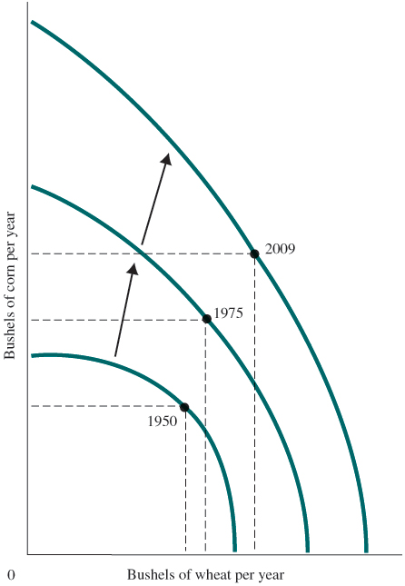
Figure 2.7 Economic Growth Shifts the PPF Up and to the Right
Productivity increases have enhanced the ability of the United States to produce both corn and wheat.
As Table 2.2 shows, productivity increases were more dramatic for corn than for wheat. Thus, the shifts in the ppf were not parallel.
Notes:
Note: The ppf also shifts if the amount of land or labor in corn and wheat production changes. Although we emphasize productivity increases here, the actual shifts between years were due in part to land and labor changes.

Slide 25
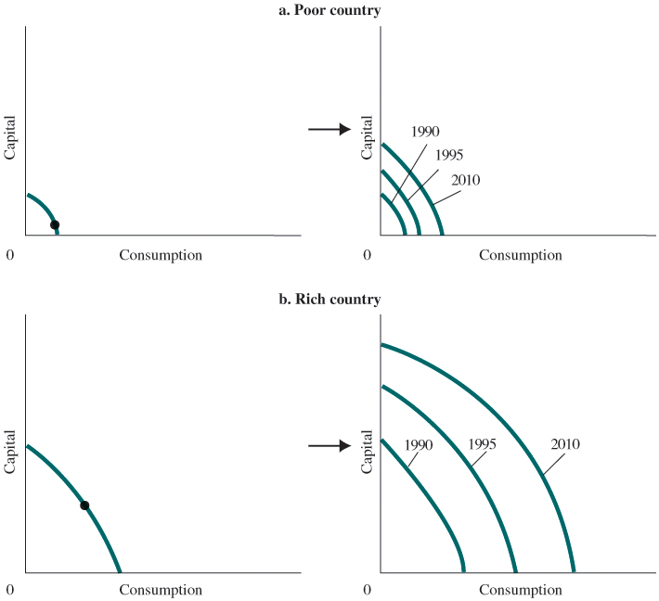
Figure 2.8 Capital Goods and Growth in Poor and Rich Countries
Rich countries find it easier than poor countries to devote resources to the production of capital, and the more resources that flow into capital production, the faster the rate of economic growth.
Thus, the gap between poor and rich countries has grown over time.

Slide 26

Economics In Practice (2 of 2)
Trade-Offs among the Rich and Poor
In all societies, for all people, resources are limited relative to people’s demands.
In 1990, the World Bank defined the extremely poor people of the world as those earning less than $1 a day.
Even for the poorest consumers, biological need is not all determining. So even in extremely poor societies, household choice plays a role.
CRITICAL THINKING
Why might we see a greater demand for festivals in poor countries than in rich ones? How might this be affected by choices available?

Slide 27
The Economic Problem
Recall the three basic questions facing all economic systems:
What gets produced?
How is it produced?
Who gets it?
Given scarce resources, how do large, complex societies go about answering the three basic economic questions?

Slide 28
Economic Systems and the Role of Government (1 of 7)
Command Economies
command economy An economy in which a central government either directly or indirectly sets output targets, incomes, and prices.
Laissez-Faire Economies: The Free Market
laissez-faire economy Literally from the French: “allow [them] to do.” An economy in which individual people and firms pursue their own self-interest without any central direction or regulation.

Slide 29
Economic Systems and the Role of Government (2 of 7)
market The institution through which buyers and sellers interact and engage in exchange.
Some markets are simple and others are complex, but they all involve buyers and sellers engaging in exchange.
The behavior of buyers and sellers in a laissez-faire economy determines what gets produced, how it is produced, and who gets it.

Slide 30
Economic Systems and the Role of Government (3 of 7)
Consumer Sovereignty
consumer sovereignty The idea that consumers ultimately dictate what will be produced (or not produced) by choosing what to purchase (and what not to purchase).
The mix of output is dictated by consumers who “vote” by buying or not buying.

Slide 31
Economic Systems and the Role of Government (4 of 7)
Individual Production Decisions: Free Enterprise
Under a free market system, individual producers must determine how to organize and coordinate their production.
In a free market economy, production decisions are made by private organizations acting in their own interest.

Slide 32
Economic Systems and the Role of Government (5 of 7)
Distribution of Output
A household’s income affects the amount of output it can get.
Income is the amount that a household earns each year. It comes in a number of forms, such as wages, salaries, and interest.
You may be able to increase your income by getting more education or training.

Slide 33
Economic Systems and the Role of Government (6 of 7)
Price Theory
In a free market system, the basic economic questions are answered without the help of a central government plan or directives.
This is what the “free” in free market means—the system is left to operate on its own, with no outside interference. Individuals pursuing their own self-interest will go into business and produce the products and services that people want.

Slide 34
Economic Systems and the Role of Government (7 of 7)
Price Theory
Other individuals will decide whether to acquire skills; whether to work; and whether to buy, sell, invest, or save the income that they earn.
The basic coordinating mechanism is price.

Slide 35
Mixed Systems, Markets, and Governments
The differences between command economies and laissez-faire economies in their pure forms are enormous.
In fact, these pure forms do not exist in the world.
All real systems are in some sense “mixed.”

Slide 36
Looking Ahead
This chapter described the economic problem in broad terms.
We outlined the questions that all economic systems must answer.
We also discussed broadly the two kinds of economic systems.
In the next chapter, we analyze the way market systems work.

Slide 37
Review Terms and Concepts
absolute advantage
capital
command economy
comparative advantage
consumer goods
consumer sovereignty
economic growth
factors of production (or factors)
inputs or resources
investment
laissez-faire economy
marginal rate of transformation (MRT)
market
opportunity cost
outputs
production
production possibility frontier (ppf)
theory of comparative advantage

Slide 38
Copyright
This work is protected by United States copyright laws and is provided solely for the use of instructors in teaching their courses and assessing student learning. Dissemination or sale of any part of this work (including on the World Wide Web) will destroy the integrity of the work and is not permitted. The work and materials from it should never be made available to students except by instructors using the accompanying text in their classes. All recipients of this work are expected to abide by these restrictions and to honor the intended pedagogical purposes and the needs of other instructors who rely on these materials.

