Slide 1

Principles of Economics (1 of 2)
Thirteenth Edition
Part IV
Concepts and Problems In Macroeconomics
Copyright © 2020, 2016, 2011 Pearson Education, Inc. All Rights Reserved
Notes:
If this PowerPoint presentation contains mathematical equations, you may need to check that your computer has the following installed:
1) MathType Plugin
2) Math Player (free versions available)
3) NVDA Reader (free versions available)

Slide 2
Part IV Concepts and Problems In Macroeconomics
When the macroeconomy is doing well, jobs are easy to find, incomes are generally rising, and profits of corporations are high.
If the macroeconomy is in a slump, new jobs are scarce, incomes are not growing, and profits are low.
Given the large effect that the macroeconomy can have on our lives, it is important that we understand how it works.

Slide 3
Principles of Economics (2 of 2)
Thirteenth Edition
Chapter 20
Introduction to Macroeconomics
Slides in this presentation contain hyperlinks. JAWS users should be able to get a list of links by using INSERT+F7
Copyright © 2020, 2016, 2011 Pearson Education, Inc. All Rights Reserved

Slide 4
Chapter Outline and Learning Objectives
20.1 Macroeconomic Concerns
Describe the primary three concerns of macroeconomics.
20.2 The Components of the Macroeconomy
Discuss the interaction between the four components of the macroeconomy.
20.3 A Brief History of Macroeconomics
Summarize the macroeconomic history of the United States between 1929 and 1970.
20.4 The U.S. Economy since 1970
Describe the U.S. economy since 1970.

Slide 5
Chapter 20 Introduction to Macroeconomics (1 of 2)
microeconomics Examines the functioning of individual industries and the behavior of individual decision-making units—firms and households.
macroeconomics Deals with the economy as a whole. Macroeconomics focuses on the determinants of total national income, deals with aggregates such as aggregate consumption and investment, and looks at the overall level of prices instead of individual prices.

Slide 6
Chapter 20 Introduction to Macroeconomics (2 of 2)
aggregate behavior The behavior of all households and firms together.
sticky prices Prices that do not always adjust rapidly to maintain equality between quantity supplied and quantity demanded.

Slide 7
Macroeconomic Concerns
Three of the major concerns of macroeconomics are:
Output growth
Unemployment
Inflation and deflation

Slide 8
Output Growth (1 of 2)
business cycle The cycle of short-term ups and downs in the economy.
aggregate output The total quantity of goods and services produced in an economy in a given period.

Slide 9
Output Growth (2 of 2)
expansion or boom The period in the business cycle from a trough up to a peak during which output and employment grow.
contraction, recession, or slump The period in the business cycle from a peak down to a trough during which output and employment fall.
depression A prolonged and deep recession.

Slide 10
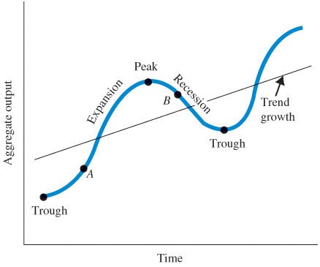
Figure 20.1 A Typical Business Cycle
In this business cycle, the economy is expanding as it moves through point A from the trough to the peak.
When the economy moves from a peak down to a trough, through point B, the economy is in recession

Slide 11
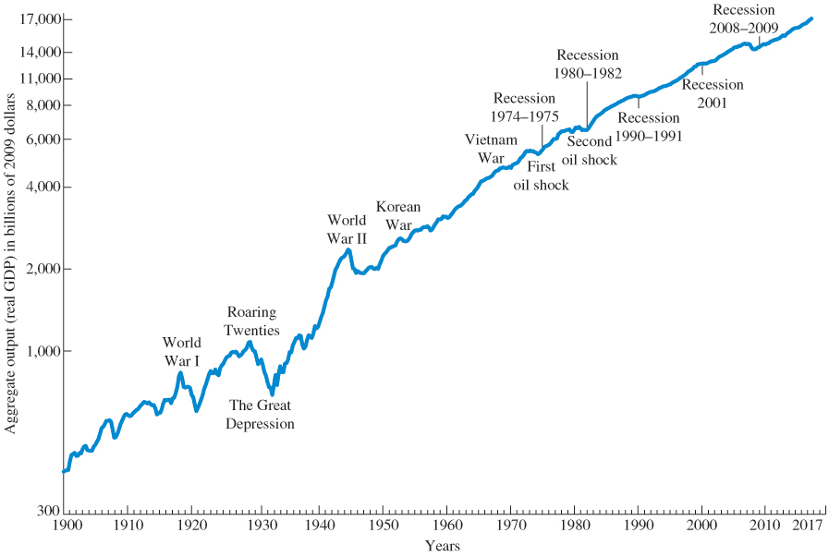
Figure 20.2 U.S. Aggregate Output (Real G D P), 1900–2017
The periods of the Great Depression and World Wars I and II show the largest fluctuations in aggregate output.

Slide 12
Unemployment
unemployment rate The percentage of the labor force that is unemployed.
The existence of unemployment seems to imply that the aggregate labor market is not in equilibrium.

Slide 13
Inflation and Deflation
inflation An increase in the overall price level.
hyperinflation A period of very rapid increases in the overall price level.
deflation A decrease in the overall price level.

Slide 14
The Components of the Macroeconomy
To see the big picture of the macroeconomy, we divide the participants in the economy into four broad groups:
Households
Firms
The government
The rest of the world
Households and firms make up the private sector, the government is the public sector, and the rest of the world is the foreign sector.

Slide 15
The Circular Flow Diagram
circular flow A diagram showing the flows in and out of the sectors in the economy.
transfer payments Cash payments made by the government to people who do not supply goods, services, or labor in exchange for these payments. They include Social Security benefits, veterans’ benefits, and welfare payments.

Slide 16
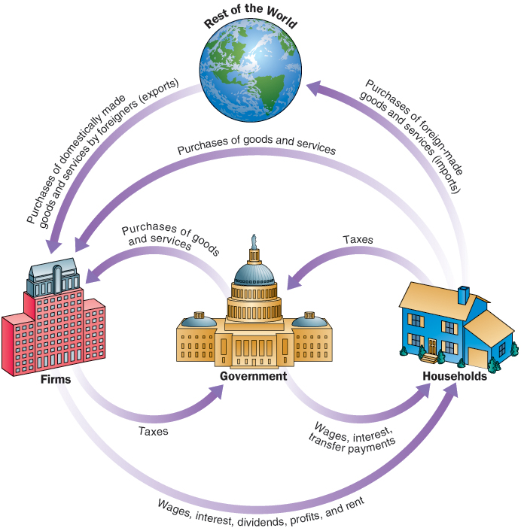
Figure 20.3 The Circular Flow of Payments
Households receive income from firms and the government, purchase goods and services from firms, and pay taxes to the government. They also purchase foreign-made goods and services (imports).
Firms receive payments from households and the government for goods and services; they pay wages, dividends, interest, and rents to households and taxes to the government.
The government receives taxes from firms and households, pays firms and households for goods and services—including wages to government workers—and pays interest and transfers to households.
Finally, people in other countries purchase goods and services produced domestically (exports).
Note: Although not shown in this diagram, firms and governments also purchase imports.

Slide 17
The Three Market Arenas (1 of 6)
Another way of looking at the ways households, firms, the government, and the rest of the world relate to one another is to consider the markets in which they interact.
We divide the markets into three broad arenas:
The goods-and-services market
The labor market
The money (financial) market

Slide 18
The Three Market Arenas (2 of 6)
Goods-and-Services Market
Households and the government purchase goods and services from firms in the goods-and-services market.
Firms purchase goods and services from each other and also supply to the goods-and-services market.
Households, the government, and firms demand from this market.
The rest of the world buys from and sells to the goods-and-services market.

Slide 19
The Three Market Arenas (3 of 6)
Labor Market
In the labor market, households supply labor, and firms and the government demand labor.
Labor is also supplied to and demanded from the rest of the world.

Slide 20
The Three Market Arenas (4 of 6)
Money Market
Households supply funds to the money market (or financial market) in the expectation of earning income in the form of dividends on stocks and interest on bonds.
Households also demand (borrow) funds from this market to finance various purchases.
Firms borrow to build new facilities in the hope of earning more in the future.

Slide 21
The Three Market Arenas (5 of 6)
Money Market
The government borrows by issuing bonds.
The rest of the world borrows from and lends to the money market.
Much of this borrowing and lending is coordinated by financial institutions, which take deposits from one group and lend them to others.

Slide 22
The Three Market Arenas (6 of 6)
Money Market
Treasury bonds, notes, or bills Promissory notes issued by the federal government when it borrows money.
corporate bonds Promissory notes issued by corporations when they borrow money.
shares of stock Financial instruments that give to the holder a share in the firm’s ownership and therefore the right to share in the firm’s profits.
dividends The portion of a firm’s profits that the firm pays out each period to its shareholders.

Slide 23
The Role of the Government in the Macroeconomy
fiscal policy Government policies concerning taxes and spending.
monetary policy The tools used by the Federal Reserve to control short-term interest rates.

Slide 24
A Brief History of Macroeconomics
Great Depression The period of severe economic contraction and high unemployment that began in 1929 and continued throughout the 1930s.
fine-tuning The phrase used by Walter Heller to refer to the government’s role in regulating inflation and unemployment.
stagflation A situation of both high inflation and high unemployment.

Slide 25
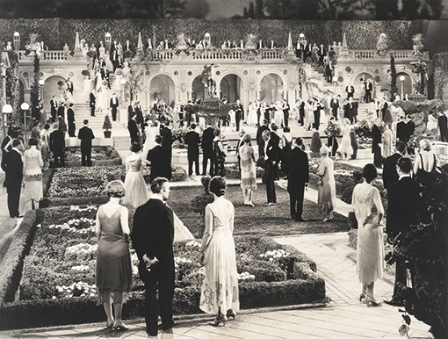
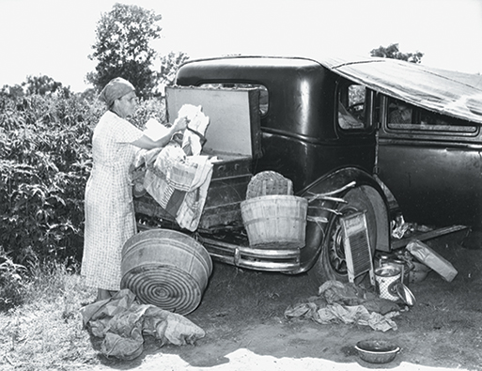
Economics In Practice
Macroeconomics in Literature
The underlying phenomena that economists study are the stuff of novels as well as graphs and equations.
If you look at Figure 20.2 for these two periods, you will see the translation of Fitzgerald and Steinbeck into macroeconomics.
The Great Gatsby, set in the 1920s
CRITICAL THINKING
As we indicate in the introduction to this chapter, macroeconomics focuses on three concerns. Which of these concerns is covered in The Grapes of Wrath excerpt?
What economics textbook is featured in The Great Gatsby?
Hint: Go to fairmodel.com.yale.edu/rayfair/pdf/2000c.pdf.
The Grapes of Wrath, set in the early 1930s
Source: From The Grapes of Wrath by John Steinbeck, copyright 1939, renewed © 1967 by John Steinbeck. Used by permission of Viking Penguin, a division of Penguin Group (USA) Inc. and Penguin Group (UK) Ltd.

Slide 26
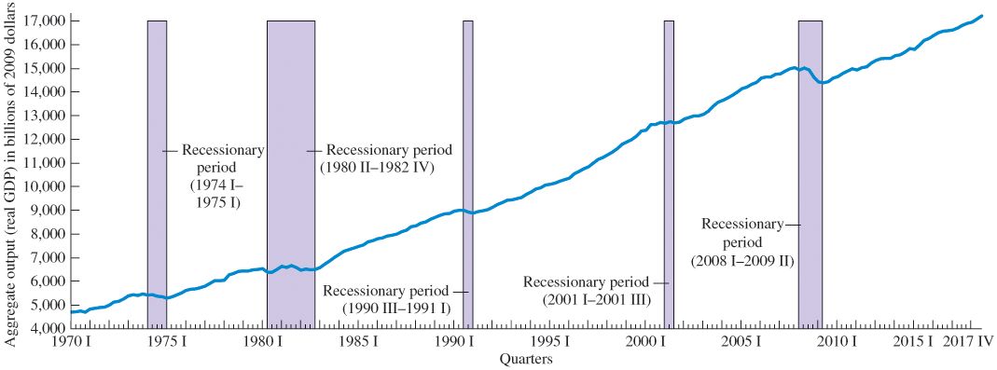
Figure 20.4 Aggregate Output (Real GDP), 1970 I–2017 IV
Aggregate output in the United States since 1970 has risen overall, but there have been five recessionary periods: 1974 I–1975 I, 1980 II–1982 IV, 1990 III–1991 I, 2001 I–2001 III, and 2008 I–2009 II.

Slide 27
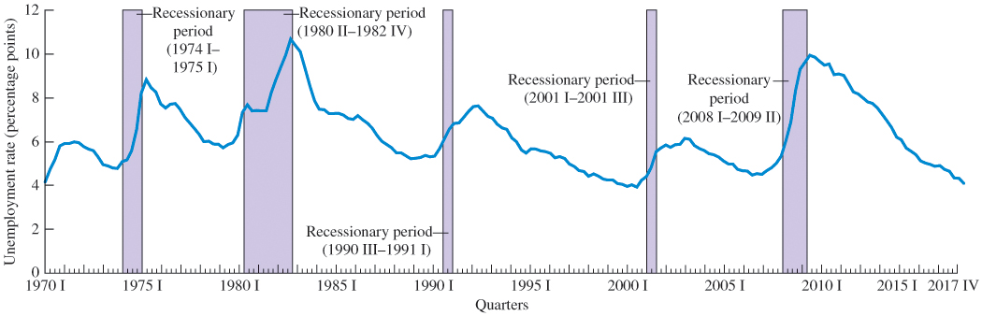
Figure 20.5 Unemployment Rate, 1970 I–2017 IV
The U.S. unemployment rate since 1970 shows wide variations.
The five recessionary reference periods show increases in the unemployment rate.

Slide 28
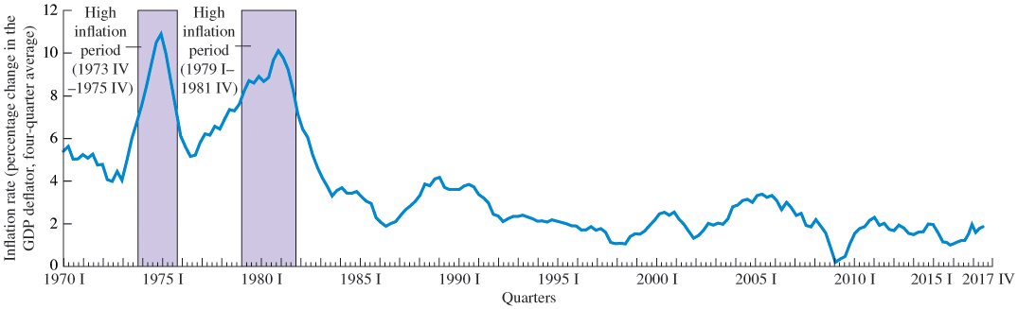
Figure 20.6 Inflation Rate (Percentage Change in the GDP Deflator, Four-Quarter Average), 1970 I–2017 IV
Since 1970, inflation has been high in two periods: 1973 IV–1975 IV and 1979 I–1981 IV.
Inflation between 1983 and 1992 was moderate.
Since 1992, it has been fairly low.

Slide 29
Review Terms and Concepts
aggregate behavior
aggregate output
business cycle
circular flow
contraction, recession, or slump
corporate bonds
deflation
depression
dividends
expansion or boom
fine-tuning
fiscal policy
Great Depression
hyperinflation
inflation
macroeconomics
microeconomics
monetary policy
shares of stock
stagflation
sticky prices
transfer payments
Treasury bonds, notes, or bills
unemployment rate

Slide 30
Copyright
This work is protected by United States copyright laws and is provided solely for the use of instructors in teaching their courses and assessing student learning. Dissemination or sale of any part of this work (including on the World Wide Web) will destroy the integrity of the work and is not permitted. The work and materials from it should never be made available to students except by instructors using the accompanying text in their classes. All recipients of this work are expected to abide by these restrictions and to honor the intended pedagogical purposes and the needs of other instructors who rely on these materials.

