Slide 1

Principles of Economics
Thirteenth Edition
Chapter 22
Unemployment, Inflation, and Long-Run Growth
Copyright © 2020, 2016, 2011 Pearson Education, Inc. All Rights Reserved
Notes:
If this PowerPoint presentation contains mathematical equations, you may need to check that your computer has the following installed:
1) MathType Plugin
2) Math Player (free versions available)
3) NVDA Reader (free versions available)

Slide 2
Chapter Outline and Learning Objectives (1 of 2)
22.1 Unemployment
Explain how unemployment is measured.
22.2 Inflation and Deflation
Describe the tools used to measure inflation and discuss the costs and effects of inflation.
22.3 Long-Run Growth
Discuss the components and implications of long-run growth.
Looking Ahead

Slide 3
Chapter 22 Unemployment, Inflation, and Long-Run Growth
The unemployment rate and inflation are key macroeconomic variables.
Each month the U.S. Bureau of Labor statistics (BLS) announces the previous month’s unemployment rate and the consumer price index (CPI).
Although much of macroeconomics is concerned with business cycles, long-run growth is also a major concern.

Slide 4
Unemployment
Measuring Unemployment
employed Any person 16 years old or older (1) who works for pay, either for someone else or in his or her own business for 1 or more hours per week, (2) who works without pay for 15 or more hours per week in a family enterprise, or (3) who has a job but has been temporarily absent with or without pay.
unemployed A person 16 years old or older who is not working, is available for work, and has made specific efforts to find work during the previous 4 weeks.

Slide 5
Measuring Unemployment (1 of 2)
not in the labor force A person who is not looking for work because he or she does not want a job or has given up looking.
labor force The number of people employed plus the number of unemployed.

Slide 6
Measuring Unemployment (2 of 2)
unemployment rate The ratio of the number of people unemployed to the total number of people in the labor force.
labor force participation rate The ratio of the labor force to the total population 16 years old or older.

Slide 7

Economics In Practice (1 of 4)
Time Use for the Unemployed in a Recession
During the recession of 2008–2009, aggregate market work hours in the United States decreased substantially.
Economists found that only 2%–6% of the lost market hours went to job search. The rest went to:
Activities tied to longer job placement, education, etc. (12%)
Nonmarket work, e.g., cleaning, child care (35%)
Leisure activities, e.g., sleeping (about 50%)
CRITICAL THINKING
How would you expect the time use of the unemployed to differ in a boom time?

Slide 8
Table 22.1 Employed, Unemployed, and the Labor Force, 1950–2017
Blank | (1) Population 16 Years Old or Over (Millions) | (2) Labor Force (Millions) | (3) Employed (Millions) | (4) Unemployed (Millions) | (5) Labor Force Participation Rate (Percentage Points) | (6) Unemployment Rate (Percentage Points)
1950 | 105.0 | 62.2 | 58.9 | 3.3 | 59.2 | 5.3
1960 | 117.2 | 69.6 | 65.8 | 3.9 | 59.4 | 5.5
1970 | 137.1 | 82.8 | 78.7 | 4.1 | 60.4 | 4.9
1980 | 167.7 | 106.9 | 99.3 | 7.6 | 63.8 | 7.1
1990 | 189.2 | 125.8 | 118.8 | 7.0 | 66.5 | 5.6
2000 | 212.6 | 142.6 | 136.9 | 5.7 | 67.1 | 4.0
2010 | 237.8 | 153.9 | 139.1 | 14.8 | 64.7 | 9.6
2017 | 255.1 | 160.3 | 153.3 | 7.0 | 62.9 | 4.4
Note: Figures are civilian only (Military excluded).
Source: Economic Report of the President, 2018 and U.S. Bureau of Labor Statistics.

Slide 9
Components of the Unemployment Rate (1 of 3)
Unemployment Rates for Different Demographic Group
Table 22.2 Unemployment Rates by Demographic Group, 1982 and 2018
Blank | Years | November 1982 | February 2018
Total | Blank | 10.8 | 4.1
White | Blank | 9.6 | 3.7
Men | 20+ | 9.0 | 3.4
Women | 20+ | 8.1 | 3.3
Both sexes | 16-19 | 21.3 | 12.6
African American | Blank | 20.2 | 6.9
Men | 20+ | 19.3 | 5.9
Women | 20+ | 16.5 | 6.2
Both sexes | 16-19 | 49.5 | 27.2
Source: U.S. Bureau of Labor Statistics. Data are seasonally adjusted.

Slide 10
Components of the Unemployment Rate (2 of 3)
Discouraged-Worker Effects
discouraged-worker effect The decline in the measured unemployment rate that results when people who want to work but cannot find jobs grow discouraged and stop looking, thus dropping out of the ranks of the unemployed and the labor force.

Slide 11
Components of the Unemployment Rate (3 of 3)
Discouraged-Worker Effects
If a BLS survey respondent cites inability to find employment as the sole reason for not searching for work, that person might be classified as a discouraged worker.
Some economists argue that including the number of discouraged workers as unemployed gives a better picture of the unemployment situation.

Slide 12

Economics In Practice (2 of 4)
A Quiet Revolution: Women Join the Labor Force
The labor force participation rate of women increased from 36% in 1955 to 60% in 1996.
Meanwhile, the participation rate for men declined from 85% in 1955 to 75% in 1996.
No doubt, some men dropped out to assume more traditional women’s roles, such as child care.
CRITICAL THINKING
When a household decides to hire someone else to clean their house and uses their extra time to watch television, the wages paid to that household worker increase GDP. Is economic output in fact larger?

Slide 13
The Duration of Unemployment
Table 22.3 Average Duration of Unemployment, 1970-2017
Blank | Weeks | Blank | Weeks | Blank | Weeks
1970 | 8.6 | 1986 | 15.0 | 2002 | 16.6
1971 | 11.3 | 1987 | 14.5 | 2003 | 19.2
1972 | 12.0 | 1988 | 13.5 | 2004 | 19.6
1973 | 10.0 | 1989 | 11.9 | 2005 | 18.4
1974 | 9.8 | 1990 | 12.0 | 2006 | 16.8
1975 | 14.2 | 1991 | 13.7 | 2007 | 16.8
1976 | 15.8 | 1992 | 17.7 | 2008 | 17.9
1977 | 14.3 | 1993 | 18.0 | 2009 | 24.4
1978 | 11.9 | 1994 | 18.8 | 2010 | 33.0
1979 | 10.8 | 1995 | 16.6 | 2011 | 39.3
1980 | 11.9 | 1996 | 16.7 | 2012 | 39.4
1981 | 13.7 | 1997 | 15.8 | 2013 | 36.5
1982 | 15.6 | 1998 | 14.5 | 2014 | 33.7
1983 | 20.0 | 1999 | 13.4 | 2015 | 29.2
1984 | 18.2 | 2000 | 12.7 | 2016 | 27.5
1985 | 15.6 | 2001 | 13.1 | 2017 | 25.0
Source: U.S. Bureau of Labor Statistics.

Slide 14

Economics In Practice (3 of 4)
The Consequences of Unemployment Persist
Throughout the recession of 2008–2009 and the slow recovery afterward, many young college graduates found themselves unemployed for a number of months.
Even 15 years following the recession in 1979–1982, wage rates of those with post-college unemployment lagged substantially.
CRITICAL THINKING
Describe a mechanism that might help explain the persistence of wage effects from a recession.

Slide 15
The Costs of Unemployment (1 of 4)
There are three categories of unemployment:
Frictional unemployment
Structural unemployment
Cyclical unemployment

Slide 16
The Costs of Unemployment (2 of 4)
Frictional, Structural, and Cyclical Unemployment
frictional unemployment The portion of unemployment that is as a result of the normal turnover in the labor market; used to denote short-run job/skill-matching problems.
structural unemployment The portion of unemployment that is as a result of changes in the structure of the economy that result in a significant loss of jobs in certain industries.

Slide 17
The Costs of Unemployment (3 of 4)
Frictional, Structural, and Cyclical Unemployment
natural rate of unemployment The unemployment rate that occurs as a normal part of the functioning of the economy. Sometimes taken as the sum of the frictional unemployment rate and the structural unemployment rate.
cyclical unemployment Unemployment that is above frictional plus structural unemployment.

Slide 18
The Costs of Unemployment (4 of 4)
Social Consequences
The costs of unemployment are neither evenly distributed across the population nor easily quantified.
The social consequences of the Depression of the 1930s are perhaps the hardest to comprehend:
At the bottom were the poor and the fully unemployed, about 25% of the labor force.
Even those who kept their jobs found themselves working part time.
Many people lost all or part of their savings as the stock market crashed and thousands of banks failed.

Slide 19
Inflation and Deflation
The Consumer Price Index
consumer price index (CPI) A price index computed each month by the Bureau of Labor Statistics using a bundle that is meant to represent the “market basket” purchased monthly by the typical urban consumer.
producer price indexes (PPIs) Measures of prices that producers receive for products at all stages in the production process.
Once called wholesale price indexes, PPIs are calculated separately for various stages in the production process.

Slide 20
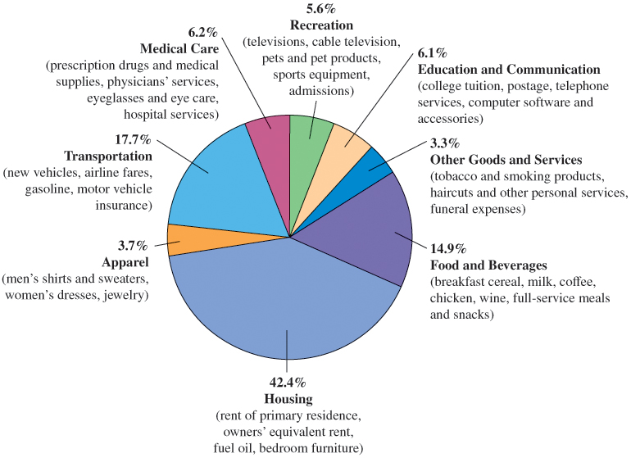
Figure 22.1 The CPI Market Basket
Source: The Bureau of Labor Statistics.
The CPI market basket shows how a typical consumer divides his or her money among various goods and services.
Most of a consumer’s money goes toward housing, transportation, and food and beverages.

Slide 21
Table 22.4 The CPI, 1950–2017
Blank | Percentage Change in CPI | CPI | Blank | Percentage Change in CPI | CPI | Blank | Percentage Change in CPI | CPI
1950 | 1.3 | 24.1 | 1973 | 6.2 | 44.4 | 1996 | 3.0 | 156.9
1951 | 7.9 | 26.0 | 1974 | 11.0 | 49.3 | 1997 | 2.3 | 160.5
1952 | 1.9 | 26.5 | 1975 | 9.1 | 53.8 | 1998 | 1.6 | 163.0
1953 | 0.8 | 26.7 | 1976 | 5.8 | 56.9 | 1999 | 2.2 | 166.6
1954 | 0.7 | 26.9 | 1977 | 6.5 | 6.6 | 2000 | 3.4 | 172.2
1955 | -0.4 | 26.8 | 1978 | 7.6 | 70.6 | 2001 | 2.8 | 177.1
1956 | 1.5 | 27.2 | 1979 | 11.3 | 65.2 | 2002 | 1.6 | 179.9
1957 | 3.3 | 28.1 | 1980 | 13.5 | 82.4 | 2003 | 2.3 | 184.0
1958 | 2.8 | 28.9 | 1981 | 10.3 | 90.9 | 2004 | 2.7 | 188.9
1959 | 0.7 | 29.1 | 1982 | 6.2 | 96.5 | 2005 | 3.4 | 195.3
1960 | 1.7 | 29.6 | 1983 | 3.2 | 99.6 | 2006 | 3.2 | 201.6
1961 | 1.0 | 29.9 | 1984 | 4.3 | 103.9 | 2007 | 2.8 | 207.3
1962 | 1.0 | 30.2 | 1985 | 3.6 | 107.6 | 2008 | 3.9 | 215.3
1963 | 1.3 | 30.6 | 1986 | 1.9 | 109.6 | 2009 | -0.4 | 214.5
1964 | 1.3 | 31.0 | 1987 | 3.6 | 113.6 | 2010 | 1.7 | 218.1
1965 | 1.6 | 31.5 | 1988 | 4.1 | 118.3 | 2011 | 3.1 | 224.9
1966 | 2.9 | 32.4 | 1989 | 4.8 | 124.0 | 2012 | 2.1 | 229.6
1967 | 3.1 | 33.4 | 1990 | 5.4 | 130.7 | 2013 | 1.5 | 233.0
1968 | 4.2 | 34.8 | 1991 | 4.2 | 136.2 | 2014 | 1.6 | 236.7
1969 | 5.5 | 36.7 | 1992 | 3.0 | 140.3 | 2015 | 1.3 | 237.0
1970 | 5.7 | 38.8 | 1993 | 3.0 | 144.5 | 2016 | 1.3 | 240.0
1971 | 4.4 | 40.5 | 1994 | 2.6 | 148.2 | 2017 | 2.1 | 245.1
1972 | 3.2 | 41.6 | 1995 | 2.8 | 152.4 | Blank | Blank | Blank
Sources: U.S. Bureau of Labor Statistics.

Slide 22
The Costs of Inflation (1 of 3)
During inflations, most prices—including input prices like wages—tend to rise together, and input prices determine both the incomes of workers and the incomes of owners of capital and land.
So inflation by itself does not necessarily reduce one’s purchasing power.

Slide 23
The Costs of Inflation (2 of 3)
Inflation May Change the Distribution of Income
The effects of anticipated inflation on the distribution of income are likely to be fairly small, since people and institutions will adjust to the anticipated inflation.
Unanticipated inflation may have large effects, depending, among other things, on the amount of indexing to inflation.
real interest rate The difference between the interest rate on a loan and the inflation rate.
Actual inflation that is higher (lower) than anticipated benefits debtors (creditors).

Slide 24
The Costs of Inflation (3 of 3)
Administrative Costs and Inefficiencies
There may be costs associated even with anticipated inflation, such as the administrative cost associated with simply keeping up.
Interest rates tend to rise with anticipated inflation. When interest rates are high, the opportunity costs of holding cash outside banks is high.

Slide 25

Economics In Practice (4 of 4)
Chain-Linked Consumer Price Index in the News
The fixed-weight version of the consumer price index (CPI) is the one that is used to adjust social security benefits and veteran benefits to price changes.
If the chain-linked CPI were used instead, benefits would tend to increase more slowly because of product substitution.
The Congressional Budget Office estimated that if the chain-linked CPI were adopted, it would save the federal government about $145 billion over a 10-year period from the lower benefits.
CRITICAL THINKING
Tax brackets are also tied to the fixed-weight CPI. How would tax revenue be affected if the chain-linked CPI were used instead?

Slide 26
What about Deflation?
In 2017 most of the developed world experienced very little inflation, so some governments began to worry about deflation.
If falling prices are unanticipated, borrowers will gain at the expense of lenders, and those on fixed pensions will gain at the expense of governments and firms paying those pensions.

Slide 27
Long-Run Growth
output growth The growth rate of the output of the entire economy.
per-capita output growth The growth rate of output per person in the economy.
productivity growth The growth rate of output per worker.

Slide 28
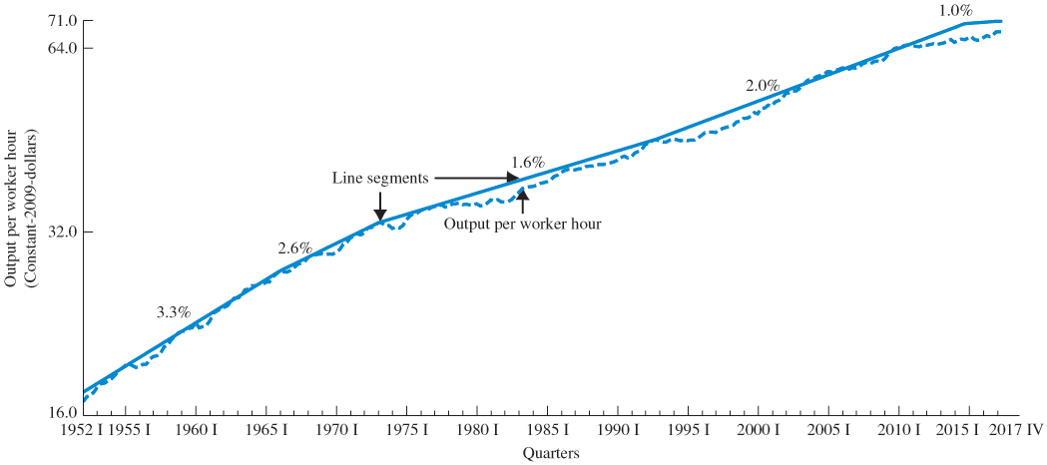
Output and Productivity Growth
Figure 22.2 Output per Worker Hour (Productivity), 1952 I–2017 IV
Productivity grew much faster in the 1950s and 1960s than it has since.

Slide 29
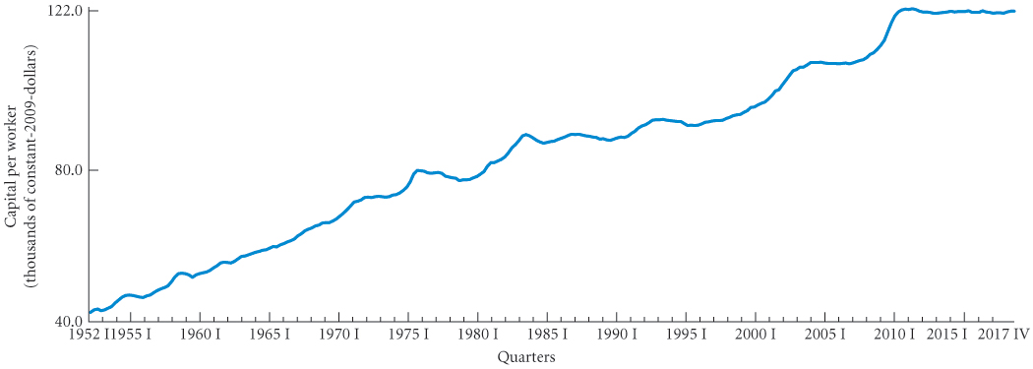
Figure 22.3 Capital per Worker, 1952 I–2017 IV
Capital per worker grew until about 1980 and then leveled off somewhat.

Slide 30
Looking Ahead
This ends our introduction to the basic concepts and problems of macroeconomics.
The first chapter of this part introduced the field; the second chapter discussed the measurement of national product and national income; and this chapter discussed unemployment, inflation, and long-run growth.
We are now ready to begin the analysis of how the macroeconomy works.

Slide 31
Review Terms and Concepts (1 of 2)
consumer price index (CPI)
cyclical unemployment
discouraged-worker effect
employed
frictional unemployment
labor force
labor force participation rate
natural rate of unemployment
not in the labor force
output growth
per-capita output growth
producer price indexes (PPIs)
productivity growth
real interest rate
structural unemployment
unemployed
unemployment rate

Slide 32
Review Terms and Concepts (2 of 2)
Equations:

Slide 33
Copyright
This work is protected by United States copyright laws and is provided solely for the use of instructors in teaching their courses and assessing student learning. Dissemination or sale of any part of this work (including on the World Wide Web) will destroy the integrity of the work and is not permitted. The work and materials from it should never be made available to students except by instructors using the accompanying text in their classes. All recipients of this work are expected to abide by these restrictions and to honor the intended pedagogical purposes and the needs of other instructors who rely on these materials.

