Slide 1

Principles of Economics
Thirteenth Edition
Chapter 3
Demand, Supply, and
Market Equilibrium
Copyright © 2020, 2016, 2011 Pearson Education, Inc. All Rights Reserved
Notes:
If this PowerPoint presentation contains mathematical equations, you may need to check that your computer has the following installed:
1) MathType Plugin
2) Math Player (free versions available)
3) NVDA Reader (free versions available)

Slide 2
Chapter Outline and Learning Objectives (1 of 2)
3.1 Firms and Households: The Basic Decision-Making Units
Understand the roles of firms, entrepreneurs, and households in the market.
3.2 Input Markets and Output Markets: The Circular Flow
Understand the role of households as both suppliers to firms and buyers of what firms produce.
3.3 Demand in Product/Output Markets
Understand what determines the position and shape of the demand curve and what factors move you along a demand curve and what factors shift the demand curve.

Slide 3
Chapter Outline and Learning Objectives (2 of 2)
3.4 Supply in Product/Output Markets
Be able to distinguish between forces that shift a supply curve and changes that cause a movement along a supply curve.
3.5 Market Equilibrium
Be able to explain how a market that is not in equilibrium responds to restore an equilibrium.
Demand and Supply in Product Markets: A Review
Looking Ahead: Markets and the Allocation of Resources

Slide 4
Chapter 3 Demand, Supply, and Market Equilibrium
Chapter 2 discusses how individuals solve economic problems directly.
This chapter explains the basic forces at work in market systems.
This chapter explains how individual decisions answer the three basic economic questions.

Slide 5
Firms and Households: The Basic Decision-Making Units
firm An organization that transforms resources (inputs) into products (outputs). Firms are the primary producing units in a market economy.
entrepreneur A person who organizes, manages, and assumes the risks of a firm, taking a new idea or a new product and turning it into a successful business.
households The consuming units in an economy.

Slide 6
Input Markets and Output Markets: The Circular Flow (1 of 4)
product or output markets The markets in which goods and services are exchanged.
input or factor markets The markets in which the resources used to produce goods and services are exchanged.

Slide 7
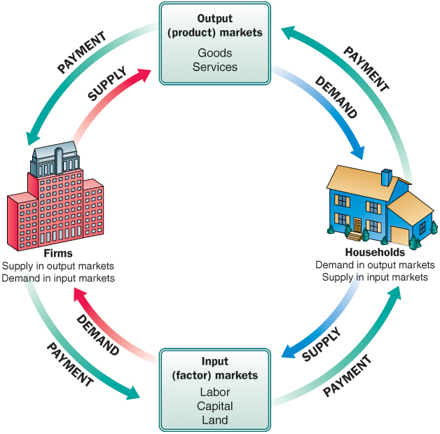
Figure 3.1 The Circular Flow of Economic Activity
Diagrams like this one show the circular flow of economic activity, hence the name circular flow diagram. Here goods and services flow clockwise: Labor services supplied by households flow to firms, and goods and services produced by firms flow to households.
Payment (usually money) flows in the opposite (counterclockwise) direction: Payment for goods and services flows from households to firms, and payment for labor services flows from firms to households.
Note: Color Guide—In this figure households are depicted in blue, and firms are depicted in red. From now on, all diagrams relating to the behavior of households will be blue or shades of blue, and all diagrams relating to the behavior of firms will be red or shades of red. The green color indicates a monetary flow.

Slide 8
Input Markets and Output Markets: The Circular Flow (2 of 4)
labor market The input/factor market in which households supply work for wages to firms that demand labor.
capital market The input/factor market in which households supply their savings, for interest or for claims to future profits, to firms that demand funds to buy capital goods.

Slide 9
Input Markets and Output Markets: The Circular Flow (3 of 4)
land market The input/factor market in which households supply land or other real property in exchange for rent.
factors of production The inputs into the production process. Land, labor, and capital are the three key factors of production.

Slide 10
Input Markets and Output Markets: The Circular Flow (4 of 4)
Input and output markets are connected through the behavior of both firms and households.
Firms determine the quantities and character of outputs produced and the types and quantities of inputs demanded.
Households determine the types and quantities of products demanded and the quantities and types of inputs supplied.

Slide 11
Demand in Product/Output Markets (1 of 2)
A household’s decision about what quantity of a particular output, or product, to demand depends on a number of factors, including:
The price of the product in question
The income available to the household
The household’s amount of accumulated wealth
The prices of other products available to the household
The household’s tastes and preferences
The household’s expectations about future income, wealth, and prices

Slide 12
Demand in Product/Output Markets (2 of 2)
quantity demanded The amount (number of units) of a product that a household would buy in a given period if it could buy all it wanted at the current market price.
It is important to focus on the price change alone with the ceteris paribus, or “all else equal,” assumption.

Slide 13
Changes in Quantity Demanded versus Changes in Demand
Changes in the price of a product affect the quantity demanded per period.
Changes in any other factor, such as income or preferences, affect demand.
Thus, we say that an increase in the price of Coca-Cola is likely to cause a decrease in the quantity of Coca-Cola demanded. However, we say that an increase in income is likely to cause an increase in the demand for most goods.

Slide 14
Price and Quantity Demanded: The Law of Demand (1 of 3)
demand schedule Shows how much of a given product a household would be willing to buy at different prices for a given time period.
demand curve A graph illustrating how much of a given product a household would be willing to buy at different prices.

Slide 15
Table 3.1 Alex’s Demand Schedule for Gasoline
Price (per Gallon) | Quantity Demanded (Gallons per Week)
$8.00 | 0
7.00 | 2
6.00 | 3
5.00 | 5
4.00 | 7
3.00 | 10
2.00 | 14
1.00 | 20
0.00 | 26

Slide 16
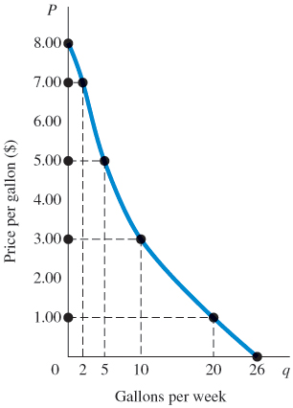
Figure 3.2 Alex’s Demand Curve
The relationship between price (P) and quantity demanded (q) presented graphically is called a demand curve.
Demand curves have a negative slope, indicating that lower prices cause quantity demanded to increase.
Note that Alex’s demand curve is blue; demand in product markets is determined by household choice.

Slide 17
Price and Quantity Demanded: The Law of Demand (2 of 3)
Demand Curves Slope Downward
law of demand The negative relationship between price and quantity demanded: Ceteris paribus, as price rises, quantity demanded decreases; as price falls, quantity demanded increases during a given period of time, all other things remaining constant.
It is reasonable to expect quantity demanded to fall when price rises, ceteris paribus, and to expect quantity demanded to rise when price falls, ceteris paribus.
A demand curve has a negative slope.

Slide 18
Price and Quantity Demanded: The Law of Demand (3 of 3)
Other Properties of Demand Curves
To summarize what we know about the shape of demand curves:
They have a negative slope.
They intersect the quantity (X) axis, a result of time limitations and diminishing marginal utility.
They intersect the price (Y) axis, a result of limited income and wealth.
The actual shape of an individual household demand curve depends on the unique tastes and preferences of the household and other factors.

Slide 19
Other Determinants of Household Demand (1 of 3)
Income and Wealth
income The sum of all a household’s wages, salaries, profits, interest payments, rents, and other forms of earnings in a given period of time. It is a flow measure.
wealth or net worth The total value of what a household owns minus what it owes. It is a stock measure.

Slide 20
Other Determinants of Household Demand (2 of 3)
Income and Wealth
normal goods Goods for which demand goes up when income is higher and for which demand goes down when income is lower.
inferior goods Goods for which demand tends to fall when income rises.

Slide 21
Other Determinants of Household Demand (3 of 3)
Prices of Other Goods and Services
substitutes Goods that can serve as replacements for one another; when the price of one increases, demand for the other increases.
perfect substitutes Identical products.
complements, complementary goods Goods that “go together”; a decrease in the price of one results in an increase in demand for the other and vice versa.

Slide 22

ECONOMICS IN PRACTICE (1 of 4)
Have You Bought This Textbook?
One might think that the total number of textbooks, used plus new, should match class enrollment. After all, the text is required!
Economists found that the higher the textbook price, the more text sales fell below class enrollments.
Students found substitutes when textbook prices were high.
CRITICAL THINKING
If you were to construct a demand curve for a required text in a course, where would that demand curve intersect the horizontal axis?
In the year before a new edition of a text is published, many college bookstores will not buy the older edition. Given this fact, what do you think happens to the gap between enrollments and new plus used book sales in the year before a new edition of a text is expected?

Slide 23
Other Determinants of Household Demand ( 1 of 2)
Tastes and Preferences
Changes in preferences can and do manifest themselves in market behavior.
Within the constraints of prices and incomes, preference shapes the demand curve, but it is difficult to generalize about tastes and preferences.

Slide 24

ECONOMICS IN PRACTICE (2 of 4)
On Sunny Days People Buy Convertibles!
Cars are durable goods that last for a number of years.
But some economists recently found that car purchasers’ choices were heavily influenced by temporary weather changes at the time of purchase.
An increase of 10 degrees on a fall or spring day over the norm increased purchase of convertibles by almost 3%.
CRITICAL THINKING
Economists predict that my interest in purchasing a convertible also depends on how much I think other people like convertibles. How is this prediction related to the durability of cars?

Slide 25
Other Determinants of Household Demand (2 of 2)
Expectations
What you decide to buy today certainly depends on today’s prices and your current income and wealth.
Increasingly, economic theory has come to recognize the importance of expectations.
It is important to understand that demand depends on more than just current incomes, prices, and tastes.

Slide 26
Shift of Demand versus Movement along a Demand Curve (1 of 2)
shift of a demand curve The change that takes place in a demand curve corresponding to a new relationship between quantity demanded of a good and price of that good. The shift is brought about by a change in the original conditions.
movement along a demand curve The change in quantity demanded brought about by a change in price.

Slide 27
TABLE 3.2 Shift of Alex’s Demand Schedule Resulting from an Increase in Income
Price (per Gallon) | Schedule D₀ Quantity Demanded (Gallons per Week at an Income of $500 per Week) | Schedule D₁ Quantity Demanded (Gallons per Week at an Income of $700 per Week)
$8.00 | 0 | 3
7.00 | 2 | 5
6.00 | 3 | 7
5.00 | 5 | 10
4.00 | 7 | 12
3.00 | 10 | 15
2.00 | 14 | 19
1.00 | 20 | 24
0.00 | 26 | 30

Slide 28
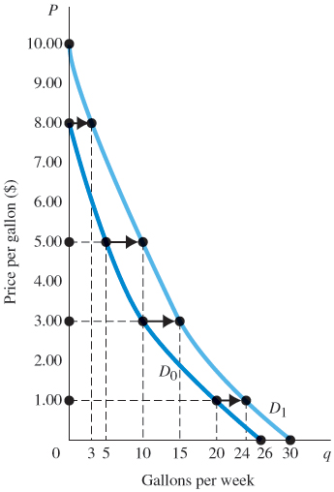
Figure 3.3 Shift of a Demand Curve Following a Rise in Income
When the price of a good changes, we move along the demand curve for that good.
When any other factor that influences demand changes (income, tastes, and so on), the demand curve shifts, in this case from D₀ to D₁.
Gasoline is a normal good, so an income increase shifts the curve to the right.

Slide 29
Shift of Demand versus Movement along a Demand Curve (2 of 2)
Change in price of a good or service leads to change in quantity demanded (movement along a demand curve).
Change in income, preferences, or prices of other goods or services leads to change in demand (shift of a demand curve).

Slide 30
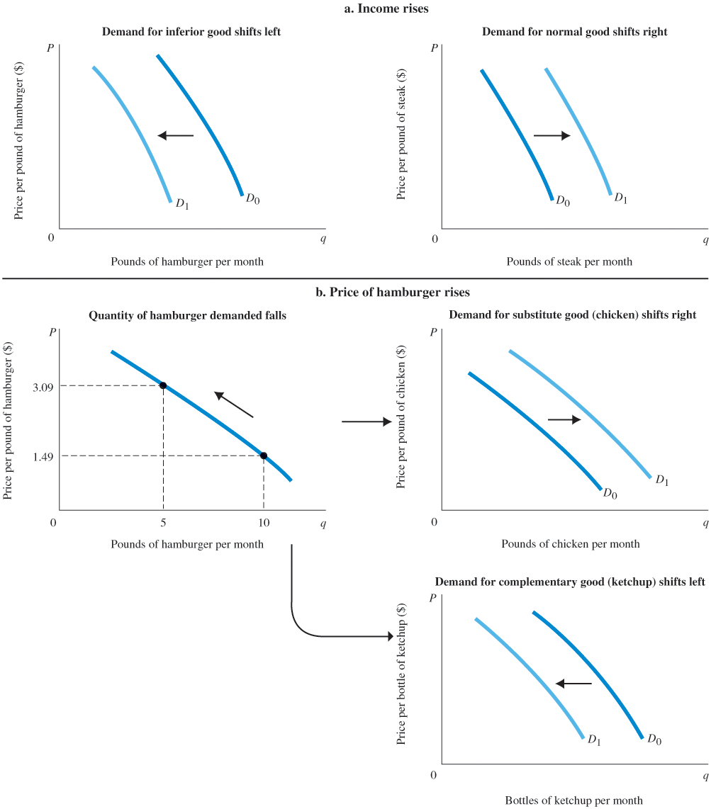
Figure 3.4 Shifts versus Movement along a Demand Curve (1 of 2)
a. When income increases, the demand for inferior goods shifts to the left, and the demand for normal goods shifts to the right.

Slide 31
Figure 3.4 Shifts versus Movement along a Demand Curve (2 of 2)
b. If the price of hamburger rises, the quantity of hamburger demanded declines; this is a movement along the demand curve.
The same price rise for hamburger would shift the demand for chicken (a substitute for hamburger) to the right and the demand for ketchup (a complement to hamburger) to the left.

Slide 32
From Household Demand to Market Demand
market demand The sum of all the quantities of a good or service demanded per period by all the households buying in the market for that good or service.

Slide 33
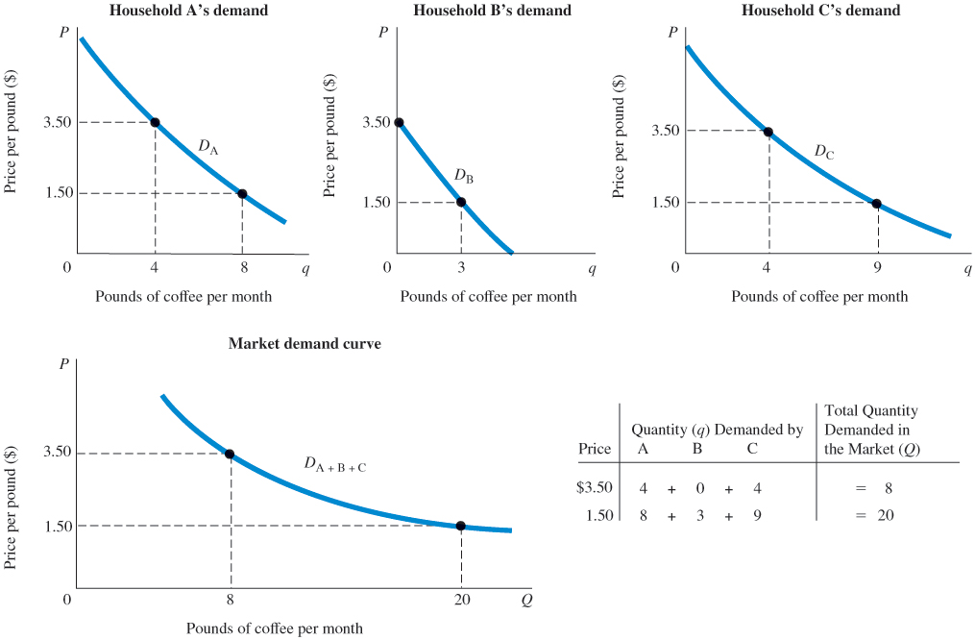
Figure 3.5 Deriving Market Demand from Individual Demand Curves
Total demand in the marketplace is simply the sum of the demands of all the households shopping in a particular market. It is the sum of all the individual demand curves—that is, the sum of all the individual quantities demanded at each price.

Slide 34
Supply in Product/Output Markets
Firms build factories, hire workers, and buy raw materials because they believe they can sell the products they make for more than it costs to produce them.
profit The difference between revenues and costs.

Slide 35
Price and Quantity Supplied: The Law of Supply (1 of 3)
quantity supplied The amount of a particular product that a firm would be willing and able to offer for sale at a particular price during a given time period.
supply schedule Shows how much of a product firms will sell at alternative prices.

Slide 36
Price and Quantity Supplied: The Law of Supply (2 of 3)
law of supply The positive relationship between price and quantity of a good supplied: An increase in market price, ceteris paribus, will lead to an increase in quantity supplied, and a decrease in market price will lead to a decrease in quantity supplied.
supply curve A graph illustrating how much of a product a firm will sell at different prices.

Slide 37
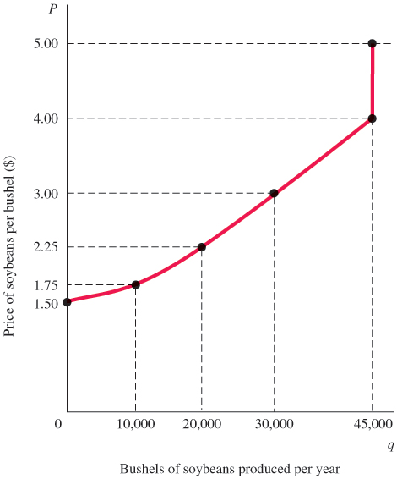
TABLE 3.3 Clarence Brown’s Supply Schedule for Soybeans
Figure 3.6 Clarence Brown’s Individual Supply Curve
Price (per Bushel) | Quantity Supplied (Bushels per Year)
$1.50 | 0
1.75 | 10,000
2.25 | 20,000
3.00 | 30,000
4.00 | 45,000
5.00 | 45,000
A producer will supply more when the price of output is higher. The slope of a supply curve is positive.
Note that the supply curve is red: Supply is determined by choices made by firms.

Slide 38
Other Determinants of Supply (1 of 2)
The Cost of Production
For a firm to make a profit, its revenue must exceed its costs.
Cost of production depends on a number of factors, including the available technologies and the prices and quantities of the inputs needed by the firm (labor, land, capital, energy, and so on).

Slide 39
Other Determinants of Supply (2 of 2)
The Prices of Related Products
Assuming that its objective is to maximize profits, a firm’s decision to supply depends on:
The price of the good or service.
The cost of producing the product, which in turn depends on:
The price of required inputs (labor, capital, and land)
The technologies that can be used to produce the product.
The prices of related products.

Slide 40
Shift of Supply versus Movement along a Supply Curve (1 of 2)
movement along a supply curve The change in quantity supplied brought about by a change in price.
shift of a supply curve The change that takes place in a supply curve corresponding to a new relationship between quantity supplied of a good and the price of that good. The shift is brought about by a change in the original conditions.

Slide 41
TABLE 3.4 Shift of Supply Schedule for Soybeans following Development of a New Disease-Resistant Seed Strain
Price (per Bushel) | Schedule S₀ Quantity Supplied (Bushels per Year Using Old Seed) | Schedule S₁ Quantity Supplied (Bushels per Year Using New Seed)
$1.50 | 0 | 5,000
1.75 | 10,000 | 23,000
2.25 | 20,000 | 33,000
3.00 | 30,000 | 40,000
4.00 | 45,000 | 54,000

Slide 42
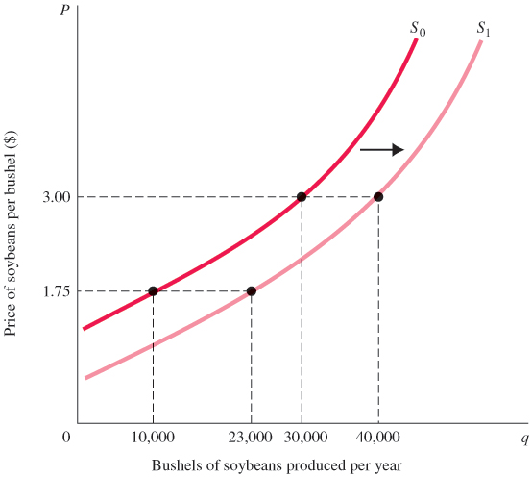
Figure 3.7 Shift of the Supply Curve for Soybeans Following Development of a New Seed Strain
When the price of a product changes, we move along the supply curve for that product; the quantity supplied rises or falls.
When any other factor affecting supply changes, the supply curve shifts.

Slide 43
Shift of Supply versus Movement along a Supply Curve (2 of 2)
It is very important to distinguish between movements along supply curves (changes in quantity supplied) and shifts in supply curves (changes in supply):
Change in price of a good or service leads to change in quantity supplied (movement along a supply curve).
Change in costs, input prices, technology, or prices of related goods and services leads to change in supply (shift of a supply curve).

Slide 44
From Individual Supply to Market Supply
market supply The sum of all that is supplied each period by all producers of a single product.

Slide 45
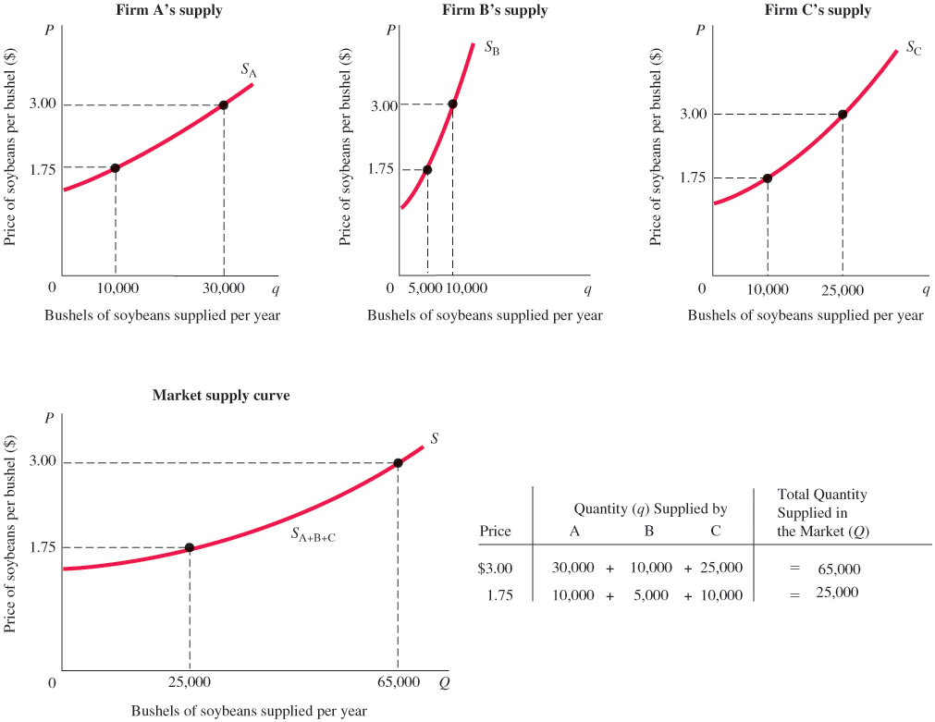
Figure 3.8 Deriving Market Supply from Individual Firm Supply Curves (1 of 2)
Total supply in the marketplace is the sum of all the amounts supplied by all the firms selling in the market. It is the sum of all the individual quantities supplied at each price.

Slide 46
Figure 3.8 Deriving Market Supply from Individual Firm Supply Curves (2 of 2)

Slide 47
Market Equilibrium
equilibrium The condition that exists when quantity supplied and quantity demanded are equal. At equilibrium, there is no tendency for price to change.
Excess Demand
excess demand or shortage The condition that exists when quantity demanded exceeds quantity supplied at the current price.

Slide 48
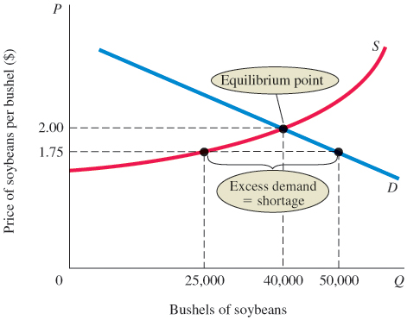
Figure 3.9 Excess Demand, or Shortage
At a price of $1.75 per bushel, quantity demanded exceeds quantity supplied.
When excess demand exists, there is a tendency for price to rise.
When quantity demanded equals quantity supplied, excess demand is eliminated and the market is in equilibrium.
Here the equilibrium price is $2.00, and the equilibrium quantity is 40,000 bushels.

Slide 49
Excess Supply
excess supply or surplus The condition that exists when quantity supplied exceeds quantity demanded at the current price.
When quantity supplied exceeds quantity demanded at the current price, the price tends to fall.
When price falls, quantity supplied is likely to decrease, and quantity demanded is likely to increase until an equilibrium price is reached where quantity supplied and quantity demanded are equal.

Slide 50
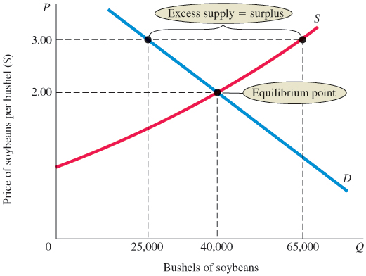
Figure 3.10 Excess Supply (Surplus)
At a price of $3.00, quantity supplied exceeds quantity demanded by 40,000 bushels.
This excess supply will cause the price to fall.

Slide 51
Market Equilibrium with Equations (1 of 3)
When economists work with demand and supply, they use equations to measure the quantitative size of markets.
Assume demand is a straight (linear) line, then the equation of the inverse demand curve is
where Q_{d} = quantity demanded in units
P = price
a = y intercept (price at which quantity demanded is 0)
b = slope of the demand curve
The demand curve becomes

Slide 52
Market Equilibrium with Equations (2 of 3)
Assume supply is a straight (linear) line, then the equation of the inverse supply curve is
where Q_{s} = quantity supplied in units
c = y intercept (price at which quantity supplied is 0)
d = slope of the supply curve
The supply curve becomes
Set Q_{d} = Q_{s} = Q, then we can solve for the two unknowns of Q and P from the two equations.

Slide 53
Market Equilibrium with Equations (3 of 3)
Assume that the demand and supply curves are written mathematically as
Setting the quantity demanded equal to the quantity supplied, we have
which gives us a price of $2.
Substituting back into either the supply or demand equation gives us an equilibrium quantity demanded and supplied of 10 units.

Slide 54
Changes in Equilibrium
When supply and demand curves shift, the equilibrium price and quantity change.

Slide 55
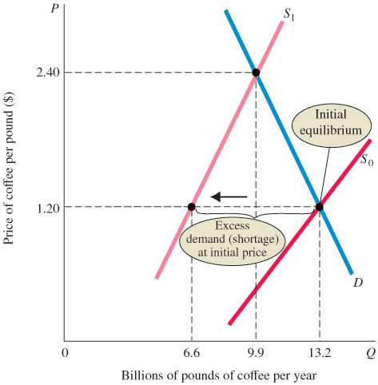
Figure 3.11 The Coffee Market: A Shift of Supply and Subsequent Price Adjustment
Before the freeze, the coffee market was in equilibrium at a price of $1.20 per pound.
At that price, quantity demanded equaled quantity supplied.
The freeze shifted the supply curve to the left (from S₀ to S₁), increasing the equilibrium price to $2.40.

Slide 56

ECONOMICS IN PRACTICE (3 of 4)
Quinoa
Quinoa, a high-protein grain, was once eaten mostly by people in Peru and Bolivia.
Growth in vegetarianism shifted the demand curve for quinoa to the right, resulting in higher prices.
Despite new farmer entry in response to higher quinoa prices, the particular nature of the production process limited the amount of the shift.
CRITICAL THINKING
Use a graph to show the movement in prices and quantities described in the quinoa market.

Slide 57
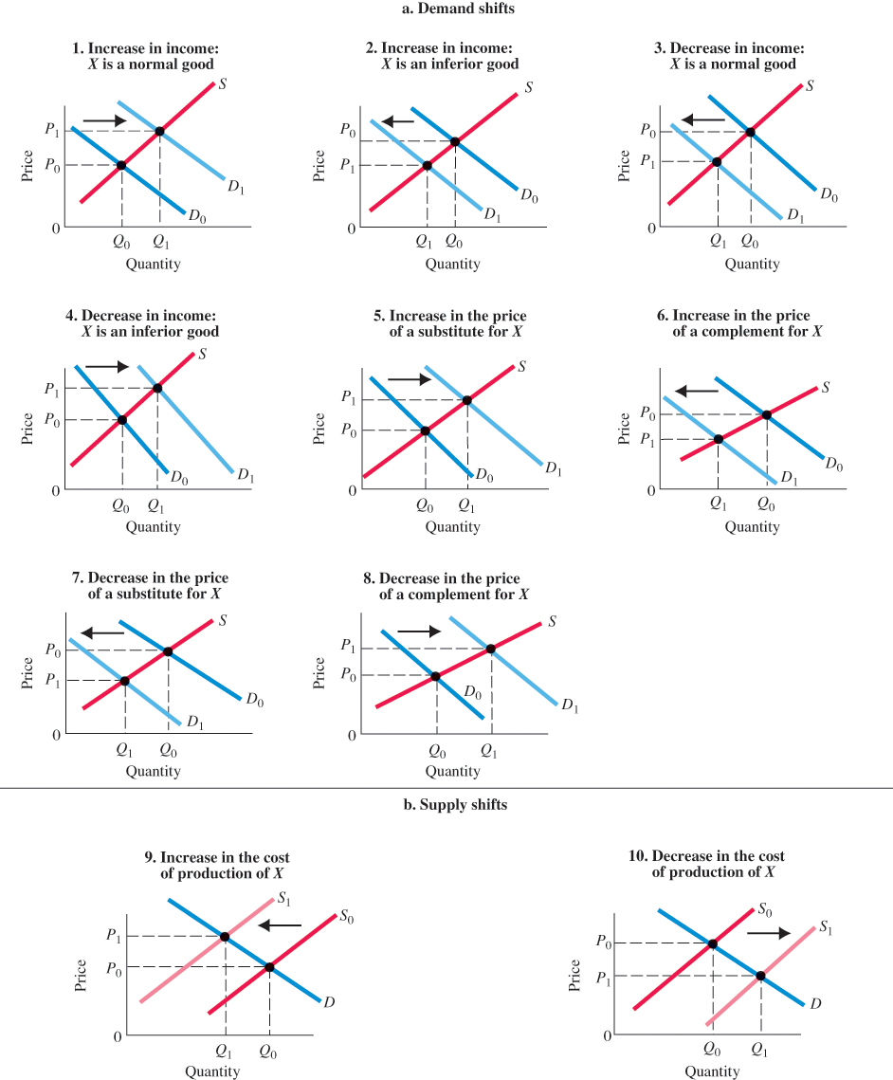
Figure 3.12 Examples of Supply and Demand Shifts for Product X

Slide 58
Demand and Supply in Product Markets: A Review (1 of 2)
Important points to remember about the mechanics of supply and demand in product markets:
A demand curve shows how much of a product a household would buy if it could buy all it wanted at the given price. A supply curve shows how much of a product a firm would supply if it could sell all it wanted at the given price.
Demand and supply can also be represented by equations.
Quantity demanded and quantity supplied are always per time period—that is, per day, per month, or per year.
The demand for a good is determined by price, household income and wealth, prices of other goods and services, tastes and preferences, and expectations.

Slide 59
Demand and Supply in Product Markets: A Review (2 of 2)
The supply of a good is determined by price, costs of production, and prices of related products. Costs of production are determined by available technologies of production and input prices.
Be careful to distinguish between movements along supply and demand curves and shifts of these curves. When the price of a good changes, the quantity of that good demanded or supplied changes—that is, a movement occurs along the curve. When any other factor changes, the curve shifts, or changes position.
Market equilibrium exists only when quantity supplied equals quantity demanded at the current price.

Slide 60
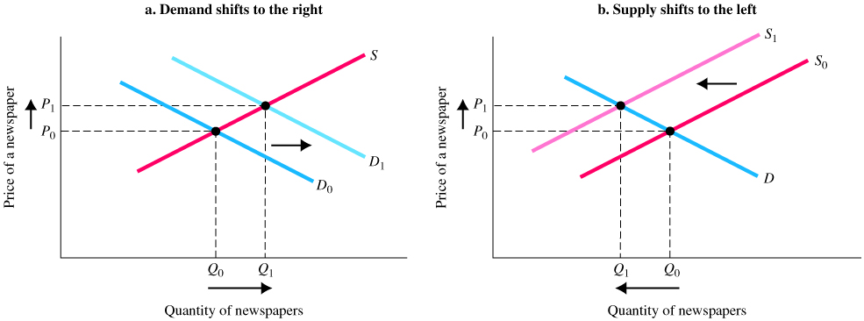
ECONOMICS IN PRACTICE (4 of 4)
Why Do the Prices of Newspapers Rise?
In 2006, the average price for a daily edition of a Baltimore newspaper was $0.50. In 2007, the average price had risen to $0.75.
Different analysts have different explanations for the higher equilibrium price.

Slide 61
Looking Ahead: Markets and the Allocation of Resources
You can see how markets answer the basic economic questions of what is produced, how it is produced, and who gets what is produced:
Demand curves reflect what people are willing and able to pay for products; they are influenced by incomes, wealth, preferences, prices of other goods, and expectations.
Firms in business to make a profit have a good reason to choose the best available technology—lower costs mean higher profits.
When a good is in short supply, price rises. As it does, only those who are willing and able to continue buying do so.

Slide 62
Review Terms and Concepts (1 of 2)
capital market
complements, complementary goods
demand curve
demand schedule
entrepreneur
equilibrium
excess demand or shortage
excess supply or surplus
factors of production
firm
households
income
inferior goods
input or factor markets
labor market
land market
law of demand
law of supply

Slide 63
Review Terms and Concepts (2 of 2)
market demand
market supply
movement along a demand curve
movement along a supply curve
normal goods
perfect substitutes
product or output markets
profit
quantity demanded
quantity supplied
shift of a demand curve
shift of a supply curve
substitutes
supply curve
supply schedule
wealth or net worth

Slide 64
Copyright
This work is protected by United States copyright laws and is provided solely for the use of instructors in teaching their courses and assessing student learning. Dissemination or sale of any part of this work (including on the World Wide Web) will destroy the integrity of the work and is not permitted. The work and materials from it should never be made available to students except by instructors using the accompanying text in their classes. All recipients of this work are expected to abide by these restrictions and to honor the intended pedagogical purposes and the needs of other instructors who rely on these materials.

