Slide 1
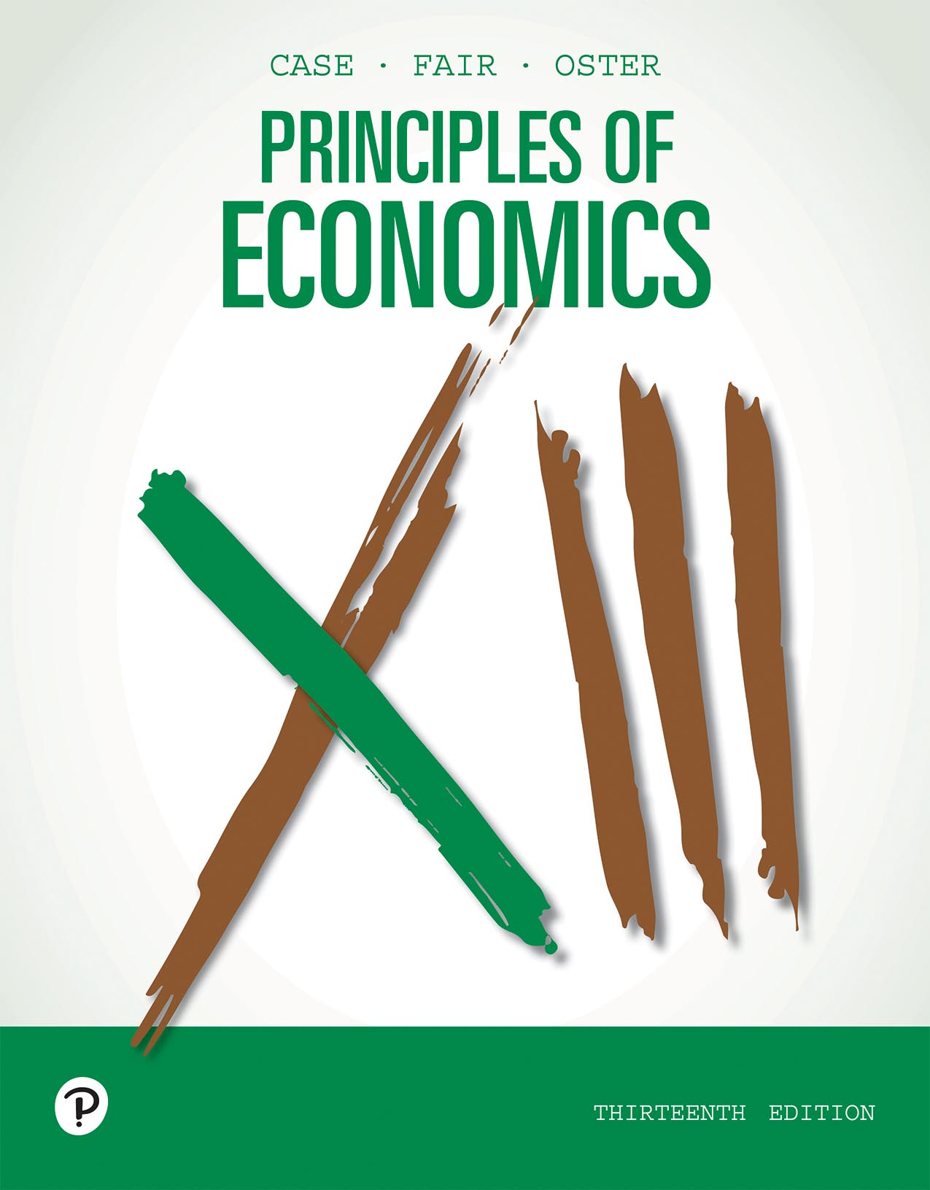
Principles of Economics
Thirteenth Edition
Chapter 4
Demand and Supply Applications
Copyright © 2020, 2016, 2011 Pearson Education, Inc. All Rights Reserved
Notes:
If this PowerPoint presentation contains mathematical equations, you may need to check that your computer has the following installed:
1) MathType Plugin
2) Math Player (free versions available)
3) NVDA Reader (free versions available)

Slide 2
Chapter Outline and Learning Objectives
4.1 The Price System: Rationing and Allocating Resources
Understand how price floors and price ceilings work in the market place.
4.2 Supply and Demand Analysis: Tariffs
Analyze the economic impact of tariffs.
4.3 Supply and Demand and Market Efficiency
Explain how consumer and producer surplus are generated.
Looking Ahead

Slide 3
Chapter 4 Demand and Supply Applications
In every society, many decisions are made in a decentralized way, through the operation of markets.
In Chapter 3 we discussed how markets operate.
This chapter continues to examine demand, supply, and the price system.

Slide 4
The Price System: Rationing and Allocating Resources
Price Rationing
price rationing The process by which the market system allocates goods and services to consumers when quantity demanded exceeds quantity supplied.
The adjustment of price is the rationing mechanism in free markets.
Price rationing means that whenever there is a need to ration a good—that is, when a shortage exists—in a free market, the price of the good will rise until quantity supplied equals quantity demanded—that is, until the market clears.

Slide 5
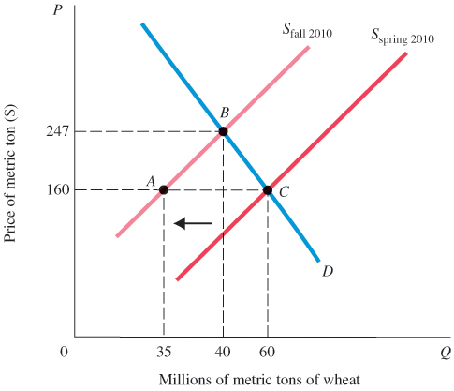
Figure 4.1 The Market for Wheat
Fires in Russia in the summer of 2010 caused a shift in the world’s supply of wheat to the left, causing the price to increase from $160 per metric ton to $247.
The equilibrium moved from C to B.

Slide 6
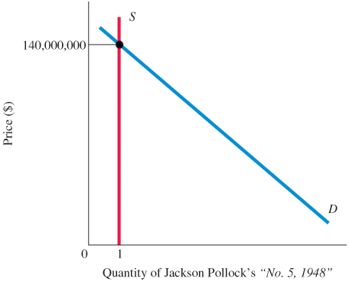
Figure 4.2 Market for a Rare Painting
There is some price that will clear any market, even if supply is strictly limited.
In an auction for a unique painting, the price (bid) will rise to eliminate excess demand until there is only one bidder willing to purchase the single available painting.
Some estimate that the Mona Lisa would sell for $600 million if auctioned.

Slide 7
Constraints on the Market and Alternative Rationing Mechanisms (1 of 6)
On occasion, both governments and private firms decide to use some mechanism other than the market system to ration an item for which there is excess demand at the current price.
Policies designed to stop price rationing are justified in a number of ways, most often in the name of fairness.

Slide 8
Constraints on the Market and Alternative Rationing Mechanisms (2 of 6)
Regardless of the rationale, two things are clear:
Attempts to bypass price rationing in the market and to use alternative rationing devices are more difficult and more costly than they would seem at first glance.
Very often such attempts distribute costs and benefits among households in unintended ways.

Slide 9
Constraints on the Market and Alternative Rationing Mechanisms (3 of 6)
Oil, Gasoline, and OPEC
The Organization of the Petroleum Exporting Counties (OPEC) is an organization of 12 countries that together produce about one-third of the world’s oil today.
In 1973 and 1974, OPEC imposed an embargo on shipments of crude oil to the United States. Congress responded by imposing a maximum price of $0.57 per gallon of leaded regular gasoline. This created a shortage as the price system was not allowed to function.
Alternative rationing systems also occurred.

Slide 10
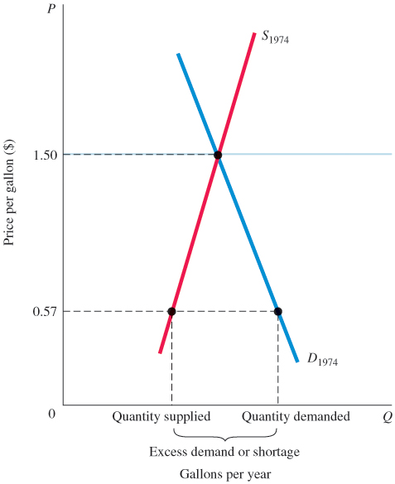
Figure 4.3 Excess Demand (Shortage) Created by a Price Ceiling
In 1974, a ceiling price of $0.57 per gallon of leaded regular gasoline was imposed.
If the price had been set by the interaction of supply and demand instead, it would have increased to approximately $1.50 per gallon.
At $0.57 per gallon, the quantity demanded exceeded the quantity supplied.
Because the price system was not allowed to function, an alternative rationing system had to be found to distribute the available supply of gasoline.

Slide 11
Constraints on the Market and Alternative Rationing Mechanisms (4 of 6)
price ceiling A maximum price that sellers may charge for a good, usually set by government.
queuing Waiting in line as a means of distributing goods and services: a nonprice rationing mechanism.
favored customers Those who receive special treatment from dealers during situations of excess demand.

Slide 12
Constraints on the Market and Alternative Rationing Mechanisms (5 of 6)
ration coupons Tickets or coupons that entitle individuals to purchase a certain amount of a given product per month.
black market A market in which illegal trading takes place at market-determined prices.

Slide 13
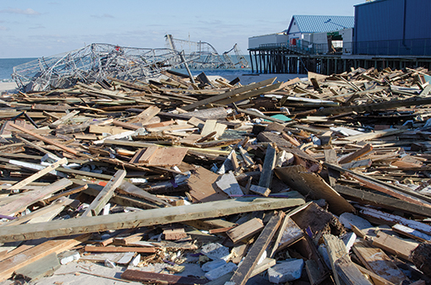
Economics In Practice (1 of 2)
Why Is My Hotel Room So Expensive? A Tale of Hurricane Sandy
To predict which prices rose after Hurricane Sandy, all we need to do is look at businesses facing large shifts in either their demand or supply curves after the storm.
The hotel industry saw a large outward shift of the demand curve in its market. Higher prices and price gouging became possible.
CRITICAL THINKING
Gas prices rose after Sandy as supply shifted to the left, or inward, given transport problems. Transport problems likely also affected the delivery of Cheerios. Do you expect the price of Cheerios to also rise substantially? Why or why not?

Slide 14
Constraints on the Market and Alternative Rationing Mechanisms (6 of 6)
Rationing Mechanisms for Concert and Sports Tickets
It is very difficult to prevent the price system from operating and to stop people’s willingness to pay from asserting itself.
Every time an alternative is tried, the price system seems to sneak in the back door.
With favored customers and black markets, the final distribution may be even more unfair than what would result from simple price rationing.

Slide 15
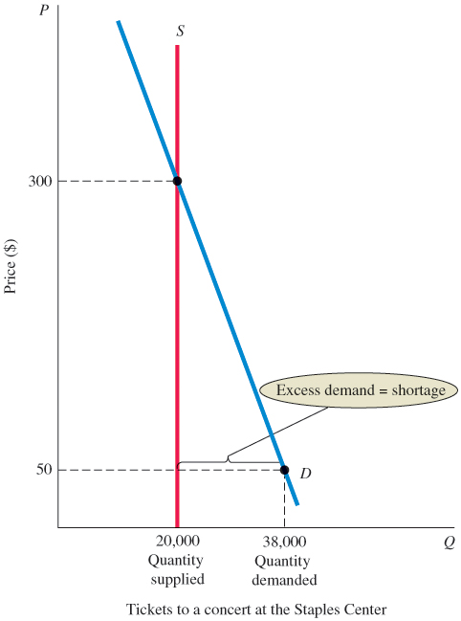
Figure 4.4 Supply of and Demand for a Concert at the Staples Center
At the face-value price of $50, there is excess demand for seats to the concert.
At $50 the quantity demanded is greater than the quantity supplied, which is fixed at 20,000 seats.
The diagram shows that the quantity demanded would equal the quantity supplied at a price of $300 per ticket.

Slide 16
Prices and the Allocation of Resources
Price changes resulting from shifts of demand in output markets cause profits to rise or fall. Profits attract capital; losses lead to disinvestment.
Higher wages attract labor and encourage workers to acquire skills.
At the core of the system, supply, demand, and prices in input and output markets determine the allocation of resources and the ultimate combinations of goods and services produced.

Slide 17
Price Floor
price floor A minimum price below which exchange is not permitted.
minimum wage A price floor set for the price of labor.

Slide 18
Supply and Demand Analysis: Tariffs (Tax)
The basic logic of supply and demand is a powerful tool of analysis.
An example of the power of this logic is a tax on goods produced outside the country, often called a tariff.
Supply and demand analysis makes the arguments of the import tax proponents easier to understand.

Slide 19
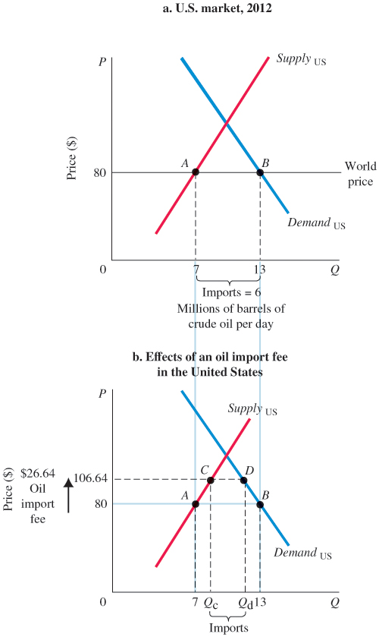
Figure 4.5 The U.S. Market for Crude Oil, 2012
In 2012 the world market price for crude oil was approximately $80 per barrel.
Domestic production in the United States that year averaged about 7 million barrels per day, whereas crude oil demand averaged just under 13 million barrels per day.
The difference between production and consumption were made up of net imports of approximately 6 million barrels per day, as we see in panel (a).
If the government imposed a tax in this market of 33.33%, or $26.64, that would increase the world price to $106.64.
That higher price caused quantity demanded to fall below its original level of 13 million barrels, while the price increase caused domestic production to rise above the original level.
As we see in panel (b), the effect was a reduction in import levels.

Slide 20

Economics In Practice (2 of 2)
Every summer, New York City puts on free performances of Shakespeare in the Park.
The true cost of a ticket is $0 plus the opportunity cost of the time spent in line.
Students can produce tickets relatively cheaply by waiting in line. They can then turn around and sell those tickets to high-wage Shakespeare lovers.
CRITICAL THINKING
Many museums offer free admission one day a week, on a weekday. On that day we observe that museumgoers are more likely to be senior citizens than on a typical Saturday. Why?

Slide 21
Supply and Demand and Market Efficiency
Supply and demand curves can be used to illustrate market efficiency, which can be understood through the concepts of consumer and producer surplus.
Consumer Surplus
consumer surplus The difference between the maximum amount a person is willing to pay for a good and its current market price.

Slide 22
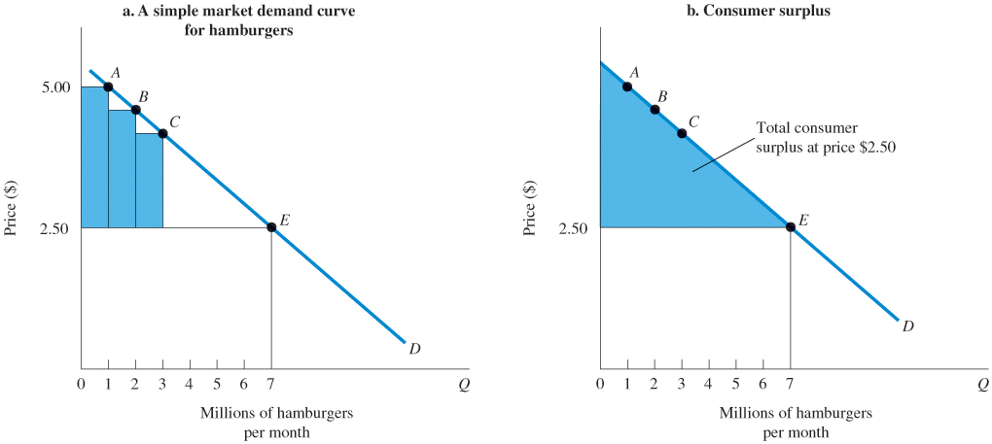
Figure 4.6 Market Demand and Consumer Surplus
As illustrated in panel (a), some consumers (see point A) are willing to pay as much as $5.00 each for hamburgers. Since the market price is just $2.50, they receive a consumer surplus of $2.50 for each hamburger that they consume.
Others (see point B) are willing to pay something less than $5.00 and receive a slightly smaller surplus.
Because the market price of hamburgers is just $2.50, the area of the shaded triangle in panel (b) is equal to total consumer surplus.

Slide 23
Producer Surplus
producer surplus The difference between the current market price and the cost of production for the firm.

Slide 24
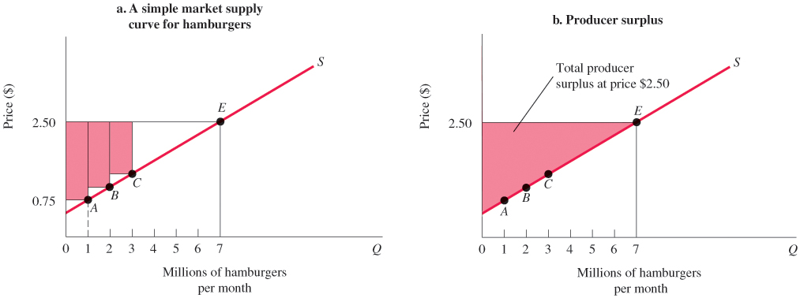
Figure 4.7 Market Supply and Producer Surplus
As illustrated in panel (a), some producers are willing to produce hamburgers for a price of $0.75 each. Since they are paid $2.50, they earn a producer surplus equal to $1.75.
Other producers are willing to supply hamburgers at prices less than $2.50, and they also earn producer surplus. Because the market price of hamburgers is $2.50, the area of the shaded triangle in panel (b) is equal to total producer surplus.

Slide 25
Competitive Markets Maximize the Sum of Producer and Consumer Surplus
deadweight loss The total loss of producer and consumer surplus from underproduction or overproduction.

Slide 26
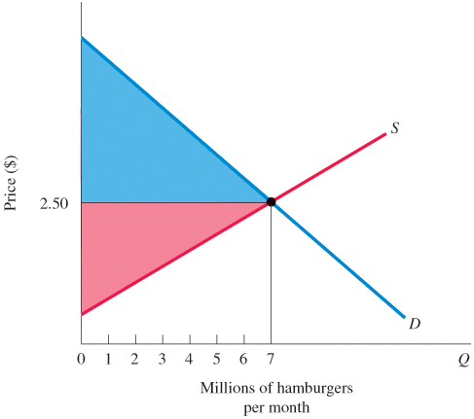
Figure 4.8 Total Producer and Consumer Surplus
Total producer and consumer surplus is greatest where supply and demand curves intersect at equilibrium.

Slide 27
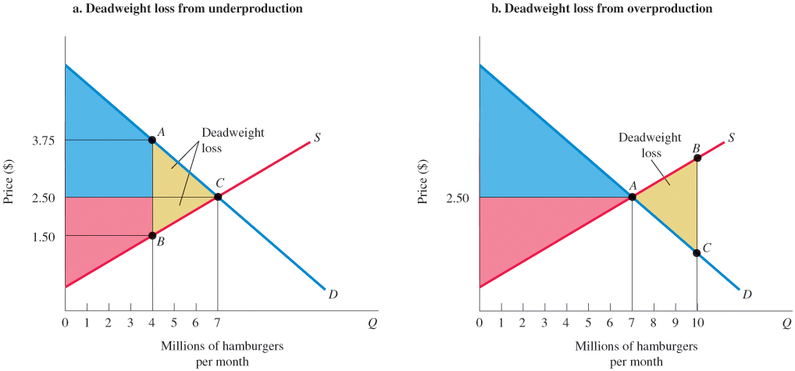
Figure 4.9 Deadweight Loss
Panel (a) shows the consequences of producing 4 million hamburgers per month instead of 7 million hamburgers per month. Total producer and consumer surplus is reduced by the area of triangle ABC shaded in yellow. This is called the deadweight loss from underproduction.
Panel (b) shows the consequences of producing 10 million hamburgers per month instead of 7 million hamburgers per month. As production increases from 7 million to 10 million hamburgers, the full cost of production rises above consumers’ willingness to pay, resulting in a deadweight loss equal to the area of triangle ABC.

Slide 28
Potential Causes of Deadweight Loss from Under- and Overproduction
Competitive markets are efficient because when supply and demand interact freely, markets produce what people want at the least cost.
There are a number of sources of market failure:
Monopoly power gives firms the incentive to underproduce and overprice.
Taxes and subsidies may distort consumer choices.
External costs such as pollution and congestion may lead to over- or underproduction of some goods.
Artificial price floors and price ceilings may have the same effects.

Slide 29
Looking Ahead
We have now examined the basic forces of supply and demand and discussed the market/price system.
These fundamental concepts will serve as building blocks for what comes next.
Whether you are studying microeconomics or macroeconomics, you will be studying the functions of markets and the behavior of market participants in more detail in the following chapters.

Slide 30
Review Terms and Concepts
black market
consumer surplus
deadweight loss
favored customers
minimum wage
price ceiling
price floor
price rationing
producer surplus
queuing
ration coupons

Slide 31
Copyright
This work is protected by United States copyright laws and is provided solely for the use of instructors in teaching their courses and assessing student learning. Dissemination or sale of any part of this work (including on the World Wide Web) will destroy the integrity of the work and is not permitted. The work and materials from it should never be made available to students except by instructors using the accompanying text in their classes. All recipients of this work are expected to abide by these restrictions and to honor the intended pedagogical purposes and the needs of other instructors who rely on these materials.

