Slide 1

Principles of Economics (1 of 2)
Thirteenth Edition
Part II
The Market System
Choices Made by Households and Firms
Copyright © 2020, 2016, 2011 Pearson Education, Inc. All Rights Reserved
Notes:
If this PowerPoint presentation contains mathematical equations, you may need to check that your computer has the following installed:
1) MathType Plugin
2) Math Player (free versions available)
3) NVDA Reader (free versions available)

Slide 2
Part II The Market System (1 of 2)
Assumptions for Chapters 6 through 12:
perfect knowledge
The assumption that households possess a knowledge of the qualities and prices of everything available in the market and that firms have all available information concerning wage rates, capital costs, technology, and output prices.
perfect competition
An industry structure in which there are many firms, each being small relative to the industry and producing virtually identical products, and in which no firm is large enough to have any control over prices.

Slide 3
Part II The Market System (2 of 2)
Products in a perfectly competitive industry are homogeneous.
homogeneous products Undifferentiated outputs; products that are identical to or indistinguishable from one another.

Slide 4
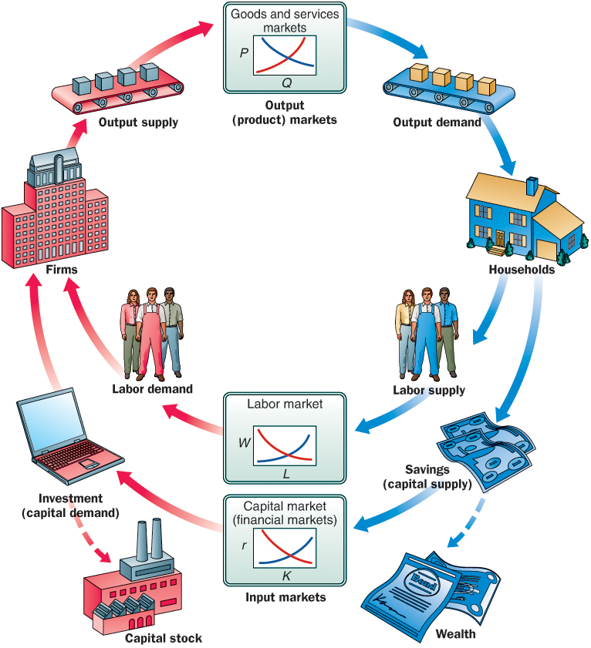
Figure II.1 Firm and Household Decisions
Households demand in output markets and supply labor and capital in input markets.
To simplify our analysis, we have not included the government and international sectors in this circular flow diagram. These topics will be discussed in detail later.

Slide 5
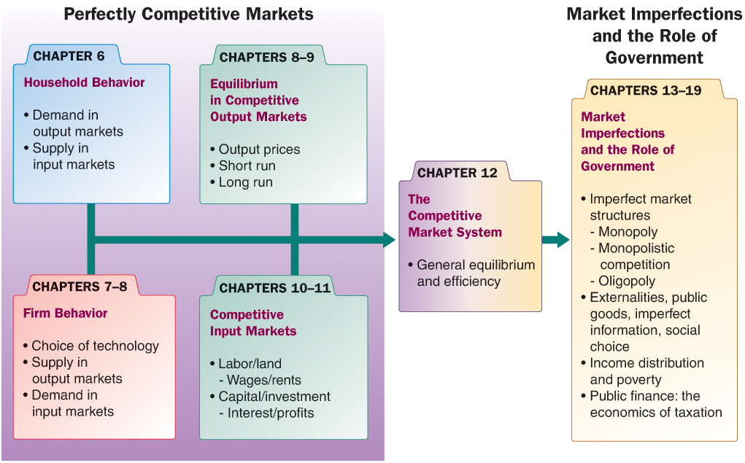
Figure II.2 Understanding the Microeconomy and the Role of Government
To understand how the economy works, it helps to build from the ground up. We start in Chapters 6–8 with an overview of household and firm decision making in simple, perfectly competitive markets. In Chapters 9–11, we see how firms and households interact in output markets (product markets) and input markets (labor/land and capital) to determine prices, wages, and profits. Once we have a picture of how a simple, perfectly competitive economy works, we begin to relax assumptions. Chapter 12 is a pivotal chapter that links perfectly competitive markets with a discussion of market imperfections and the role of government. In Chapters 13–19, we cover the three noncompetitive market structures (monopoly, monopolistic competition, and oligopoly), externalities, public goods, uncertainty and asymmetric information, and income distribution, as well as taxation and government finance..

Slide 6
Principles of Economics (2 of 2)
Thirteenth Edition
Chapter 6
Household Behavior and Consumer Choice
Copyright © 2020, 2016, 2011 Pearson Education, Inc. All Rights Reserved

Slide 7
Chapter Outline and Learning Objectives (1 of 2)
6.1 Household Choice in Output Markets
Explain where the budget constraint comes from and the role it plays in household demand.
6.2 The Basis of Choice: Utility
Understand how the utility-maximizing rule works in household choice of products.
6.3 Income and Substitution Effects
Describe the income and substitution effects of a decrease in the price of food.

Slide 8
Chapter Outline and Learning Objectives (2 of 2)
6.4 Household Choice in Input Markets
Discuss factors that affect the labor and saving decisions of households.
A Review: Households in Output and Input Markets
Appendix: Indifference Curves
Understand how to derive a demand curve from indifference curves and budget constraints.

Slide 9
Chapter 6 Household Behavior and Consumer Choice
Every day people make different decisions.
In this chapter, we will develop a set of principles that can be used to understand decisions in the product market and the labor market.
A theme in this analysis is the idea of constrained choice.

Slide 10
Household Choice in Output Markets
Every household must make three basic decisions:
How much of each product, or output, to demand.
How much labor to supply.
How much to spend today and how much to save for the future.

Slide 11
The Determinants of Household Demand
Several factors influence the quantity of a given good or service demanded by a single household:
The price of the product
The income available to the household
The household’s accumulated wealth
The prices of other products available to the household
The household’s tastes and preferences
The household’s expectations about future income, wealth, and prices

Slide 12
The Budget Constraint (1 of 3)
budget constraint The limits imposed on household choices by income, wealth, and product prices.
choice set or opportunity set The set of options that is defined and limited by a budget constraint.

Slide 13
Table 6.1 Possible Budget Choices of a Person Earning $1,000 per Month after Taxes
Option | Monthly Rent | Food | Other Expenses | Total | Available?
A | $ 400 | $ 250 | $ 350 | $ 1,000 | Yes
B | 600 | 200 | 200 | 1,000 | Yes
C | 700 | 150 | 150 | 1,000 | Yes
D | 1,000 | 100 | 100 | 1,200 | No

Slide 14
The Budget Constraint (2 of 3)
Preferences, Tastes, Trade-offs, and Opportunity Cost
Within the constraints imposed by limited incomes and fixed prices, households are free to choose what they will and will not buy.
A household makes a choice by weighing the good or service that it chooses against all the other things that the same money could buy.
With a limited budget, the real cost of any good or service is the value of the other goods and services that could have been purchased with the same amount of money.

Slide 15
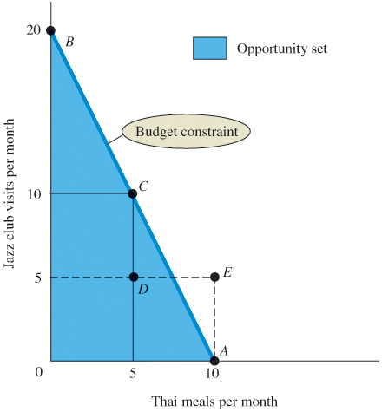
Figure 6.1 Budget Constraint and Opportunity Set for Ann and Tom
A budget constraint separates those combinations of goods and services (e.g., point C) that are available, given limited income, from those that are not (e.g., point E).
The available combinations make up the opportunity set.

Slide 16
The Budget Constraint (3 of 3)
The Budget Constraint More Formally
Both prices and income affect the size of a household’s opportunity set.
real income The set of opportunities to purchase real goods and services available to a household as determined by prices and money income.

Slide 17
The Equation of the Budget Constraint
In general, the budget constraint can be written as:
where:
P_{X} = the price of X
X = the quantity of X consumed
P_{Y} = the price of Y
Y = the quantity of Y consumed
I = household income

Slide 18
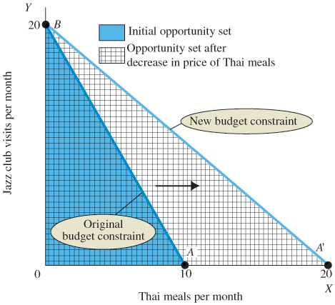
Figure 6.2 The Effect of a Decrease in Price on Ann and Tom’s Budget Constraint
When the price of a good decreases, the budget constraint swivels to the right, increasing the opportunities available and expanding choice.

Slide 19
The Basis of Choice: Utility (1 of 2)
utility The satisfaction a product yields.
Diminishing Marginal Utility
law of diminishing marginal utility The more of any one good consumed in a given period, the less satisfaction (utility) generated by consuming each additional (marginal) unit of the same good.

Slide 20
The Basis of Choice: Utility (2 of 2)
marginal utility (MU) The additional satisfaction gained by the consumption of one more unit of a good or service.
total utility The total satisfaction a product yields.

Slide 21
Table 6.2 Total Utility and Marginal Utility of Trips to the Club per Week
Trips to Club | Total Utility | Marginal Utility
1 | 12 | 12
2 | 22 | 10
3 | 28 | 6
4 | 32 | 4
5 | 34 | 2
6 | 34 | 0

Slide 22
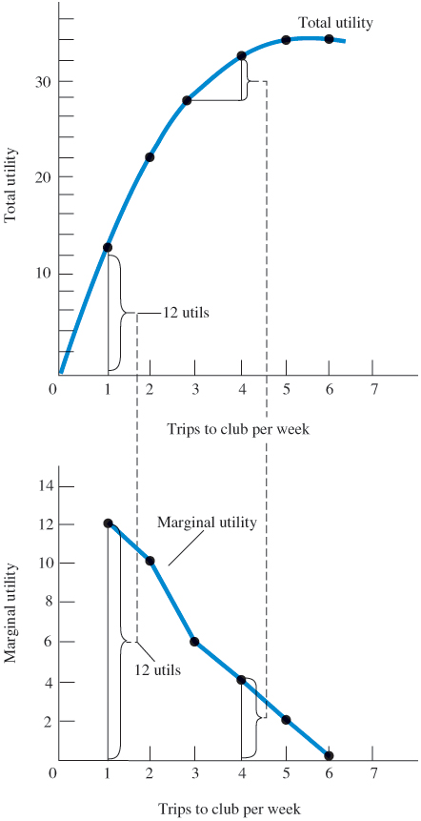
Figure 6.3 Graphs of Frank’s Total and Marginal Utility
Marginal utility is the additional utility gained by consuming one additional unit of a commodity—in this case, trips to the club.
When marginal utility is zero, total utility stops rising.

Slide 23
Allocating Income to Maximize Utility
Table 6.3 Allocation of Fixed Expenditure per Week between Two Alternatives
(1) Trips to Club per Week | (2) Total Utility | (3) Marginal Utility (MU) | (4) Price (P) | (5) Marginal Utility per Dollar (MU/P)
1 | 12 | 12 | $3.00 | 4.0
2 | 22 | 10 | 3.00 | 3.3
3 | 28 | 6 | 3.00 | 2.0
4 | 32 | 4 | 3.00 | 1.3
5 | 34 | 2 | 3.00 | 0.7
6 | 34 | 0 | 3.00 | 0
(1) Basketball Games per Week | (2) Total Utility | (3) Marginal Utility (MU) | (4) Price (P) | (5) Marginal Utility per Dollar (MU/P)
1 | 21 | 21 | $6.00 | 3.5
2 | 33 | 12 | 6.00 | 2.0
3 | 42 | 9 | 6.00 | 1.5
4 | 48 | 6 | 6.00 | 1.0
5 | 51 | 3 | 6.00 | 0.5
6 | 51 | 0 | 6.00 | 0

Slide 24
The Utility-Maximizing Rule (1 of 2)
Utility-maximizing consumers spread out their expenditures until the following condition holds:
where MU_{X} is the marginal utility derived from the last unit of X consumed, MU_{Y} is the marginal utility derived from the last unit of Y consumed, P_{X} is the price per unit of X, and P_{Y} is the price per unit of Y.

Slide 25
The Utility-Maximizing Rule (2 of 2)
utility-maximizing rule Equating the ratio of the marginal utility of a good to its price for all goods.
diamond/water paradox A paradox stating that (1) the things with the greatest value in use frequently have little or no value in exchange and (2) the things with the greatest value in exchange frequently have little or no value in use.

Slide 26

Economics In Practice (1 of 3)
Price Salience
Recent work in behavioral economics suggested that prices may not be salient to consumers.
Amy Finkelstein from MIT found that E-Zpass, the automatic toll collection system, made drivers less aware of toll levels, and thus reducing the elasticity of road travel to changes in toll rates.
CRITICAL THINKING
Can you think of another consumer product example in which prices may not be salient?

Slide 27
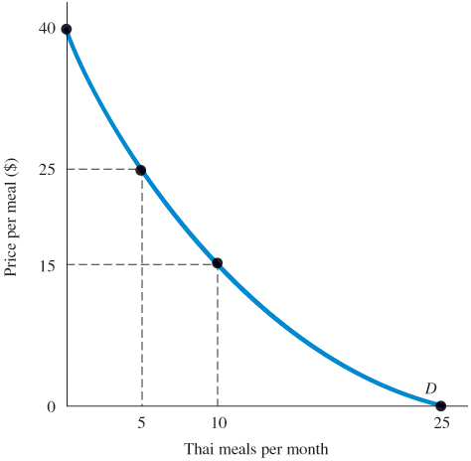
Diminishing Marginal Utility and Downward-Sloping Demand
Figure 6.4 Diminishing Marginal Utility and Downward-Sloping Demand
At a price of $40, the utility gained from even the first Thai meal is not worth the price.
However, a lower price of $25 lures Ann and Tom into the Thai restaurant five times a month. (The utility from the sixth meal is not worth $25.)
If the price is $15, Ann and Tom will eat Thai meals 10 times a month—until the marginal utility of a Thai meal drops below the utility they could gain from spending $15 on other goods.
At 25 meals a month, they cannot tolerate the thought of another Thai meal, even if it is free.

Slide 28
Income and Substitution Effects
Another explanation for downward-sloping demand curves centers on income and substitution effects.
The Income Effect
Assuming nothing else changes, a price decline in a product makes you better off because you have more income left over.
The change in consumption of X due to this improvement in well-being is called the income effect of a price change.

Slide 29
The Substitution Effect
When the price of a product falls, that product also becomes relatively cheaper.
A fall in the price of product X might cause a household to shift its purchasing pattern away from substitutes toward X.
This shift is called the substitution effect of a price change.

Slide 30
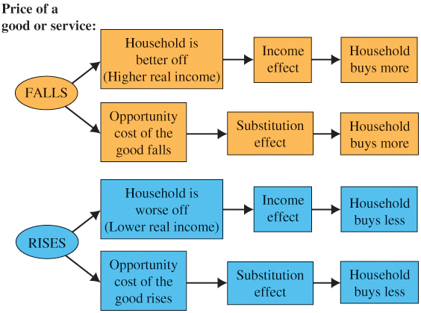
Figure 6.5 Income and Substitution Effects of a Price Change
For normal goods, the income and substitution effects work in the same direction. Higher prices lead to a lower quantity demanded, and lower prices lead to a higher quantity demanded.

Slide 31

Economics In Practice (2 of 3)
Substitution and Market Baskets
When Mr. Smith shops, he compares the marginal utility of each product he consumes relative to its price in deciding what bundle to buy.
When we artificially restrict Mr. Smith’s ability to substitute goods, we almost inevitably give him a more expensive bundle.
CRITICAL THINKING
An employer decides to transfer one of her executives to Europe. “Don’t worry,” she says, “I will increase your salary so that you can afford exactly the same things in your new home city as you can buy here.” Is this the right salary adjustment?

Slide 32
Household Choice in Input Markets
The Labor Supply Decision
As in output markets, households face constrained choices in input markets. They must decide:
Whether to work
How much to work
What kind of a job to take

Slide 33
The Labor Supply Decision
Household members must decide how much labor to supply.
The choices they make are affected by:
Availability of jobs
Market wage rates
Skills they possess
The limit of 168 hours in a week

Slide 34
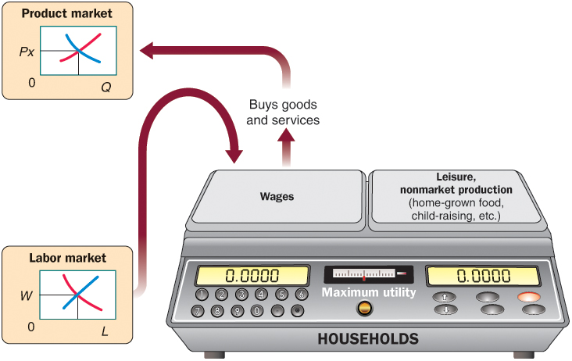
Figure 6.6 The Trade-off Facing Households
The decision to enter the workforce involves a trade-off between wages (and the goods and services that wages will buy) on the one hand and leisure and the value of nonmarket production on the other hand.

Slide 35
The Price of Leisure
Trading one good for another involves buying less of one and more of another, so households simply reallocate income from one good to the other.
“Buying” more leisure, however, means reallocating time between work and nonwork activities.
For each hour of leisure that you decide to consume, you give up one hour’s wages.
Thus, the wage rate is the price of leisure.

Slide 36
Income and Substitution Effects of a Wage Change
labor supply curve A curve that shows the quantity of labor supplied at different wage rates. Its shape depends on how households react to changes in the wage rate.

Slide 37

Economics In Practice (3 of 3)
Job Flexibility for Uber Drivers
In the “sharing economy,” people use their own personal property to produce services for sale to others.
Uber is a company that matches people who are available to use their own cars to drive people around with those who want a ride.
Looking at data from more than 200,000 Uber drivers, economists found Uber drivers to be responsive to increases in the price they received per ride (high labor supply elasticity). But the flexibility to work is the biggest lure for Uber drivers.
CRITICAL THINKING
Consider apartment sharing services, like Airbnb. Would you expect the supply elasticity to be larger for people offering a room in their own apartment or in a second apartment that they own? That is, the supply for which type of accommodation would be responsive to changes in the price?

Slide 38
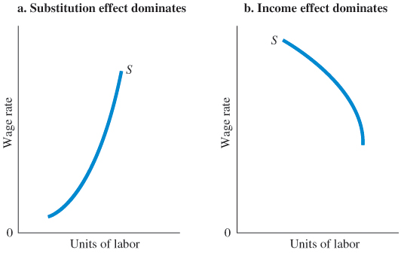
Figure 6.7 Two Labor Supply Curves
When the substitution effect outweighs the income effect, the labor supply curve slopes upward (a).
When the income effect outweighs the substitution effect, the result is a “backward-bending” labor supply curve: The labor supply curve slopes downward (b).

Slide 39
Saving and Borrowing: Present versus Future Consumption
Changes in interest rates affect household behavior in capital markets.
Empirical evidence indicates that saving tends to increase as the interest rate rises (i.e., the substitution effect is larger than the income effect).
financial capital market The complex set of institutions in which suppliers of capital (households that save) and the demand for capital (firms wanting to invest) interact.

Slide 40
A Review: Households in Output and Input Markets
We now have a rough sketch of the factors that determine output demand and input supply.
In the next three chapters, we turn to firm behavior and explore in detail the factors that affect output supply and input demand.

Slide 41
Review Terms and Concepts
budget constraint
choice set or opportunity set
diamond/water paradox
financial capital market
homogeneous products
labor supply curve
law of diminishing marginal utility
marginal utility (MU)
perfect competition
perfect knowledge
real income
total utility
utility
utility-maximizing rule

Slide 42
Chapter 6 Appendix: Indifference Curves (1 of 2)
Assumptions:
Goods yield positive marginal utility (i.e., “more is better”).
The marginal rate of substitution, the ratio at which a household is willing to substitute X for Y, MU_{X}/MU_{Y}, is diminishing.
Consumers have the ability to choose among the combinations of goods and services available.
Consumer choices are consistent with a simple assumption of rationality.

Slide 43
Chapter 6 Appendix: Indifference Curves (2 of 2)
Assumptions
marginal rate of substitution
the ratio at which a household is willing to substitute good Y for good X.
Deriving Indifference Curves
indifference curve A set of points, each point representing a combination of goods X and Y, all of which yield the same total utility.

Slide 44
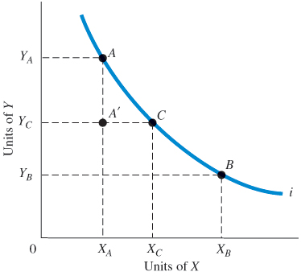
Deriving Indifference Curves
Figure 6A.1 An Indifference Curve
An indifference curve is a set of points, each representing a combination of some amount of good X and some amount of good Y, that all yield the same amount of total utility.
The consumer depicted here is indifferent between bundles A and B, B and C, and A and C.
Because “more is better,” our consumer is unequivocally worse off at A' than at A.

Slide 45
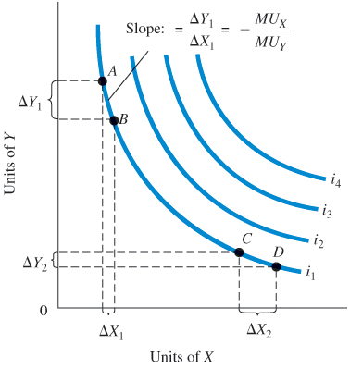
Figure 6A.2 A Preference Map: A Family of Indifference Curves
Each consumer has a unique family of indifference curves called a preference map. Higher indifference curves represent higher levels of total utility.

Slide 46
Properties of Indifference Curves
We can show how the trade-off changes more formally by deriving an expression of the slope of an indifference curve.
For good X and good Y:
Rearranging terms, we obtain

Slide 47
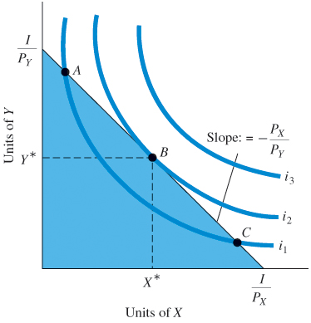
Figure 6A.3 Consumer Utility-Maximizing Equilibrium
Consumers will choose the combination of X and Y that maximizes total utility. Graphically, the consumer will move along the budget constraint until the highest possible indifference curve is reached.
At that point, the budget constraint and the indifference curve are tangent. This point of tangency occurs at X* and Y* (point B).

Slide 48
Consumer Choice
The tangency point between the indifference curve and the budget constraint has implications:
They have the same slope:
slope of indifference curve = slope of budget constraint
Utility maximization is reached when the marginal utility per dollar spent on X equals the marginal utility per dollar spent on Y:

Slide 49
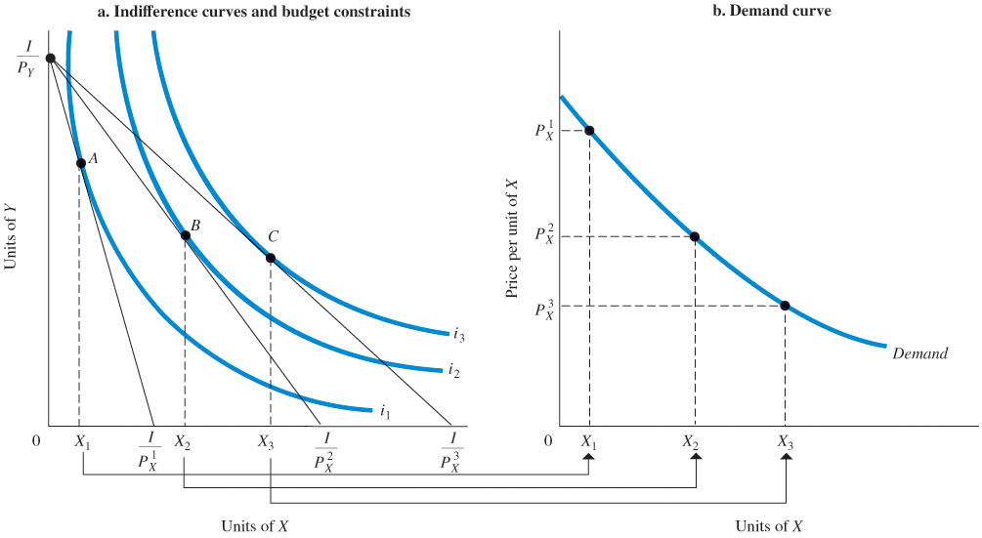
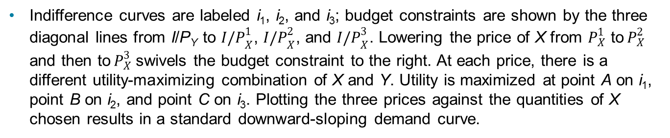
Deriving a Demand Curve from Indifference Curves and Budget Constraints
Figure 6A.4 Deriving a Demand Curve from Indifference Curves and Budget Constraint
Indifference curves are labeled i₁, i₂, and i₃; budget constraints are shown by the three diagonal lines from I/P_{Y} to ${I/P}_{X}^{1}$, ${I/P}_{X}^{2}$, and ${I/P}_{X}^{3}$. Lowering the price of X from $P_{X}^{1}$ to${ P}_{X}^{2}$ and then to${ P}_{X}^{3}$swivels the budget constraint to the right. At each price, there is a different utility-maximizing combination of X and Y. Utility is maximized at point A on i₁, point B on i₂, and point C on i₃. Plotting the three prices against the quantities of X chosen results in a standard downward-sloping demand curve.

Slide 50
Appendix Review Terms and Concepts
indifference curve
marginal rate of substitution
preference map

Slide 51
Copyright
This work is protected by United States copyright laws and is provided solely for the use of instructors in teaching their courses and assessing student learning. Dissemination or sale of any part of this work (including on the World Wide Web) will destroy the integrity of the work and is not permitted. The work and materials from it should never be made available to students except by instructors using the accompanying text in their classes. All recipients of this work are expected to abide by these restrictions and to honor the intended pedagogical purposes and the needs of other instructors who rely on these materials.

