Slide 1
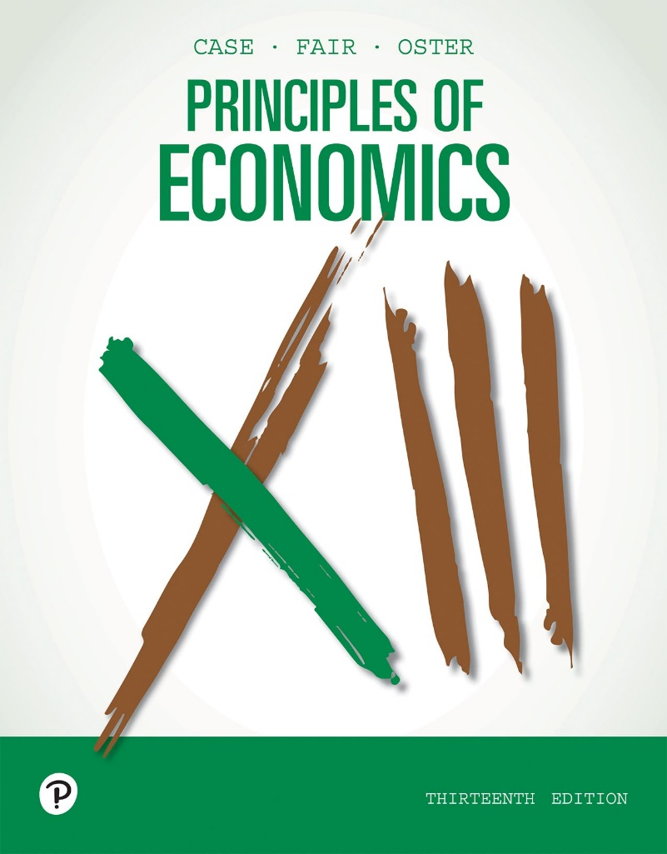
Principles of Economics
Thirteenth Edition
Chapter 7
The Production Process: The Behavior of Profit-Maximizing Firms
Copyright © 2020, 2016, 2011 Pearson Education, Inc. All Rights Reserved
Notes:
If this PowerPoint presentation contains mathematical equations, you may need to check that your computer has the following installed:
1) MathType Plugin
2) Math Player (free versions available)
3) NVDA Reader (free versions available)

Slide 2
Chapter Outline and Learning Objectives
7.1 The Behavior of Profit-Maximizing Firms
Understand the importance of opportunity costs to economic profits and how these profits feed into firm decision making.
7.2 The Production Process
Be able to describe how total, marginal, and average products relate to one another.
7.3 Choice of Technology
Discuss the factors that firms consider when choosing among production techniques.
Looking Ahead: Cost and Supply
Appendix: Isoquants and Isocosts
Derive a cost curve from isoquants and isocost lines.

Slide 3
Chapter 7 The Production Process: The Behavior of Profit-Maximizing Firms
All firms demand inputs, engage in production, and produce output.
Firms also have an incentive to maximize profits and minimize costs.
production The process by which inputs are combined, transformed, and turned into outputs.
firm An organization that comes into being when a person or a group of people decides to produce a good or service to meet a perceived demand.

Slide 4
The Behavior of Profit-Maximizing Firms
All firms must make several basic decisions to achieve what we assume to be their primary objective—maximum profits.

Slide 5
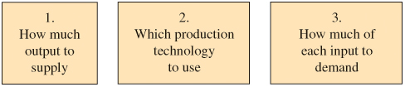
Figure 7.1 The Three Decisions That All Firms Must Make

Slide 6
Profits and Economics Costs (1 of 3)
profit The difference between total revenue and total cost.
profit = total revenue − total cost
total revenue The total amount that a firm takes in from the sale of its product: the price per unit times the quantity of output the firm decides to produce.
total cost Total fixed costs plus total variable costs.

Slide 7
Profits and Economics Costs (2 of 3)
The term profit will from here on refer to economic profit.
So whenever we say profit = total revenue − total cost, what we really mean is:
economic profit Profit that accounts for both explicit and opportunity costs.

Slide 8
Profits and Economics Costs (3 of 3)
Normal Rate of Return
The way we treat the opportunity cost of capital is to add a normal rate of return to capital as part of economic cost.
normal rate of return A rate of return on capital that is just sufficient to keep owners and investors satisfied. For relatively risk-free firms, it should be nearly the same as the interest rate on risk-free government bonds.

Slide 9
Table 7.1 Calculating Total Revenue, Total Cost, and Profit
Initial Investment: Market Interest Rate Available: | $20,000 0.10, or 10%
Total revenue (3,000 belts × $10 each) | $30,000
Costs | Blank
Belts from Supplier | $15,000
Labor cost | 14,000
Normal return/opportunity cost of capital ($20,000 × 0.10) | 2,000
Total Cost | $31,000
Profit = total revenue − total cost | −$1,000ª
ª There is a loss of $1,000.

Slide 10
Short-Run versus Long-Run Decisions
short run The period of time for which two conditions hold: The firm is operating under a fixed scale (fixed factor) of production, and firms can neither enter nor exit an industry.
long run That period of time for which there are no fixed factors of production: Firms can increase or decrease the scale of operation, and new firms can enter and existing firms can exit the industry.

Slide 11
The Bases of Decisions: Market Price of Outputs, Available Technology, and Input Prices
A firm needs to know three things:
Market price of output: potential revenues
Production techniques that are available: how much input needed
Input prices: costs
optimal method of production The production method that minimizes cost for a given level of output.

Slide 12
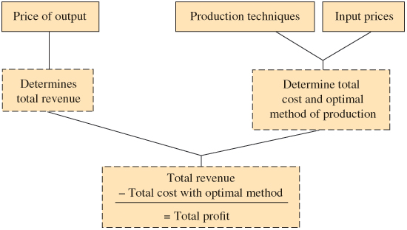
Figure 7.2 Determining the Optimal Method of Production

Slide 13
The Production Process
production technology The quantitative relationship between inputs and outputs.
labor-intensive technology Technology that relies heavily on human labor instead of capital.
capital-intensive technology Technology that relies heavily on capital instead of human labor.

Slide 14
Production Functions: Total Product, Marginal Product, and Average Product (1 of 3)
production function or total product function A numerical or mathematical expression of a relationship between inputs and outputs. It shows units of total product as a function of units of inputs.

Slide 15
Table 7.2 Production Function
(1) Labor Units (Employees) | (2) Total Product (Sandwiches per Hour) | (3) Marginal Product of Labor | (4) Average Product of Labor (Total Product ÷ Labor Units)
0 | 0 | — | —
1 | 10 | 10 | 10.0
2 | 25 | 15 | 12.5
3 | 35 | 10 | 11.7
4 | 40 | 5 | 10.0
5 | 42 | 2 | 8.4
6 | 42 | 0 | 7.0

Slide 16
Production Functions: Total Product, Marginal Product, and Average Product (2 of 3)
Marginal Product and the Law of Diminishing Returns
marginal product The additional output that can be produced by adding one more unit of a specific input, ceteris paribus.
law of diminishing returns When additional units of a variable input are added to fixed inputs, after a certain point, the marginal product of the variable input declines.
Every firm faces diminishing returns, which always apply in the short run.

Slide 17
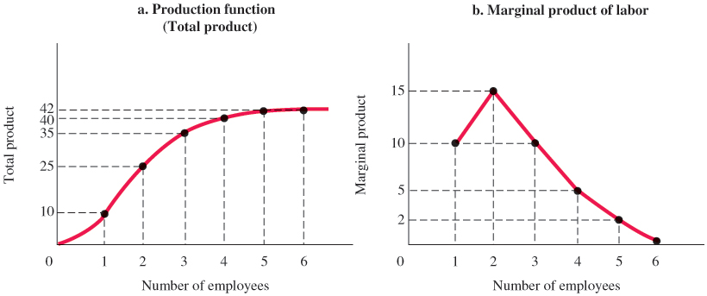
Figure 7.3 Production Function for Sandwiches
A production function is a numerical representation of the relationship between inputs and outputs.
In panel (a), total product (sandwiches) is graphed as a function of labor inputs.
The marginal product of labor is the additional output that one additional unit of labor produces.
Panel (b) shows that the marginal product of the second unit of labor at the sandwich shop is 15 units of output; the marginal product of the fourth unit of labor is 5 units of output.

Slide 18
Production Functions: Total Product, Marginal Product, and Average Product (3 of 3)
Marginal Product versus Average Product
average product The average amount produced by each unit of a variable factor of production.
If marginal product is above average product, the average rises; if marginal product is below average product, the average falls.

Slide 19
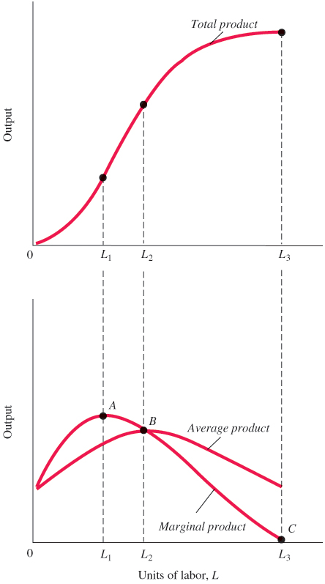
Figure 7.4 Total Average and Marginal Product
Marginal and average product curves can be derived from total product curves.
Average product is at its maximum at the point of intersection with marginal product.

Slide 20
Production Functions with Two Variable Factors of Production (1 of 2)
Inputs work together in production. Capital and labor are complementary inputs.
Additional capital increases the productivity of labor—that is, the amount of output produced per worker per hour.
This simple relationship lies at the heart of worries about productivity at the national and international levels. Building new, modern plants and equipment enhances a nation’s productivity.

Slide 21
Production Functions with Two Variable Factors of Production (2 of 2)
In the past decade, China has accumulated capital (that is, built plants and equipment) at a very high rate. The result has been growth in the average quantity of output per worker in China.

Slide 22

Economics In Practice (1 of 2)
Gains from Modern Management
Michela Giorcelli from UCLA spotlights the importance of worker training and modern machinery in increasing output.
Looking at data on the performance of more than 3,000 Italian firms whose managers took part in the United States Technical Assistance and Productivity Program between 1952 and 1958, she found productivity of the participating firms grew by 15 percent in the first year and continued to grow for more than a decade afterward.
CRITICAL THINKING
Why did Giorcelli compare participating firms with the performance of firms that applied to the program but were excluded for budget reasons? Why is this better than just comparing the participants with firms overall?

Slide 23
Choice of Technology
TABLE 7.3 Inputs Required to Produce 100 Diapers Using Alternative Technologies
Technology | Units of Capital (K) | Units of Labor (L)
A | 2 | 10
B | 3 | 6
C | 4 | 4
D | 6 | 3
E | 10 | 2
TABLE 7.4 Cost-Minimizing Choice among Alternative Technologies (100 Diapers)
(1) Technology | (2) Units of Capital (K) | (3) Units of Labor (L) | (4) P_{L} = $1 P_{K} = $1 | (5) P_{L} = $5 P_{K} = $1
A | 700 | 100 | $12 | $52
B | 650 | 200 | 9 | 33
C | 510 | 380 | 8 | 24
D | 400 | 500 | 9 | 21
E | 300 | 550 | 12 | 20
Two things determine the cost of production: (1) technologies that are available and (2) input prices. Profit-maximizing firms choose the technology that minimizes the cost of production, given current market input prices.

Slide 24
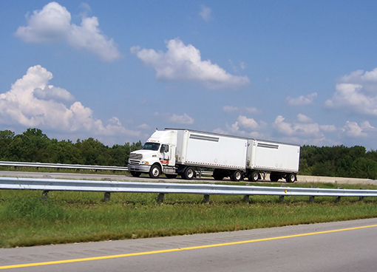
Economics In Practice (2 of 2)
How Fast Should a Truck Driver Go?
Modern technology, in the form of on-board computers, allows a modern trucking firm to monitor driving speed and instruct drivers.
Fuel Price | $3.50 | $4.00 | $4.50
Drive fast | $124.98 | $133.33 | $141.63
Drive slowly | $126.67 | $133.33 | $139.99
CRITICAL THINKING
When gasoline prices rise, accident rates fall. Provide two reasons this might be true.

Slide 25
Looking Ahead: Cost and Supply
So far, we have looked only at a single level of output.
The next chapter explores the relationship between cost and the level of output in some detail.
One of our main objectives in that chapter is to determine the amount that a competitive firm will choose to supply during a given time period.

Slide 26
Review Terms and Concepts
average product
capital-intensive technology
economic profit
firm
labor-intensive technology
law of diminishing returns
long run
marginal product
normal rate of return
optimal method of production
Production
production function or total product function
production technology
profit
short run
total cost (total economic cost)
total revenue
Equations:

Slide 27
Chapter 7 Appendix: Isoquants and Isocosts
New Look at Technology: Isoquants
This chapter has shown that the cost structure facing a firm depends on two key pieces of information: (1) input (factor) prices and (2) technology.
This appendix presents a more formal analysis of technology and factor prices and their relationship to cost.
isoquant A graph that shows all the combinations of capital and labor that can be used to produce a given amount of output.

Slide 28
Table 7A.1 Alternative Combinations of Capital (K) and Labor (L) Required to Produce 50, 100, and 150 Units of Output
 | Q_{x} = 50 | Q_{x} = 50 | Q_{x} = 100 | Q_{x} = 100 | Q_{x} = 150 | Q_{x} = 150
 | K | L | K | L | K | L
A | 1 | 8 | 2 | 10 | 3 | 10
B | 2 | 5 | 3 | 6 | 4 | 7
C | 3 | 3 | 4 | 4 | 5 | 5
D | 5 | 2 | 6 | 3 | 7 | 4
E | 8 | 1 | 10 | 2 | 10 | 3

Slide 29
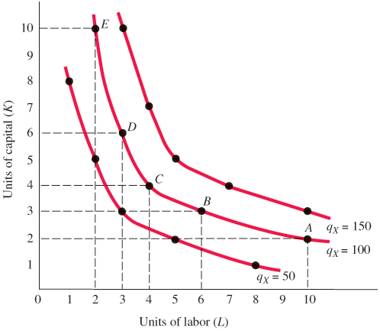
Figure 7A.1 Isoquants Showing All Combinations of Capital and Labor That Can Be Used to Produce 50, 100, 150 Units of Output

Slide 30
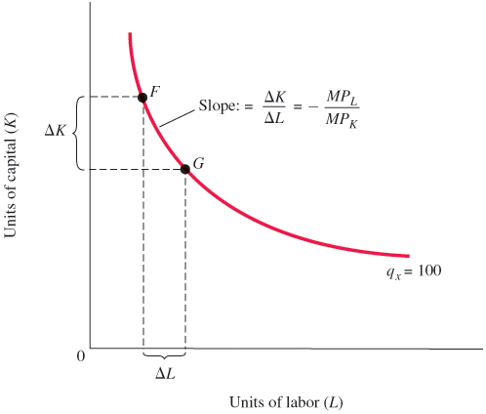
Figure 7A.2 The Slope of an Isoquant Is Equal to the Ratio of MP_{L} to MP_{K}

Slide 31
New Look at Technology: Isoquants
For output to remain constant, the loss of output from using less capital must be matched by the added output produced by using more labor.
Slope of isoquant:
marginal rate of technical substitution The rate at which a firm can substitute capital for labor and hold output constant.

Slide 32
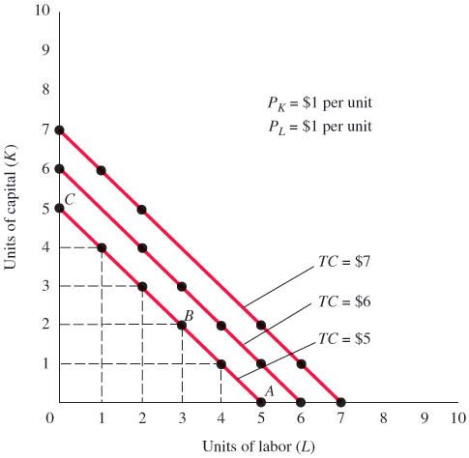
Figure 7A.3 Isocost Lines Showing the Combinations of Capital and Labor Available for $5, $6, and $7
An isocost line shows all the combinations of capital and labor that are available for a given total cost.

Slide 33
Factor Prices and Input Combinations: Isocosts
The equation of the straight line in Figure 7A.3:
Substituting our data for the lowest isocost line into this general equation, we get:
isocost line A graph that shows all the combinations of capital and labor available for a given total cost.

Slide 34
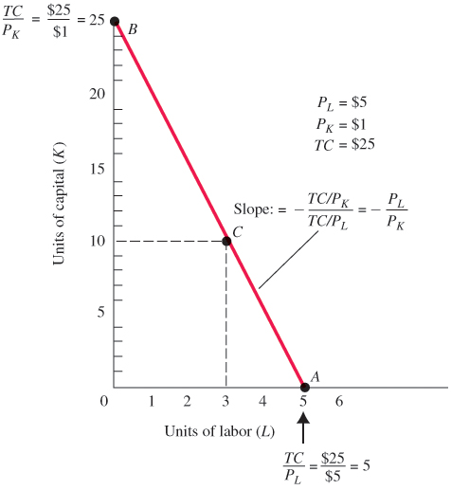
Figure 7A.4 Isocost Line Showing All Combinations of Capital and Labor Available for $25
One way to draw an isocost line is to determine the endpoints of that line and draw a line connecting them.
Slope of isocost line:

Slide 35
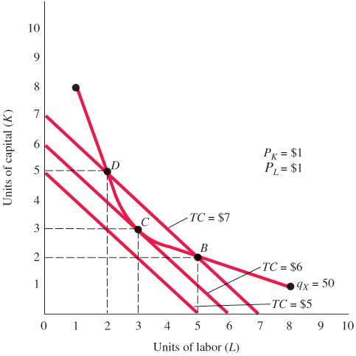
Finding the Least-Cost Technology with Isoquants and Isocosts
Figure 7A.5 Finding the Least-Cost Combination of Capital and Labor to Produce 50 Units of Output
Profit-maximizing firms will minimize costs by producing their chosen level of output with the technology represented by the point at which the isoquant is tangent to an isocost line.
Here the cost-minimizing technology—3 units of capital and 3 units of labor—is represented by point C.

Slide 36
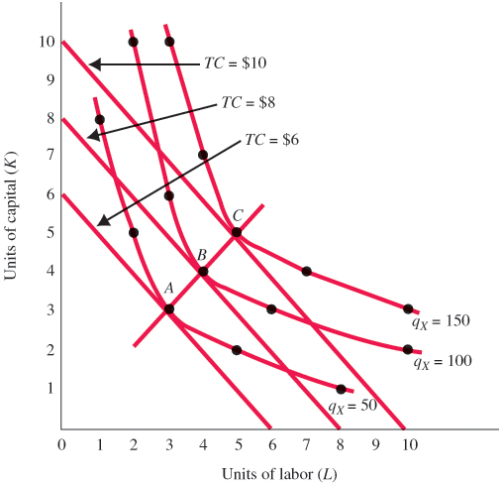
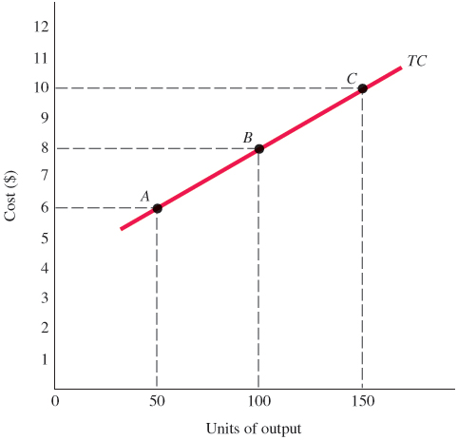
Figure 7A.6 Minimizing Cost of Production for q_{X} = 50, q_{X} = 100, and q_{X} = 150
Figure 7A.7 A Cost Curve Shows
the Minimum Cost of Producing
Each Level of Output
Plotting a series of cost-minimizing combinations of inputs—shown in Figure 7A.6 as points A, B, and C—on a separate graph results in a cost curve like the one shown in Figure 7A.7.

Slide 37
The Cost-Minimizing Equilibrium Condition
At the point where a line is just tangent to a curve, the two have the same slope. At each point of tangency, the following must be true:
Thus,
For the cost-minimizing equilibrium condition, we divide both sides by P_{L} and multiply both sides by

Slide 38
Appendix Review Terms and Concepts
isocost line
isoquant
marginal rate of technical substitution
Equations:
Slope of isoquant:
Slope of isocost line:

Slide 39
Copyright
This work is protected by United States copyright laws and is provided solely for the use of instructors in teaching their courses and assessing student learning. Dissemination or sale of any part of this work (including on the World Wide Web) will destroy the integrity of the work and is not permitted. The work and materials from it should never be made available to students except by instructors using the accompanying text in their classes. All recipients of this work are expected to abide by these restrictions and to honor the intended pedagogical purposes and the needs of other instructors who rely on these materials.

