Slide 1

Principles of Economics
Thirteenth Edition
Chapter 9
Long-Run Costs and Output Decisions
Copyright © 2020, 2016, 2011 Pearson Education, Inc. All Rights Reserved
Notes:
If this PowerPoint presentation contains mathematical equations, you may need to check that your computer has the following installed:
1) MathType Plugin
2) Math Player (free versions available)
3) NVDA Reader (free versions available)

Slide 2
Chapter Outline and Learning Objectives (1 of 2)
9.1 Short-Run Conditions and Long-Run Directions
Discuss how short-run conditions affect a firm’s short-run and long-run behavior.
9.2 Long-Run Costs: Economies and Diseconomies of Scale
Explain the causes and effects of diseconomies of scale.
9.3 Long-Run Adjustments to Short-Run Conditions
Describe long-run adjustments for short-run profits and losses.

Slide 3
Chapter Outline and Learning Objectives (2 of 2)
Output Markets: A Final Word
Appendix: External Economies and Diseconomies and the Long-Run Industry Supply Curve
Understand how external economies and diseconomies impact the slope of long-run industry supply curves.
Notes:
This chapter discusses how the international trade system and the economic, political-legal, and cultural environments affect a company’s international marketing decisions. The chapter also describes three key approaches to entering international markets.

Slide 4
Chapter 9 Long-Run Costs and Output Decisions
Output decisions in the long run are less constrained than in the short run:
Firms can choose their scale of plant and change any or all of its inputs.
Firms are free to enter and leave the industry.
Managers simultaneously make short-run and long-run decisions, making the best of the current constraints while planning for the future.
Notes:
Marketing is the process by which companies create value for customers and build strong customer relationships in order to capture value from customers in return. The dual goal of marketing is to attract new customers by promising superior value and to keep and grow current customers by delivering satisfaction.
Sound marketing is critical to the success of every organization. Marketing is used by large for-profit firms, such as Google, Target, Coca-Cola and Microsoft as well as not-for-profit organizations, such as colleges, hospitals, museums, symphony orchestras, and even churches.

Slide 5
Short-Run Conditions and Long-Run Directions
We begin our discussion of the long run by looking at firms in three short-run circumstances:
Firms that earn economic profits
Firms that suffer economic losses but continue to operate to reduce or minimize those losses
Firms that decide to shut down and bear losses just equal to fixed costs
breaking even The situation in which a firm is earning exactly a normal rate of return.
Notes:
Marketing is the process by which companies create value for customers and build strong customer relationships in order to capture value from customers in return. The dual goal of marketing is to attract new customers by promising superior value and to keep and grow current customers by delivering satisfaction.
Sound marketing is critical to the success of every organization. Marketing is used by large for-profit firms, such as Google, Target, Coca-Cola and Microsoft as well as not-for-profit organizations, such as colleges, hospitals, museums, symphony orchestras, and even churches.

Slide 6
Maximizing Profits (1 of 2)
Example: The Blue Velvet Car Wash
Table 9.1 Blue Velvet Car Wash Weekly Costs
TFC Total Fixed Cost |  | TVC Total Variable Cost (800 Washes) | TVC Total Variable Cost (800 Washes) | TC Total Cost (800 Washes) | TR Total Revenue (P = $5)
1. Normal return to investors | $1,000 | 1. Labor 2. Soap | $1,000 600 | TC = TFC + TVC = $2,000 + $1,600 = $3,600 | TR = $5 × 800 =$4,000
2. Other fixed costs (maintenance contract) | 1,000 |  | $1,600 |  | Profit = TR − TC = $400
 | $2,000
Notes:
Marketing is the process by which companies create value for customers and build strong customer relationships in order to capture value from customers in return. The dual goal of marketing is to attract new customers by promising superior value and to keep and grow current customers by delivering satisfaction.
Sound marketing is critical to the success of every organization. Marketing is used by large for-profit firms, such as Google, Target, Coca-Cola and Microsoft as well as not-for-profit organizations, such as colleges, hospitals, museums, symphony orchestras, and even churches.

Slide 7
Maximizing Profits (2 of 2)
Graphic Presentation
A profit-maximizing perfectly competitive firm will produce up to the point where
Profit is the difference between total revenue and total cost.
Because average total cost is derived by dividing total cost by q, we can get back to total cost by multiplying average total cost by q.
Notes:
Marketing is the process by which companies create value for customers and build strong customer relationships in order to capture value from customers in return. The dual goal of marketing is to attract new customers by promising superior value and to keep and grow current customers by delivering satisfaction.
Sound marketing is critical to the success of every organization. Marketing is used by large for-profit firms, such as Google, Target, Coca-Cola and Microsoft as well as not-for-profit organizations, such as colleges, hospitals, museums, symphony orchestras, and even churches.

Slide 8
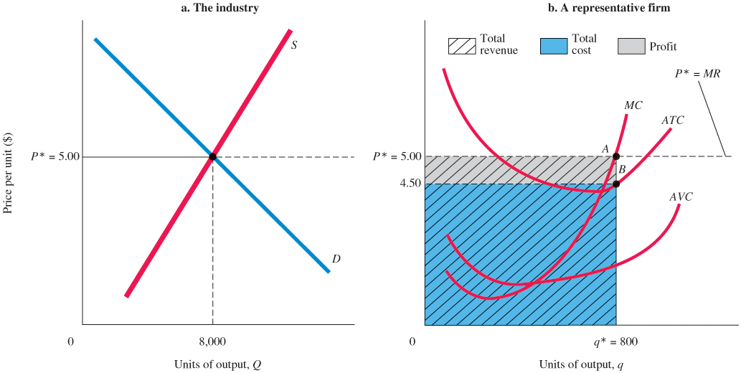
Figure 9.1 Firm Earning a Positive Profit in the Short Run
At q* = 800, total revenue is $5 × 800 = $4,000, total cost is $4.50 × 800 = $3,600, and profit is $4,000 − $3,600 = $400.
Notes:
Marketing is the process by which companies create value for customers and build strong customer relationships in order to capture value from customers in return. The dual goal of marketing is to attract new customers by promising superior value and to keep and grow current customers by delivering satisfaction.
Sound marketing is critical to the success of every organization. Marketing is used by large for-profit firms, such as Google, Target, Coca-Cola and Microsoft as well as not-for-profit organizations, such as colleges, hospitals, museums, symphony orchestras, and even churches.

Slide 9
Minimizing Losses (1 of 2)
If total revenue exceeds total variable cost, the excess revenue can be used to offset fixed costs and reduce losses, and it will pay the firm to keep operating.
If total revenue is smaller than total variable cost, the firm that operates will suffer losses in excess of fixed costs. In this case, the firm can minimize its losses by shutting down.
Notes:
Marketing is the process by which companies create value for customers and build strong customer relationships in order to capture value from customers in return. The dual goal of marketing is to attract new customers by promising superior value and to keep and grow current customers by delivering satisfaction.
Sound marketing is critical to the success of every organization. Marketing is used by large for-profit firms, such as Google, Target, Coca-Cola and Microsoft as well as not-for-profit organizations, such as colleges, hospitals, museums, symphony orchestras, and even churches.

Slide 10
Minimizing Losses (2 of 2)
Producing at a Loss to Offset Fixed Costs
shutdown point The lowest point on the average variable cost curve. When price falls below the minimum point on AVC, total revenue is insufficient to cover variable costs, and the firm will shut down and bear losses equal to fixed costs.
Notes:
Marketing is the process by which companies create value for customers and build strong customer relationships in order to capture value from customers in return. The dual goal of marketing is to attract new customers by promising superior value and to keep and grow current customers by delivering satisfaction.
Sound marketing is critical to the success of every organization. Marketing is used by large for-profit firms, such as Google, Target, Coca-Cola and Microsoft as well as not-for-profit organizations, such as colleges, hospitals, museums, symphony orchestras, and even churches.

Slide 11
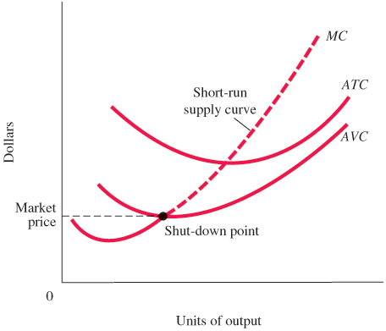
Figure 9.2 Short-Run Supply Curve of a Perfectly Competitive Firm
At prices below average variable cost, it pays a firm to shut down rather than continue operating.
Thus, the short-run supply curve of a competitive firm is the part of its marginal cost curve that lies above its average variable cost curve.
Notes:
Marketing is the process by which companies create value for customers and build strong customer relationships in order to capture value from customers in return. The dual goal of marketing is to attract new customers by promising superior value and to keep and grow current customers by delivering satisfaction.
Sound marketing is critical to the success of every organization. Marketing is used by large for-profit firms, such as Google, Target, Coca-Cola and Microsoft as well as not-for-profit organizations, such as colleges, hospitals, museums, symphony orchestras, and even churches.

Slide 12
The Short-Run Industry Supply Curve
short-run industry supply curve The sum of the marginal cost curves (above AVC) of all the firms in an industry.
Notes:
Marketing is the process by which companies create value for customers and build strong customer relationships in order to capture value from customers in return. The dual goal of marketing is to attract new customers by promising superior value and to keep and grow current customers by delivering satisfaction.
Sound marketing is critical to the success of every organization. Marketing is used by large for-profit firms, such as Google, Target, Coca-Cola and Microsoft as well as not-for-profit organizations, such as colleges, hospitals, museums, symphony orchestras, and even churches.

Slide 13
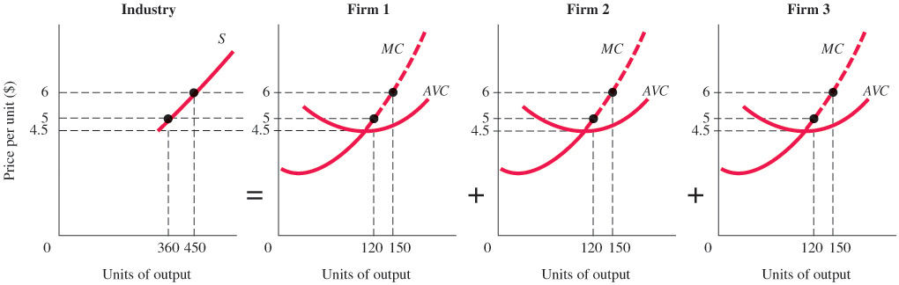
Figure 9.3 The Industry Supply Curve in the Short Run Is the Horizontal Sum of the Marginal Cost Curves (above AVC) of All the Firms in an Industry
If there are only three firms in the industry, the industry supply curve is simply the sum of all the products supplied by the three firms at each price.
For example, at $6 each firm supplies 150 units, for a total industry supply of 450.
Notes:
Marketing is the process by which companies create value for customers and build strong customer relationships in order to capture value from customers in return. The dual goal of marketing is to attract new customers by promising superior value and to keep and grow current customers by delivering satisfaction.
Sound marketing is critical to the success of every organization. Marketing is used by large for-profit firms, such as Google, Target, Coca-Cola and Microsoft as well as not-for-profit organizations, such as colleges, hospitals, museums, symphony orchestras, and even churches.

Slide 14
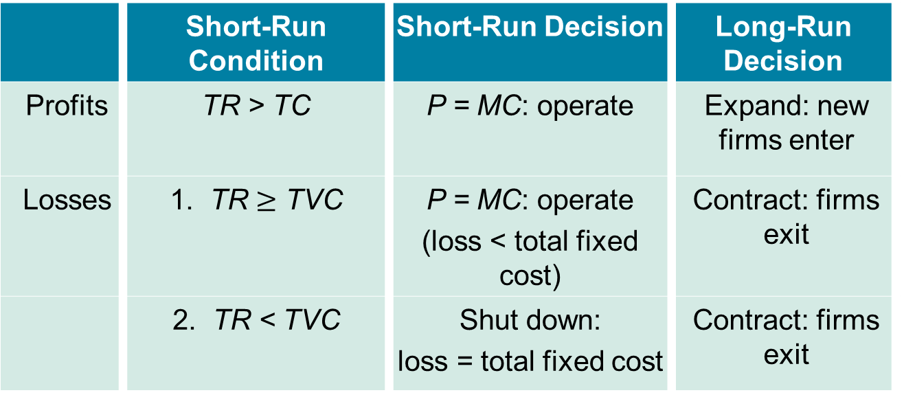
Long-Run Directions: A Review
Table 9.2 Profits, Losses, and Perfectly Competitive Firm Decisions in the Long and Short Run
 | Short-Run Condition | Short-Run Decision | Long-Run Decision
Profits | TR > TC | P = MC: operate | Expand: new firms enter
Losses | 1. TR $≥$ TVC | P = MC: operate (loss < total fixed cost) | Contract: firms exit
 | 2. TR < TVC | Shut down: loss = total fixed cost | Contract: firms exit
Notes:
Marketing is the process by which companies create value for customers and build strong customer relationships in order to capture value from customers in return. The dual goal of marketing is to attract new customers by promising superior value and to keep and grow current customers by delivering satisfaction.
Sound marketing is critical to the success of every organization. Marketing is used by large for-profit firms, such as Google, Target, Coca-Cola and Microsoft as well as not-for-profit organizations, such as colleges, hospitals, museums, symphony orchestras, and even churches.

Slide 15
Long-Run Costs: Economies and Diseconomies of Scale
long-run average cost curve (LRAC) Shows the way per unit costs change with output in the long run.
increasing returns to scale or economies of scale An increase in a firm’s scale of production leads to lower costs per unit produced.
constant returns to scale An increase in a firm’s scale of production has no effect on costs per unit produced.
decreasing returns to scale or diseconomies of scale An increase in a firm’s scale of production leads to higher costs per unit produced.
Notes:
Marketing is the process by which companies create value for customers and build strong customer relationships in order to capture value from customers in return. The dual goal of marketing is to attract new customers by promising superior value and to keep and grow current customers by delivering satisfaction.
Sound marketing is critical to the success of every organization. Marketing is used by large for-profit firms, such as Google, Target, Coca-Cola and Microsoft as well as not-for-profit organizations, such as colleges, hospitals, museums, symphony orchestras, and even churches.

Slide 16
Increasing Returns to Scale
The Sources of Economies of Scale
Some economies of scale result not from technology but from firm-level efficiencies and bargaining power that can come with size.
Economies of scale have come from advantages of larger firm size rather than gains from plant size.
minimum efficient scale (MES) The smallest size at which the long-run average cost curve is at its minimum.
Notes:
Marketing is the process by which companies create value for customers and build strong customer relationships in order to capture value from customers in return. The dual goal of marketing is to attract new customers by promising superior value and to keep and grow current customers by delivering satisfaction.
Sound marketing is critical to the success of every organization. Marketing is used by large for-profit firms, such as Google, Target, Coca-Cola and Microsoft as well as not-for-profit organizations, such as colleges, hospitals, museums, symphony orchestras, and even churches.

Slide 17
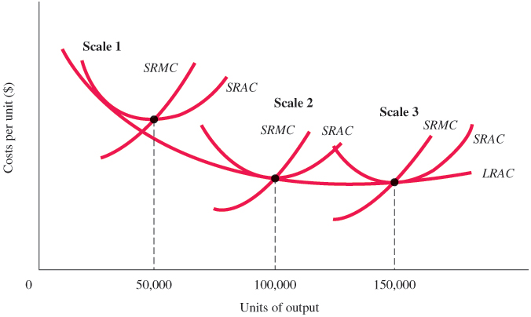
Figure 9.4 A Firm Exhibiting Economies of Scale
The long-run average cost curve of a firm shows the different scales on which the firm can choose to operate in the long run. Each scale of operation defines a different short run. Here we see a firm exhibiting economies of scale; moving from scale 1 to scale 3 reduces average cost.
Notes:
Marketing is the process by which companies create value for customers and build strong customer relationships in order to capture value from customers in return. The dual goal of marketing is to attract new customers by promising superior value and to keep and grow current customers by delivering satisfaction.
Sound marketing is critical to the success of every organization. Marketing is used by large for-profit firms, such as Google, Target, Coca-Cola and Microsoft as well as not-for-profit organizations, such as colleges, hospitals, museums, symphony orchestras, and even churches.

Slide 18

Economics In Practice (1 of 4)
Economies of Scale in the Search Business
Online search is a scale-driven business: The search behavior of one user can be used to improve the search of future users.
Google—the top search engine—has more than three times the searches of Microsoft’s Bing but employs only about twice as many engineers and spends less per search on its data centers.
CRITICAL THINKING
Google was an early pioneer in the search business. How did that early lead interact with the fact of scale economies in Google’s favor?

Slide 19
Constant Returns to Scale
Technically, the term constant returns means that the quantitative relationship between input and output stays constant, or the same, when output is increased.
Constant returns to scale means that the firm’s long-run average cost curve remains flat.
Notes:
Marketing is the process by which companies create value for customers and build strong customer relationships in order to capture value from customers in return. The dual goal of marketing is to attract new customers by promising superior value and to keep and grow current customers by delivering satisfaction.
Sound marketing is critical to the success of every organization. Marketing is used by large for-profit firms, such as Google, Target, Coca-Cola and Microsoft as well as not-for-profit organizations, such as colleges, hospitals, museums, symphony orchestras, and even churches.

Slide 20
Diseconomies of Scale
When average cost increases with scale of production, a firm faces decreasing returns to scale, or diseconomies of scale.
Notes:
Marketing is the process by which companies create value for customers and build strong customer relationships in order to capture value from customers in return. The dual goal of marketing is to attract new customers by promising superior value and to keep and grow current customers by delivering satisfaction.
Sound marketing is critical to the success of every organization. Marketing is used by large for-profit firms, such as Google, Target, Coca-Cola and Microsoft as well as not-for-profit organizations, such as colleges, hospitals, museums, symphony orchestras, and even churches.

Slide 21

Economics In Practice (2 of 4)
Diseconomies of Scale in Secondary School Education
The number of school districts in the United States reduced from 100,000 in the 1940s to just over 10,000 by the late 1990s.
Schools searched for scale economies by expanding the number of students with the same amounts of fixed costs, such as the costs for a gym or library.
More recently, there was recognition that larger schools increased bureaucracy, which increased school costs and potentially reduces school quality.
CRITICAL THINKING
If you were only concerned about the cost side of education, where do you think you would find the biggest opportunities for cost saving with size?

Slide 22
U-Shaped Long-Run Average Costs
optimal scale of plant The scale of plant that minimizes long-run average cost.
Notes:
Marketing is the process by which companies create value for customers and build strong customer relationships in order to capture value from customers in return. The dual goal of marketing is to attract new customers by promising superior value and to keep and grow current customers by delivering satisfaction.
Sound marketing is critical to the success of every organization. Marketing is used by large for-profit firms, such as Google, Target, Coca-Cola and Microsoft as well as not-for-profit organizations, such as colleges, hospitals, museums, symphony orchestras, and even churches.

Slide 23
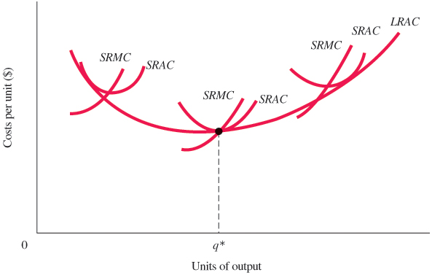
Figure 9.5 A Firm Exhibiting Economies and Diseconomies of Scale
Economies of scale push this firm’s average costs down to q*.
Beyond q*, the firm experiences diseconomies of scale; q* is the level of production at lowest long-run average costs, using optimal scale.
Notes:
Marketing is the process by which companies create value for customers and build strong customer relationships in order to capture value from customers in return. The dual goal of marketing is to attract new customers by promising superior value and to keep and grow current customers by delivering satisfaction.
Sound marketing is critical to the success of every organization. Marketing is used by large for-profit firms, such as Google, Target, Coca-Cola and Microsoft as well as not-for-profit organizations, such as colleges, hospitals, museums, symphony orchestras, and even churches.

Slide 24

Economics In Practice (3 of 4)
The Long-Run Average Cost Curve: Flat or U-Shaped?
A long-run average cost curve was first drawn as the “envelope” of a series of short-run curves in 1931.
Jacob Viner drew the long-run curve through the minimum points of all the short-run average cost curves.
In 1986, Professor Herbert Simon of Carnegie-Mellon University explained that studies show that a firm’s cost curves are not U-shaped but instead slope down to the right and then level off.
CRITICAL THINKING
Some have argued that even if long-run AC curves do eventually slope up, we would not likely see many firms operating at this size. Why not?

Slide 25
Long-Run Adjustments to Short-Run Conditions
Short-Run Profits: Moves In and Out of Equilibrium
Suppose demand increases when the industry is in long-run equilibrium. What will happen?
Notes:
Marketing is the process by which companies create value for customers and build strong customer relationships in order to capture value from customers in return. The dual goal of marketing is to attract new customers by promising superior value and to keep and grow current customers by delivering satisfaction.
Sound marketing is critical to the success of every organization. Marketing is used by large for-profit firms, such as Google, Target, Coca-Cola and Microsoft as well as not-for-profit organizations, such as colleges, hospitals, museums, symphony orchestras, and even churches.

Slide 26
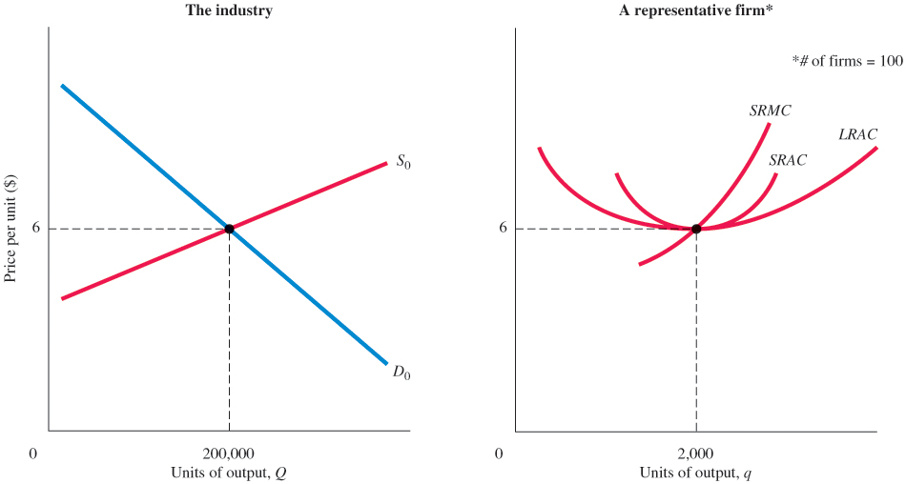
Figure 9.6 Equilibrium for an Industry with U-Shaped Cost Curves
The individual firm on the right is producing 2,000 units, and we also know that the industry consists of 100 firms.
All firms are identical, and all are producing at the uniquely best output level of 2,000 units.
Notes:
Marketing is the process by which companies create value for customers and build strong customer relationships in order to capture value from customers in return. The dual goal of marketing is to attract new customers by promising superior value and to keep and grow current customers by delivering satisfaction.
Sound marketing is critical to the success of every organization. Marketing is used by large for-profit firms, such as Google, Target, Coca-Cola and Microsoft as well as not-for-profit organizations, such as colleges, hospitals, museums, symphony orchestras, and even churches.

Slide 27
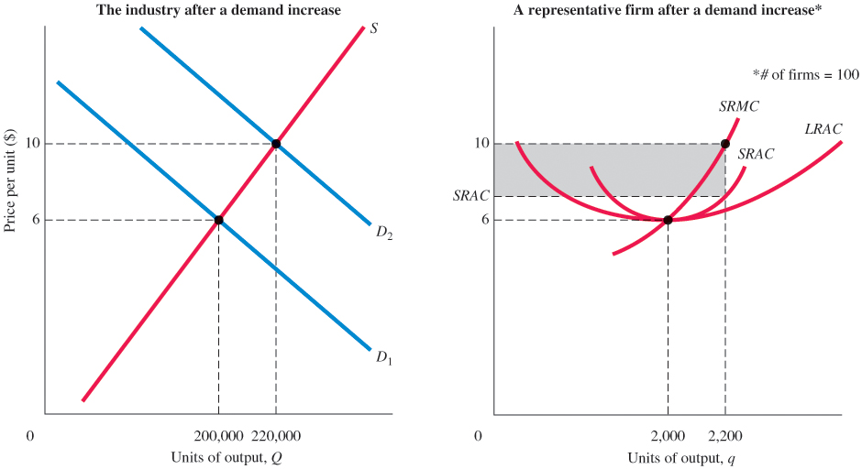
Figure 9.7 Industry Response to an Increase in Demand
Notes:
Marketing is the process by which companies create value for customers and build strong customer relationships in order to capture value from customers in return. The dual goal of marketing is to attract new customers by promising superior value and to keep and grow current customers by delivering satisfaction.
Sound marketing is critical to the success of every organization. Marketing is used by large for-profit firms, such as Google, Target, Coca-Cola and Microsoft as well as not-for-profit organizations, such as colleges, hospitals, museums, symphony orchestras, and even churches.

Slide 28
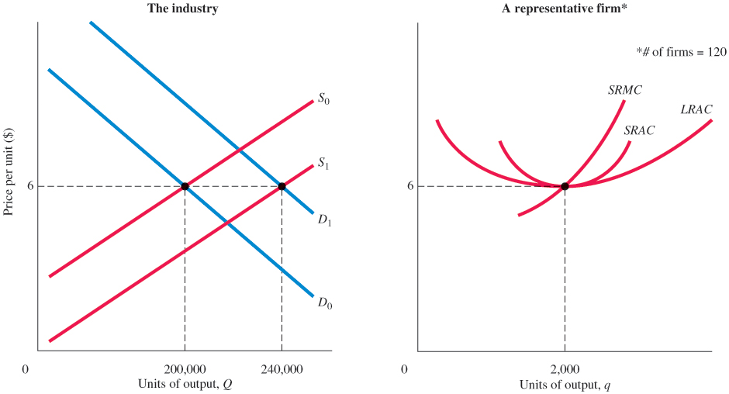
Figure 9.8 New Equilibrium with Higher Demand
Notes:
Marketing is the process by which companies create value for customers and build strong customer relationships in order to capture value from customers in return. The dual goal of marketing is to attract new customers by promising superior value and to keep and grow current customers by delivering satisfaction.
Sound marketing is critical to the success of every organization. Marketing is used by large for-profit firms, such as Google, Target, Coca-Cola and Microsoft as well as not-for-profit organizations, such as colleges, hospitals, museums, symphony orchestras, and even churches.

Slide 29
Short-Run Profits: Moves In and Out of Equilibrium
In equilibrium, each firm has:
Firms make no excess profits so that:
and there are enough firms so that supply equals demand.
Notes:
Marketing is the process by which companies create value for customers and build strong customer relationships in order to capture value from customers in return. The dual goal of marketing is to attract new customers by promising superior value and to keep and grow current customers by delivering satisfaction.
Sound marketing is critical to the success of every organization. Marketing is used by large for-profit firms, such as Google, Target, Coca-Cola and Microsoft as well as not-for-profit organizations, such as colleges, hospitals, museums, symphony orchestras, and even churches.

Slide 30
The Long-Run Adjustment Mechanism: Investment Flows toward Profit Opportunities (1 of 2)
The entry and exit of firms in response to profit opportunities usually involve the financial capital market.
In capital markets, people are constantly looking for profits. When firms in an industry do well, capital is likely to flow into that industry in a variety of forms.
long-run competitive equilibrium When
and profits are zero.
Notes:
Marketing is the process by which companies create value for customers and build strong customer relationships in order to capture value from customers in return. The dual goal of marketing is to attract new customers by promising superior value and to keep and grow current customers by delivering satisfaction.
Sound marketing is critical to the success of every organization. Marketing is used by large for-profit firms, such as Google, Target, Coca-Cola and Microsoft as well as not-for-profit organizations, such as colleges, hospitals, museums, symphony orchestras, and even churches.

Slide 31
The Long-Run Adjustment Mechanism: Investment Flows toward Profit Opportunities (2 of 2)
Investment—in the form of new firms and expanding old firms—will over time tend to favor those industries in which profits are being made.
Also, over time, industries in which firms are suffering losses will gradually contract from disinvestment.
Notes:
Marketing is the process by which companies create value for customers and build strong customer relationships in order to capture value from customers in return. The dual goal of marketing is to attract new customers by promising superior value and to keep and grow current customers by delivering satisfaction.
Sound marketing is critical to the success of every organization. Marketing is used by large for-profit firms, such as Google, Target, Coca-Cola and Microsoft as well as not-for-profit organizations, such as colleges, hospitals, museums, symphony orchestras, and even churches.

Slide 32

Economics In Practice (4 of 4)
Why Are Hot Dogs So Expensive in Central Park?
Licenses to sell hot dogs in New York City’s Central Park are auctioned off for thousands of dollars, while licenses to operate in more remote parts of the city cost only about $1,000.
Since hot dogs are $0.50 more in the park, the added cost of a license each year must be roughly $0.50 per hot dog sold.
CRITICAL THINKING
Show on a graph how a higher-priced license increases hot dog prices.
Who is the woman in the coat?

Slide 33
Output Markets: A Final Word (1 of 2)
In the last four chapters, we have been building a model of a simple market system under the assumption of perfect competition.
Changes in market price and thus profits are the basic signal that leads to a reallocation of society’s resources.
In the short run, producers are constrained by their scales of operation.
Notes:
Marketing is the process by which companies create value for customers and build strong customer relationships in order to capture value from customers in return. The dual goal of marketing is to attract new customers by promising superior value and to keep and grow current customers by delivering satisfaction.
Sound marketing is critical to the success of every organization. Marketing is used by large for-profit firms, such as Google, Target, Coca-Cola and Microsoft as well as not-for-profit organizations, such as colleges, hospitals, museums, symphony orchestras, and even churches.

Slide 34
Output Markets: A Final Word (2 of 2)
In the long run, however, we would expect to see resources flow in to compete for these profits. What starts as a shift in preferences thus ends up as a shift in resources.
You have now seen what lies behind the demand curves and supply curves in competitive output markets.
The next two chapters complete the picture by taking up competitive input markets.
Notes:
Marketing is the process by which companies create value for customers and build strong customer relationships in order to capture value from customers in return. The dual goal of marketing is to attract new customers by promising superior value and to keep and grow current customers by delivering satisfaction.
Sound marketing is critical to the success of every organization. Marketing is used by large for-profit firms, such as Google, Target, Coca-Cola and Microsoft as well as not-for-profit organizations, such as colleges, hospitals, museums, symphony orchestras, and even churches.

Slide 35
Review Terms and Concepts
breaking even
constant returns to scale
decreasing returns to scale or diseconomies of scale
increasing returns to scale or economies of scale
long-run average cost curve (LRAC)
long-run competitive equilibrium
minimum efficient scale (MES)
optimal scale of plant
short-run industry supply curve
shutdown point
Equation:
long-run competitive equilibrium,

Slide 36
Chapter 9 Appendix: External Economies and Diseconomies
When industry growth results in a decrease in long-run average costs, there are external economies.
When industry growth results in an increase in long-run average costs, there are external diseconomies.
Notes:
Marketing is the process by which companies create value for customers and build strong customer relationships in order to capture value from customers in return. The dual goal of marketing is to attract new customers by promising superior value and to keep and grow current customers by delivering satisfaction.
Sound marketing is critical to the success of every organization. Marketing is used by large for-profit firms, such as Google, Target, Coca-Cola and Microsoft as well as not-for-profit organizations, such as colleges, hospitals, museums, symphony orchestras, and even churches.

Slide 37
Table 9A.1 Construction of New Housing and Construction Materials Costs, 2000–2005
Year | House Prices % over the Previous Year | Housing Starts (Thousands) | Housing Starts % Change over the Previous Year | Construction Materials Prices % Change over the Previous Year | Consumer Prices % Change over the Previous Year
2000 | - | 1,573 | - | - | -
2001 | 7.5 | 1,661 | 5.6% | 0% | 2.8%
2002 | 7.5 | 1,710 | 2.9% | 1.5% | 1.5%
2003 | 7.9 | 1,853 | 8.4% | 1.6% | 2.3%
2004 | 12.0 | 1,949 | 5.2% | 8.3% | 2.7%
2005 | 13.0 | 2,053 | 5.3% | 5.4% | 2.5%
Source: Based on Economy.com and the Office of Federal Housing Enterprise Oversight (OFHEO).

Slide 38
The Long-Run Industry Supply Curve (1 of 2)
long-run industry supply curve (LRIS) A graph that traces out price and total output over time as an industry expands.
decreasing-cost industry An industry that realizes external economies—that is, average costs decrease as the industry grows. The long-run supply curve for such an industry has a negative slope.
Notes:
Marketing is the process by which companies create value for customers and build strong customer relationships in order to capture value from customers in return. The dual goal of marketing is to attract new customers by promising superior value and to keep and grow current customers by delivering satisfaction.
Sound marketing is critical to the success of every organization. Marketing is used by large for-profit firms, such as Google, Target, Coca-Cola and Microsoft as well as not-for-profit organizations, such as colleges, hospitals, museums, symphony orchestras, and even churches.

Slide 39
The Long-Run Industry Supply Curve (2 of 2)
increasing-cost industry An industry that encounters external diseconomies—that is, average costs increase as the industry grows. The long-run supply curve for such an industry has a positive slope.
constant-cost industry An industry that shows no economies or diseconomies of scale as the industry grows. Such industries have flat, or horizontal, long-run supply curves.
Notes:
Marketing is the process by which companies create value for customers and build strong customer relationships in order to capture value from customers in return. The dual goal of marketing is to attract new customers by promising superior value and to keep and grow current customers by delivering satisfaction.
Sound marketing is critical to the success of every organization. Marketing is used by large for-profit firms, such as Google, Target, Coca-Cola and Microsoft as well as not-for-profit organizations, such as colleges, hospitals, museums, symphony orchestras, and even churches.

Slide 40
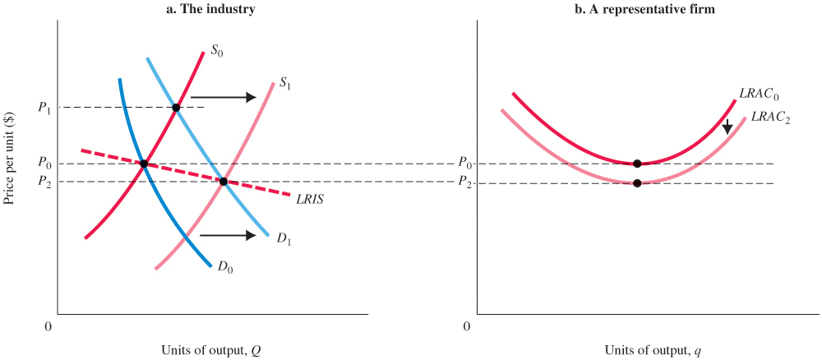
Figure 9A.1 A Decreasing-Cost Industry: External Economies
In a decreasing-cost industry, average cost declines as the industry expands.
As demand expands from D₀ to D₁, price rises from P₀ to P₁.
As new firms enter and existing firms expand, supply shifts from S₀ to S₁, driving price down.
If costs decline as a result of the expansion to LRAC₂, the final price will be below P₀ at P₂.
The long-run industry supply curve (LRIS) slopes downward in a decreasing-cost industry.
Notes:
Marketing is the process by which companies create value for customers and build strong customer relationships in order to capture value from customers in return. The dual goal of marketing is to attract new customers by promising superior value and to keep and grow current customers by delivering satisfaction.
Sound marketing is critical to the success of every organization. Marketing is used by large for-profit firms, such as Google, Target, Coca-Cola and Microsoft as well as not-for-profit organizations, such as colleges, hospitals, museums, symphony orchestras, and even churches.

Slide 41
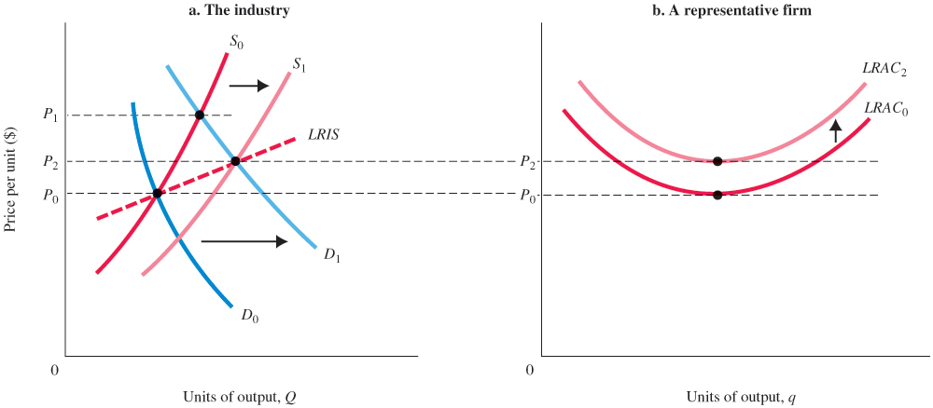
Figure 9A.2 An Increasing-Cost Industry: External Diseconomies
In an increasing-cost industry, average cost increases as the industry expands.
As demand shifts from D₀ to D₁, price rises from P₀ to P₁.
As new firms enter and existing firms expand output, supply shifts from S₀ to S₁, driving price down.
If long-run average costs rise, as a result, to LRAC₂, the final price will be P₂.
The long-run industry supply curve (LRIS) slopes up in an increasing-cost industry.
Notes:
Marketing is the process by which companies create value for customers and build strong customer relationships in order to capture value from customers in return. The dual goal of marketing is to attract new customers by promising superior value and to keep and grow current customers by delivering satisfaction.
Sound marketing is critical to the success of every organization. Marketing is used by large for-profit firms, such as Google, Target, Coca-Cola and Microsoft as well as not-for-profit organizations, such as colleges, hospitals, museums, symphony orchestras, and even churches.

Slide 42
Appendix review terms and concepts
constant-cost industry
decreasing-cost industry
external economies and diseconomies
increasing-cost industry
long-run industry supply curve (LRIS)

Slide 43
Copyright
This work is protected by United States copyright laws and is provided solely for the use of instructors in teaching their courses and assessing student learning. Dissemination or sale of any part of this work (including on the World Wide Web) will destroy the integrity of the work and is not permitted. The work and materials from it should never be made available to students except by instructors using the accompanying text in their classes. All recipients of this work are expected to abide by these restrictions and to honor the intended pedagogical purposes and the needs of other instructors who rely on these materials.

