Slide 1

Exploring Customer Behavior with SQL Analysis
Unlocking the full potential of customer data with SQL analysis. This project delves deep into customer behavior, revealing insights that can inform effective marketing strategies and boost overall revenue.
l
by Liaqat Ali

Slide 2

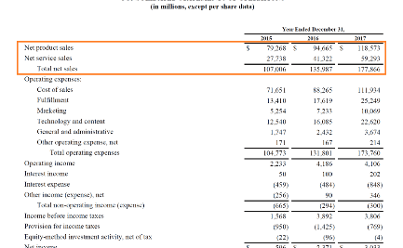
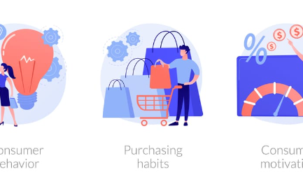
Basic Queries: Understanding Order Values and Unique Products
Purchase Analysis
Revenue Analysis
Behavior Analysis
Examine order values, order frequency, and identify which products are being sold the most.
Calculate total sales revenue, average order value, and identify highest spenders among customers.
Understand customer behavior by analyzing most frequent purchases, what products customers prefer to bundle, and more.

Slide 3
Advanced Queries: Segmentation, Churn Analysis, and Product Affinities
Segmentation: Purchase Frequency
Average Order Value by Country
Classify customers based on buying frequency, and analyze consumer behavior per segment to understand how different consumer segments interact with your offerings.
Identify differences in average order values by country and optimize marketing strategies per region.
Churn Analysis
Product Affinities
Pinpoint the factors that result in customer churn, and create targeted campaigns to retain them.
Discover which products customers are likely to purchase together, and create personalized, dynamic bundles that convert more leads into buyers.

Slide 4
Time-based Trends and Actionable Insights
Customer Retention Rate
Calculate customer retention rate over time and identify where improvements can be made to maximize customer lifetime value.
1
2
3
Monthly Sales Trends
Email Campaign Metrics
Identify which months see the most sales, and contrast it with a previous period to see which strategies worked and didn't.
Track email campaign metrics like open rates, click-through rates, and see which campaign gets the most responses from customers.
Incorporate findings from analysis into actionable insights to improve marketing campaigns, retain customers, and make strategic business decisions based on relevant data.

Slide 5
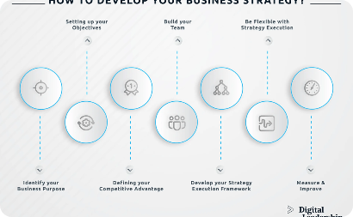

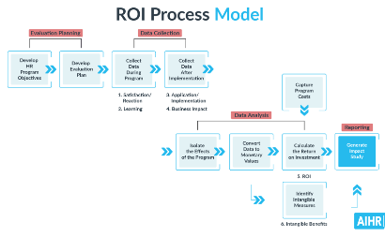
Conclusion: Key Findings and Recommendations
Business Strategy
Customer Satisfaction
ROI
Use data insights to identify new opportunities to reach customers and generate more revenue.
Focus on customers' needs and pains to create the best customer experience that drives loyalty, retention, and growth.
Craft targeted marketing campaigns to increase customer acquisition and retention, thus, increasing overall revenue and ROI.
Apply these key findings and recommendations to implement effective strategies that drive positive change across the organization.

